Slide 1
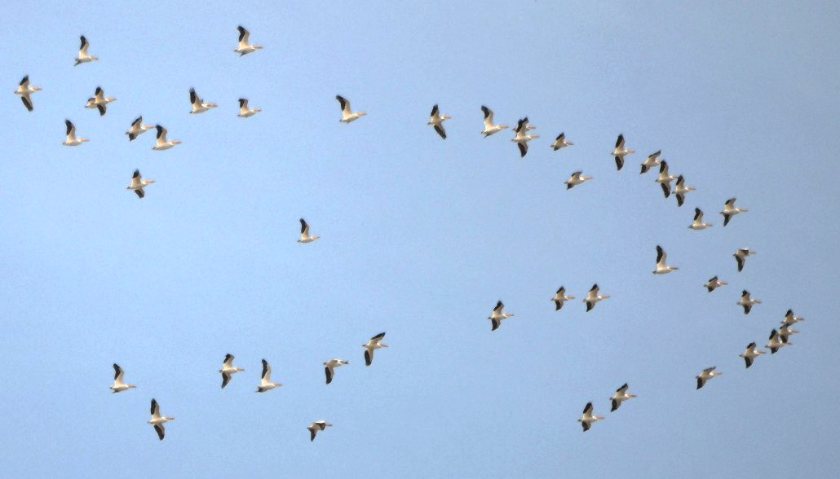
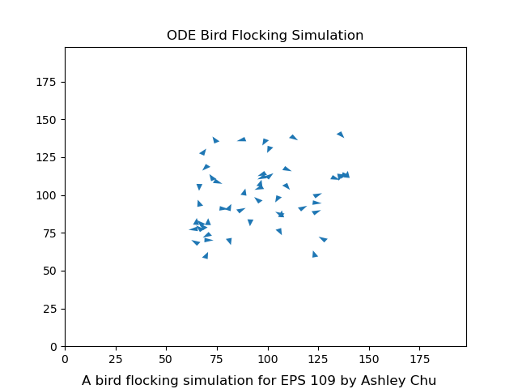
EPS 109: Computer Simulations
Bird Flocking
Simulation 🦅
By Ashley Chu

Slide 2
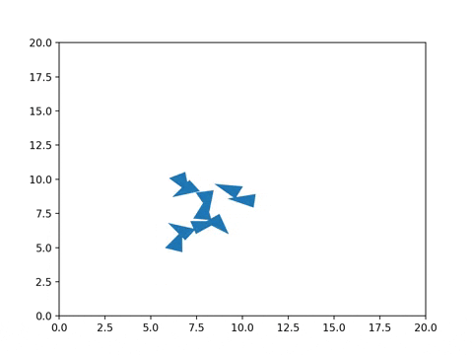
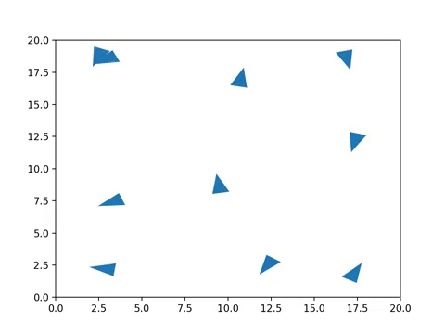
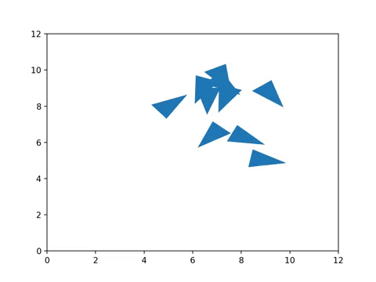
2D Flocking Simulation as an ODE
How do animals flock together?
Modeled each bird as a particle with independent position, velocity to begin with
Each bird is subject to three main forces using an ordinary differential equation (ODE)
1. Cohesion
2. Separation
3. Alignment
Steer to move toward the average position of neighbors
Steer to avoid crowding neighbors
Steer towards the average heading of neighbors
Sources: Craig Reynolds, Boids (https://www.red3d.com/cwr/boids/)
Notes:
How can we simulate this emergent behavior?

Slide 3
Final Simulation

