Slide 1
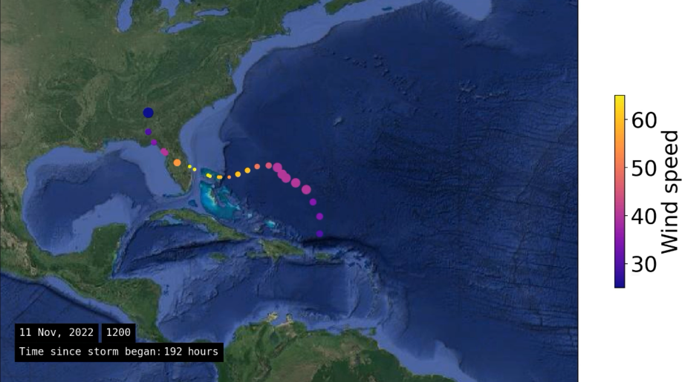
Plotting tropical storms in the western Atlantic over time
Nolan Force

Slide 2
Topic and methods
How do tropical storm patterns change over time?
HURDAT2 Atlantic tropical storm database from NOAA
Storm statistics (wind speed, location, radius, etc.) for every tropical storm since 1851, available as a .txt for free
Imported into Excel, removed unnecessary statistics, formatted dates and longitude/latitude properly
No storm radius data pre-2021
Incorporated elements of labs 2, 7, 8, and 10, as well as the help of matplotlib documentation pages to import the data, plot it on satellite imagery, and produce animations
np.loadtxt()
cartopy.io.img_tiles.GoogleTiles(style=‘satellite’)
matplotlib.animation.FFMpegWriter
https://matplotlib.org/stable/ for all matplotlib documentation
Notes:
This primary objective of this project was to answer the question: how do tropical storm patterns change over time? The best record of tropical storm statistics I could find was the HURDAT2 database from the National Oceanographic and Atmospheric Administration, which goes back over 170 years. I was able to download this data as a .txt, then I filtered out the useful data (including wind speed, lat and long coordinates, etc.) in Excel. Once I loaded that into Jupyter Notebooks as a .txt file, I used the scatterplot method to plot each timepoint for the storms on a satellite image of the western Atlantic provided by Google. Further detailed customizations were done by altering function parameters.

Slide 3
Hurricane Nicole: Nov. 6 – 11, 2023
Data points taken every ~6 hours: space between dots represents storm velocity
Size of dot represents storm radius
Hurricane Nicole represents the typical path of western Atlantic tropical storms:
Starts in open ocean east of the Caribbean
Migrates west into the Caribbean/Gulf of Mexico
Swings northward into the United States
Higher wind speed, smaller storm radius as it nears the coast, then slows and widens over land
Notes:
This first animation shows Hurricane Nicole, which I used as a representative sample to show the general trend of hurricane paths in the western Atlantic. Some important features of my animations are shown here: data points are taken every 6 hours approximately, so the spacing between dots represents storm velocity. Dot size indicates storm radius. The color of the dot corresponds to the storm’s maximum wind speed, shown on the color bar on the right.

Slide 4
All storms of 2021 and 2022
All tropical storms from the last 2 years (before 2023)
General pattern follows the “typical path” outlined on previous slide:
Forms in middle of Atlantic
Moves west into Gulf of Mexico
Moves north into/beyond the United States
*There are a few deviations from the pattern, but there is still a fairly clear trend
Notes:
The second animation takes it a step further and plots all storms from 2021 and 2022 to look at how that general trend tabulated from the Hurricane Nicole animation holds up. You can see that, although not perfect, the general pattern of forming out in the Atlantic, moving northwest into the Caribbean, and then moving northeast over the United States seems to be occurring. I was not able to plot the dates of these storms because the date format feature in Excel wasn’t working properly for this many storms.

Slide 5
Comparing storms from 1851, 1939, and 2022
Scientific question: do tropical storm paths change over time with changing climate?
6 storms from 1851, 1936, and 2022
Observed changes from 1851 to 2022:
Recent storms form farther out in the ocean, and may push farther into the Gulf of Mexico
Storm paths become more erratic over time
No obvious changes in maximum wind speed or storm velocity
Notes:
Then I wanted to get to the central question: how do storms change over time? So I picked 6 storms from 1851, 6 from 1936, and 6 from 2022, and plotted them together. The oldest storms are in silver, the 1936 storms are in magenta, and the 2022 storms are in cyan. You can see from the plot that the more recent storms appear to be more erratic in their movements, and can either form farther from land than usual or much closer, and penetrate farther inland. As you can imagine, this increase in variance could prove to be problematic for coastal communities in the Gulf of Mexico.
However, it is important to note that there is far less data (and likely less accurate data) the farther back you go in the record. Additionally, this is just a snapshot of Caribbean storms, and does not account for any changes in storm patterns elsewhere, such as the monsoons in southeast Asia. Therefore, I acknowledge that this may not be a fair and accurate comparison, and more research would have to be done here to actually determine whether or not tropical storms are changing with climate change.

