Slide 1
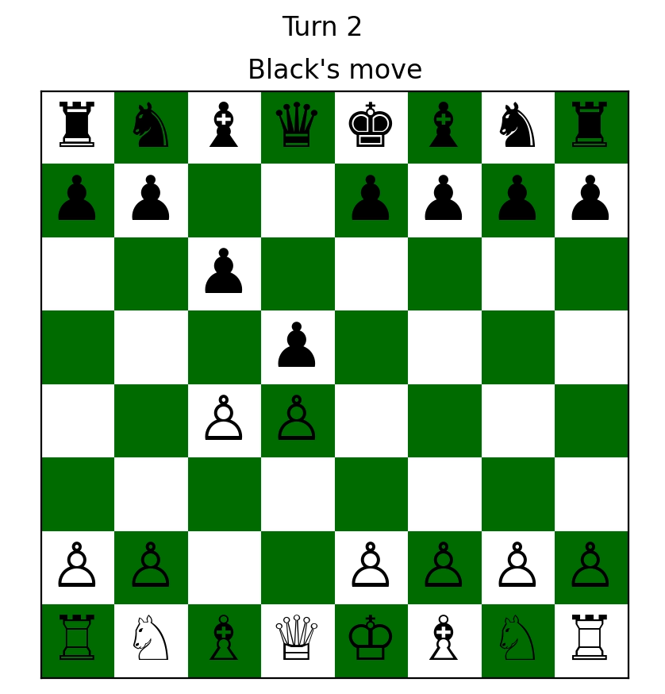
Visualizing Chess
Edward Gilmore

Slide 2
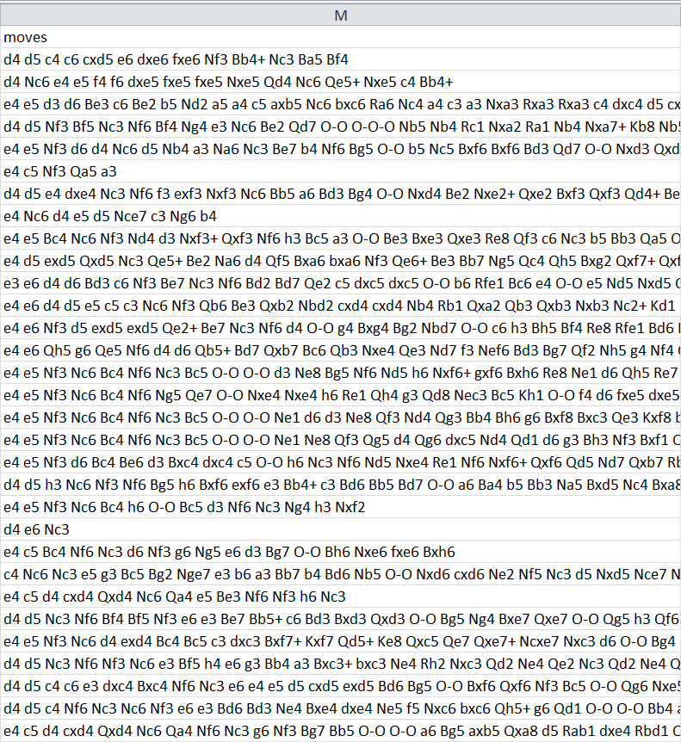
Challenges with data
I don’t know a lot about chess…
CSV files use Chess Notation
(eg: Nxe6; O-O-O; Rbd1+; Rxa3, Rxa3)
Working backwards from a destination
Visualized using pyplot and arrays

Slide 3
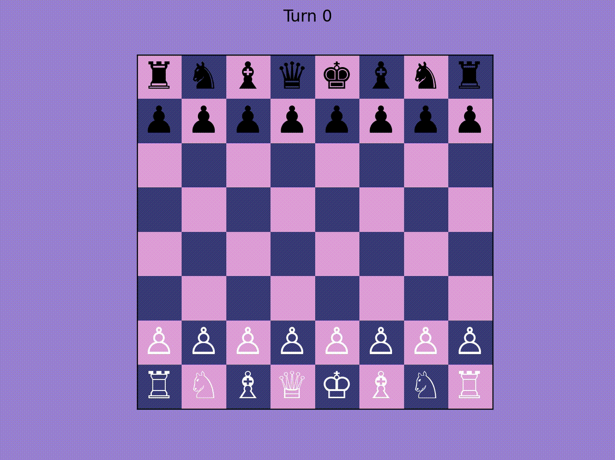
e4 e5 d3 d6 Be3 c6 Be2 b5 Nd2 a5 a4 c5 axb5 Nc6 bxc6 Ra6 Nc4 a4 c3 a3 Nxa3 Rxa3 Rxa3 c4 dxc4 d5 cxd5 Qxd5 exd5 Be6 Ra8+ Ke7 Bc5+ Kf6 Bxf8 Kg6 Bxg7 Kxg7 dxe6 Kh6 exf7 Nf6 Rxh8 Nh5 Bxh5 Kg5 Rxh7 Kf5 Qf3+ Ke6 Bg4+ Kd6 Rh6+ Kc5 Qe3+ Kb5 c4+ Kb4 Qc3+ Ka4 Bd1#

Slide 4
Resources
Chess games CSV file:
https://www.kaggle.com/datasets/datasnaek/chess
Reading CSV files:
https://www.statology.org/pandas-read-csv-only-specific-rows/
Understanding chess notation:
https://www.chess.com/terms/chess-notation

