Slide 1
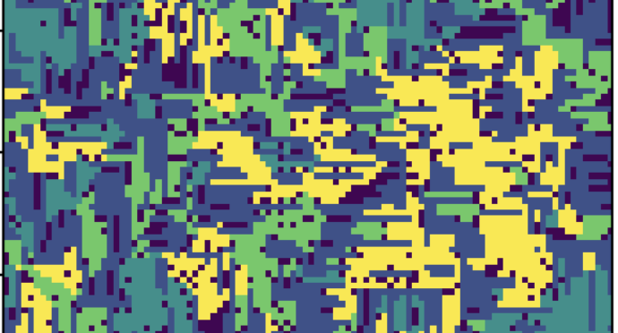
Microbial Dispersion and Growth Strategies in Soils
Gabriel Husain

Slide 2
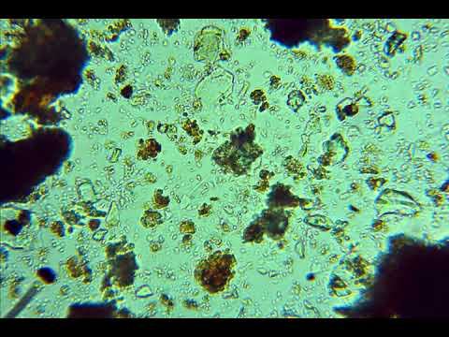
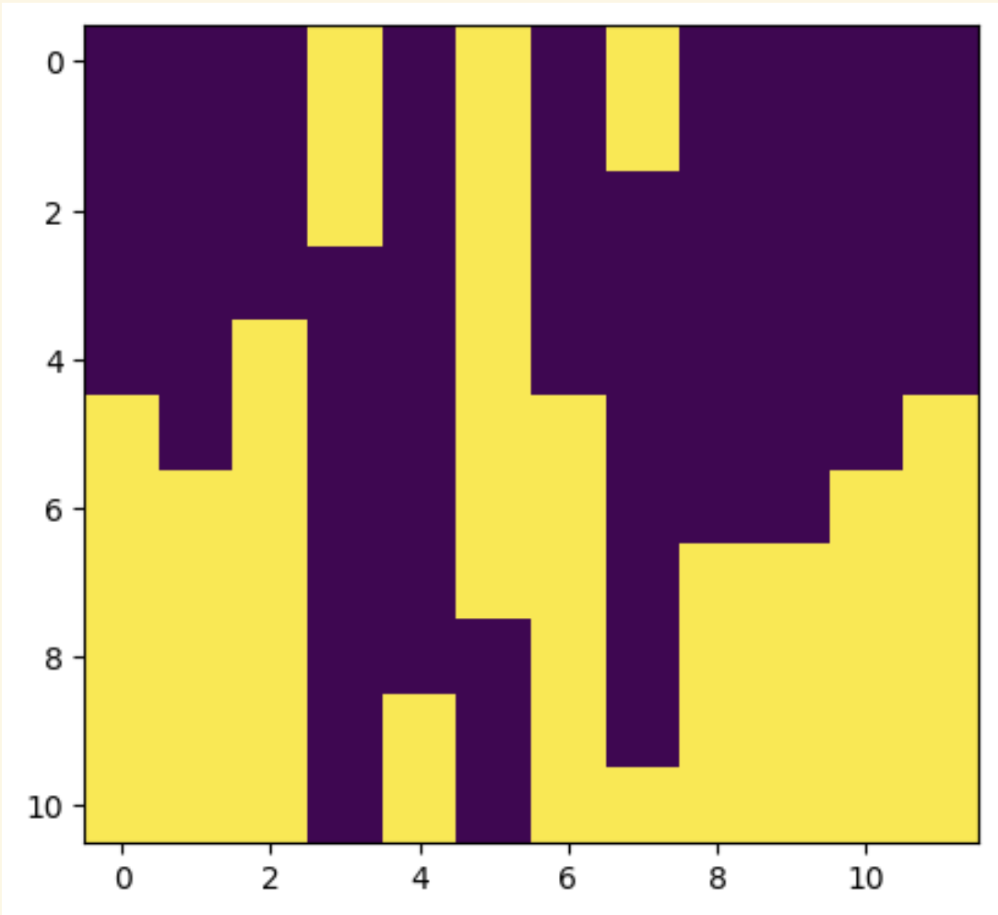
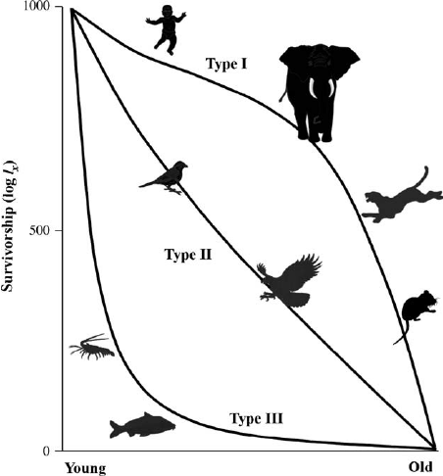
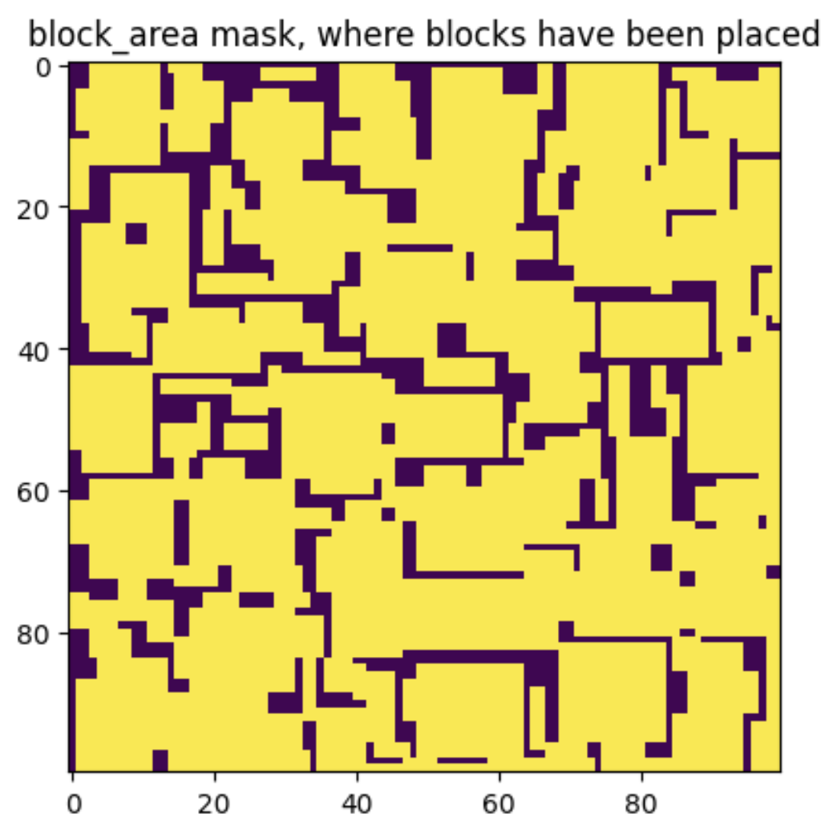
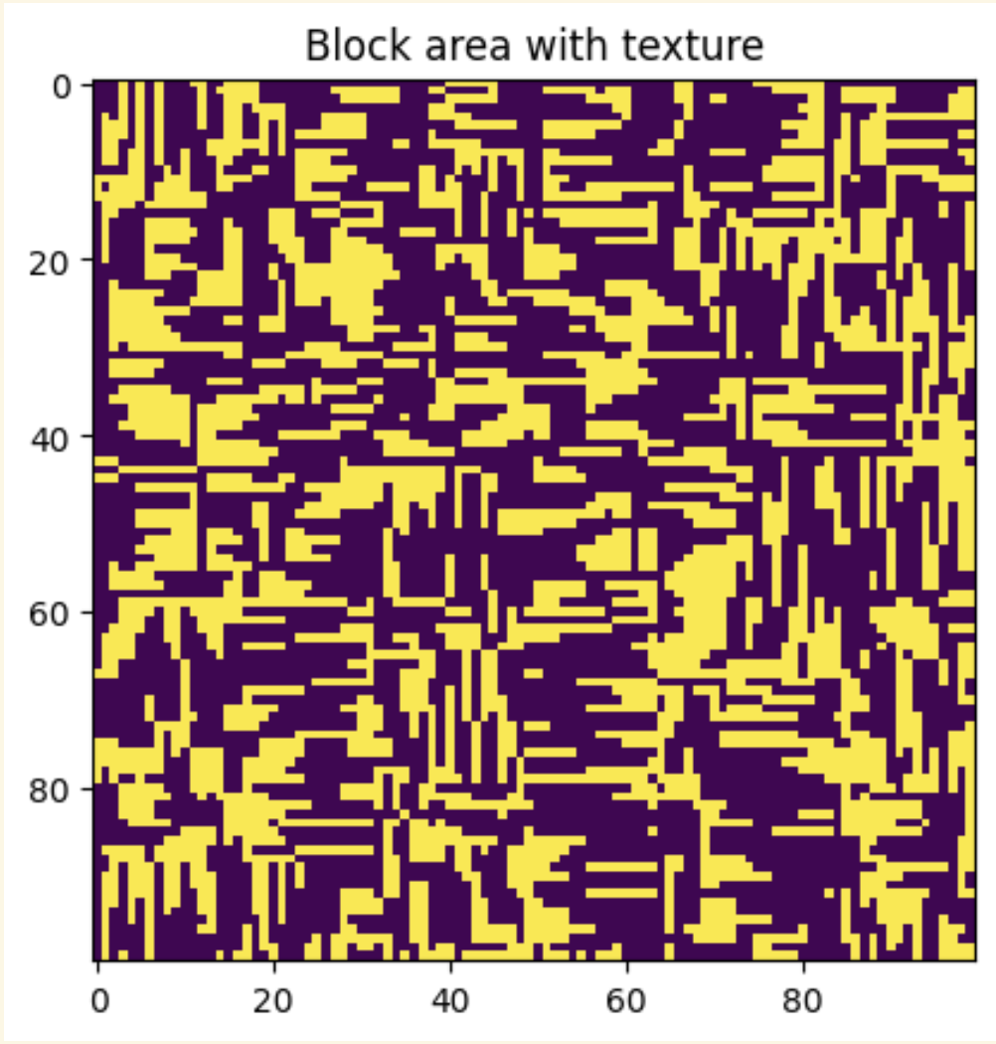
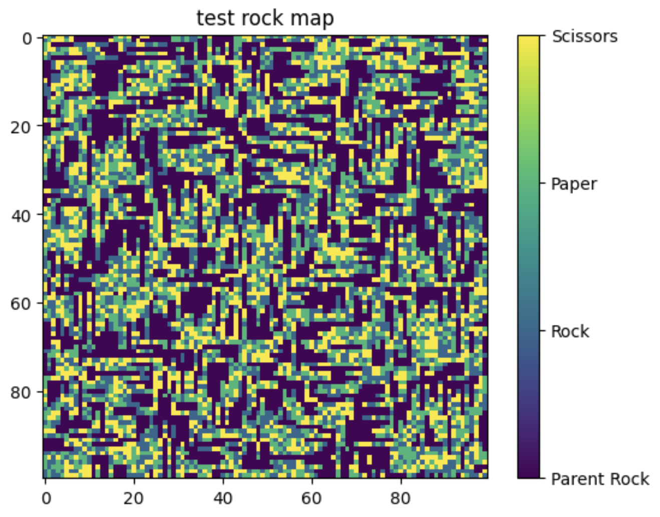
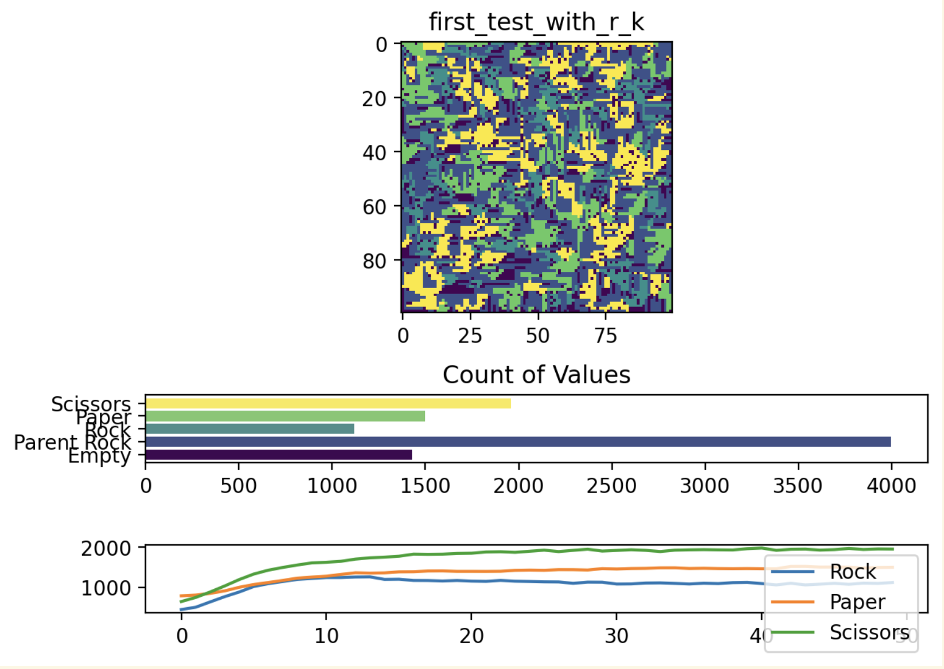
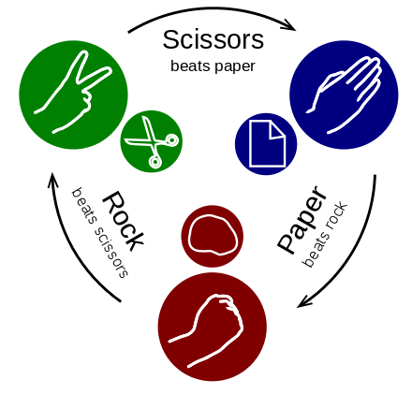
Microbial Dispersion and Growth
R and K strategies:
Methods Used:
Random-Biased Rock Gen
Rock Placement Masking
Airy Texture Generation
Bacteria under the Microscope
Random Initial Placement
Interaction, Growth Simulation

Slide 3
Growth and Predation in place doesn’t mean anything, because you can’t see the names

Slide 4
Can see counted Values

Slide 5
Increased Death by suffocation,
20% mortality

Slide 6
R (Rock) vs K (Paper) Scissors Normal We see Scissors benefit from less rock Paper predate on Rock

Slide 7
Only Paper and Rock They live in competition

Slide 8
50% chance of moving 50% chance of doing anything else (dying reproducing)

Slide 9
50% reduced death if wall & r or k strategy Normal for scissors

Slide 10
50% reduced death if wall & r or k strategy Normal for scissors

