Slide 1
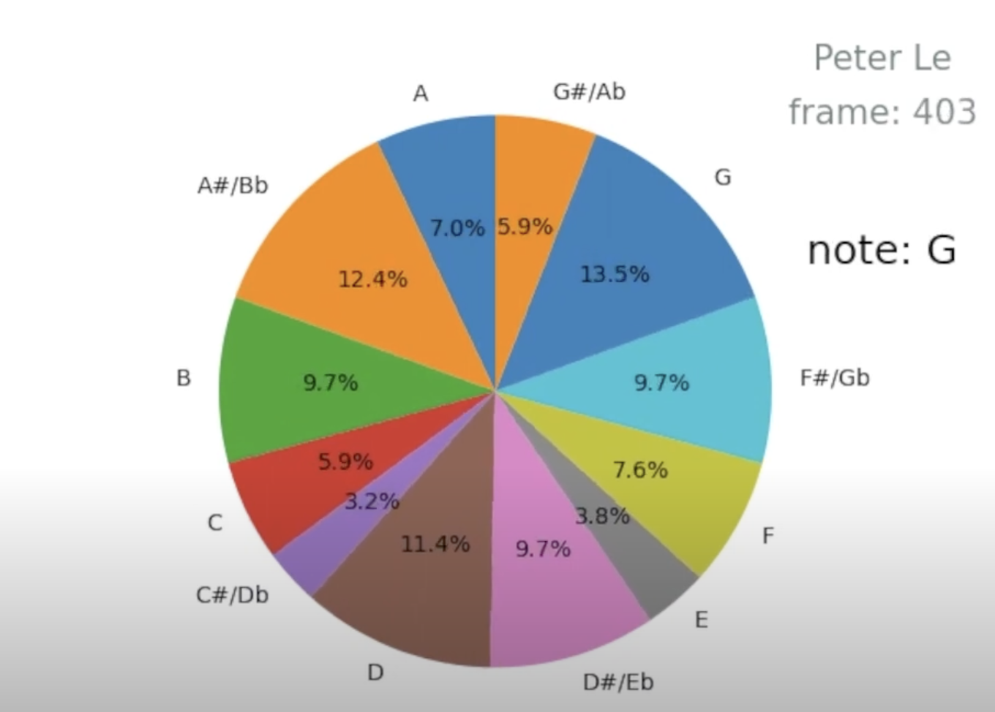
Giant Steps Distribution: EPS 109 Project
Peter Le

Slide 2
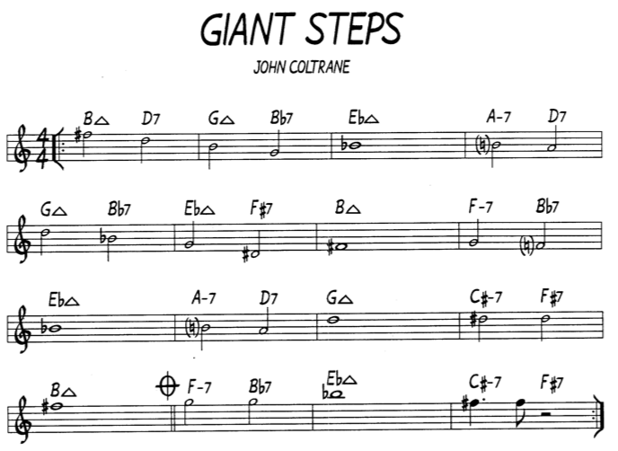
Overview
In 1960, saxophonist John Coltrane released Giant Steps
known for 26 chord changes for every 16 measures
No central key signature
Idea: Are the types of notes played in Coltrane’s solo evenly distributed?

Slide 3
Implementation
Sampled the 2 choruses of the melody and 2 choruses of solo
Animation demonstrates pie chart of which notes have been played as the tune progresses
Frame number and my name are displayed on the top right corner in black (0,0,0)
notes from C - D# raise the R value by 2/255
notes from E - G raise the G value by 2/255
notes from A# - B raise the G value by 2/255
If notes are uniformly distributed, the R, G, and B values should be similar to each other and

Slide 4
Animation

Slide 5
Conclusion
Final Color Value: [0.62, 0.75, 0.73]
Notes are relatively evenly distributed.
Fewer Notes from C - Eb (not popular notes to play on tenor sax in general when improvising a solo)
Error factors: Didn’t sample whole song (would’ve been a 5 minute video)

