Slide 1
Reaction-Diffusion Simulation with Gray-Scott Model
EPS 109
Khoi Nguyen

Slide 2
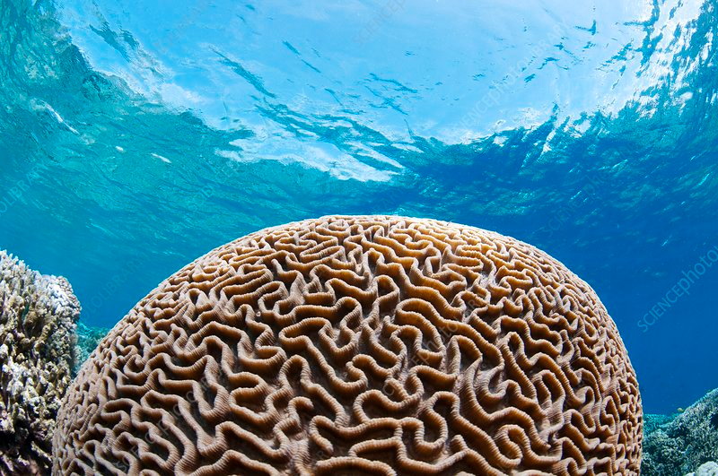
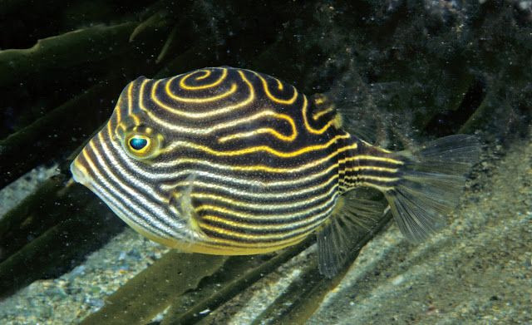
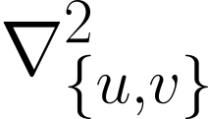
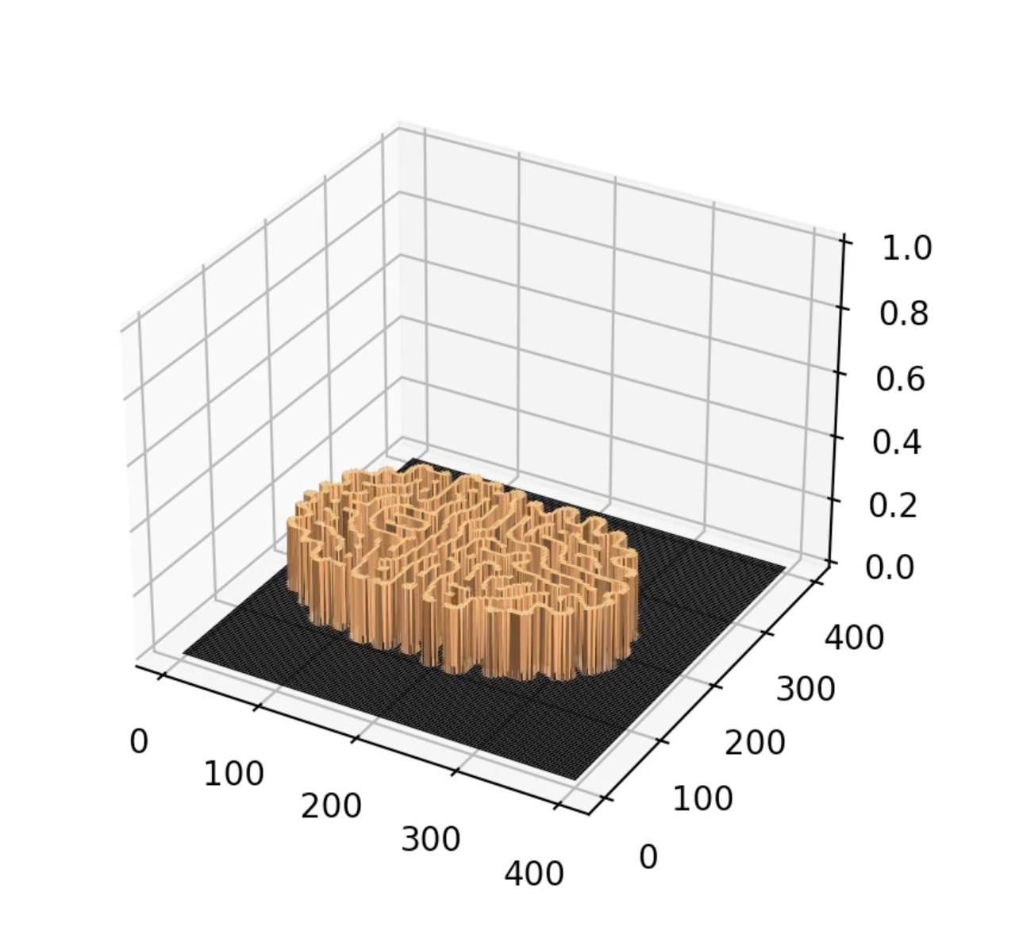
Reaction-Diffusion Simulation
Theory and Methods
Occurs everywhere in nature
Gray-Scott model is a reaction-diffusion system that simulates chemical reaction of two substances $u$ and $v$—both diffuse over time.
Update equations of the two substances:
Rate of diffusion:
2D Laplacian function—difference between neighboring cells and current cells:
Kill rate:
Feed rate:
Time step:
Code: set initial value of 1 for some of cells of substance $v$ to initialize the reaction, then change kill & feed rates as liking for different simulations. Have both 2D and 3D versions for more visual appeals.

Slide 3
k = .05952, f = .03250

Slide 4
k = .05952, f = .03250

Slide 5
k = .05364, f = .01634

Slide 6
k = .06134 f = .02749

Slide 7
bonus

Slide 8
Works Cited
https://en.wikipedia.org/wiki/Reaction%E2%80%93diffusion_system
https://www.karlsims.com/rdtool.html
https://www.karlsims.com/rd.html

