Slide 1
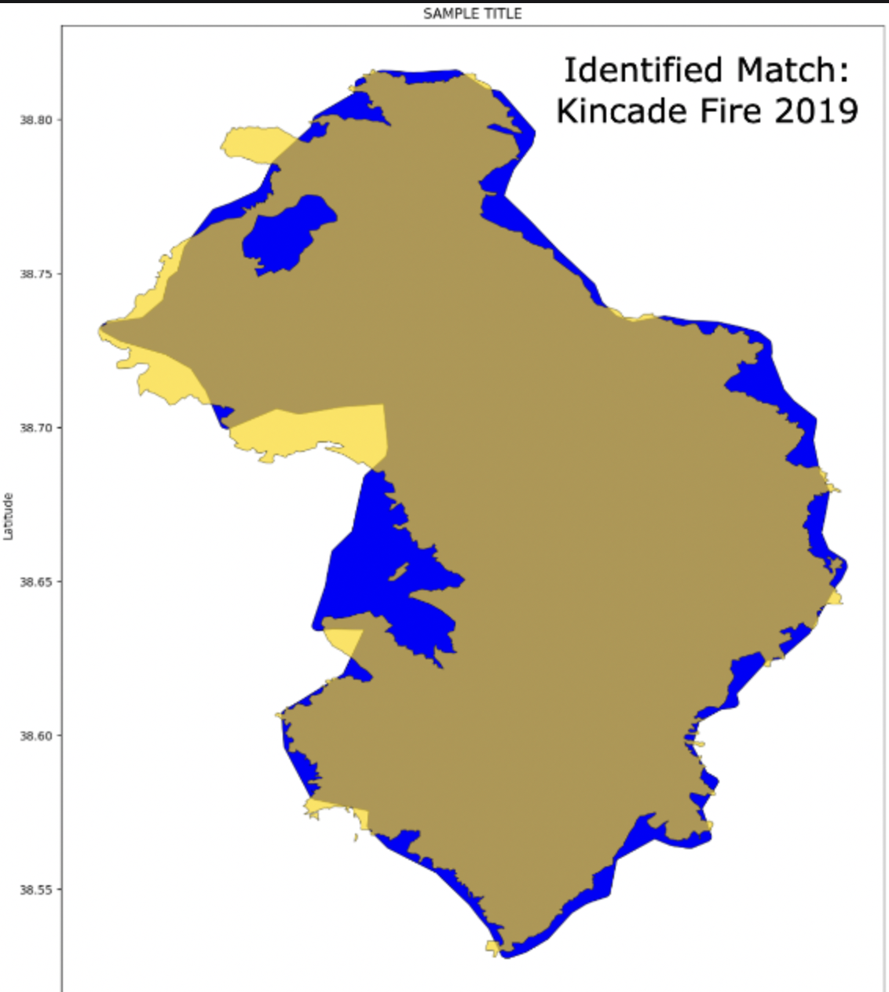
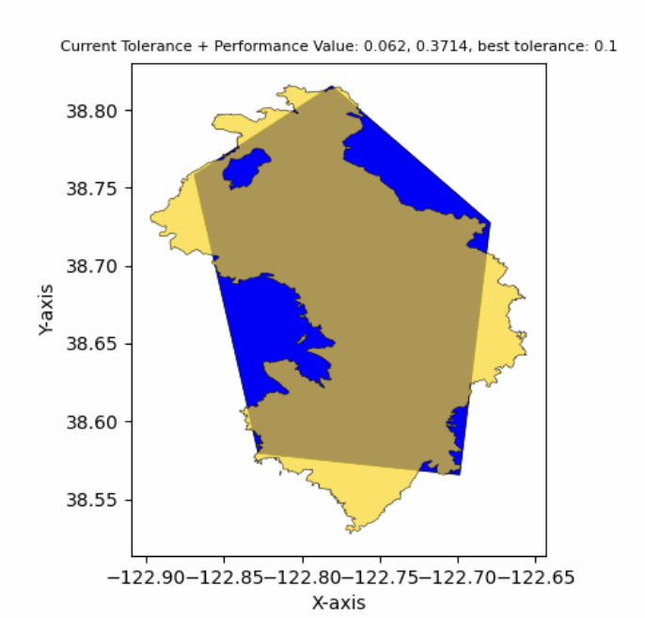
Wildfire Satellites vs. Aircraft:
Auto calculations and Resolution Matching
Satellite
Aircraft
Katrina Sharonin
Notes:
Demand for fire perimeter tracking means demand for algorithms
FEDS based on VIIRS for CONUS in near real time.
How “good” is an algorithm?
Sometimes remote-sensing sources of fire data are wrong, have pixels that are too big, etc.
We need to compare to a standard that people trust, like NIFC.
Notes:
Drop in some visuals from FEDS vs NIFC to demonstrate need to compare
Getting datasources to talk to each other
Automated that action, generalizable
Need to intro FEDS!!! API visual + what even is it! (1 visual and quote is good)
Fix the intro, make it visually driven (little to no text…)
Ipynb; just zoom out dont walkthrough; “this is a nb you can work with” focu on plots
Fires: make 1st obviously names, for 2nd; not a fire known, just able to find comparison for!

Slide 2
Code Set-up
Requires NASA MAAP platform access for specific data sets
Email ksharonin@berkeley.edu
Download all files, keep in same dir
Use .sh + .yml for dependency install
Run any of ipynbs to walk through process
main.ipynb
2020demo.ipynb
Key data sets
NASA VEDA FEDS: https://www.earthdata.nasa.gov/dashboard/data-catalog/fire
NIFC InterAgency Archive: https://data-nifc.opendata.arcgis.com/datasets/nifc::interagencyfireperimeterhistory-all-years-view/explore
Notes:
Source for left: Overwatch Imaging, Dixie Fire
With rapid growth and resource constraint, we explore and build algorithms for satellite-based fire perimeters which contrast with aerial imagery

Slide 3
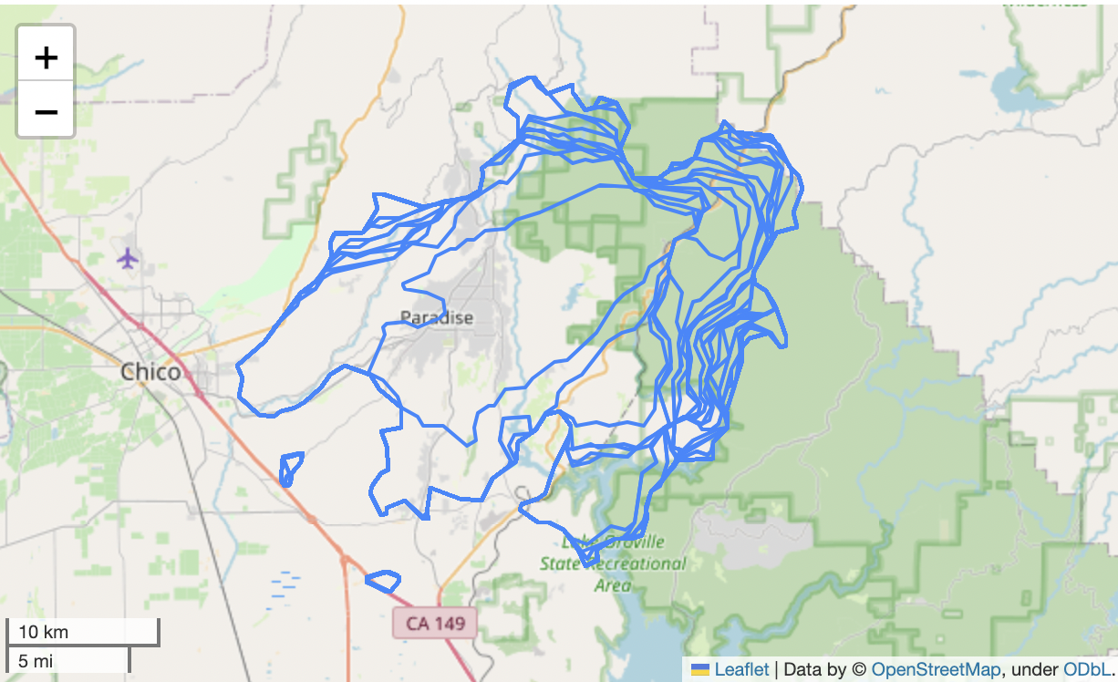
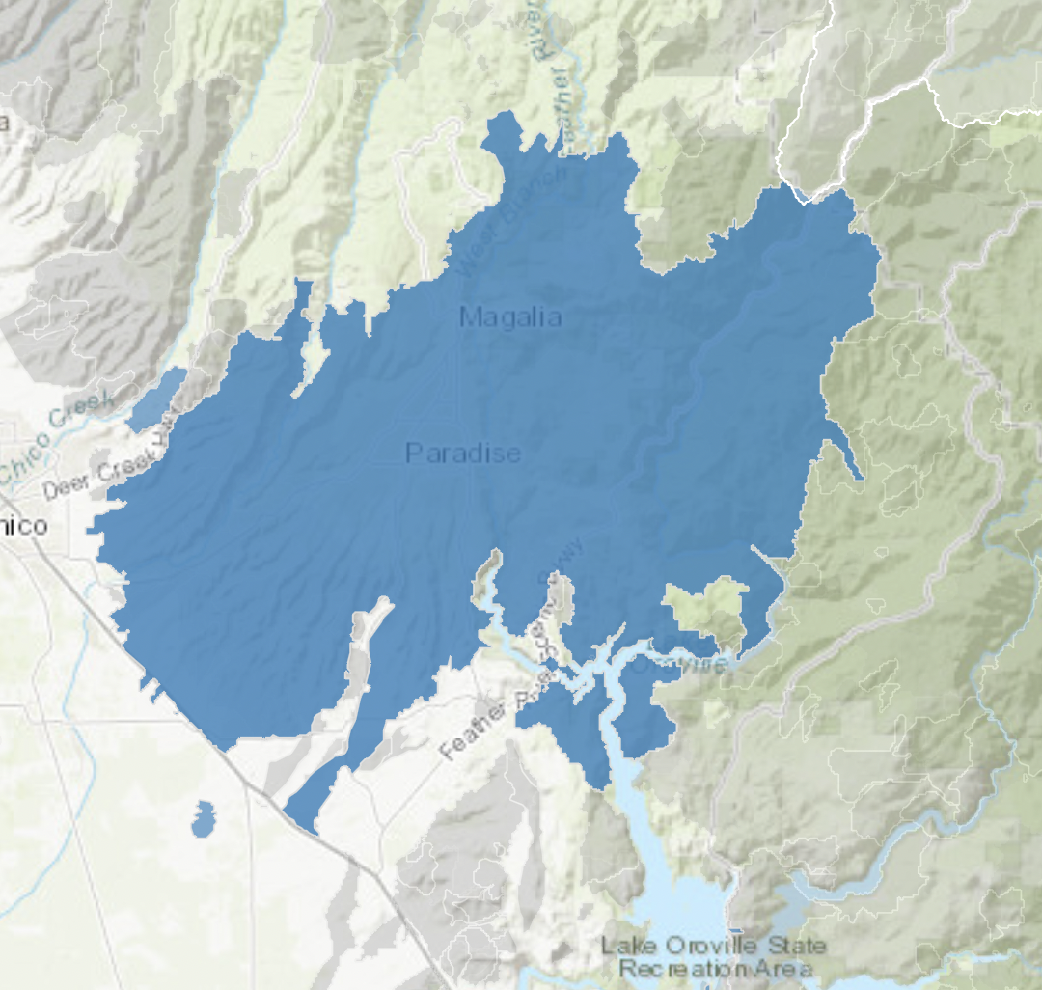
Topic:
Automate satellite vs aircraft performance measurements and labeling, identify simplification effectiveness
Satellite Paradise Fire
Aircraft Paradise Fire
Notes:
Source for left: Overwatch Imaging, Dixie Fire
With rapid growth and resource constraint, we explore and build algorithms for satellite-based fire perimeters which contrast with aerial imagery

Slide 4
Project Features
Access datasets →
mass match-making →
mass calculations to trend performance →
Recursive simplification to find best threshold
Notes:
FEDS is a particular fire perimeter algorithm developed by the EIS-FIRE team at Goddard. This algorithm uses raw VIIRS observations to generate a polygon of the fire, locations of the active fire line, and estimates of fire mean Fire Radiative Power (FRP)
With new methods, we need a way to identify what is “good” performance vs bad. Common among academics and researchers is to take official fire perimeters from NIFC/USFS (who has a GIS team) and overlaying perimeters. This however takes energy to write libraries that accomplish this. How can we easily enable this connection of courses and analysis?
FEDS documentation: https://nasa-impact.github.io/veda-docs/notebooks/tutorials/mapping-fires.html#about-the-data
NIFC documentation/dataset:

Slide 5
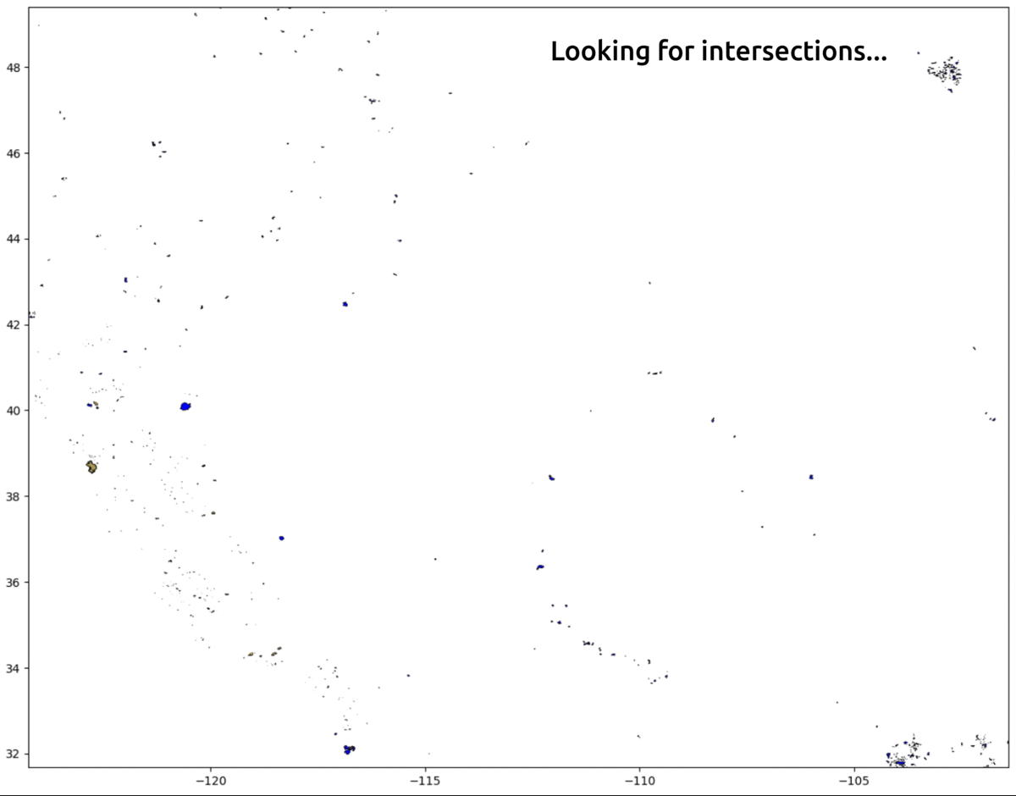
Feature: satellite-aircraft perimeter matchmaker
Satellite
(NASA FEDS)
Aircraft (NIFC)

Slide 6
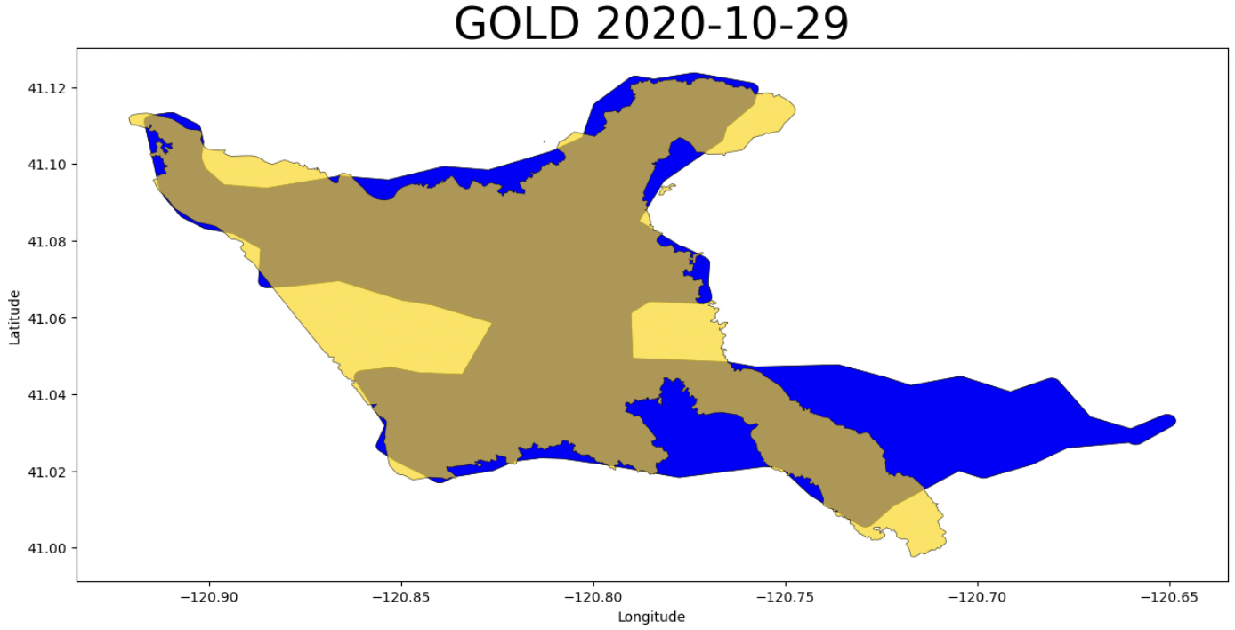
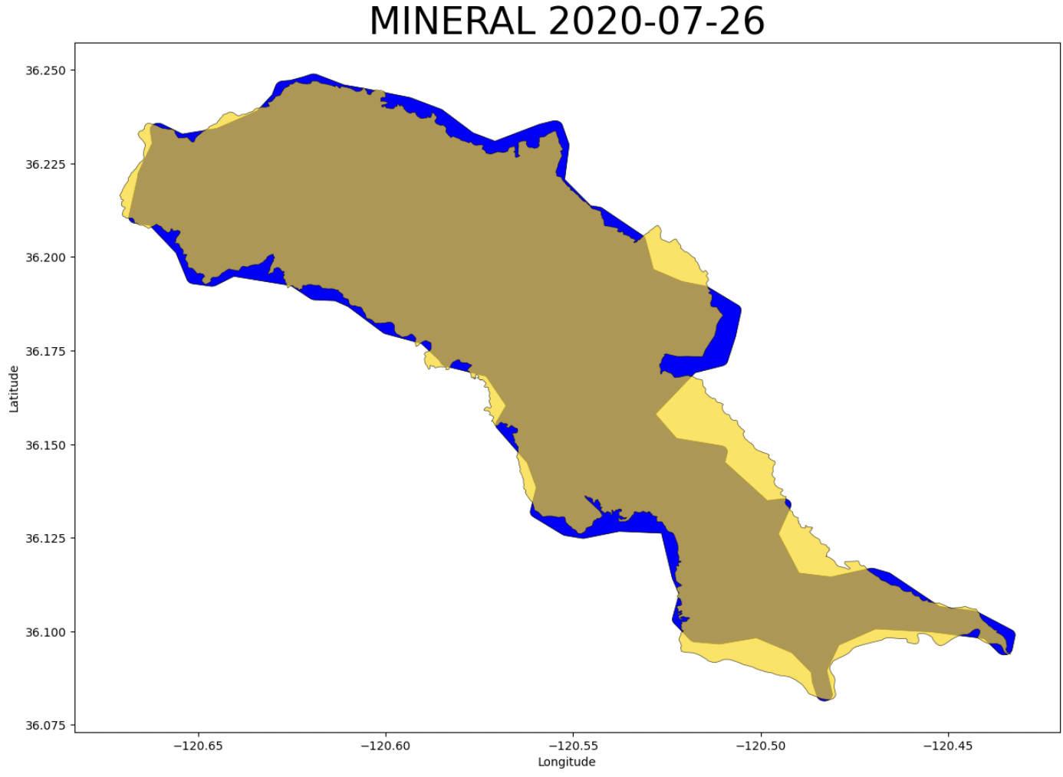
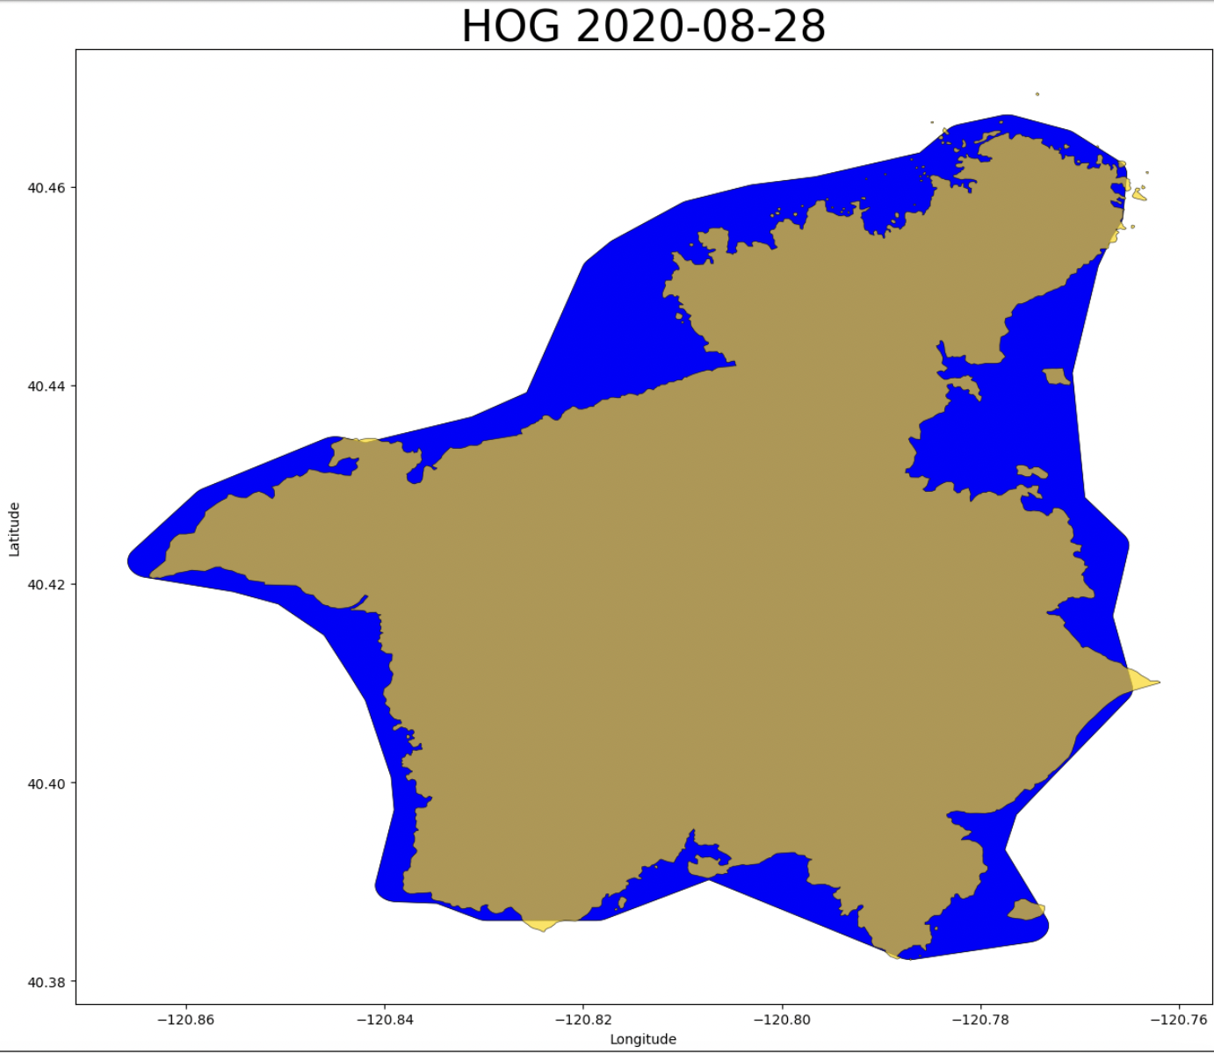
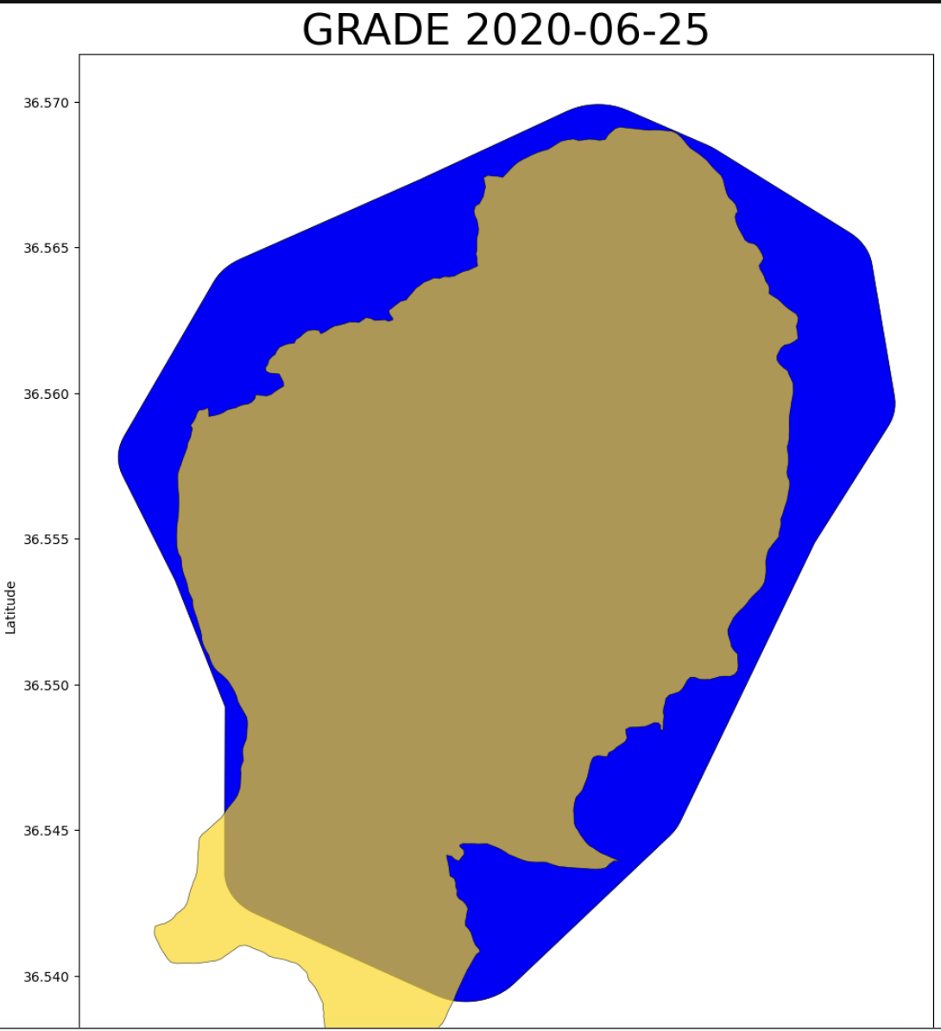
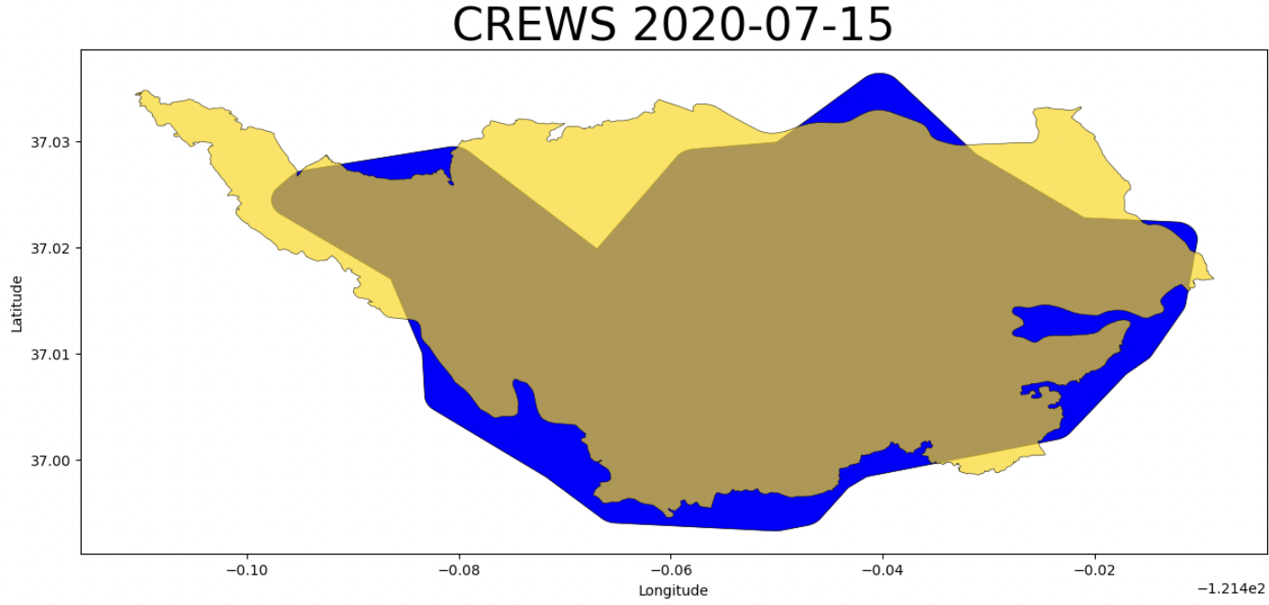
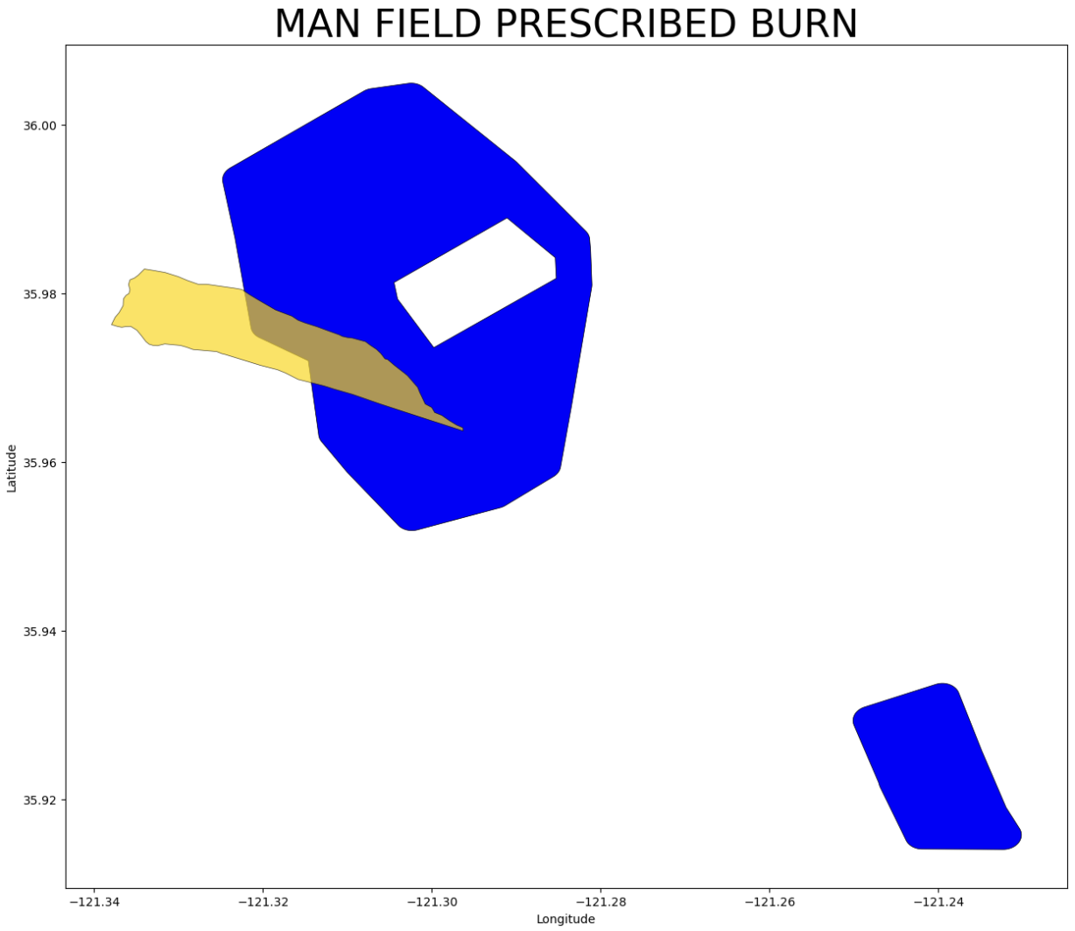
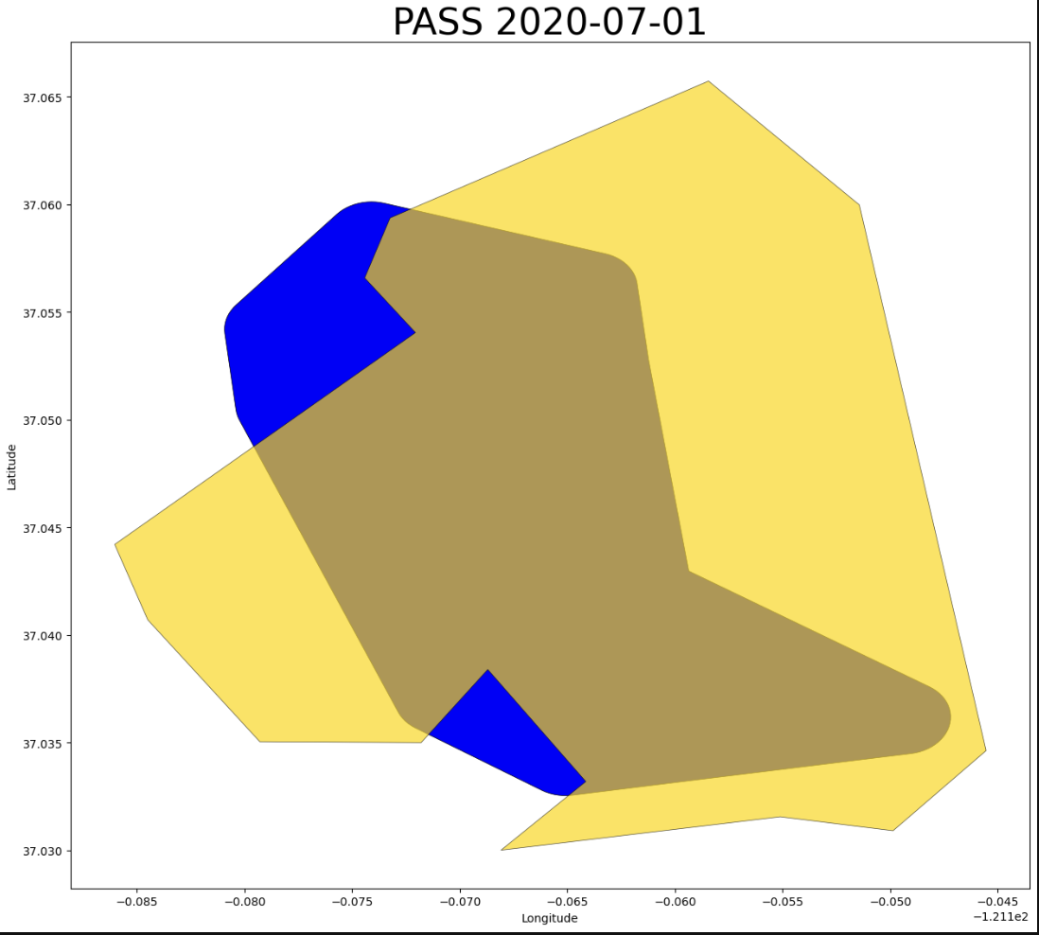
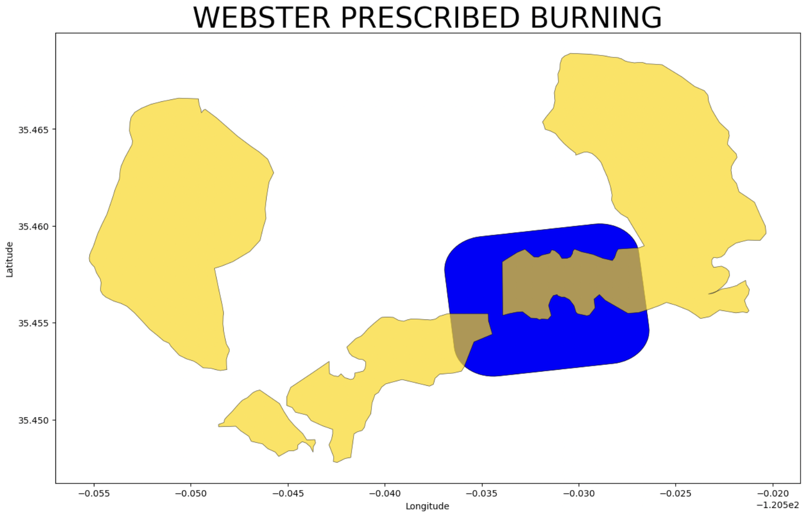
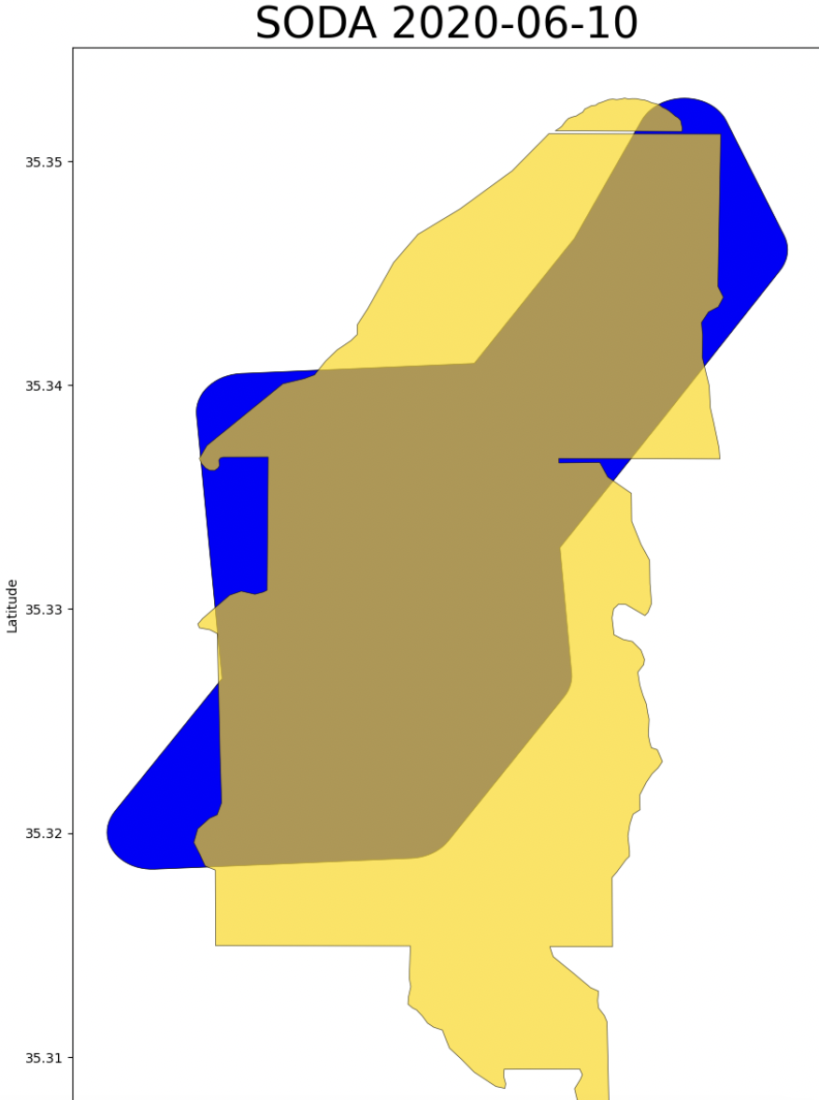
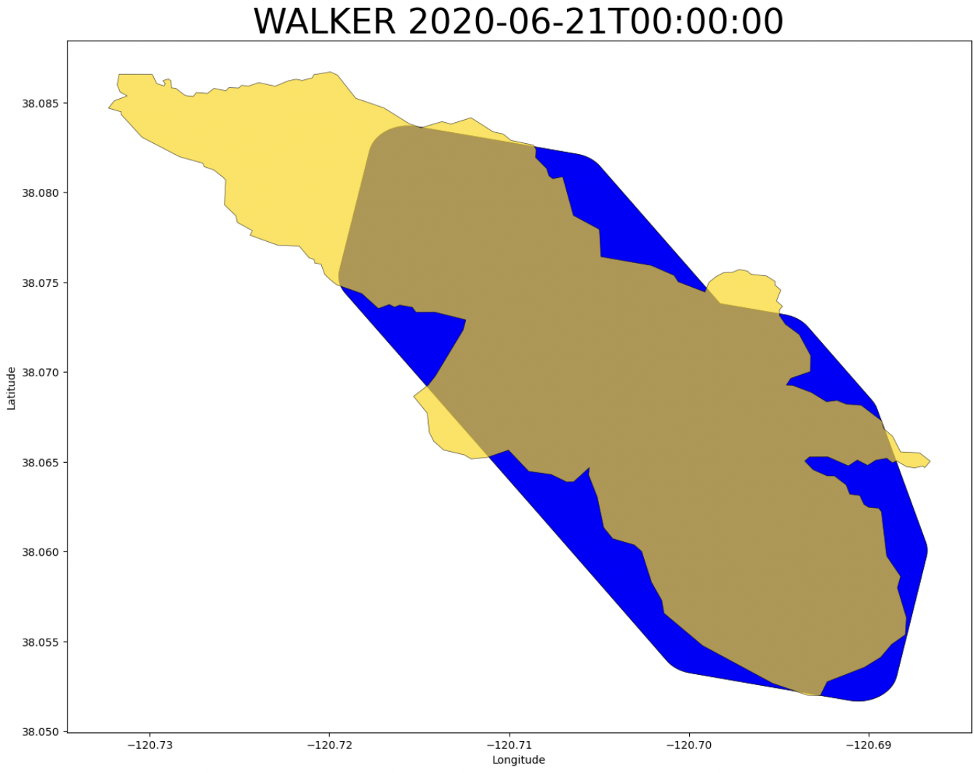

Slide 7
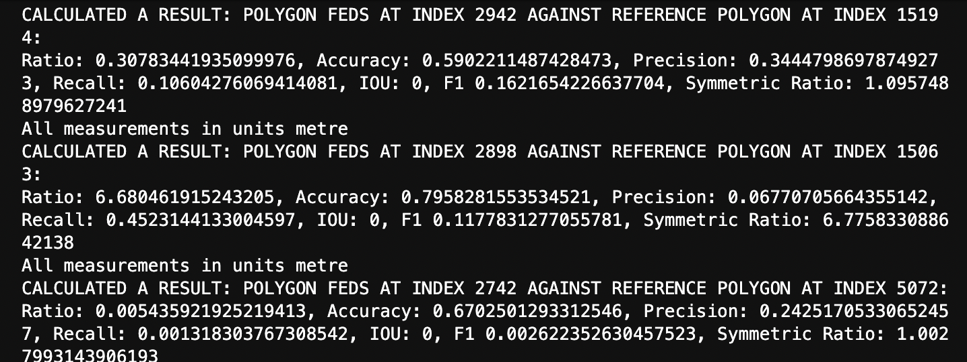
Feature: automated mass calculations
…

Slide 8
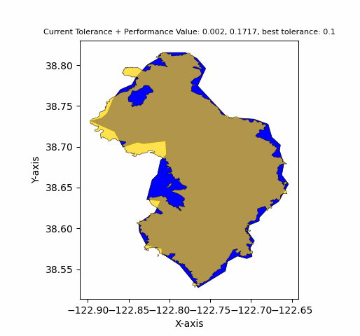
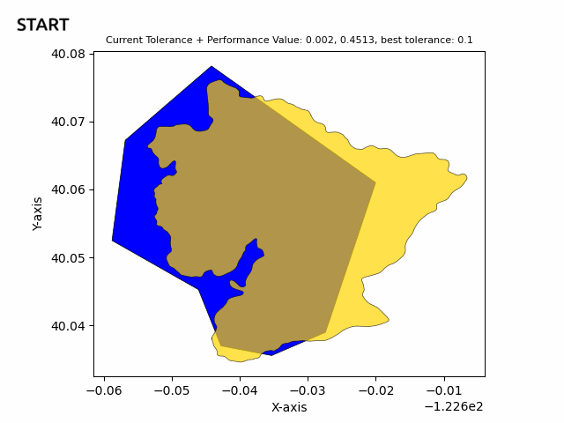
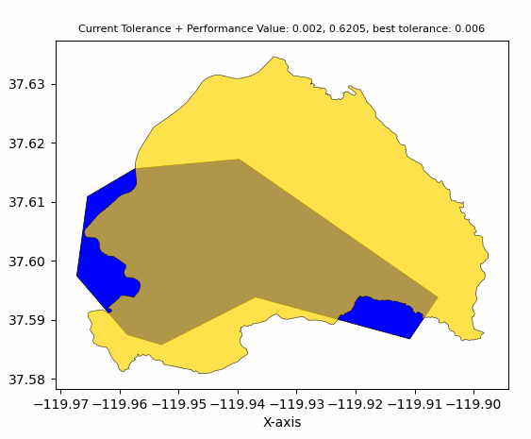
Feature: Best Simplification Seeker
Satellite
(NASA FEDS)
Aircraft (NIFC)
Kincade
Ranch
Briceburg
Best tolerance: 0.1
Best tolerance: 0.1
Best tolerance: 0.0059
Calculation func: symmetric difference ratio, higher == better

