Slide 1
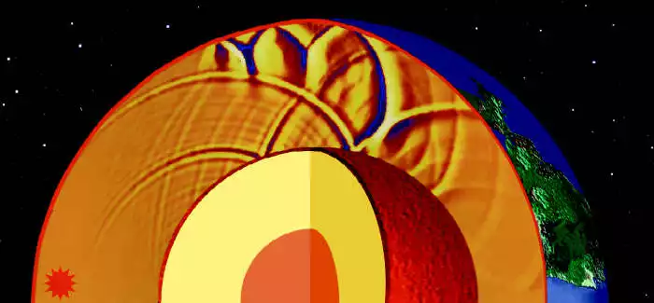
2D Shear Wave Simulation in Heterogeneous Media
EPS 109 Fall 2023 Final Project
Nicolas Valencia - November 28, 2023

Slide 2
Project Details
Computer simulations can be used to model wave propagation through media with different properties. This is especially important for seismic tomography and exploration geophysics.
This project utilized a finite-difference method developed to model shear wave propagation based on velocity and stress (Virieux 1984). The 2D wave equation is discretized into a matrix of velocity and stress components. Source excitation is done with a short-lived sinusoidal function and rigid boundary conditions are imposed along the edges.
Two animations presented: 1st animation shows propagation in homogeneous medium, 2nd animation shows propagation in heterogeneous medium with change in shear modulus at y = 40.
Shear wave velocity is proportional to the shear modulus of medium. Simulation results show higher velocity waves in region with higher shear modulus values. Higher attenuation is observed within this region as well. Notice the reflection along the boundary between the two different shear modulus regions.
Source: ”SH-wave propagation in heterogeneous media: Velocity-stress finite-difference method" (Virieux 1984).

Slide 3
Y
X

Slide 4
Y
X

