Slide 1
10 Story Building Consolidation Settlement
San Francisco vs. Boston
By: Ashley Woodward

Slide 2
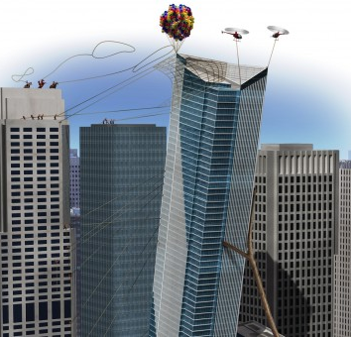
Background
What is consolidation?
Ground settlement due to the dissipation of excess pore pressures in soil
Common in clay materials due low hydraulic conductivity
Motivation
Consolidation is an integral part of building design and if not done properly can lead to structure failure
Example: Millennium tower leaning (100+ million-dollar mistake)

Slide 3
Key Concepts
Clay has a memory of its stress history
Normally Consolidated vs Over consolidated
Taylor Expansion and Finite Difference Method
Where U is % excess pore pressure; therefore, % consolidation = 1 – U
NC: $σ_{v0}$’ $≈P_{p}′$
$$δ_{c}= ∑\frac{C_{c}}{1+e_{0}}Hlog\left(\frac{σ_{vf}′}{σ_{v0}′}\right)$$
OC: $σ_{v0}$’ $≈P_{p}′$
$$δ_{c}= ∑\frac{C_{r}}{1+e_{0}}Hlog\left(\frac{σ_{vf}′}{σ_{v0}′}\right)$$
$$\frac{δu}{δt}= C_{v}\frac{δ^{2}u}{δz^{2}}$$
$$β= C_{v}\frac{Δt}{Δz}$$
$U_{i}, t+Δt=U_{i}, t$ + $β[U_{i−1}, t −2U_{i}, t$ + $U_{i+1}, t]$

Slide 4
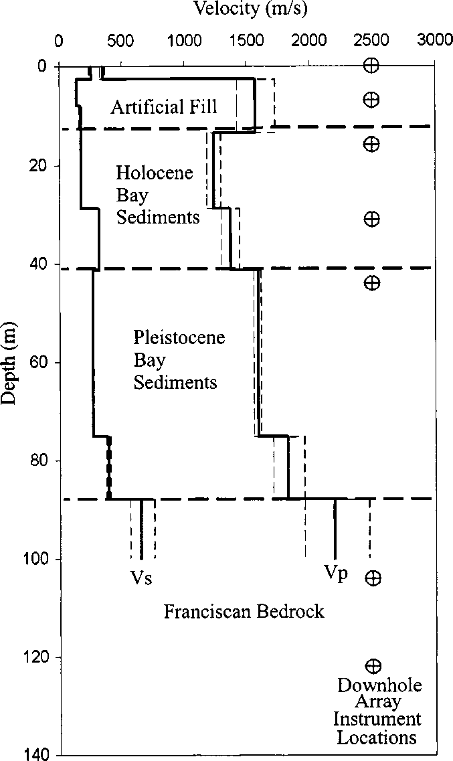
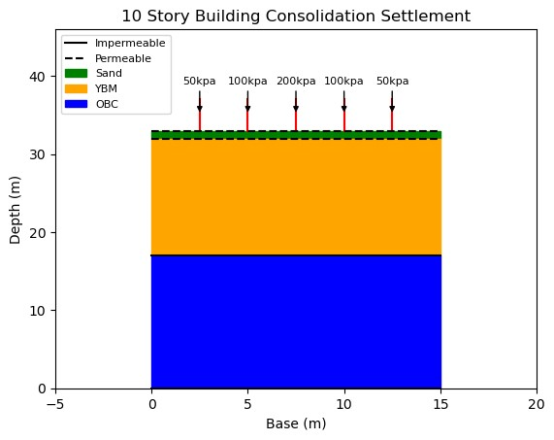
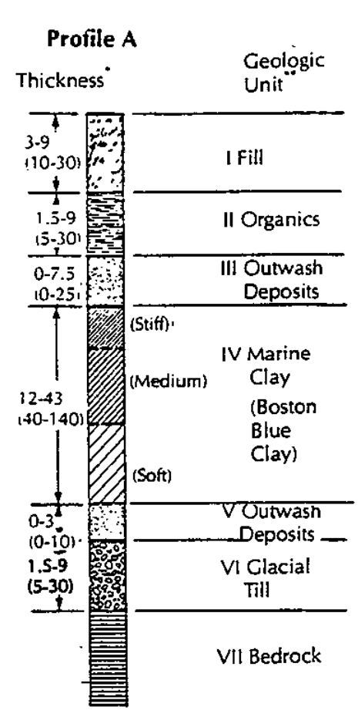
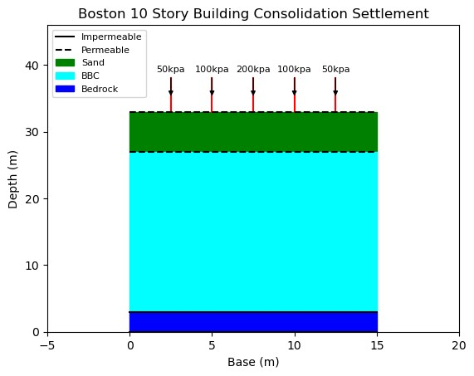
The Model

Slide 7
Boston Blue Clay Information
https://faculty.uml.edu/spaikowsky/Teaching/14.533/documents/Connors_Bkgnd_EngPropofBBC.pdf
https://caenlucier.com/blog-press/2016/10/27/the-big-sink

