Slide 1
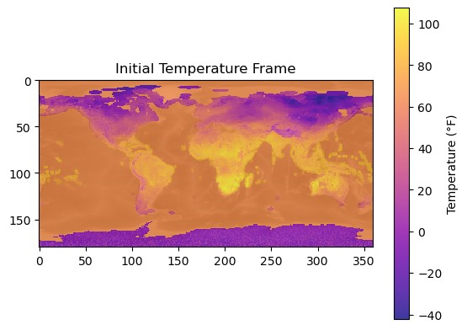
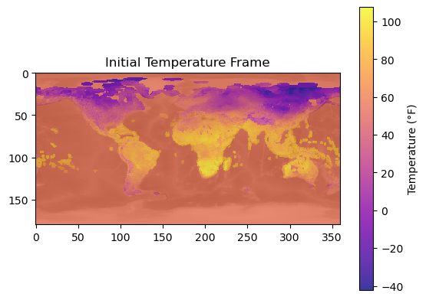
Simulating Earth’s Surface Temperature in 1000 Years
Kevin Zhu

Slide 2
Methods
Data Preparation:
Used historical average temperature data (1875-2022).
Used API to gather temperature data into a file based on coordinates (weatherapi.com)
Simulation Approach:
Monte Carlo Simulation: Conducted 100 runs over a 1000-year period.
Temperature Initialization: Used historical data / real time to initialize temperature maps.
Simulation Processes:
Heat Equation Solution:
$$∆T_{ij}=\frac{{\text{κ}}_{adjusted}×Diffusion×∆t}{ρC}+\frac{SolarEffect×∆t}{ρC}$$
2. Simulate Solar Radiation Solution:
$$∆T_{ij}=\frac{AbsoredRadiation×∆t}{HeatCapacityMap}+DiffusionChange+HeatDissipation$$

Slide 3
Heat Equation
Solar Radiation

