Slide 1
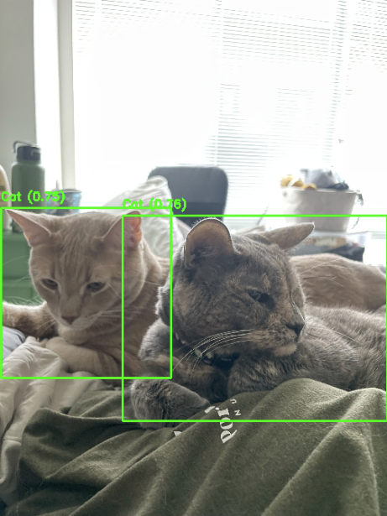
A Tail of Two Kitties :
Tracking Pet Movement
Omar Ramos, EPS 109 Fall 2023

Slide 2
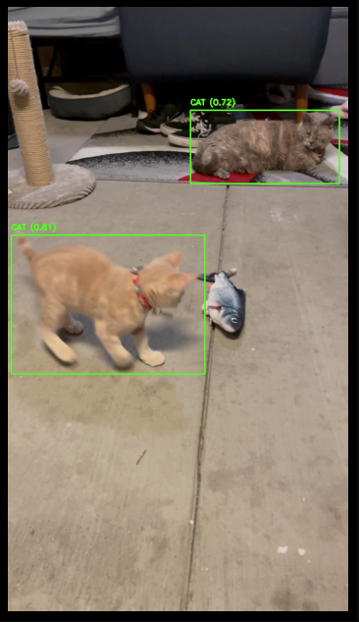
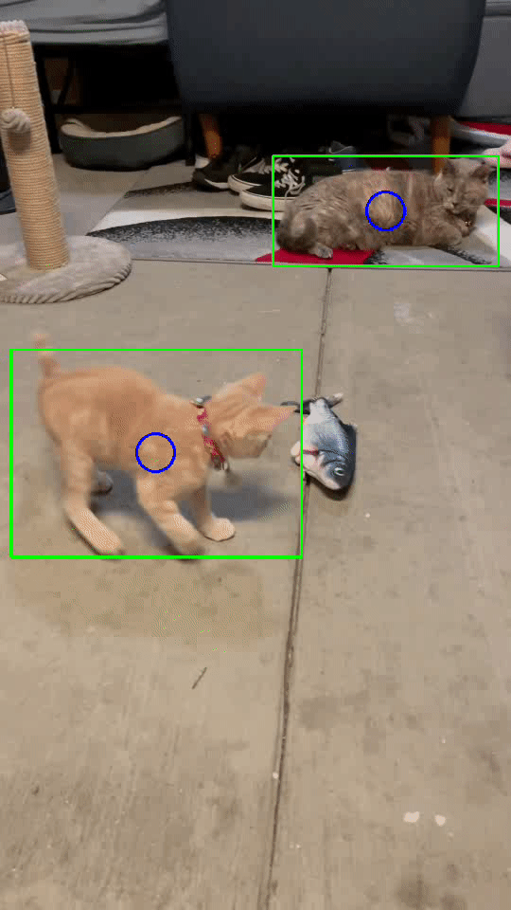
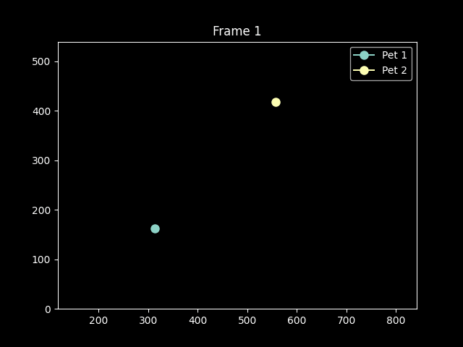
Tracking Pet Movement w/ ML and Animations
Collect and animate pet movement data
Object Detection, Tracking: Google MobileNetV2, Tensor Flow
Image Processing and Animation: OpenCV, matplot, numpy
Initial Detection
Tracking
Animation!

Slide 3
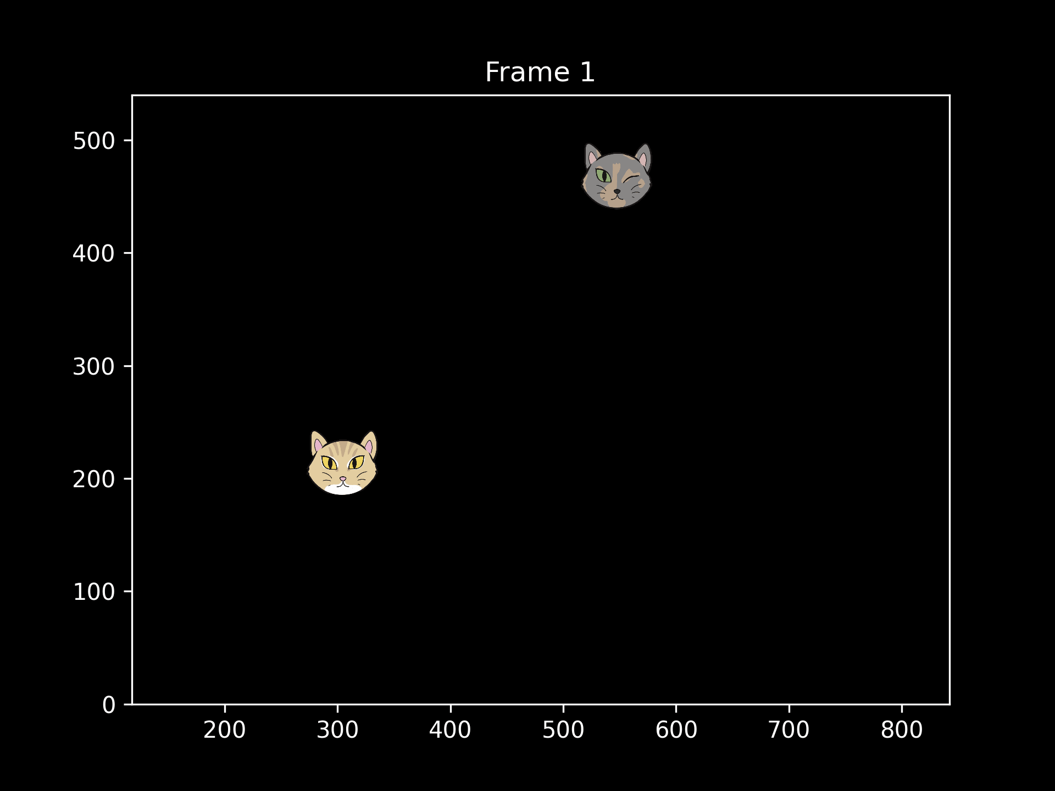
Animation

Slide 4
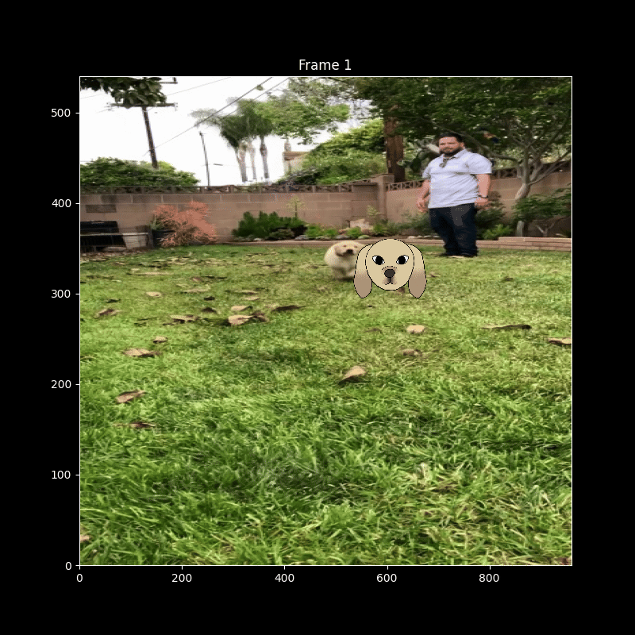
Doggo Example

Slide 5
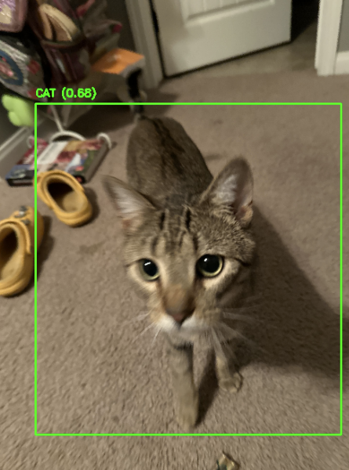
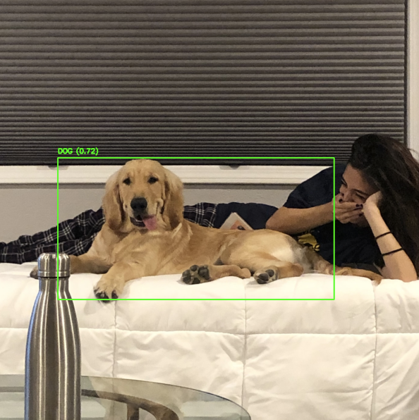
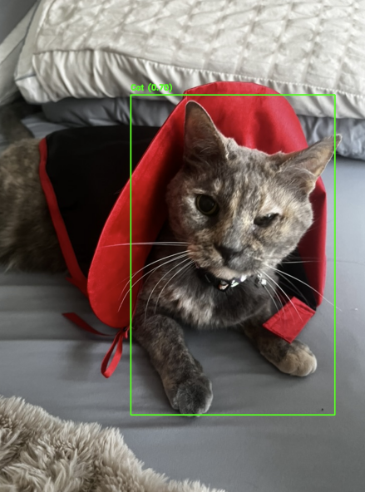
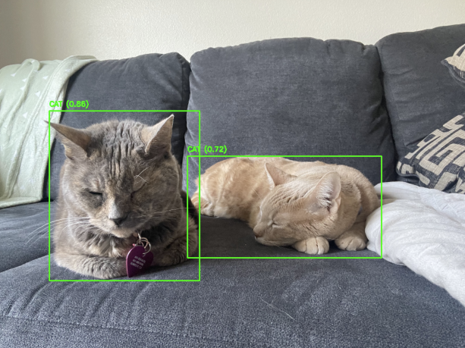
Cute Stuff!

Slide 6
Thanks!

