Slide 1
Simulating Density Waves in Compressible Fluids with LBM
By: Charlie Diaz

Slide 2
Background:
Computational Fluid Dynamics (CFD)
Most CFD methods rely on directly solving some form of the Navier-Stokes Equations (NSE) —>
NSE can generally be understood as Newton’s second law, but applied specifically to fluids
Some notable CFD methods that directly solve NSE:
FVM, SPH, FDM
https://www.nuclear-power.com/nuclear-engineering/fluid-dynamics/navier-stokes-equations/

Slide 3
Background:
Computational Fluid Dynamics (CFD)
Within CFD, methods are categorized into two main groups: Lagrangian and Eulerian:
Lagrangian methods simulate fluids as individual particles which can independently move in an environment (the method shown in last week’s lecture on MD). Good for microscopic simulations (ie. MD)
Eulerian methods simulate fluids as a mesh, each point containing information about the fluid at that point. Good for macroscopic fluid simulations.

Slide 4
The Lattice-Boltzmann Method
Alternative method to simulating fluid (doesn’t directly solve NSE)
Instead, simulates fluid as a grid of densities and velocities and uses streaming and collision of particles to approximate NSE
Advantages:
Like all Eulerian methods, simulating a mesh is more efficient than simulating particles, especially for macroscopic fluids
Relatively simple implementation

Slide 5
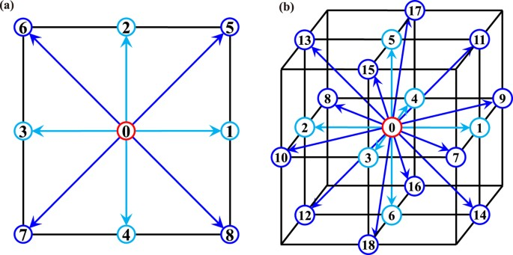
The Lattice-Boltzmann Method
The Lattice-Boltzmann method I used was D2Q9
2 Dimensions, 9 Neighbor Cells
Streaming: project the density at point 0 to all neighboring points
Collision: Determine the equilibrium state (with respect to an attribute of the fluid, ie. temperature, which is held constant) for each point
Iterate streaming and collision for the whole grid over time
https://www.nature.com/articles/s41598-017-10833-w

Slide 6
Evolution of Fluid Density in an Enclosed Box:

Slide 7
Sources:
https://www.nuclear-power.com/nuclear-engineering/fluid-dynamics/navier-stokes-equations/
https://www.nature.com/articles/s41598-017-10833-w
https://medium.com/swlh/create-your-own-lattice-boltzmann-simulation-with-python-8759e8b53b1c
https://en.wikipedia.org/wiki/Lattice_Boltzmann_methods
https://www.dive-solutions.de/blog/cfd-methods
https://en.wikipedia.org/wiki/Navier%E2%80%93Stokes_equations

