Slide 1
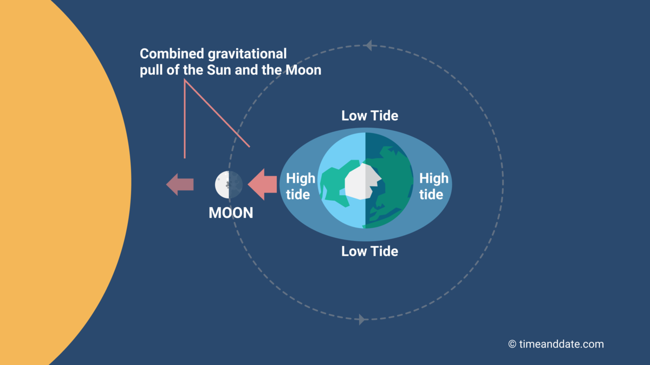
Simulating the Tidal Bulge Model
Mira Bhatt, EPS 109 F23
Source: https://www.timeanddate.com/astronomy/moon/tides.html

Slide 2
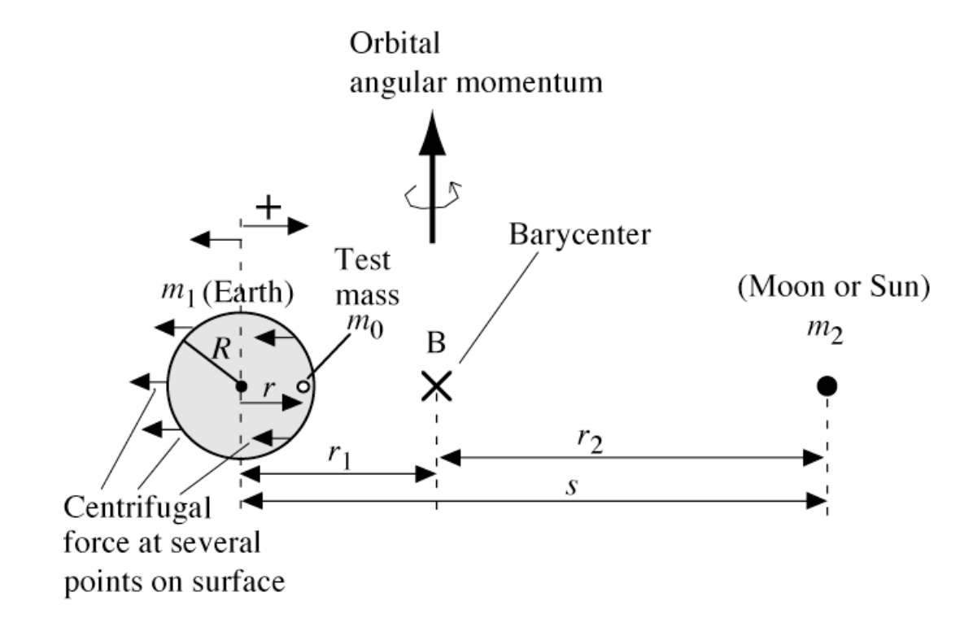
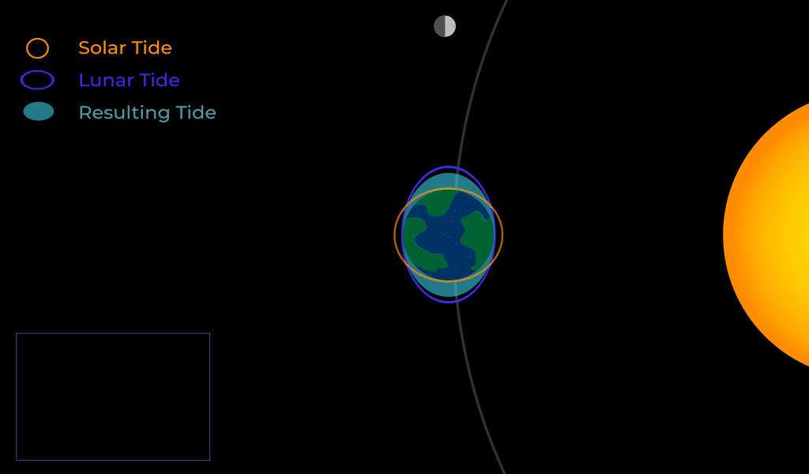
Topic & Methods
Tide: the alternate rising and falling of the surface of the ocean and of water bodies (such as gulfs and bays) connected with the ocean
Tidal bulge model:
Source: https://oceanservice.noaa.gov/education/tutorial_tides/tides03_gravity.html
Find / calculate relative locations of sun and moon for any date + time, then calculate each for a grid of points:
Gravity due to moon
Gravity due to sun
Centrifugal force – earth-moon
Centrifugal force – earth-sun
Angle between sun and moon
Spring and Neap tides:
Source: https://www.cambridge.org/us/files/1913/6681/8626/7708_Tidal_distortion.pdf
Source: https://moon.nasa.gov/moon-in-motion/earth-and-tides/tides/

Slide 3
Animation 1

Slide 4
Animation 2

