Slide 1
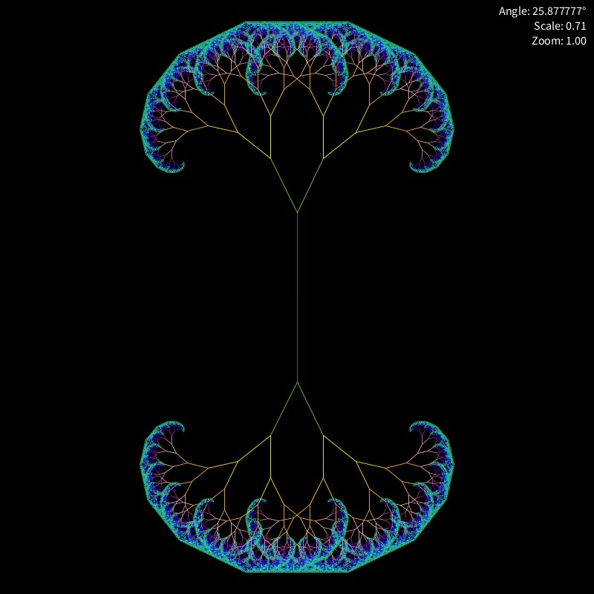
Fractal Visions: An Evolving Journey Through Geometric Complexity
By: Michelangelo Dominguez

Slide 2
Topic & Methods
Generates a colorful fractal tree structure that evolves over time
Made using recursive function calls ‘rec’ which creates a fractal tree
Fractal changed by angle of rotation, scale factor, and zoom of the recursion
Used the ‘Event’ class and ‘events’ array to make sequence of changes
An RGB color cycling mechanism changes the color of the tree branches
In an array such as (0, 0, 255) for Blue
‘lerp’ function for smooth transitions in angle, scale, and zoom during events.
Then converted from Jupyter Notebook to Processing.org
For Smoother Animation
Input audio file loading and playback
Used FFmpeg to compile the frames into an MP4
Inspiration: Psychedelic Tree (Google Images)

