Slide 1
2D Glacial Flow Simulation
Tim Elnitiarta

Slide 2
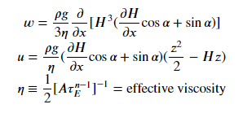
Topic and Methods
Glacial flow:
Deceiving complexity
Environmentally relevant
Methods:
Navier-Stokes Equation
Modified for non-Newtonian ice
Discretized time-dependent PDE
Moving grid points

Slide 3
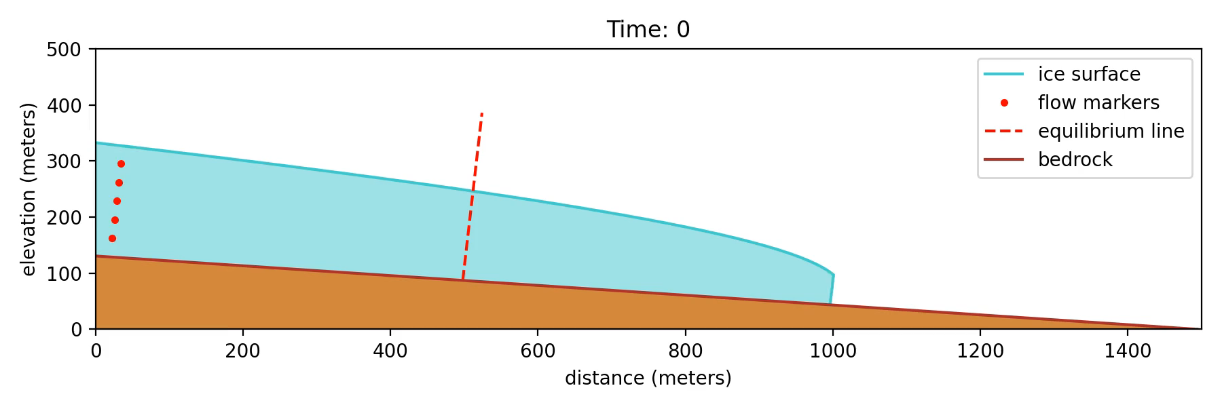
Animation: Ice Flow Down 5˚ Slope

