Slide 1
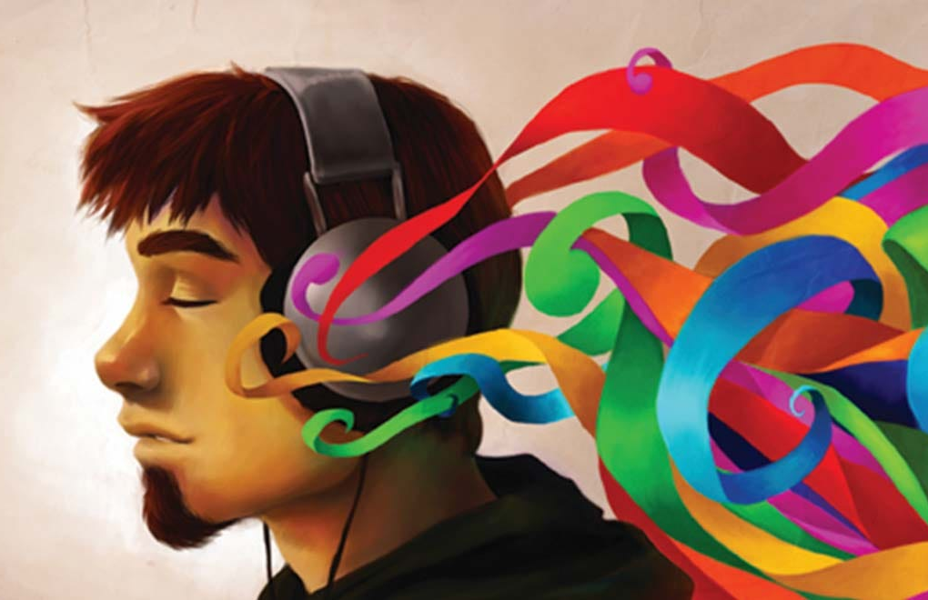
Scriabin’s Pseudo Synesthesia
Ellie Mak

Slide 2
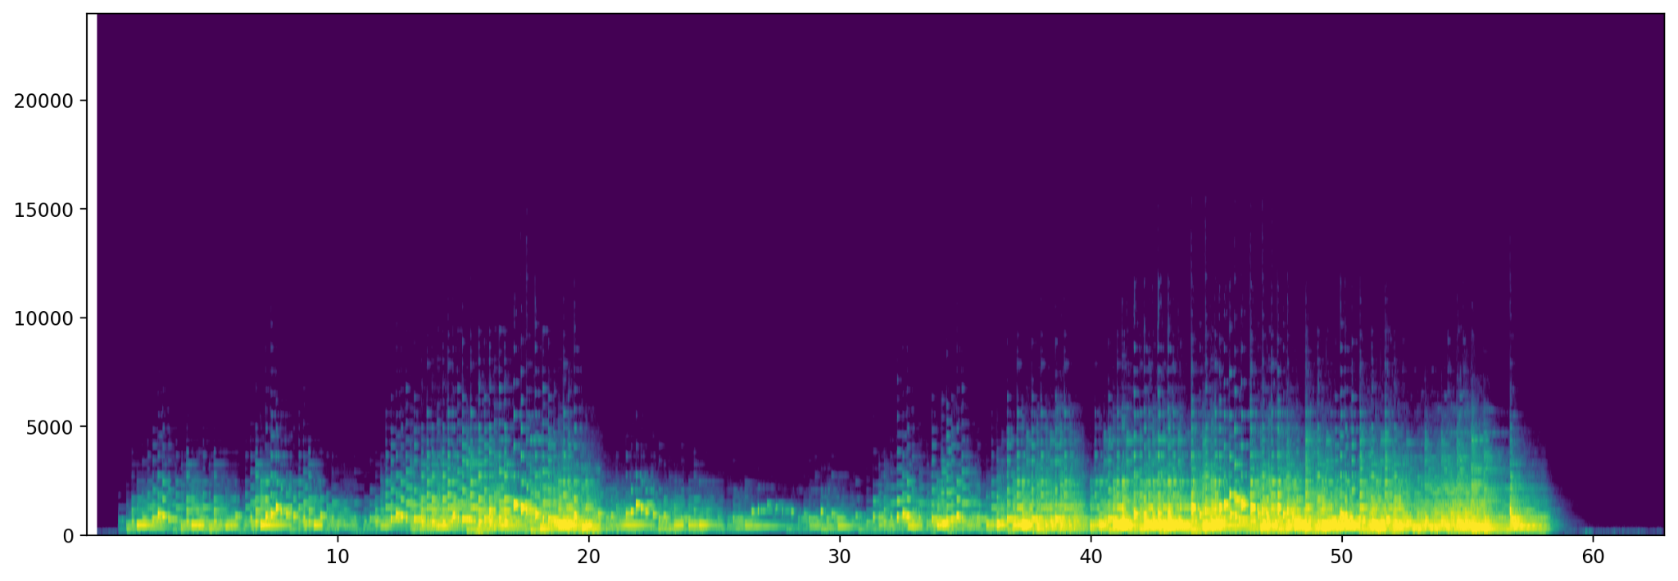
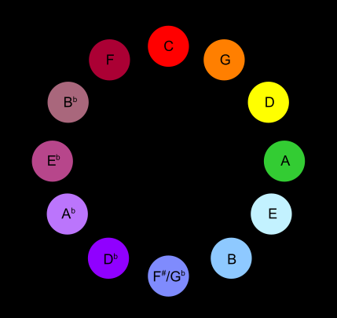
Chromesthesia: sound-to-color synesthesia (sound evokes an experience of color, shape, movement)
Spectrogram: spectrum of frequencies over time
Alexander Scriabin’s (Romantic composer) color wheel: notes/frequencies map to color
How can we visualize this with a piece of music?
Hz
Time (s)
Scriabin 24 Preludes Op.11 - No.1 in C major:
Used fast Fourier transform to calculate the most dominant frequency per “note” (sample rate 48 kHz)
Created a frequency-color map dictionary and table (notemap.csv) across 9 octaves
Analyzed the .wav file of music in 0.125 second chunks: extracted the “peak” frequency in that chunk and found the note/color that most closely matches
Created one frame of animation per chunk to visualize the corresponding Scriabin color (~500 frames for ~1 min of music)
Animation:
The animation displays both the “peak” frequency and the Scriabin color in each frame (approx. melody of the piece)
Used numpy FFT, simpleaudio, matplotlib.animation, and moviepy to layer sound on the animation
In small sections where there is no music playing, the code approximates to low frequency notes

