Slide 1
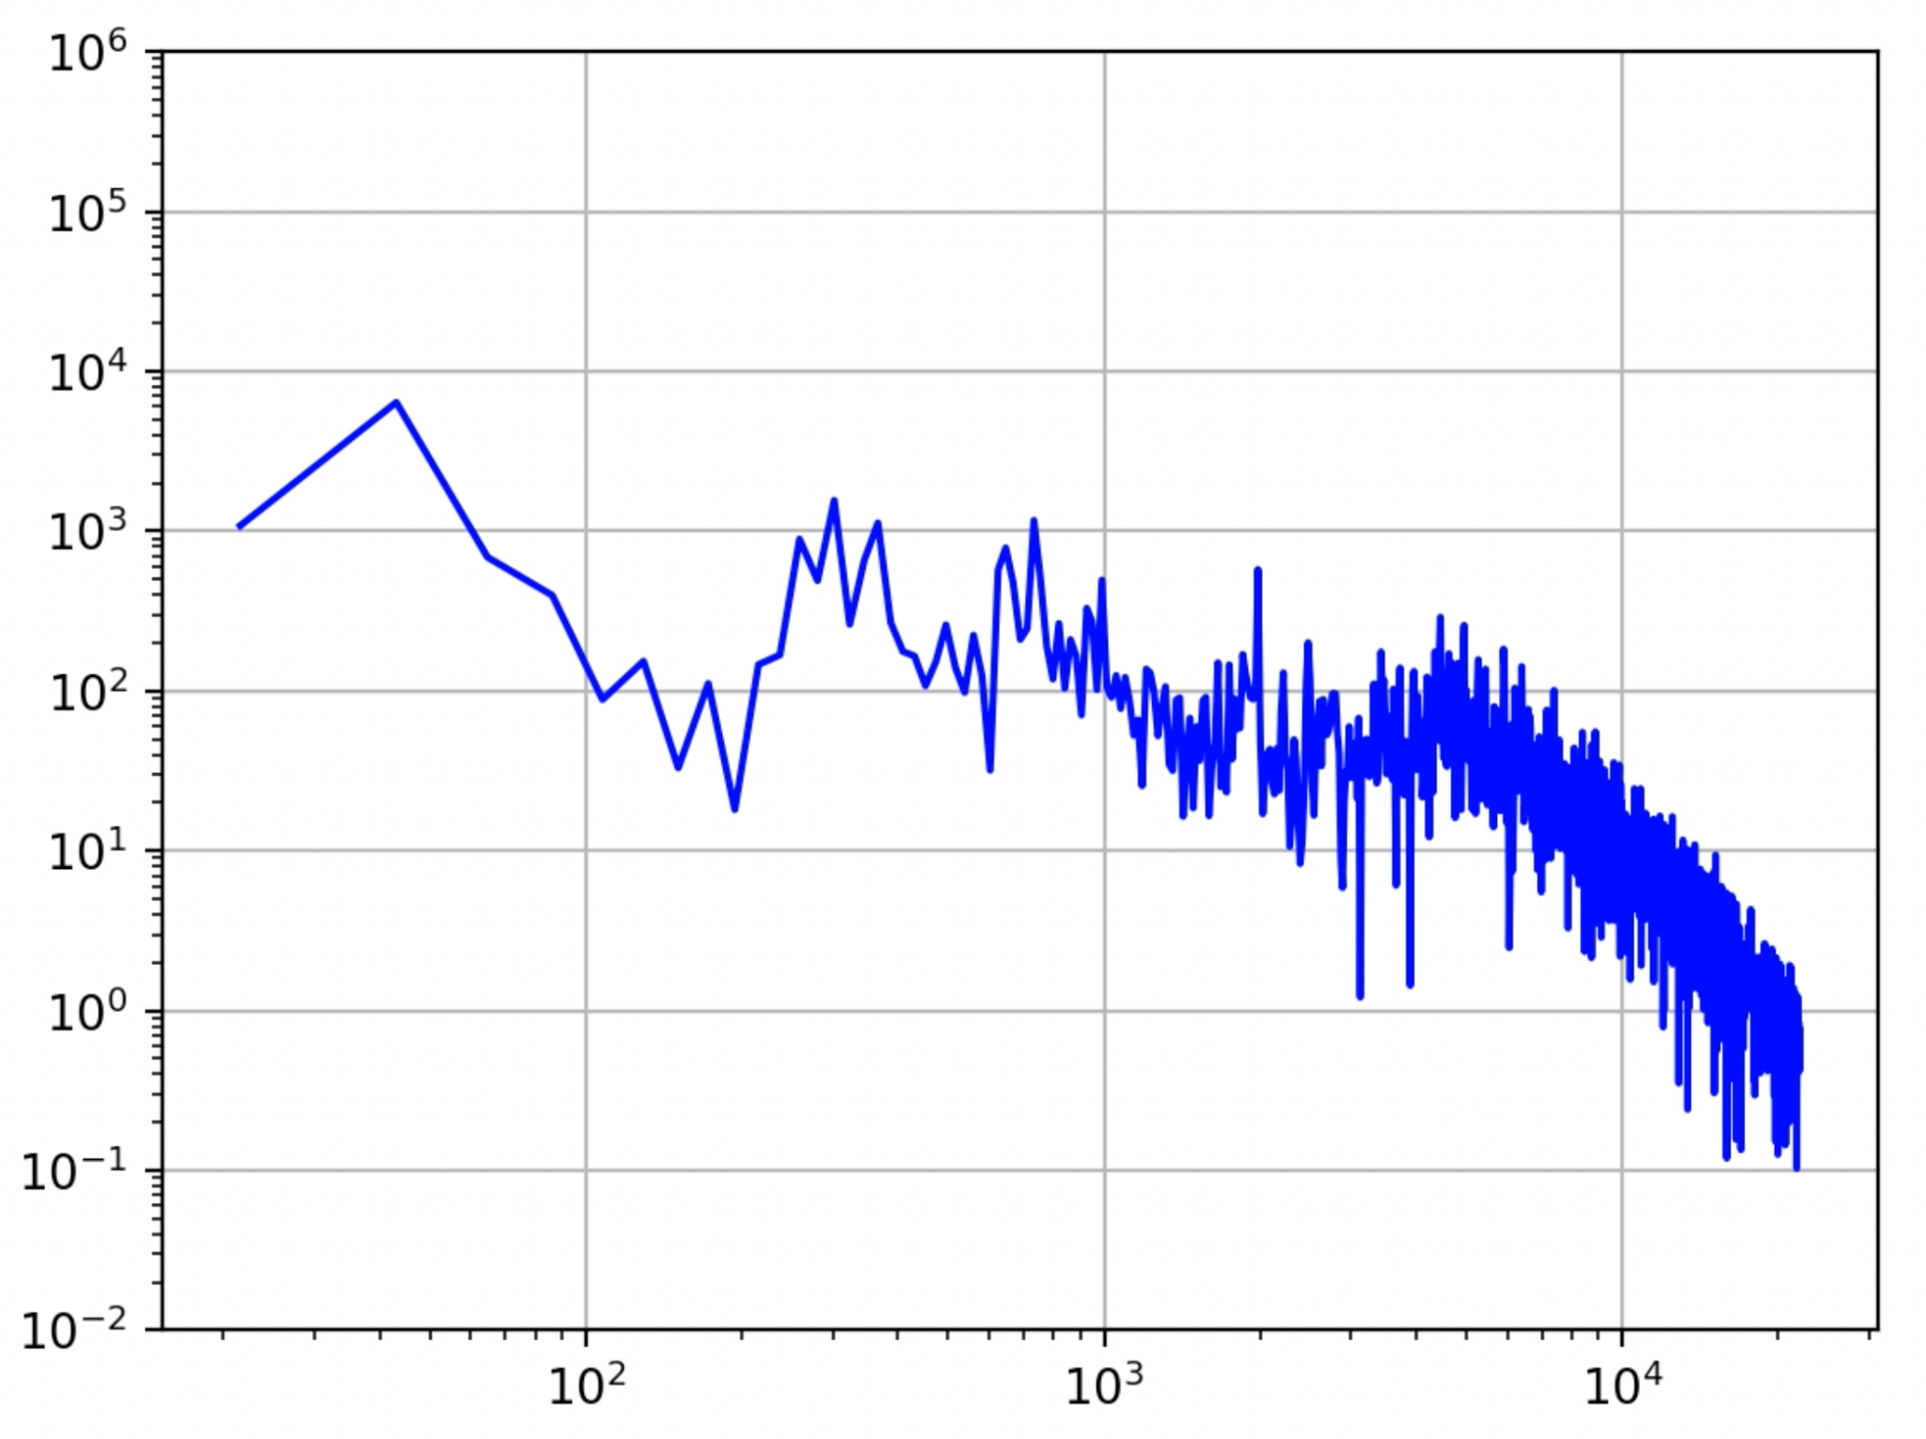
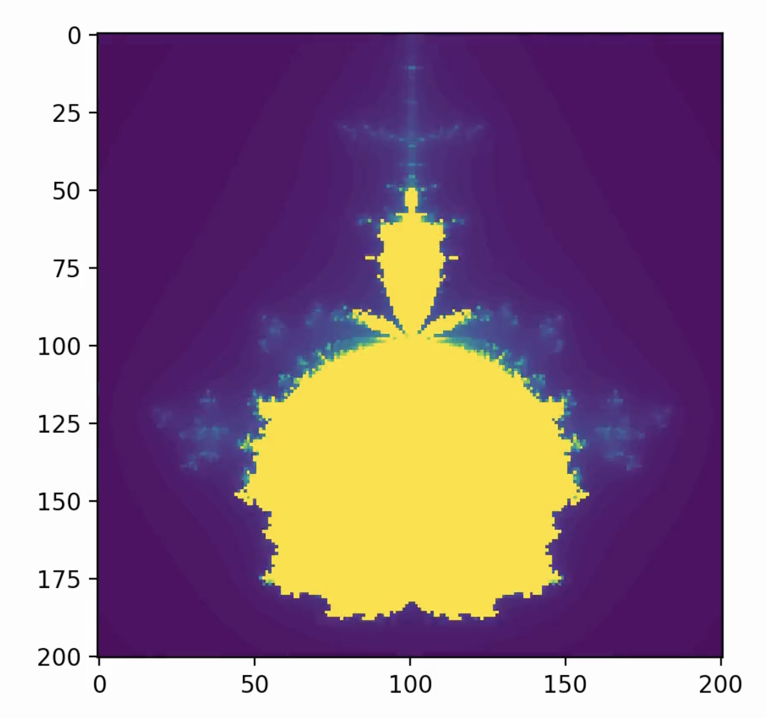
Audio Reactive Mandelbrot Set through FFT
Anjo Pagdanganan

Slide 2
Methods
Mandelbrot Sets and FFT → music visualizer
Used SciPy’s FFT library to analyze the frequencies in a song along different intervals
512 or 2048-sample block size, no overlap, hamming window to prevent spectral leakage
Took highest value across low (<150hz), mids (150-6000hz), highs (>6000hz)
Used this data to generate a Mandelbrot set frame
Bass controls shape/size of fractal, mids and highs control bloom (# iterations)
Seems to mostly respond to drums
Hard to separate harmonics of lead elements from percussion, so the loudest (and most visible) changes occur on sharp transient hits
May change depending on input song dynamics; currently tuned for modern ~-6-8 LUFS songs

Slide 3
Misc. thoughts + Demo
2048 block size → ~20 FPS, 512 block size → ~80 FPS
Higher FPS is a little too responsive, flickers; lower FPS sometimes misses a drum hit
May consider “dampening” the data to generate higher FPS videos
Interpolation also an option, though unsure if it would technically preserve “fractal” structure

