Slide 1
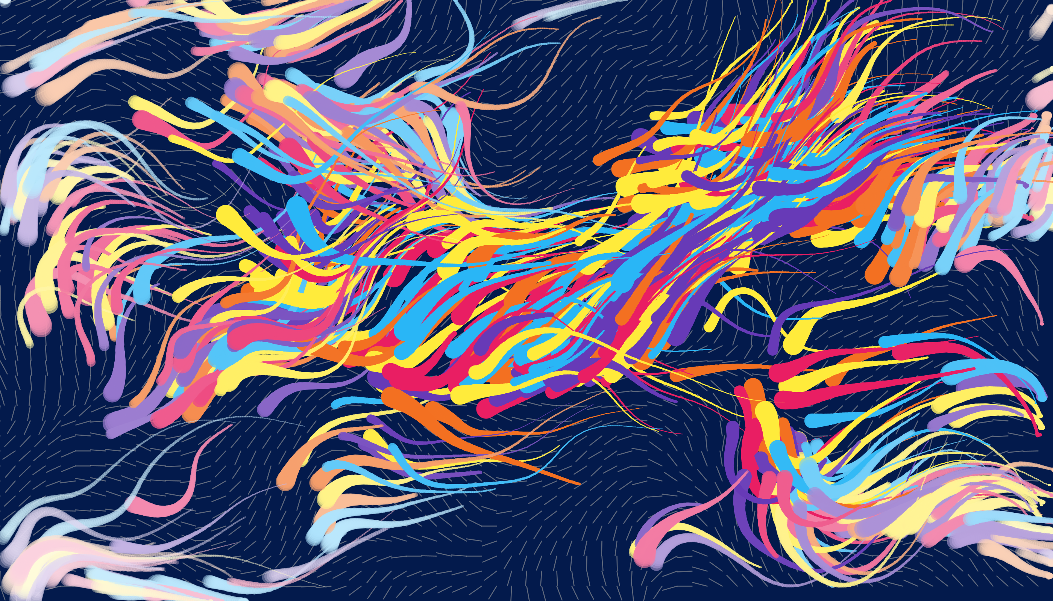
Friendly Fishes in Flow
Combining Flocking Simulations, Kinematic Movement, and Perlin Noise Flow Fields
By Anuj Panta

Slide 2
2D Inverse Kinematics
How can we simulate a the silky smooth movement of a fish ?
Treat head and tail as the initial and end effectors

Slide 3
Boid Algorithm
Craig Renyolds !
Fish hangout smarter than humans
Let’s flock to make schools of fish !
Fish are happier when with friends sad alone

Slide 4
Perlin Noise
My favorite Noise Alog.
A set of similar random values
Water moves kinda random… but also not weird ?
We will use this idea of a 2D flow field to represent water movement

