Slide 1
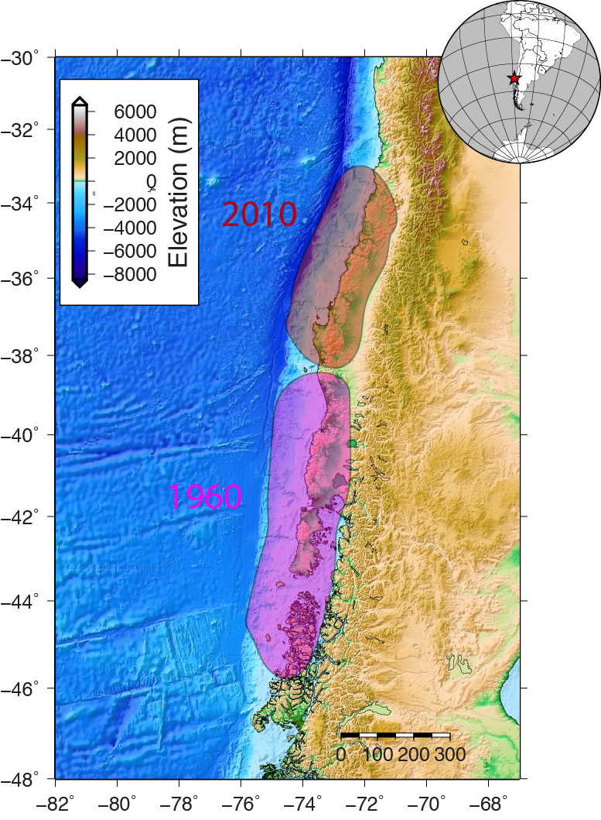
Holy Maule: Chilean Earthquake Distribution
Isis Lemus
Pic: 1960 & 2010 rupture areas
Credit: Diego Melgar, BSL

Slide 2
Purpose
Demonstrate the distribution of Chilean Earthquakes before and shortly after the Maule Earthquake in February 2010
Maule Earthquake: 8.8 MW
Thrust Fault, up to 15m of fault slip
Tsunami
Largest since Great Chilean Earthquake of 1960 (9.5)
Methods:
ObsPy
CartoPy
External sources (see References)

Slide 3
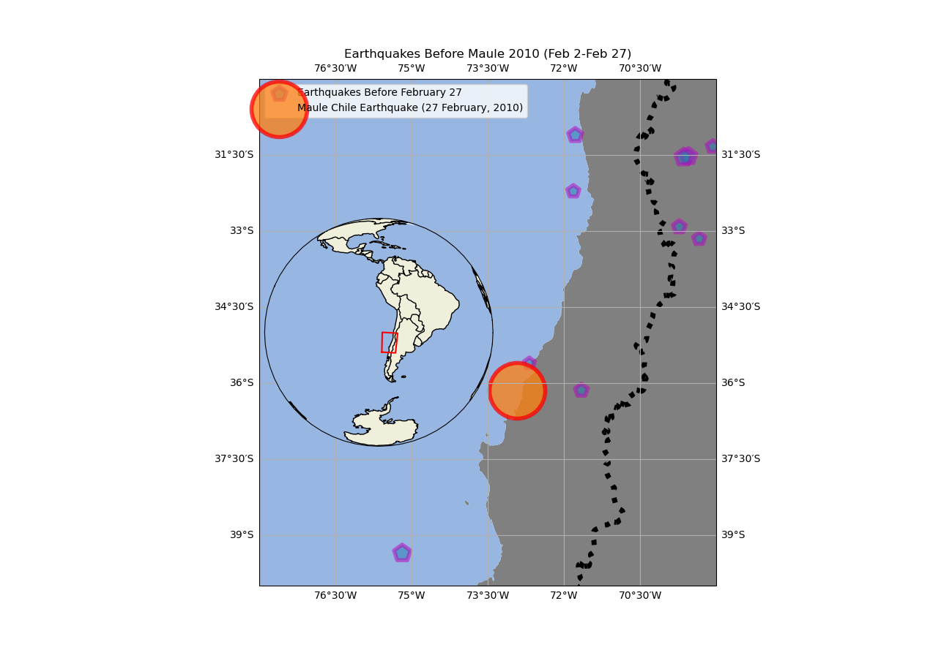
Purple: Earthquakes preceding Maule 2010 event
Size: Earthquake magnitude raised to an exponent (for visibility)

Slide 4
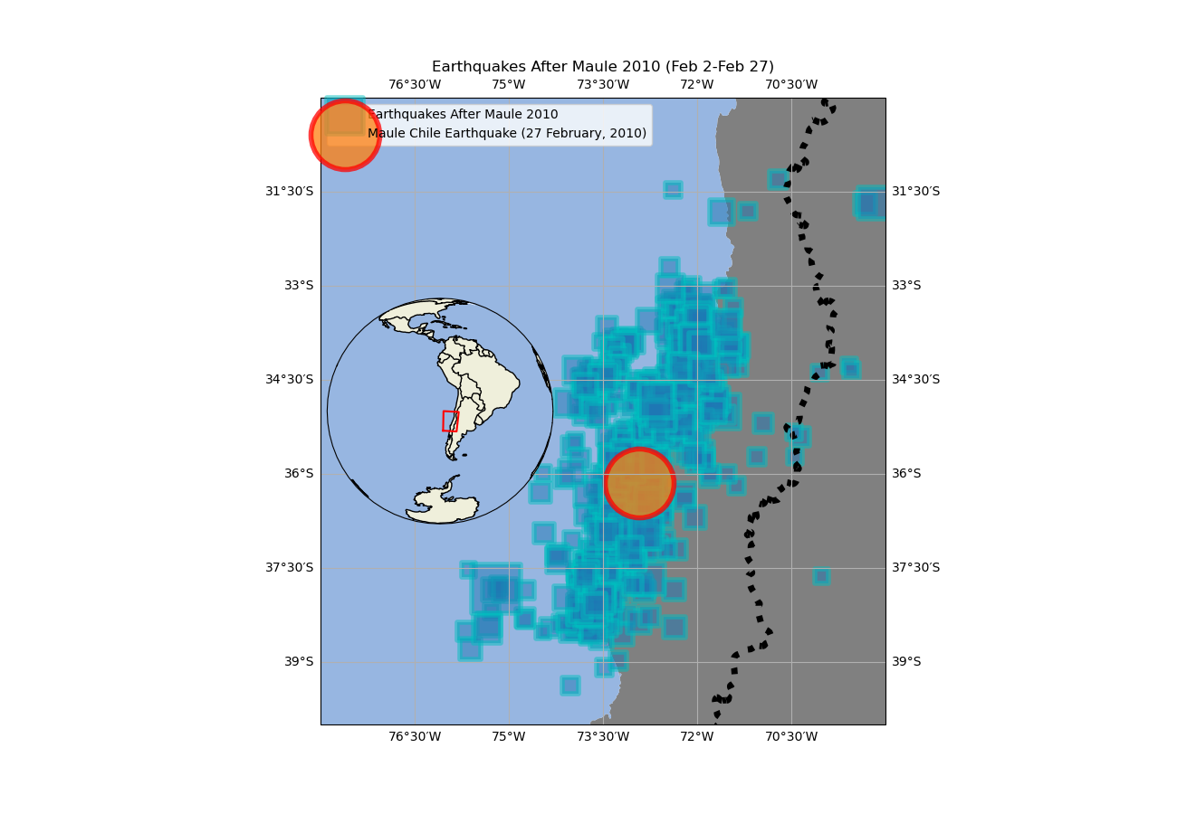
Blue: Earthquakes immediately after Maule 2010 event
Size: Earthquake magnitude raised to an exponent (for visibility)
* 24 hrs after mainshock

Slide 5
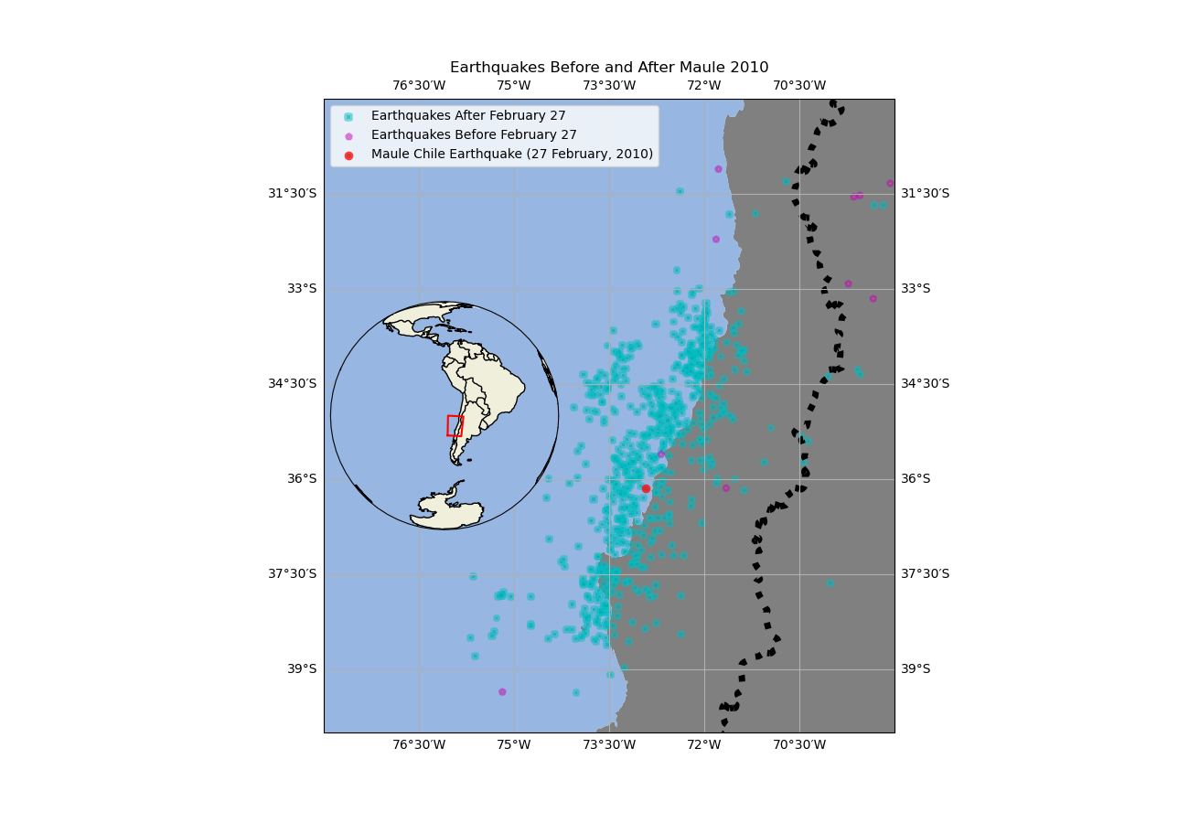
Purple: Foreshocks
Blue: Aftershocks
Red: Maule 2010 Earthquake (Mainshock)
Size: Earthquake magnitude

Slide 6
Holy Maule!
Earthquake Distribution in Feb 2010 (daily slices)
Animation shows days when earthquakes occurred
Color: Depth (km)
Size: Earthquake Magnitude

Slide 7
References:
cartopy features: https://scitools.org.uk/cartopy/docs/latest/gallery/lines_and_polygons/features.html#sphx-glr-gallery-lines-and-polygons-features-py
inset plot: https://stackoverflow.com/questions/55385515/embed-small-map-cartopy-on-matplotlib-figure
Inset tutorial: https://semba-blog.netlify.app/07/04/2020/mapping-with-cartopy-in-python/
Adding lat/lon measurements to gridlines: https://scitools.org.uk/cartopy/docs/latest/gallery/gridlines_and_labels/gridliner.html#sphx-glr-gallery-gridlines-and-labels-gridliner-py
Str tutorial + floating zeros: https://bobbyhadz.com/blog/python-add-leading-zeros-to-number
Catalog plot: https://docs.obspy.org/packages/autogen/obspy.core.event.Catalog.plot.html
Maule Earthquake information: https://earthquake.usgs.gov/earthquakes/eventpage/official20100227063411530_30/executive

