Slide 1
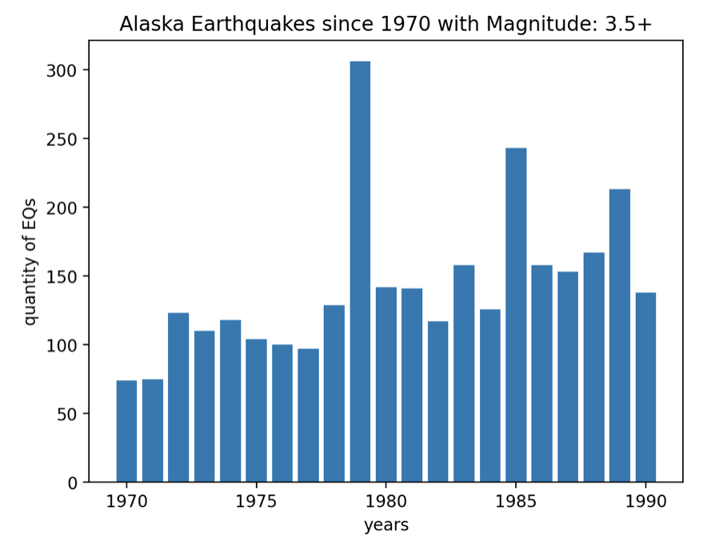
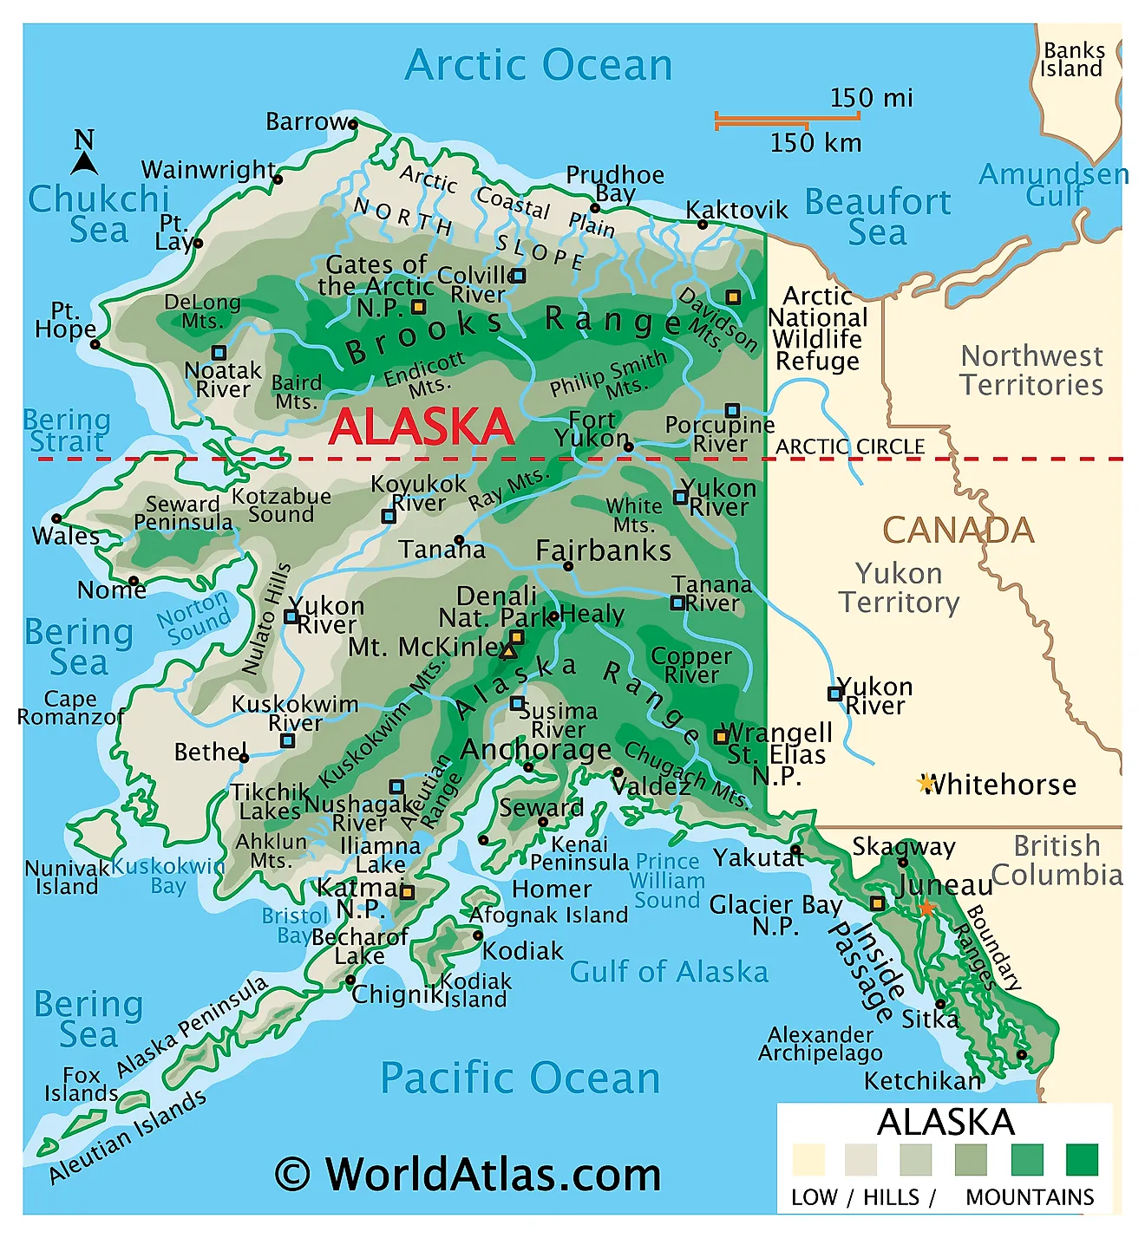
Gutenberg-Richter in Alaska: Does it work?
Yash Bhargava

Slide 2
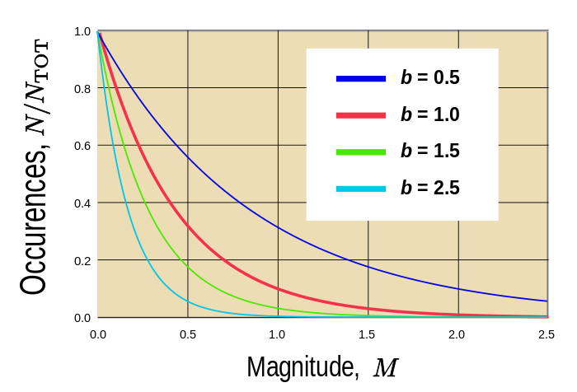
Topic of Simulation; methods used
Does the Gutenberg-Richter law apply to earthquakes that happened between 1970 and 1990 in a particularly seismically active region
Alaska accounts for 11 percent of the world’s earthquakes
Goal: Want to find the perfect b-value for the Gutenberg equation to match with Alaska’s earthquakes.
Methods used:
CartoPy
ObsPy
FFMpeg
Scatter plots
Histograms

Slide 3
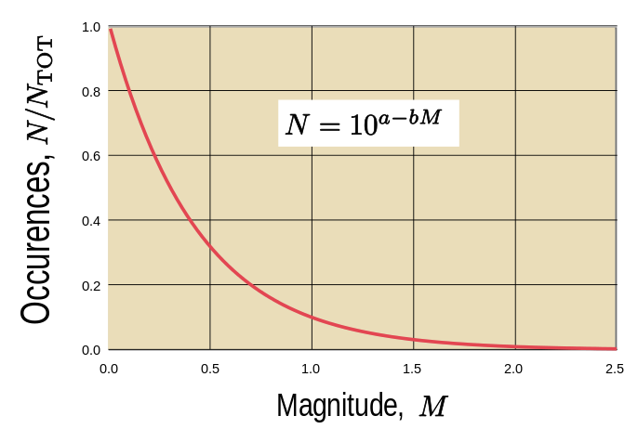
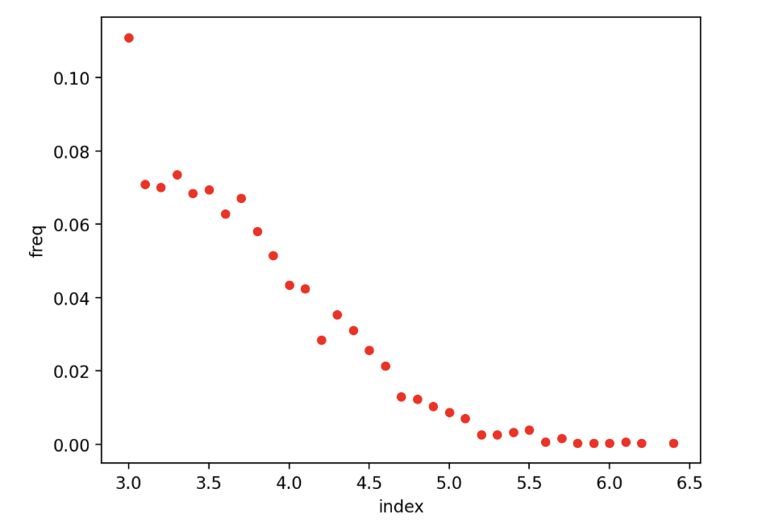
Gutenberg-Richter + Alaska Analysis
Magnitude of earthquakes in Alaska vs. Proportion of occurrences
Expresses the relationship between the magnitude and total number of earthquakes in any given region and time period of at least that magnitude
Looks somewhat logarithmic, but let’s see what value of B is needed to produce a Gutenberg-Richter plot like this plot
Notes:
Gutenberg-Richter
Expresses the relationship between the magnitude and total number of earthquakes in any given region and time period of at least that magnitude
N is the number of events having at least magnitude M
A-value represents the total seismicity of a region
B - value essentially characterizes the state of stress in the crusts
In other words, b-value determines ratio of between large and small events
B value varies between 0.3 and 2 usually in seismically active regions, like Alaska

Slide 4
Previous plot (red) vs. Gutenberg-Richter plots (blue) with b-values ranging from 0 to 1, with step size 0.05
Notes:
The blue line represents the Gutenberg-Richter line with the b-value that ranges between 0 and 1, with step sizes of 0.05. The red line represents Magnitude of earthquakes in Alaska vs. Proportion of occurrences. We can observe that the two lines are closest to each other when b is approximately 0.35.

Slide 5
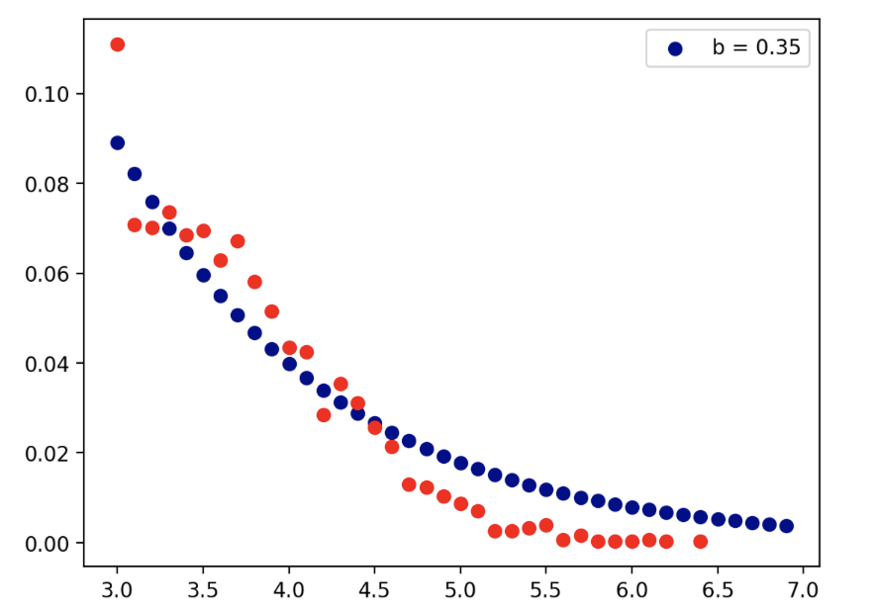
Most optimal b-value
Best b-value ended up being b=0.35

Slide 6
Conclusion
Alaskan earthquake frequency between 1970 and 1990 matches up really well with Gutenberg-Richter Equation with b=0.35
B value of 0.35 reaffirms the fact that Alaska is a zone with high seismic activity.
Can evaluate accuracy using Mean Squared Error metric
Can conclude that Gutenberg-Richter law applies to earthquakes that happened between 1970 and 1990 in Alaska, a region that accounts for about 11 percent of the world’s earthquakes

