Slide 1
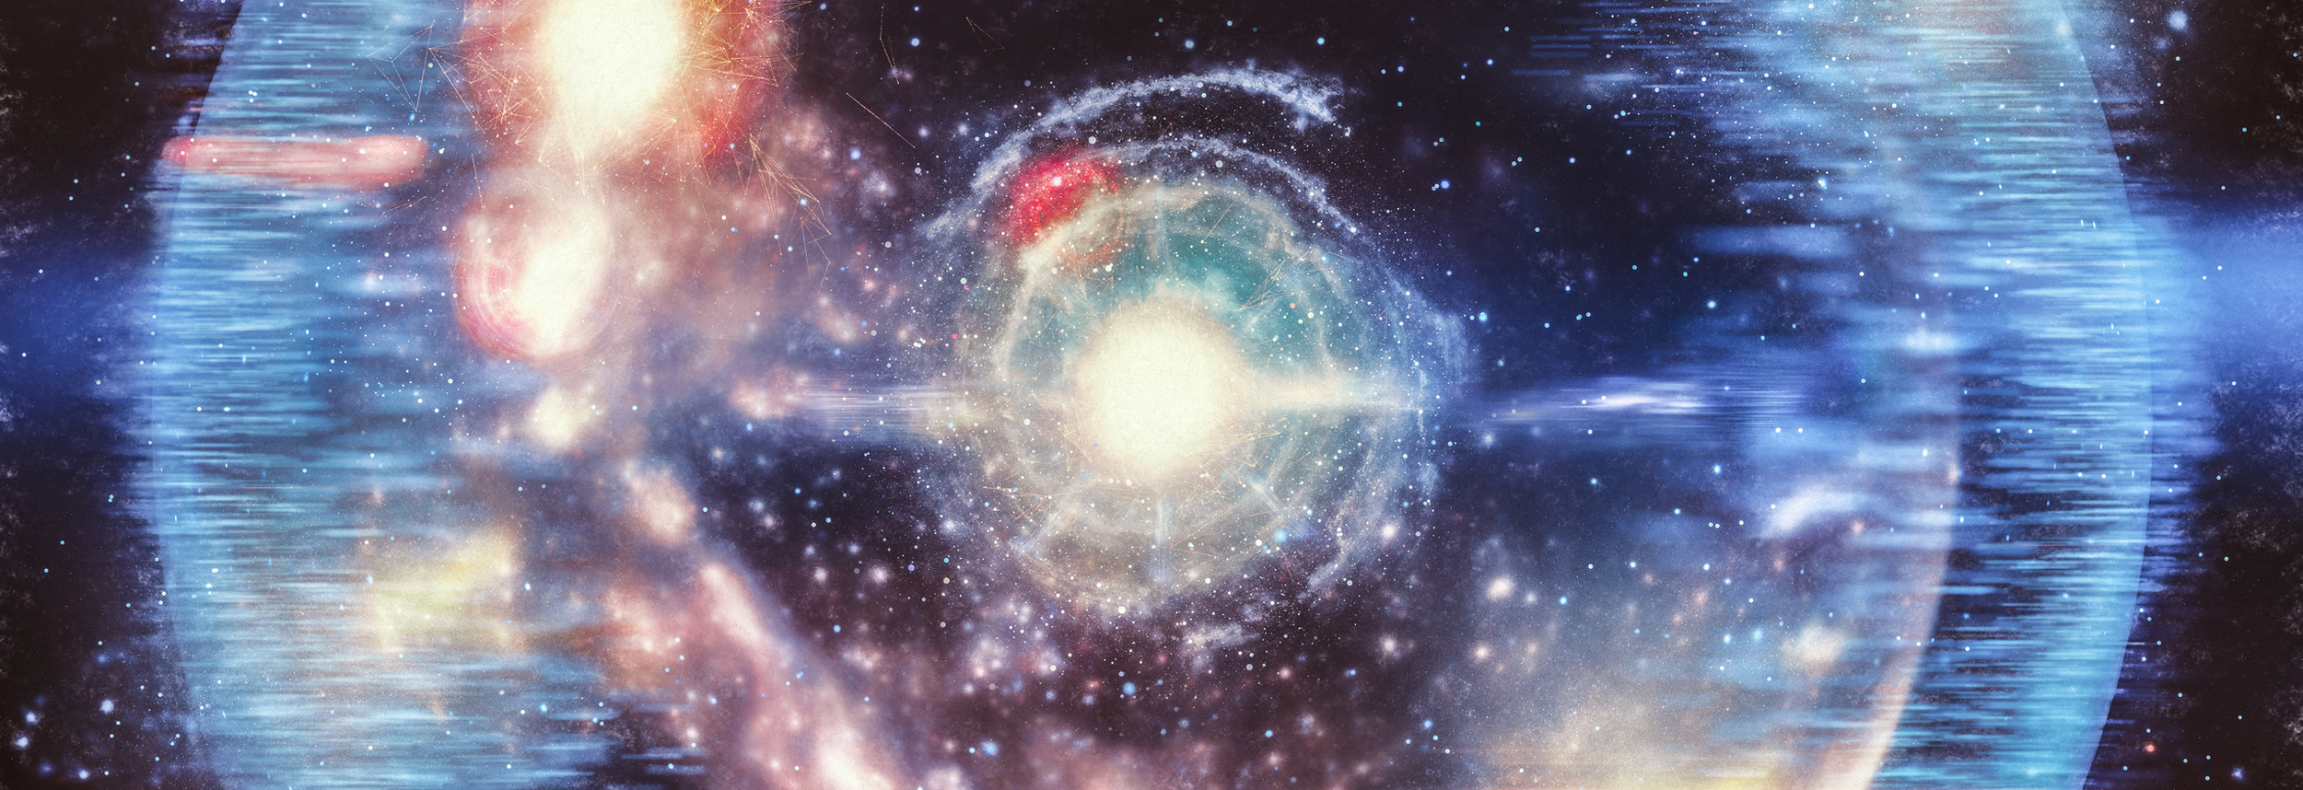
What-if solar system
Philip min

Slide 2
Goals/Methods
THE current solar system is centered around the sun, the most massive star in our solar system
The project is around the thought of what would have happened if the mass of the sun or the earth is different
Used Kepler’s third law to calculate the total orbital time (three planets)
Used Kepler ODE function and Runge-Kutta method to calculate the positions of the planets

Slide 3
Original
2x Sun’s mass
Big earth’s mass
asdf
asdf
asdf

