Slide 1
Community Park Congestion Over 24 Hours
Zach Schubert

Slide 2
Details
Main Goal: Simulating the busiest park time of the workday based on the schedules and responsibilities of adults who routinely exercise at a park.
Factors Implemented into the Simulation:
Work Schedule (full-time, part-time, unemployed)
~50% full-time, ~30% part-time, and ~20% unemployed
Responsible for children under 18 years old (yes, no)
Negatively affects the availability to workout when school starts and ends
Typical Exercise Time (morning, midday, evening)
~52% in the morning, ~20% in the afternoon, and ~18% in the evening
For this simulation, morning starts at 00:00, midday starts at 12:00, and evening starts at 17:00
Schedule of Sports Field Lighting (time range)
Wider simulation ranges for Park operation hours 08:00 to 21:00, compared to closed hours not in this interval
Random Walks, random variables, unique ranges for each person’s traits

Slide 4
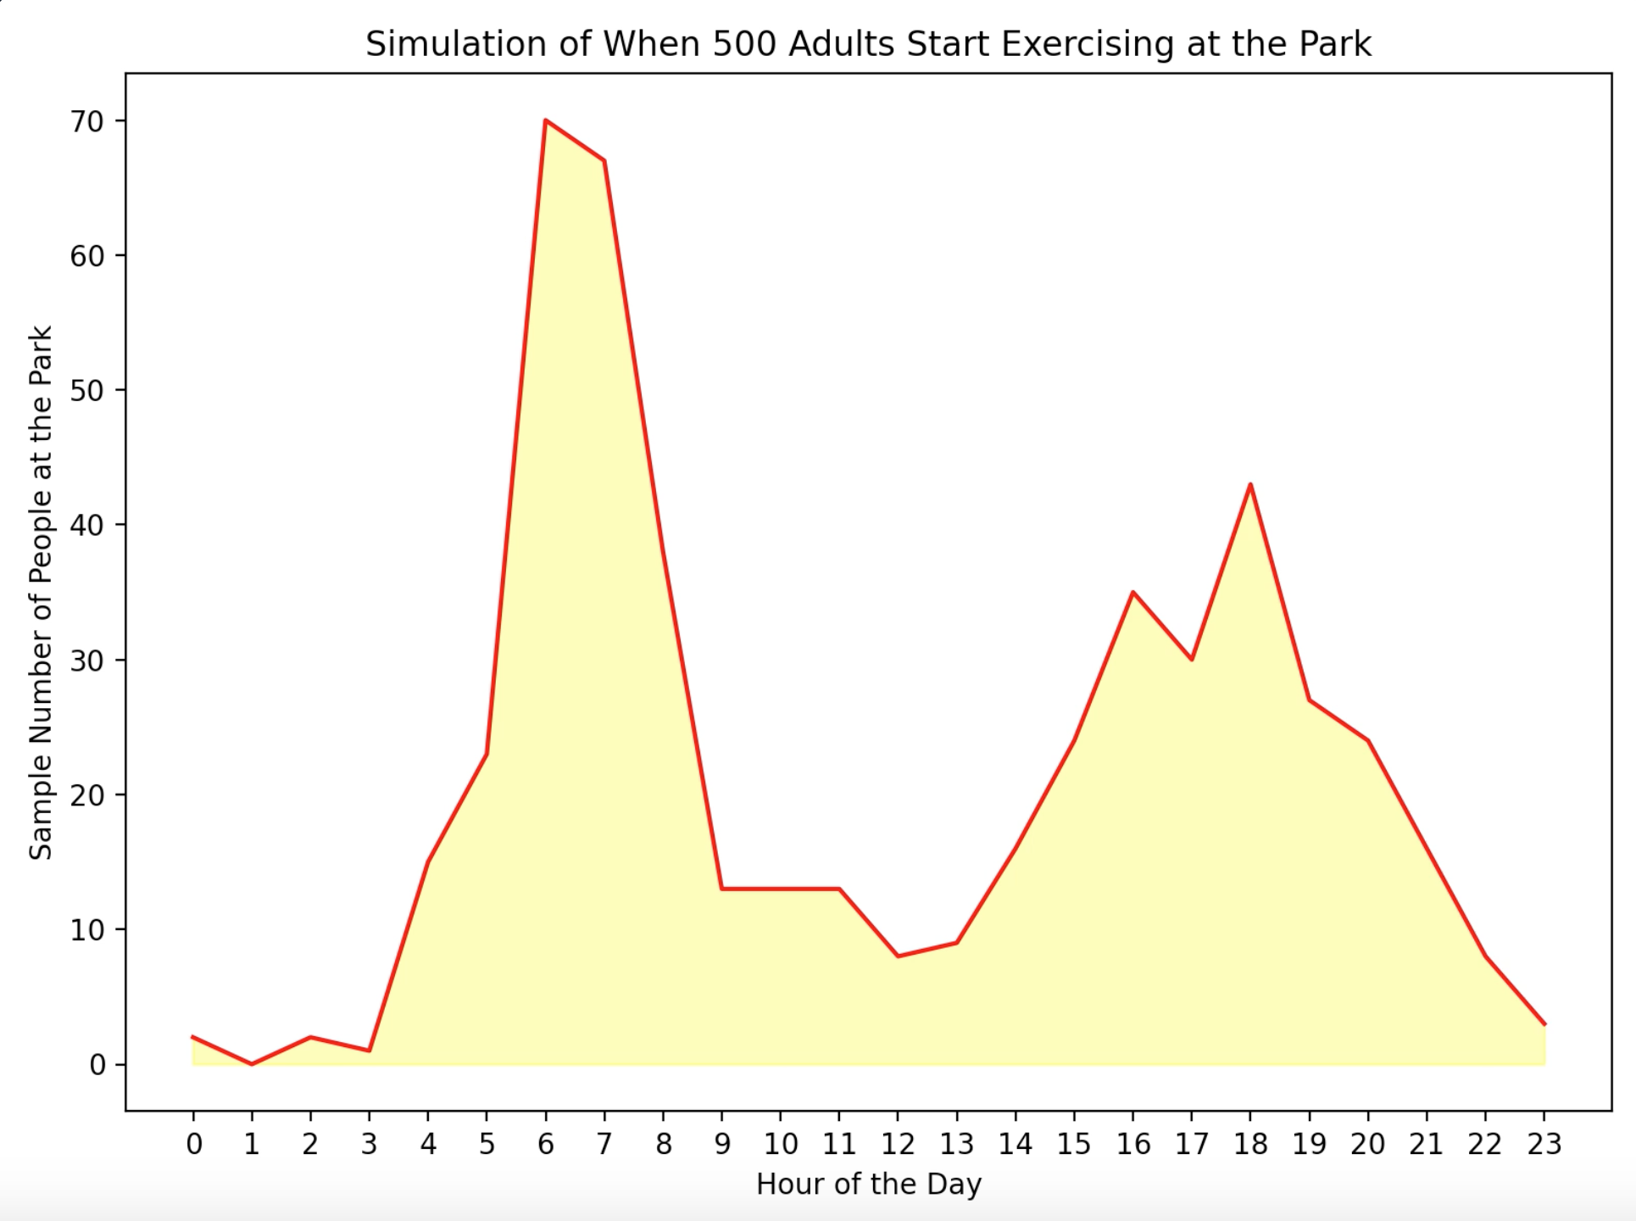

Slide 5
citations
Data Range Reference:
https://today.yougov.com/topics/society/articles-reports/2018/10/02/mornings-are-most-popular-time-americans-work-out
Images:
https://commons.wikimedia.org/wiki/File:Foot_bridge_at_John_S_Taylor_Park_Largo_Florida_July_28,_2017.JPG
https://commons.wikimedia.org/wiki/File:Park_zdrojowy,_1827,_1939,_po_1945_%2873%29.JPG
https://theworld.org/stories/2018-01-07/when-it-comes-walking-park-or-down-city-street-study-finds-not-all-exercise
https://commons.wikimedia.org/wiki/File:Hiroomote_ES_Playground_Eequipments.jpg

