Slide 1
Californian Fault Lines: AfterShocks of Cities
Brayan Velasco

Slide 2
Project Overview
This project primarily focuses on aftershocks in California, primarily centered around LA and SF
Does SF or LA produce more aftershocks than the other?
Uses cartoPy and obsPy from our earthquakes Lab to simulate
Cartopy to create our background map and obspy to process seismological data
I classified aftershocks to have occurred within one day of the previous earthquake and distance to be less than 10Km

Slide 3
Note: This isn’t a predictor of whether or not one city will produce more aftershocks than the other.
It’s simply interesting to observe, in retrospect, which city did have more earthquakes happen after an initial one.
Additionally, observing the fraction of Earthquakes both cities had as compared to California sets in how little effect they had in whole scheme of the state

Slide 4
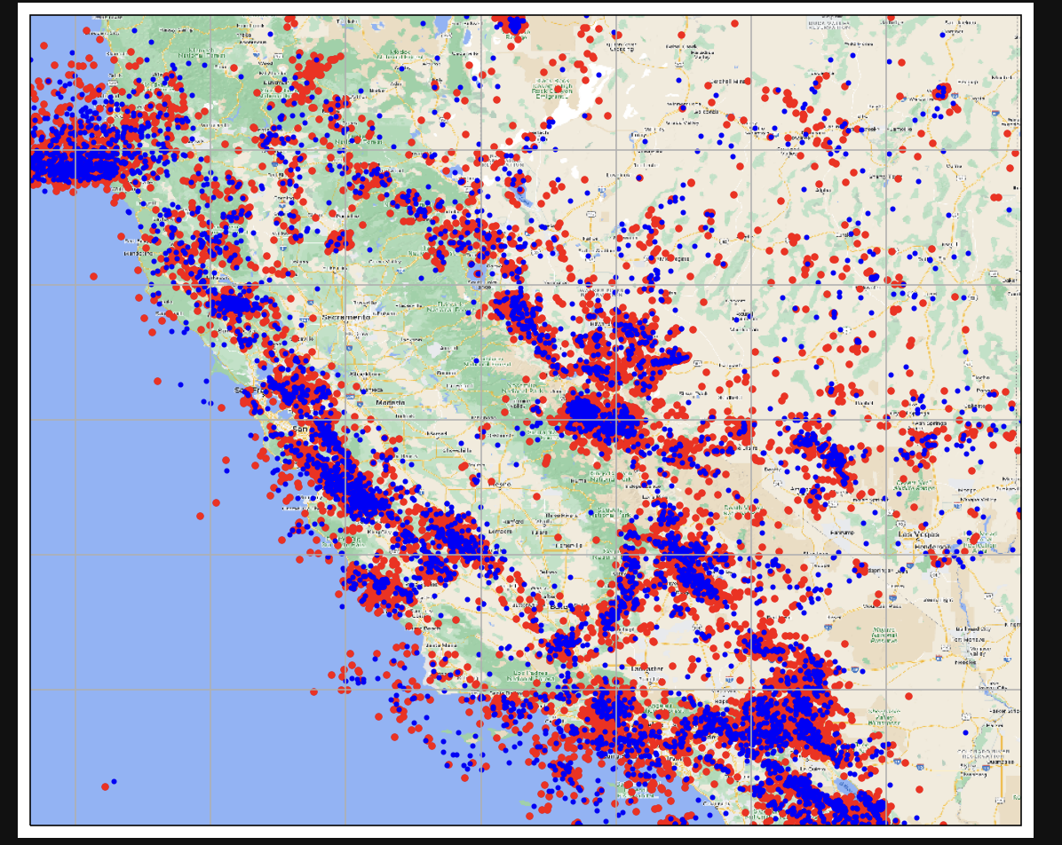
Californian Aftershocks
Number of Earthquakes >= 3.0: 22354
Aftershocks: 14933
Fraction of Earthquakes that produced an aftershock: Approximately 0.67

Slide 5
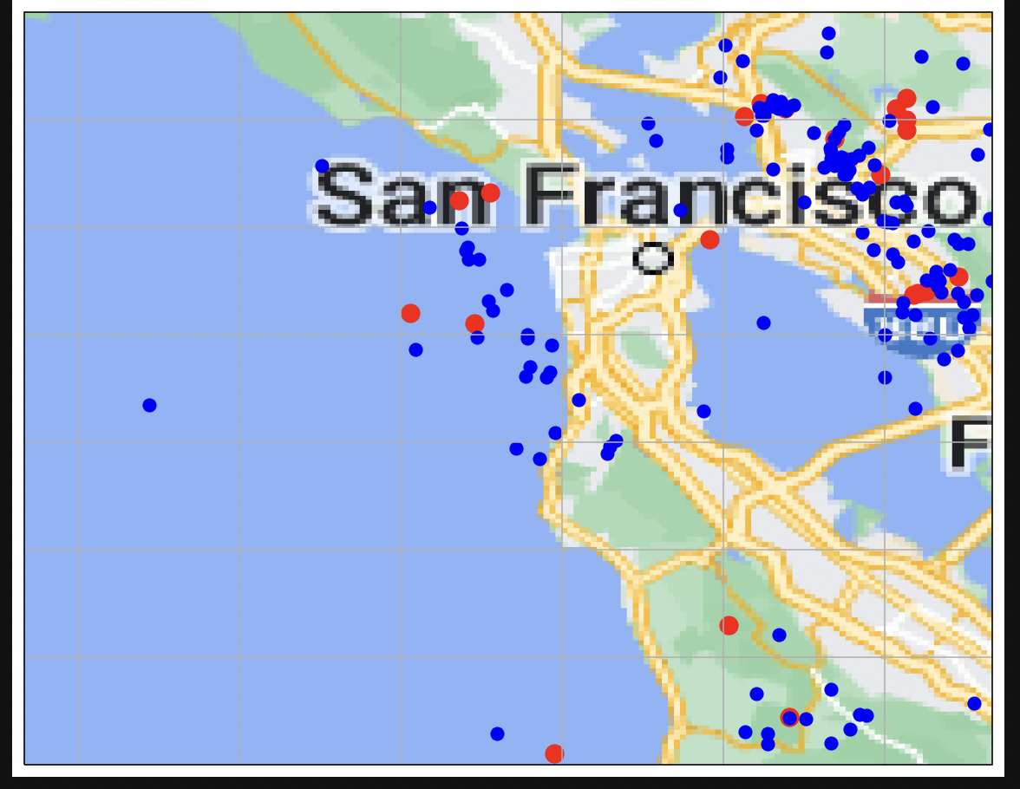
SF Aftershocks
Number of Earthquakes >= 3.0: 156
Aftershocks: 22
Fraction of Earthquakes that produced an aftershock: Approximately 0.14

Slide 6
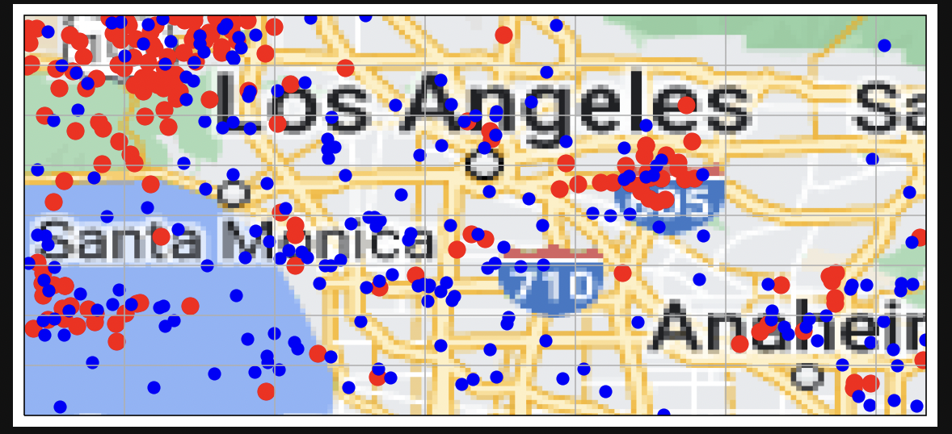
LA Aftershocks
Number of Earthquakes >= 3.0: 379
Aftershocks: 171
Fraction of Earthquakes that produced an aftershock: Approximately 0.45

Slide 7
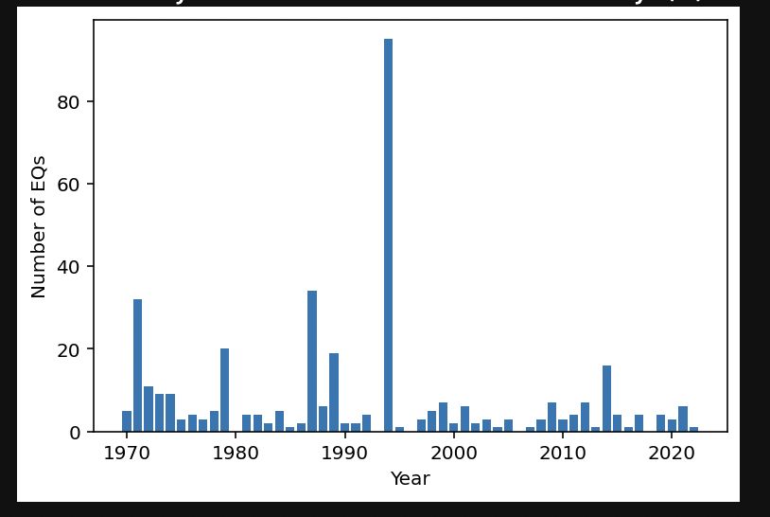
Interesting Observation LA
Only explanation I could find for this phenomenon is the Ridgecrest Earthquake that happened during this year that produced more than 2500 aftershocks in its surrounding areas

Slide 8
Conclusion: Not Like LA
San Francisco had less earthquakes than and produced less aftershocks as a fraction compared to LA. I believe the reason may be because SF, although close to two major faults, the San Andreas and Hayward Fault, was not directly on top of these faults. Whereas, LA is on top of multiple minor faults such as the Puente Hills Fault that constrain each other.
Since, the major faults align themselves closer to SF though, it could potentially have more damage done to it than LA by major earthquakes.

Slide 9
References
1995 Ridgecrest Earthquakes
Straining Earthquakes near LA
Faults near SF and their risk
HW_Seismology.pdf

