Slide 1
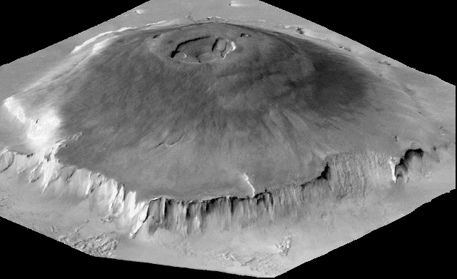
Melting the God’s volcano: Olympus mons
Daniel Gilbert

Slide 2
What is Olympus mons?
The largest volcano in the solar system on Mars
Peak elevation at 21.9 km
Highest peak on Earth is at 8.8 km for Mt. Everest
Has a “gentle sloping profile”
Covers about 300,000 km^2

Slide 3
Method
Create a landscape that resembles the shape of Olympus Mons
Matplotlib & numpy
landscapeWithOcean.py
Erosion base code

