Slide 1
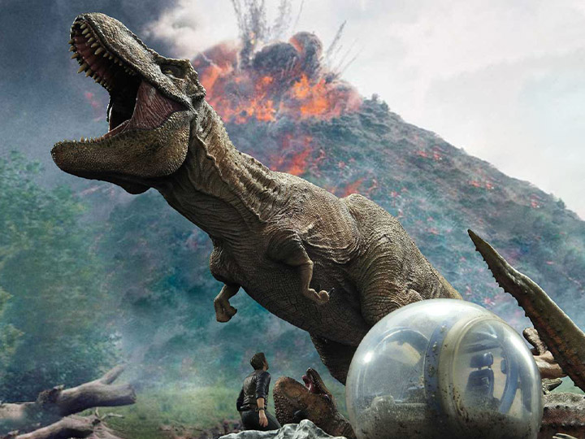
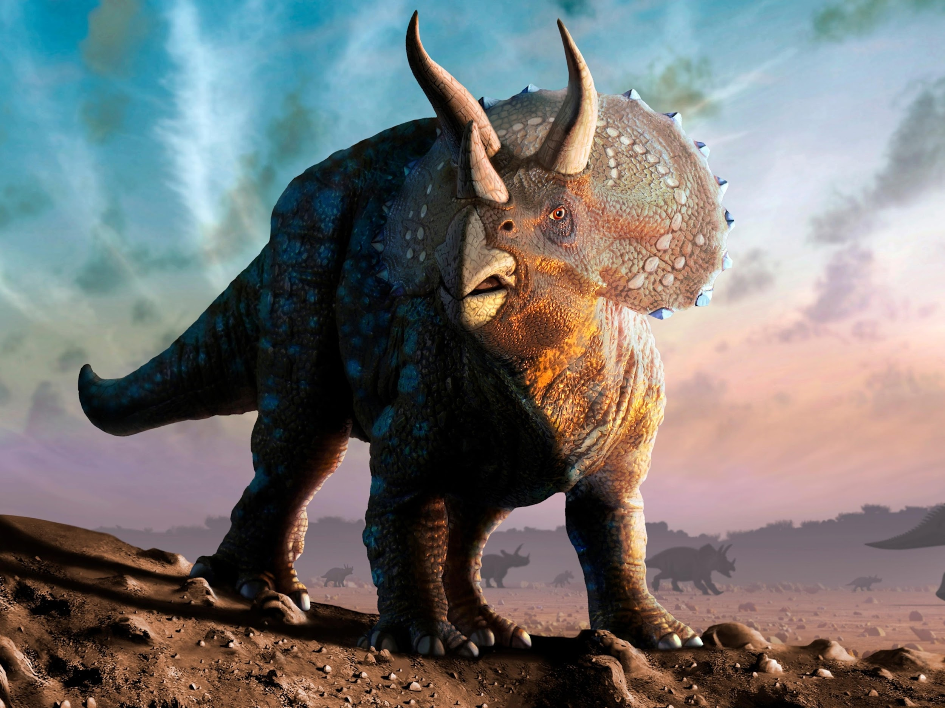
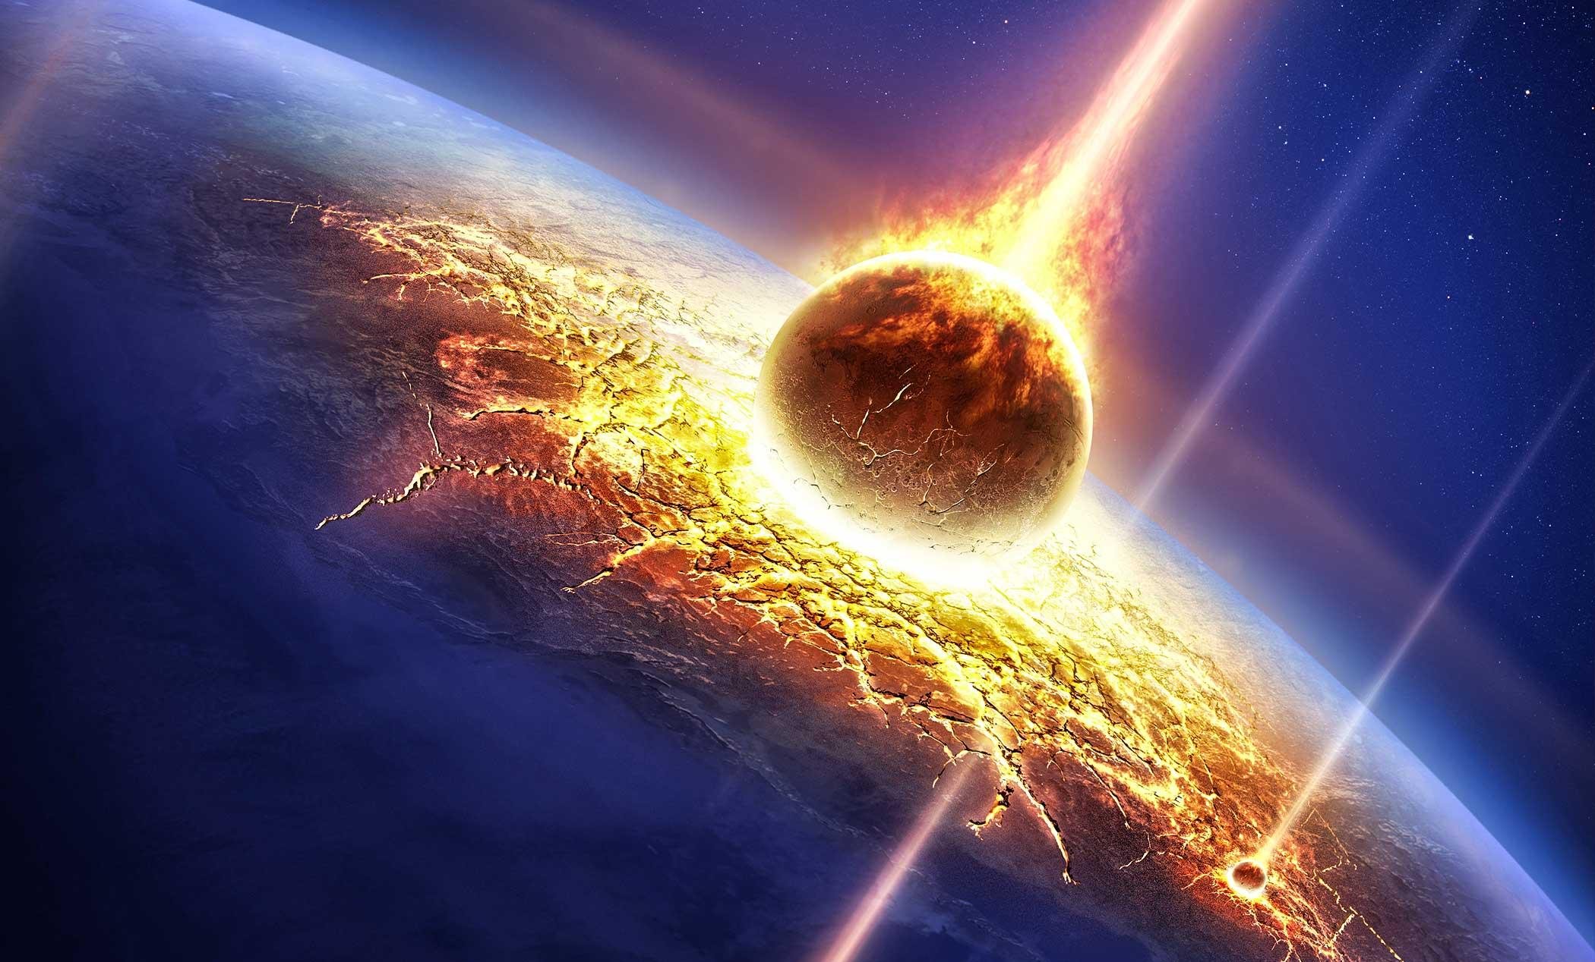
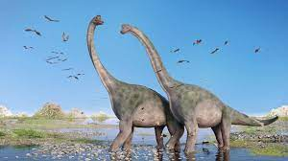
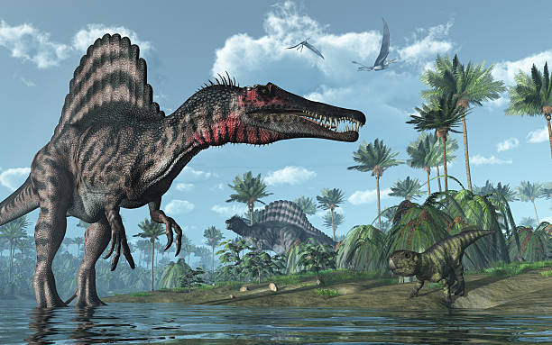
Smaller Asteroids, Bigger Dinosaurs
By: Darren Sun

Slide 2
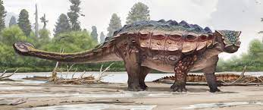
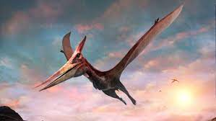
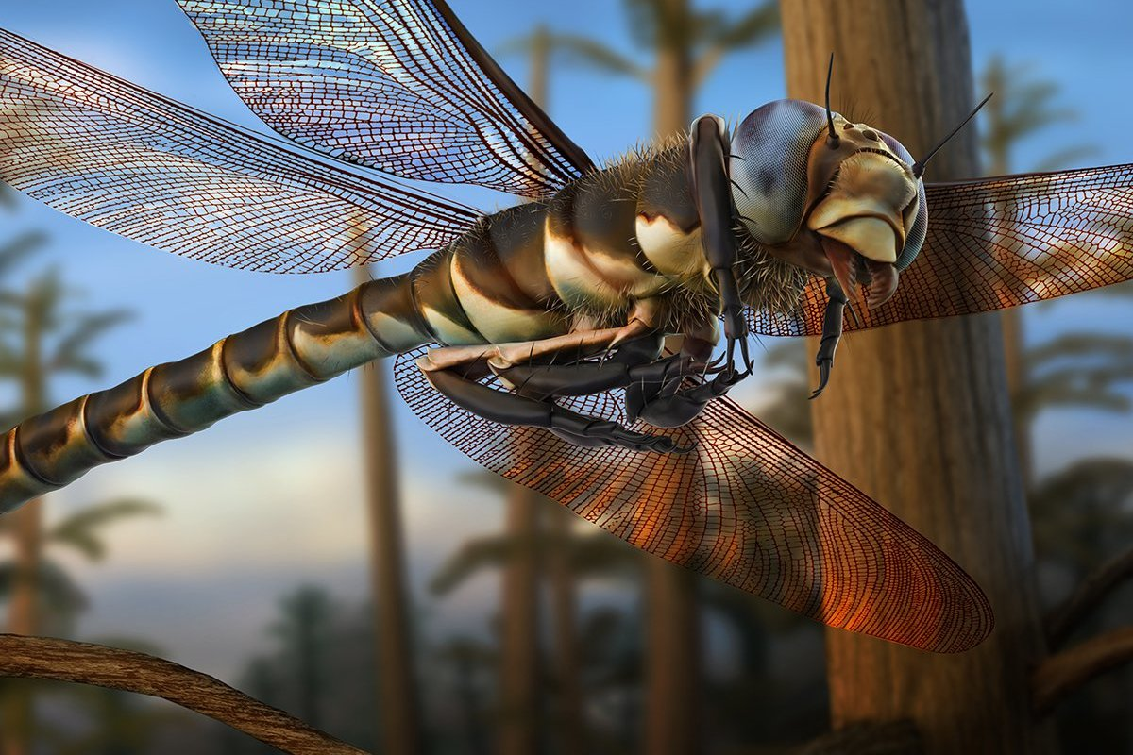
High Level Overview
Introduction to Asteroids
3 parts analysis:
Asteroid mass vs surface impact energy
Asteroid impact energy vs crater diameter
Aquatic asteroid impact energy vs tidal wave height

Slide 3
Resources Used
Computation: JupyterNB, NumPy, Pandas, Seaborn, Matplotlib
Research: Youtube, online articles
https://www.youtube.com/watch?v=Ugwg2dHUB90
https://www.astronomynotes.com/solfluf/s5.htm
https://en.wikipedia.org/wiki/Kinetic_energy
https://interactive.wttw.com/prehistoric-road-trip/stops/how-did-anything-survive-the-mass-extinction

Slide 4
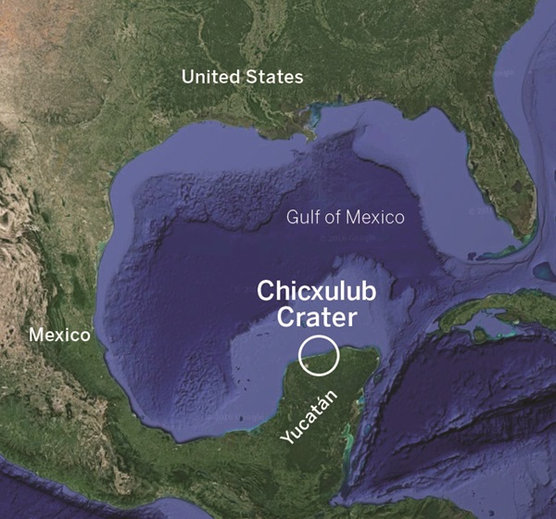
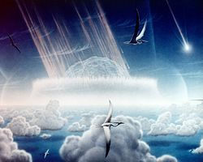
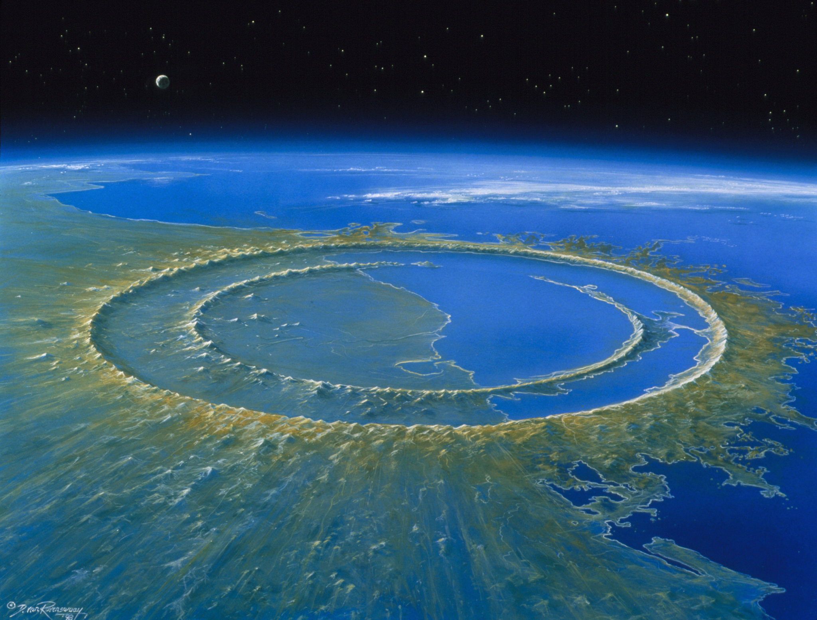
Introduction: Chicxulub Asteroid
Crashed into Earth ~66 million years ago off the coast of Mexico’s Yucatan Peninsula
Caused mass extinction of around 75% of life on Earth
Crater underwater, not visible but detectable

Slide 5
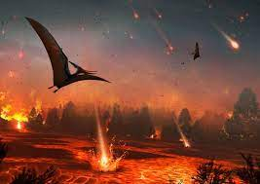
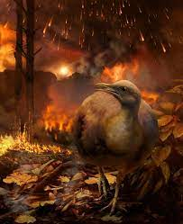
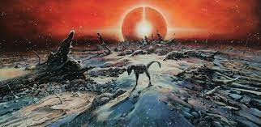
Introduction: Continued
Scientifically classified as the Cretaceous-Paleogene Extinction Event
Chicxulub’s Dimensions Estimated:
Mass: 10^15kg
Diameter: 6.2137mi
Impact velocity: 20km/s
Impact kinetic energy: 2 * 10^23J
Crater area: 9826 mi^2
Some organisms survived: By luck, by diverse diet, conditional environments
Life on Earth required 30,000 years to somewhat recover

Slide 6
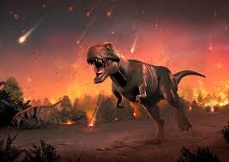
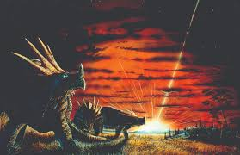
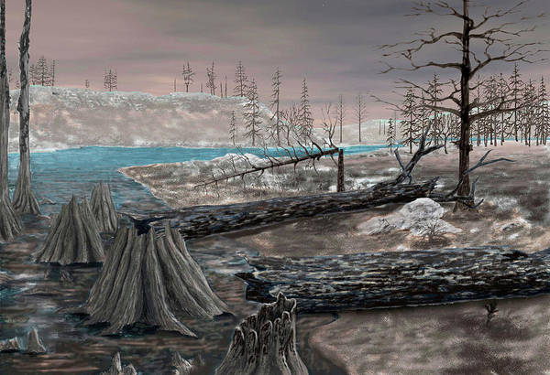
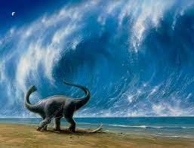
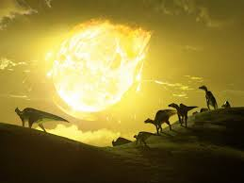
Introduction: Immediate Aftermath
Dust and smoke plume blocks Sun
Tsunamis
Fires
Extreme temperatures
Life forms die off
Acid rain
Shock waves
Heat radiation
Big crater
Equivalent energy to millions of nuclear bombs

Slide 7
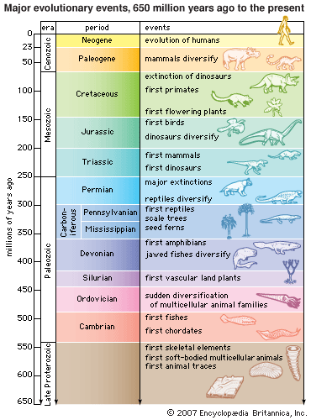
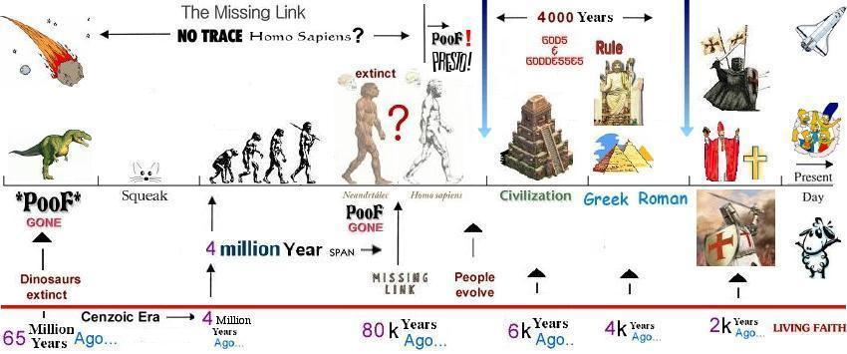
Introduction: More Asteroids
Most asteroids blow up before they hit Earth
An asteroid’s velocity is dependent on gravity, size, angle, and momentum
Air friction(drag) causes minor reduction in velocity
Falling objects have a terminal velocity
Average asteroid impact velocity is 18-20km/s
Composition: Nickel, Iron, Rock

Slide 8
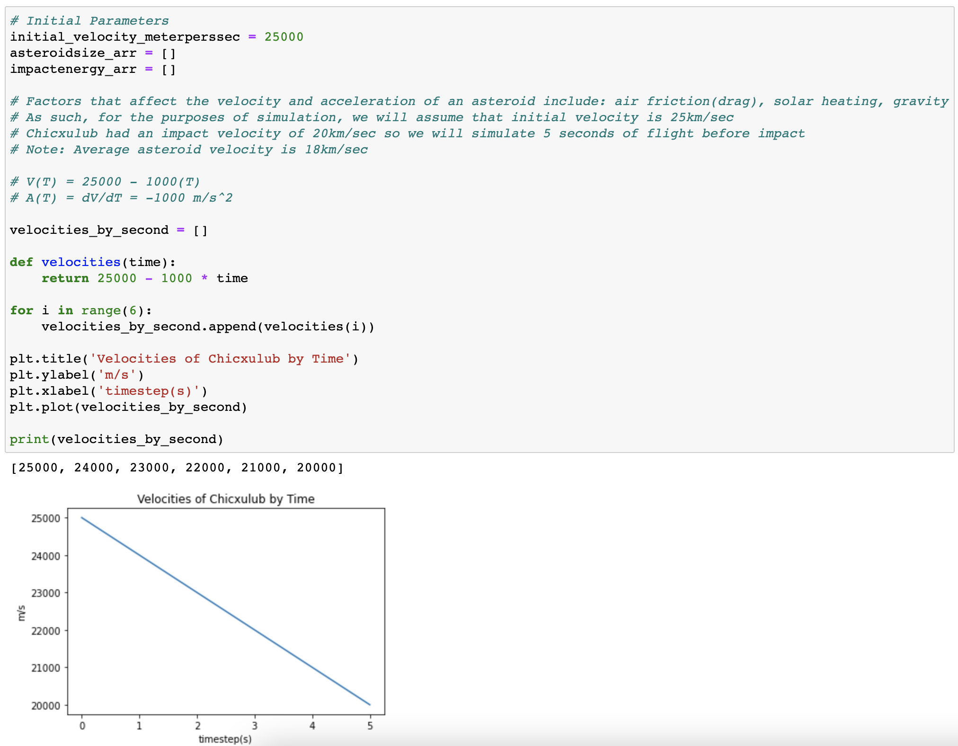
Pt 1: Relating Asteroid Impact Energy to Mass
In an effort to keep parameters consistent with the flight of Chicxulub, I assumed:
5 second flight interval
Impact velocity 20000m/s
Thus,
dV/dT = acceleration
= -1000m/s^2

Slide 9
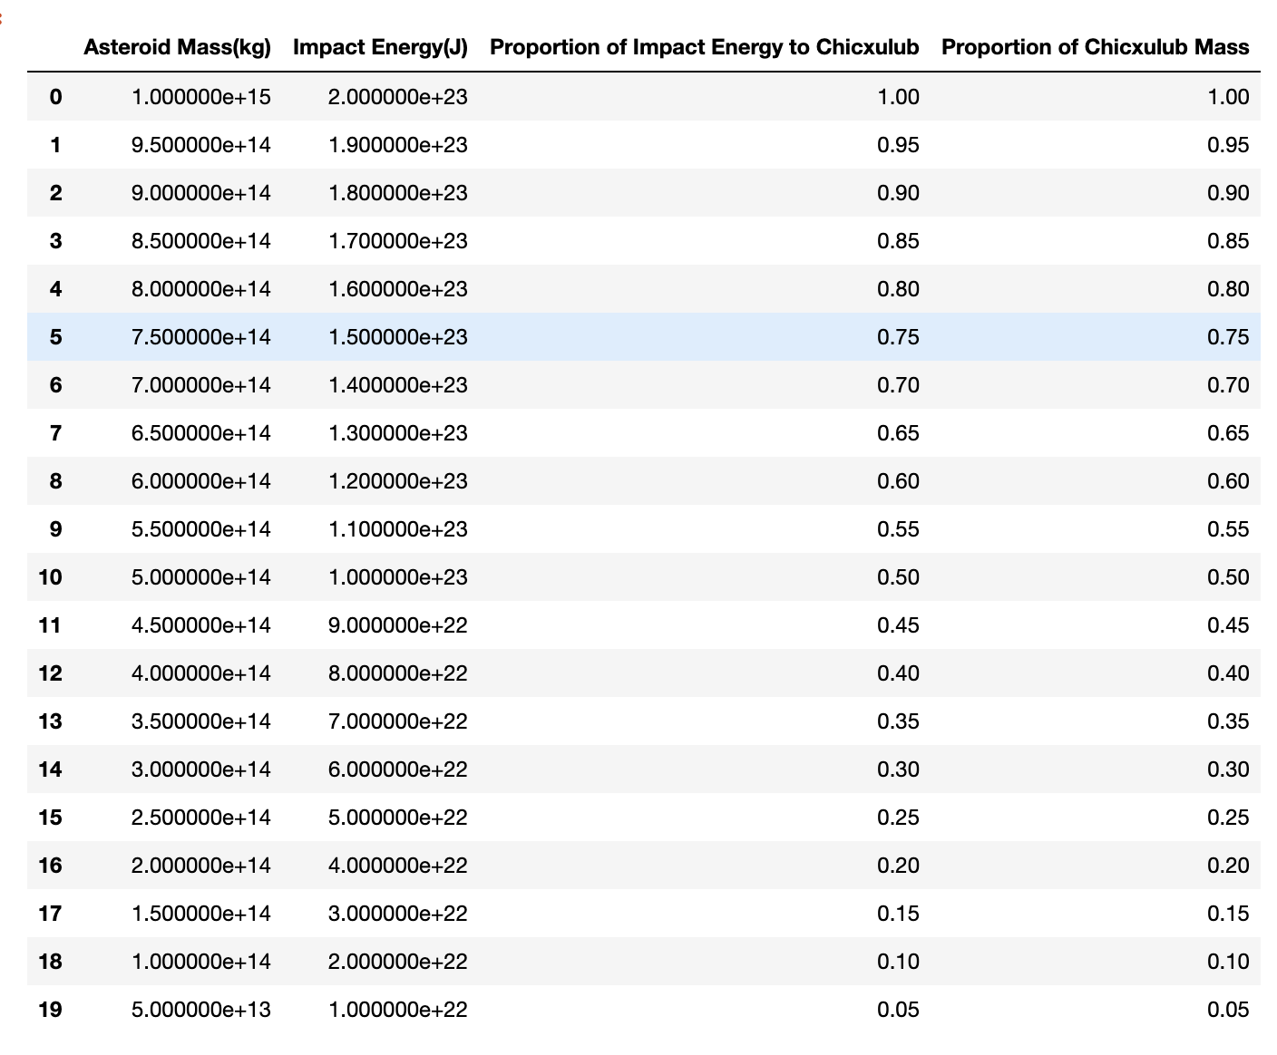
Pt 1: Relating Asteroid Impact Energy to Mass
Impact Energy, or Kinetic Energy, is calculated by Leibniz’s Formula:
KE = ½ * mv^2
My goal was to search for the mass of the asteroid that would yield 5% of Chicxulub’s original impact energy
Assume: All asteroid masses impact at 20000m/s

Slide 10
Pt 1: Relating Asteroid Impact Energy to Mass
Findings:
The relationship between an asteroid's mass and its impact energy are both linear, if we exclude external factors like an asteroid exploding in mid air, potential slowed velocities due to air friction, and assume that the asteroids come in at the same angle and rate of the original Chicxulub asteroid.
When the asteroid's mass is 5% of Chicxulub's mass, it will also yield 5% of Chicxulub's original impact energy
The asteroid's impact energy in Joules is directly linearly dependent of its total mass in kg.
In response to my original objective of finding the asteroid mass that yields 5% of Chicxulub's original impact energy, the mass of the asteroid is required to be strictly less than or equal to 5 * 10^13kg, which would yield a total kinetic energy at 20000m/s of 10^22 Joules. Chicxulub's estimated mass was 10^15kg, and at 20000m/s on impact this would have yielded 2 * 10^23 Joules of energy.

Slide 11
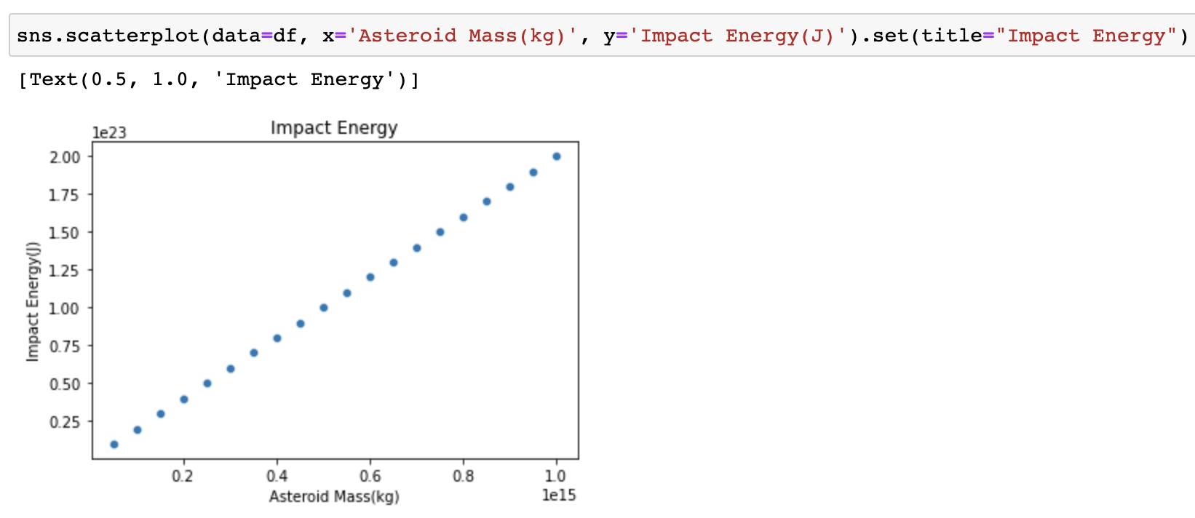
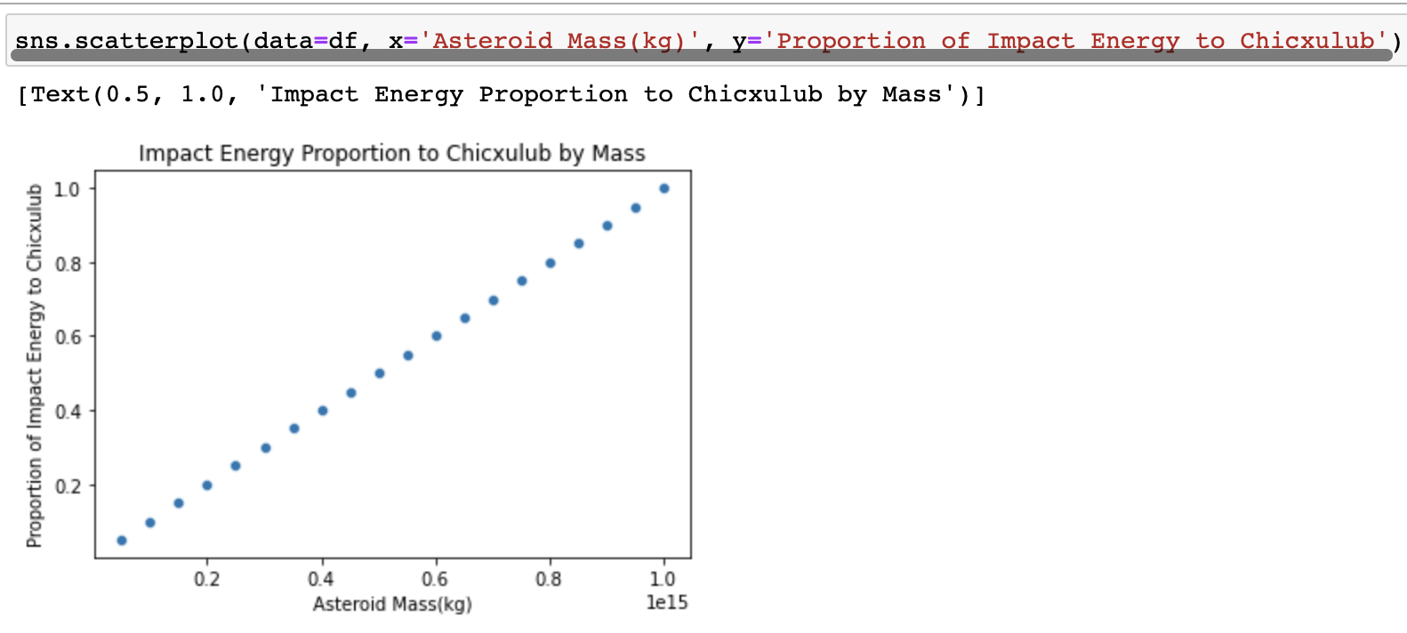
Pt 1: Relating Asteroid Impact Energy to Mass

Slide 12
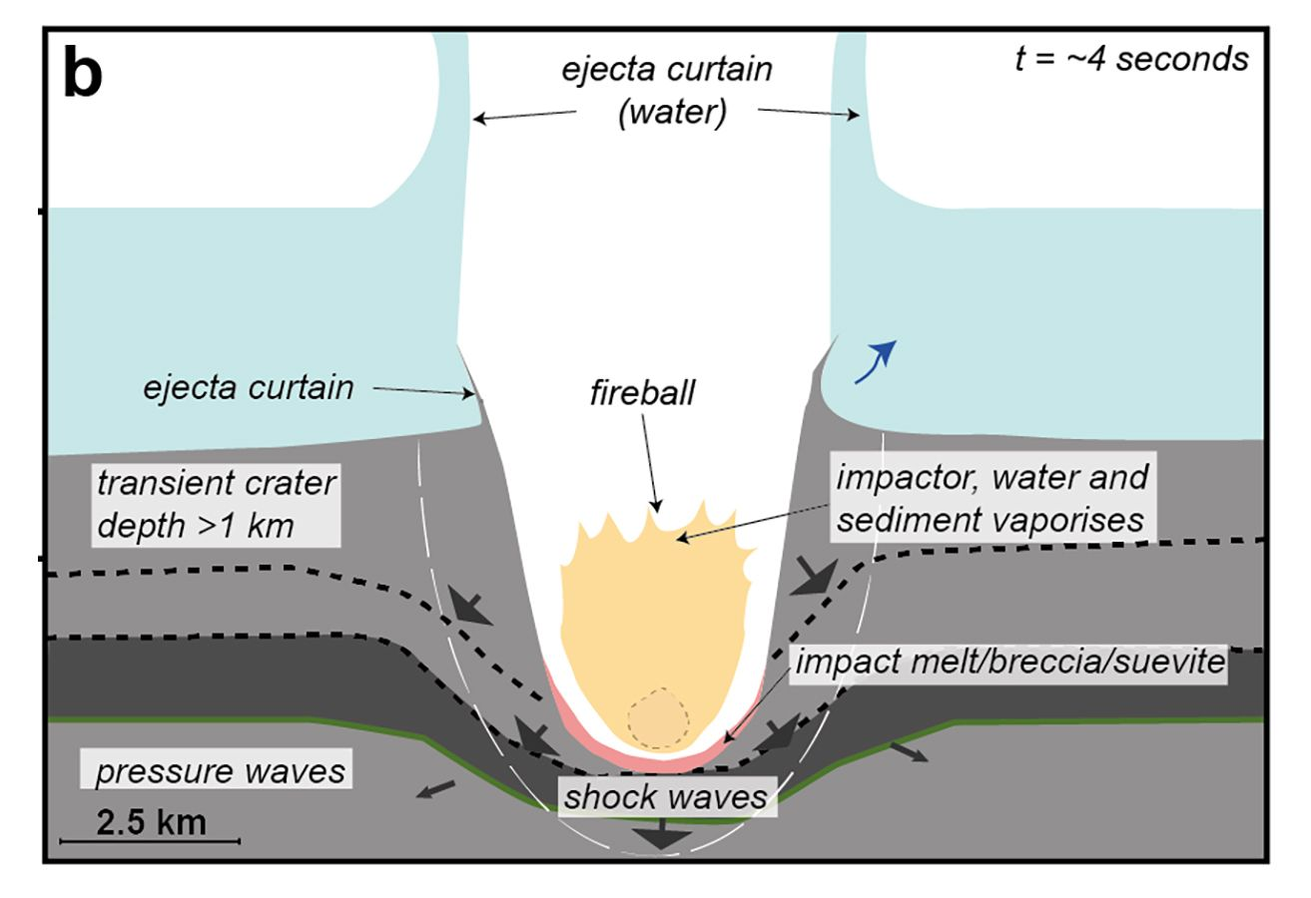
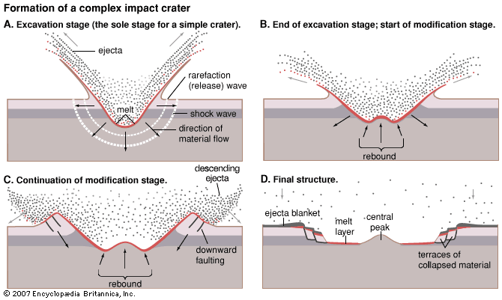
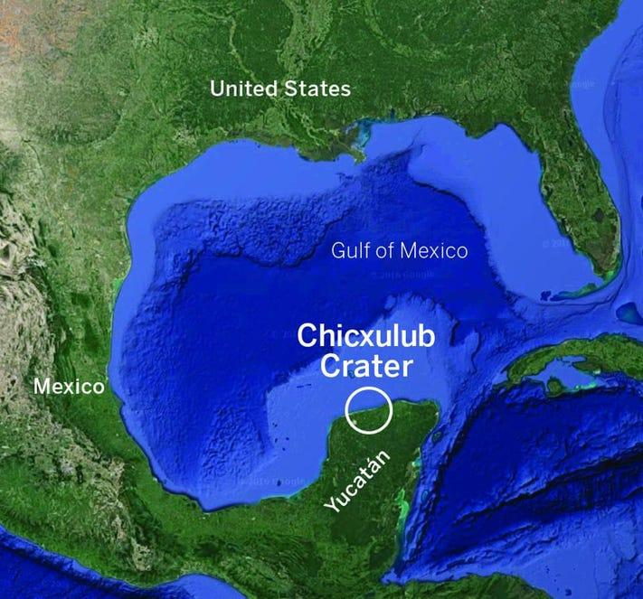
Pt 2: Relating Crater Size to Impact Energy
To calculate the diameter of the resulting impact crater, the formula that relates impact energy to diameter in km is:
Diameter of the crater(km) = 0.765 × (energy of impact in megatons TNT)^(1/3.4)
WHERE
The energy of 1 million tons of TNT is: 1 megaton of TNT = 4.2 × 10^15 Joules

Slide 13
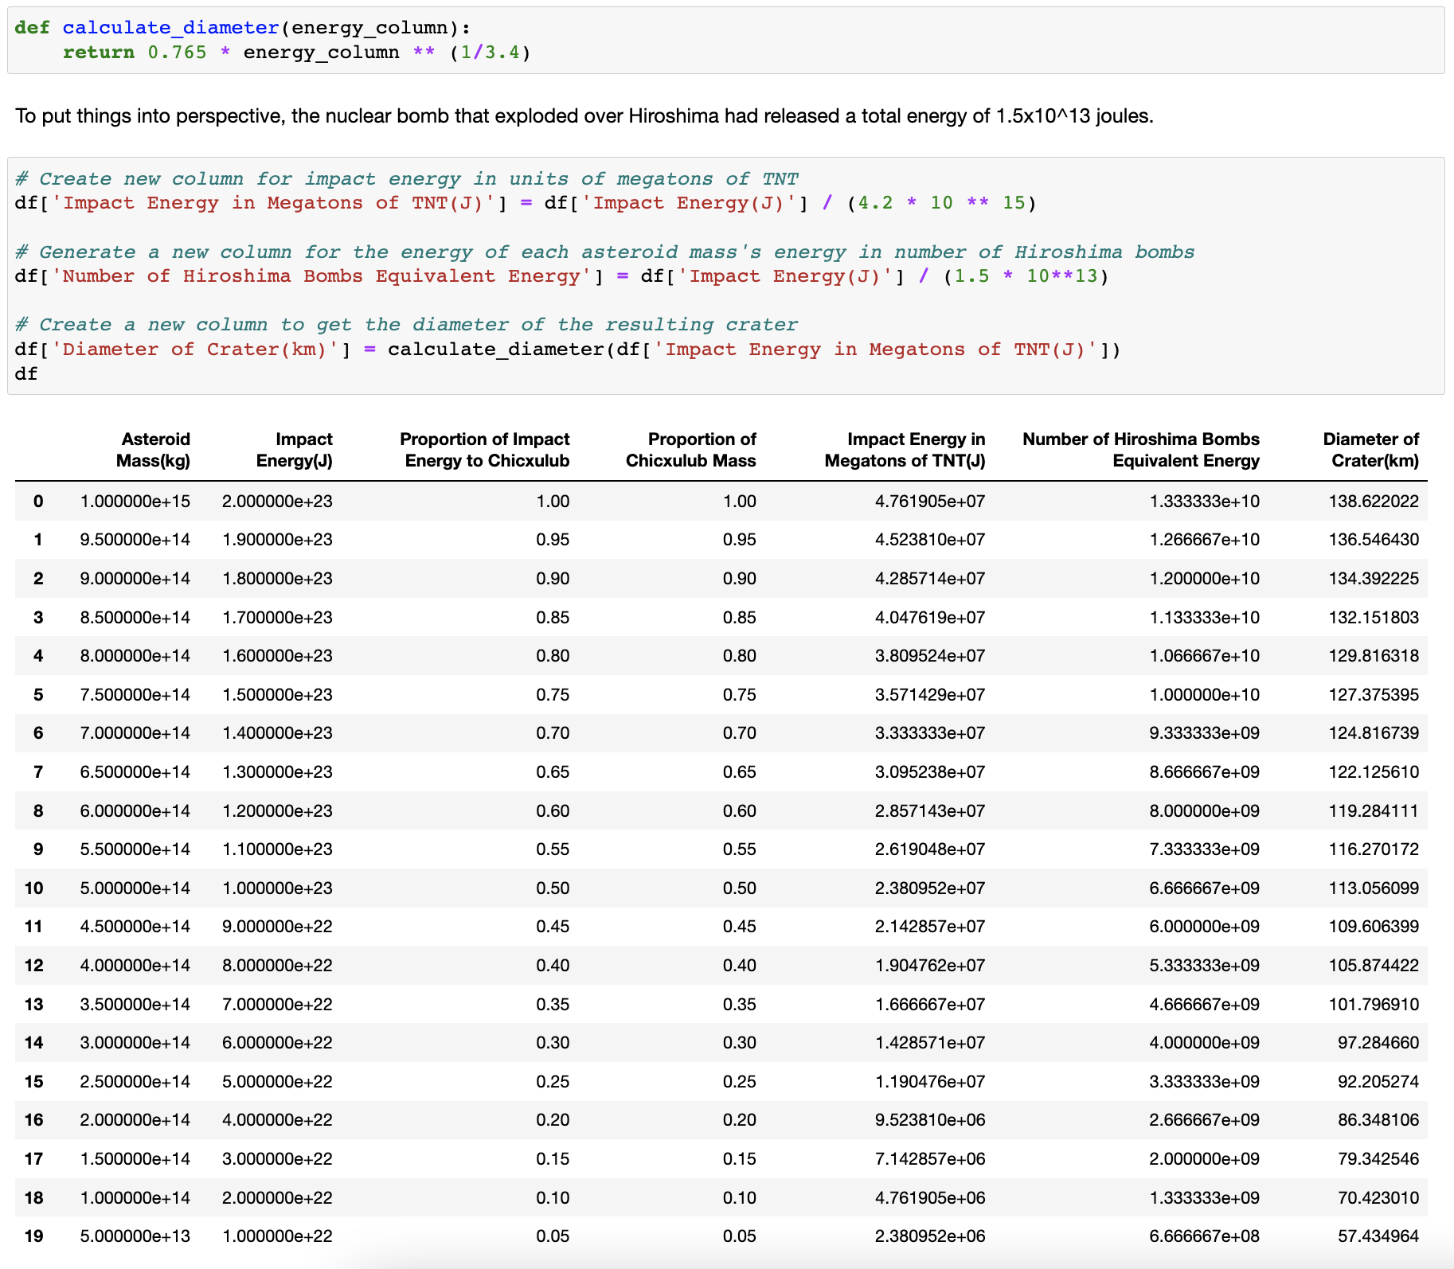
Pt 2: Relating Crater Size to Impact Energy

Slide 14
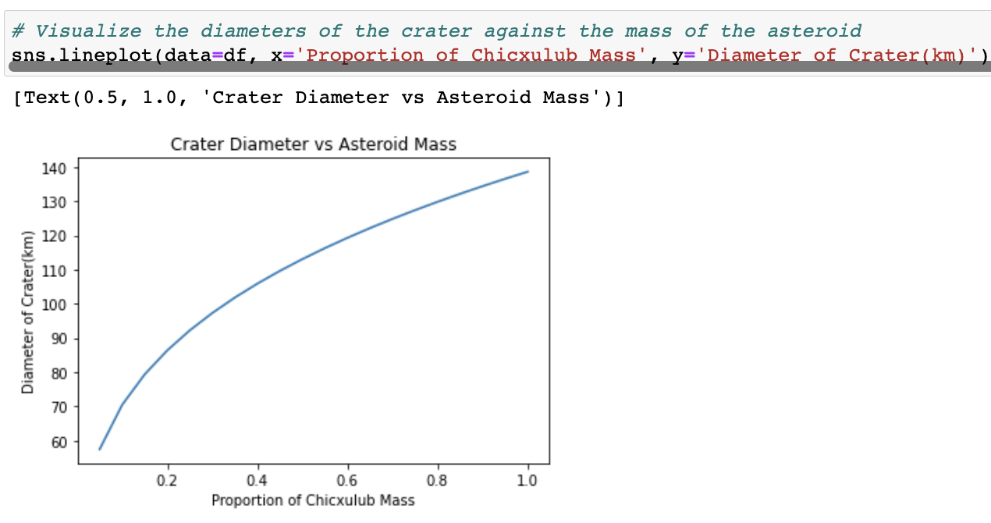
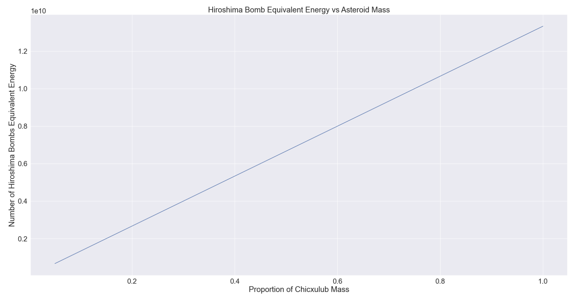
Pt 2: Relating Crater Size to Impact Energy

Slide 15
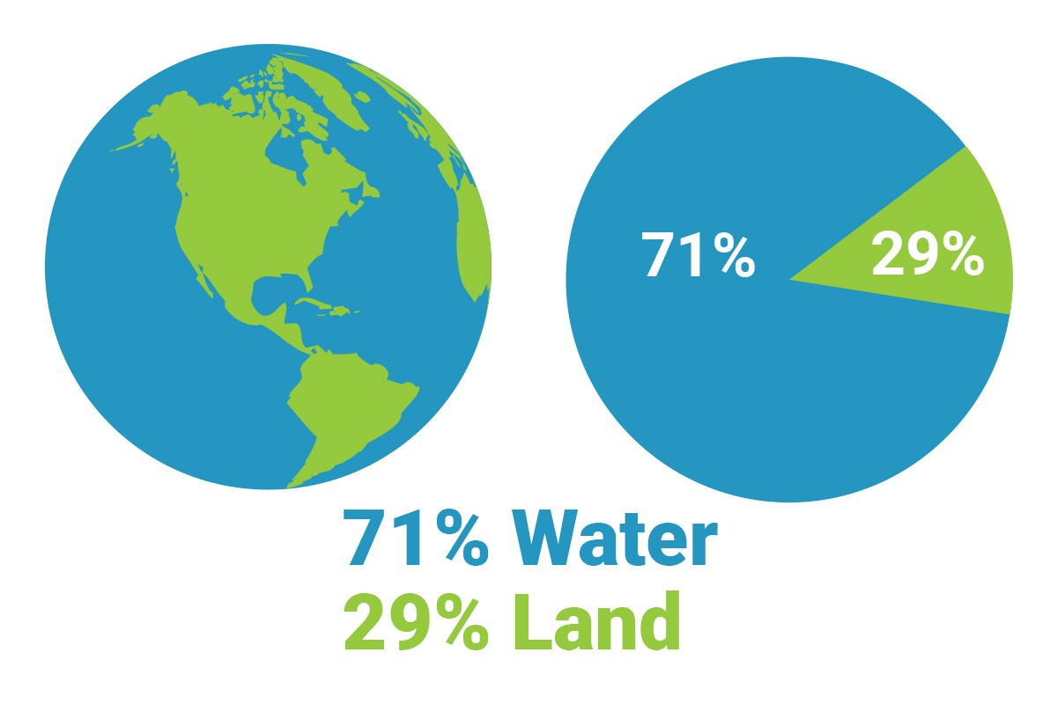
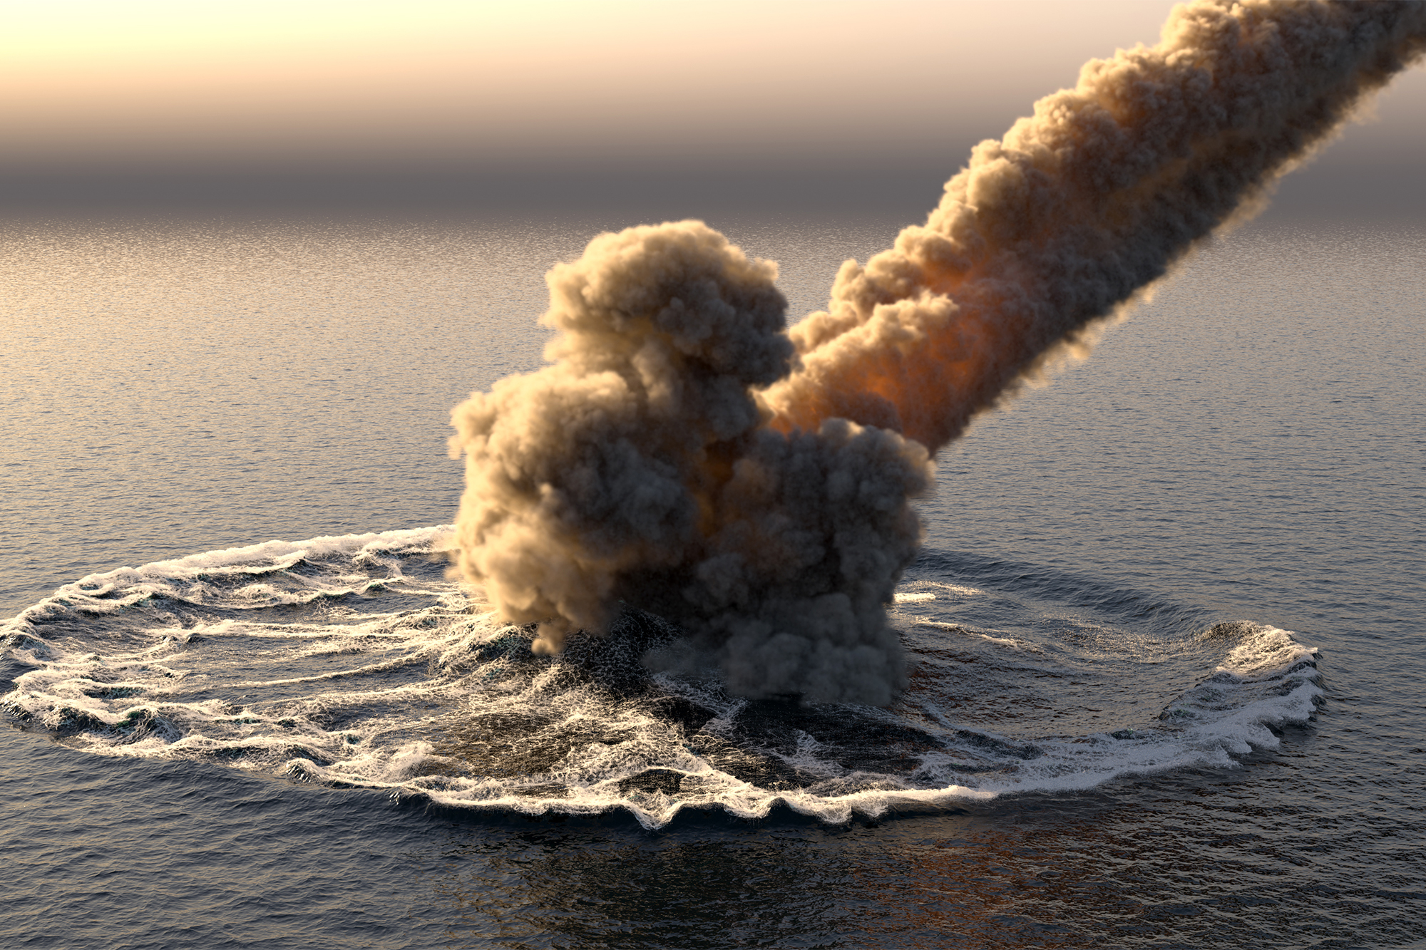
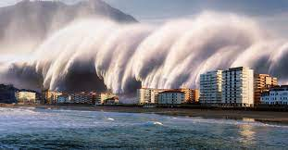
Pt 3: Relating Tidal Wave Height to Distance from Impact
Because 71% of the Earth's surface is water, simulating asteroid impacts into ocean is also critical. For this, the equation relating impact energy to tsunami wave height and distance from impact is:
Tidal wave height(m) = 10.9 × (distance from impact in kilometers)^-0.717 × (energy of impact in megatons TNT)^0.495

Slide 16
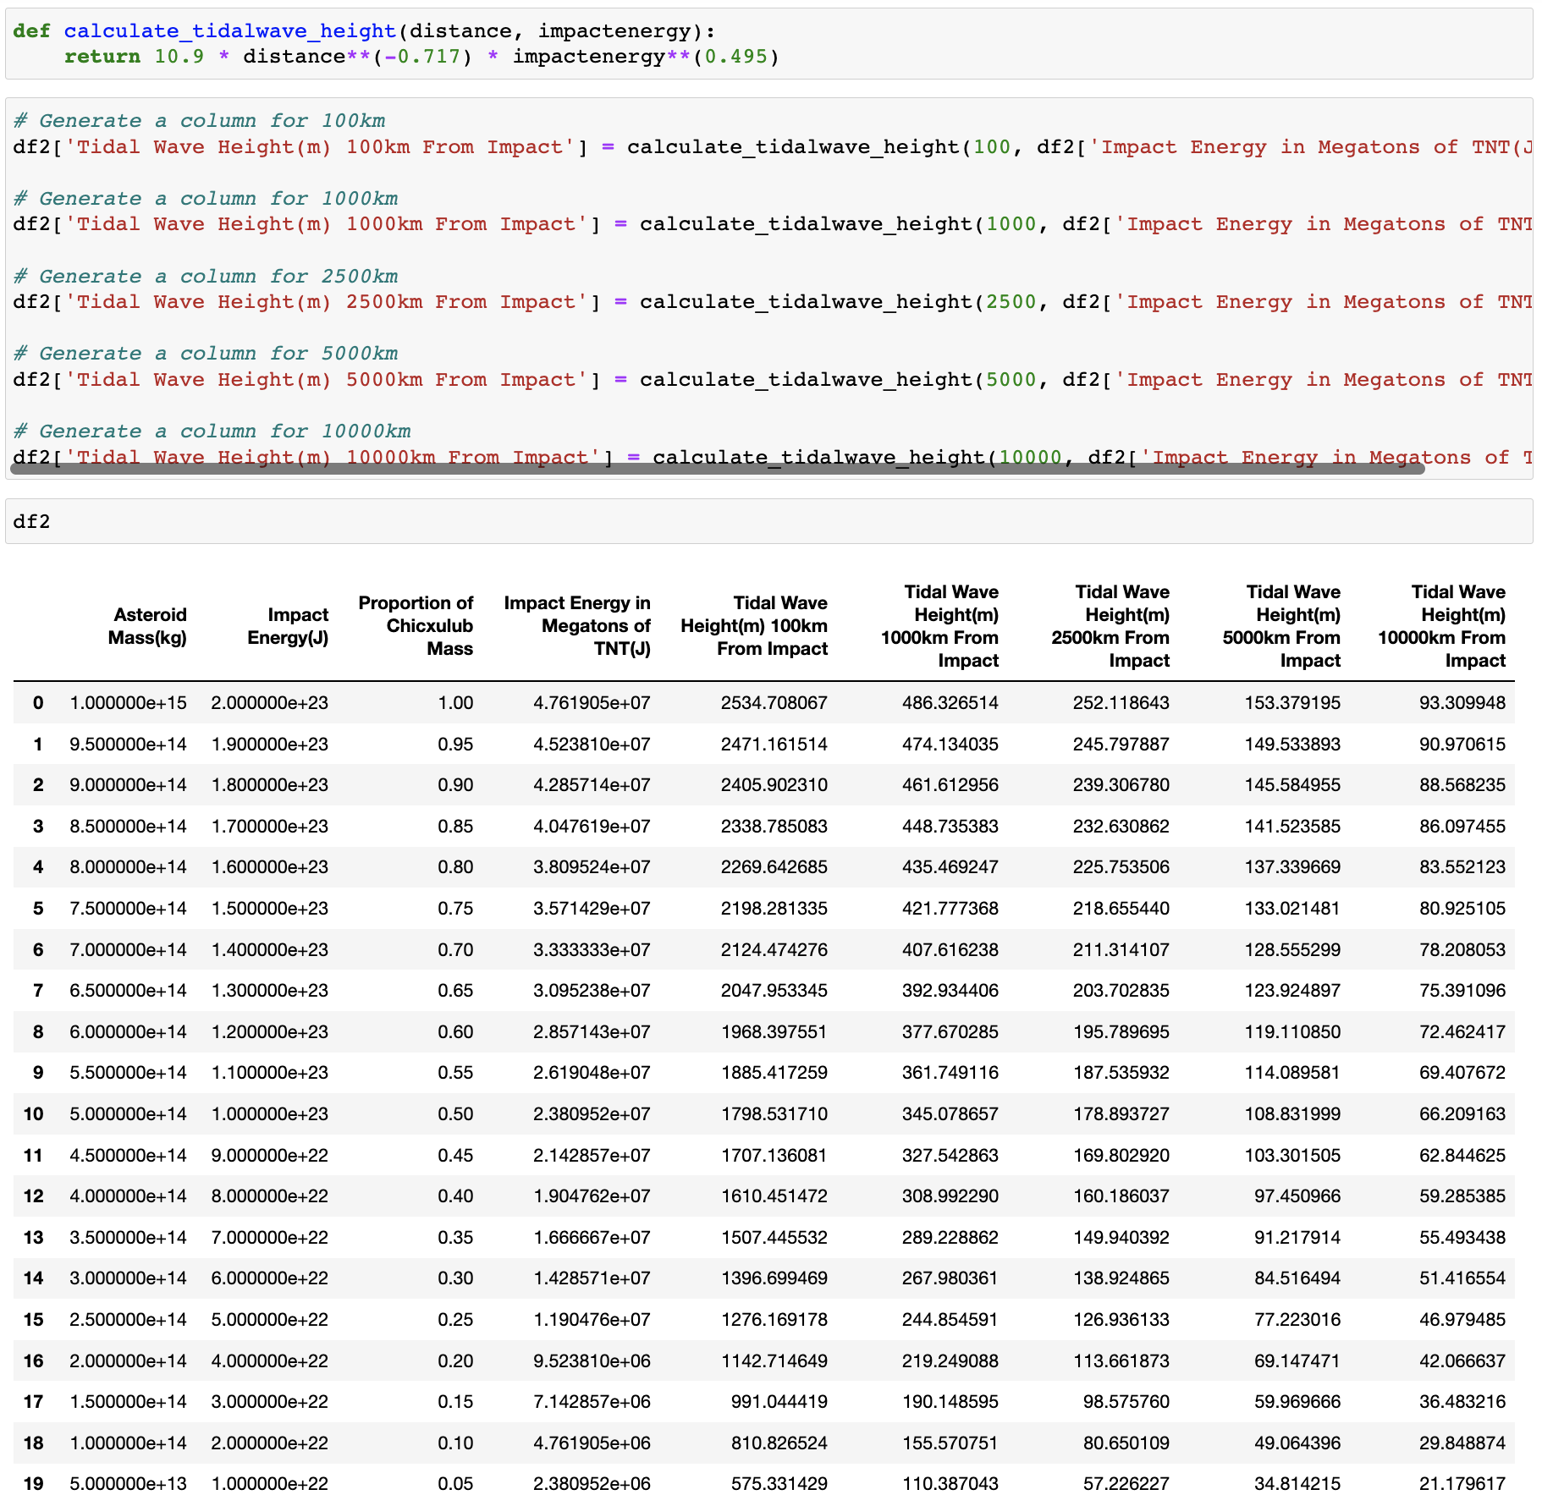
Pt 3: Relating Tidal Wave Height to Distance from Impact

Slide 17
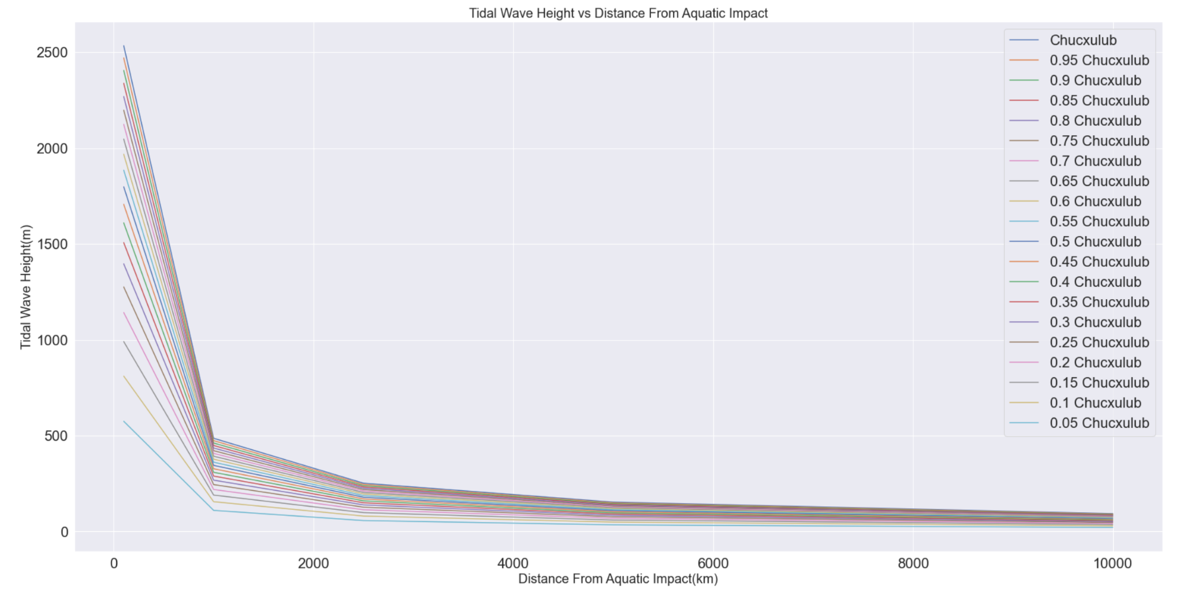
Pt 3: Relating Tidal Wave Height to Distance from Impact

Slide 18
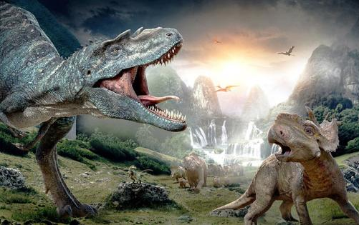
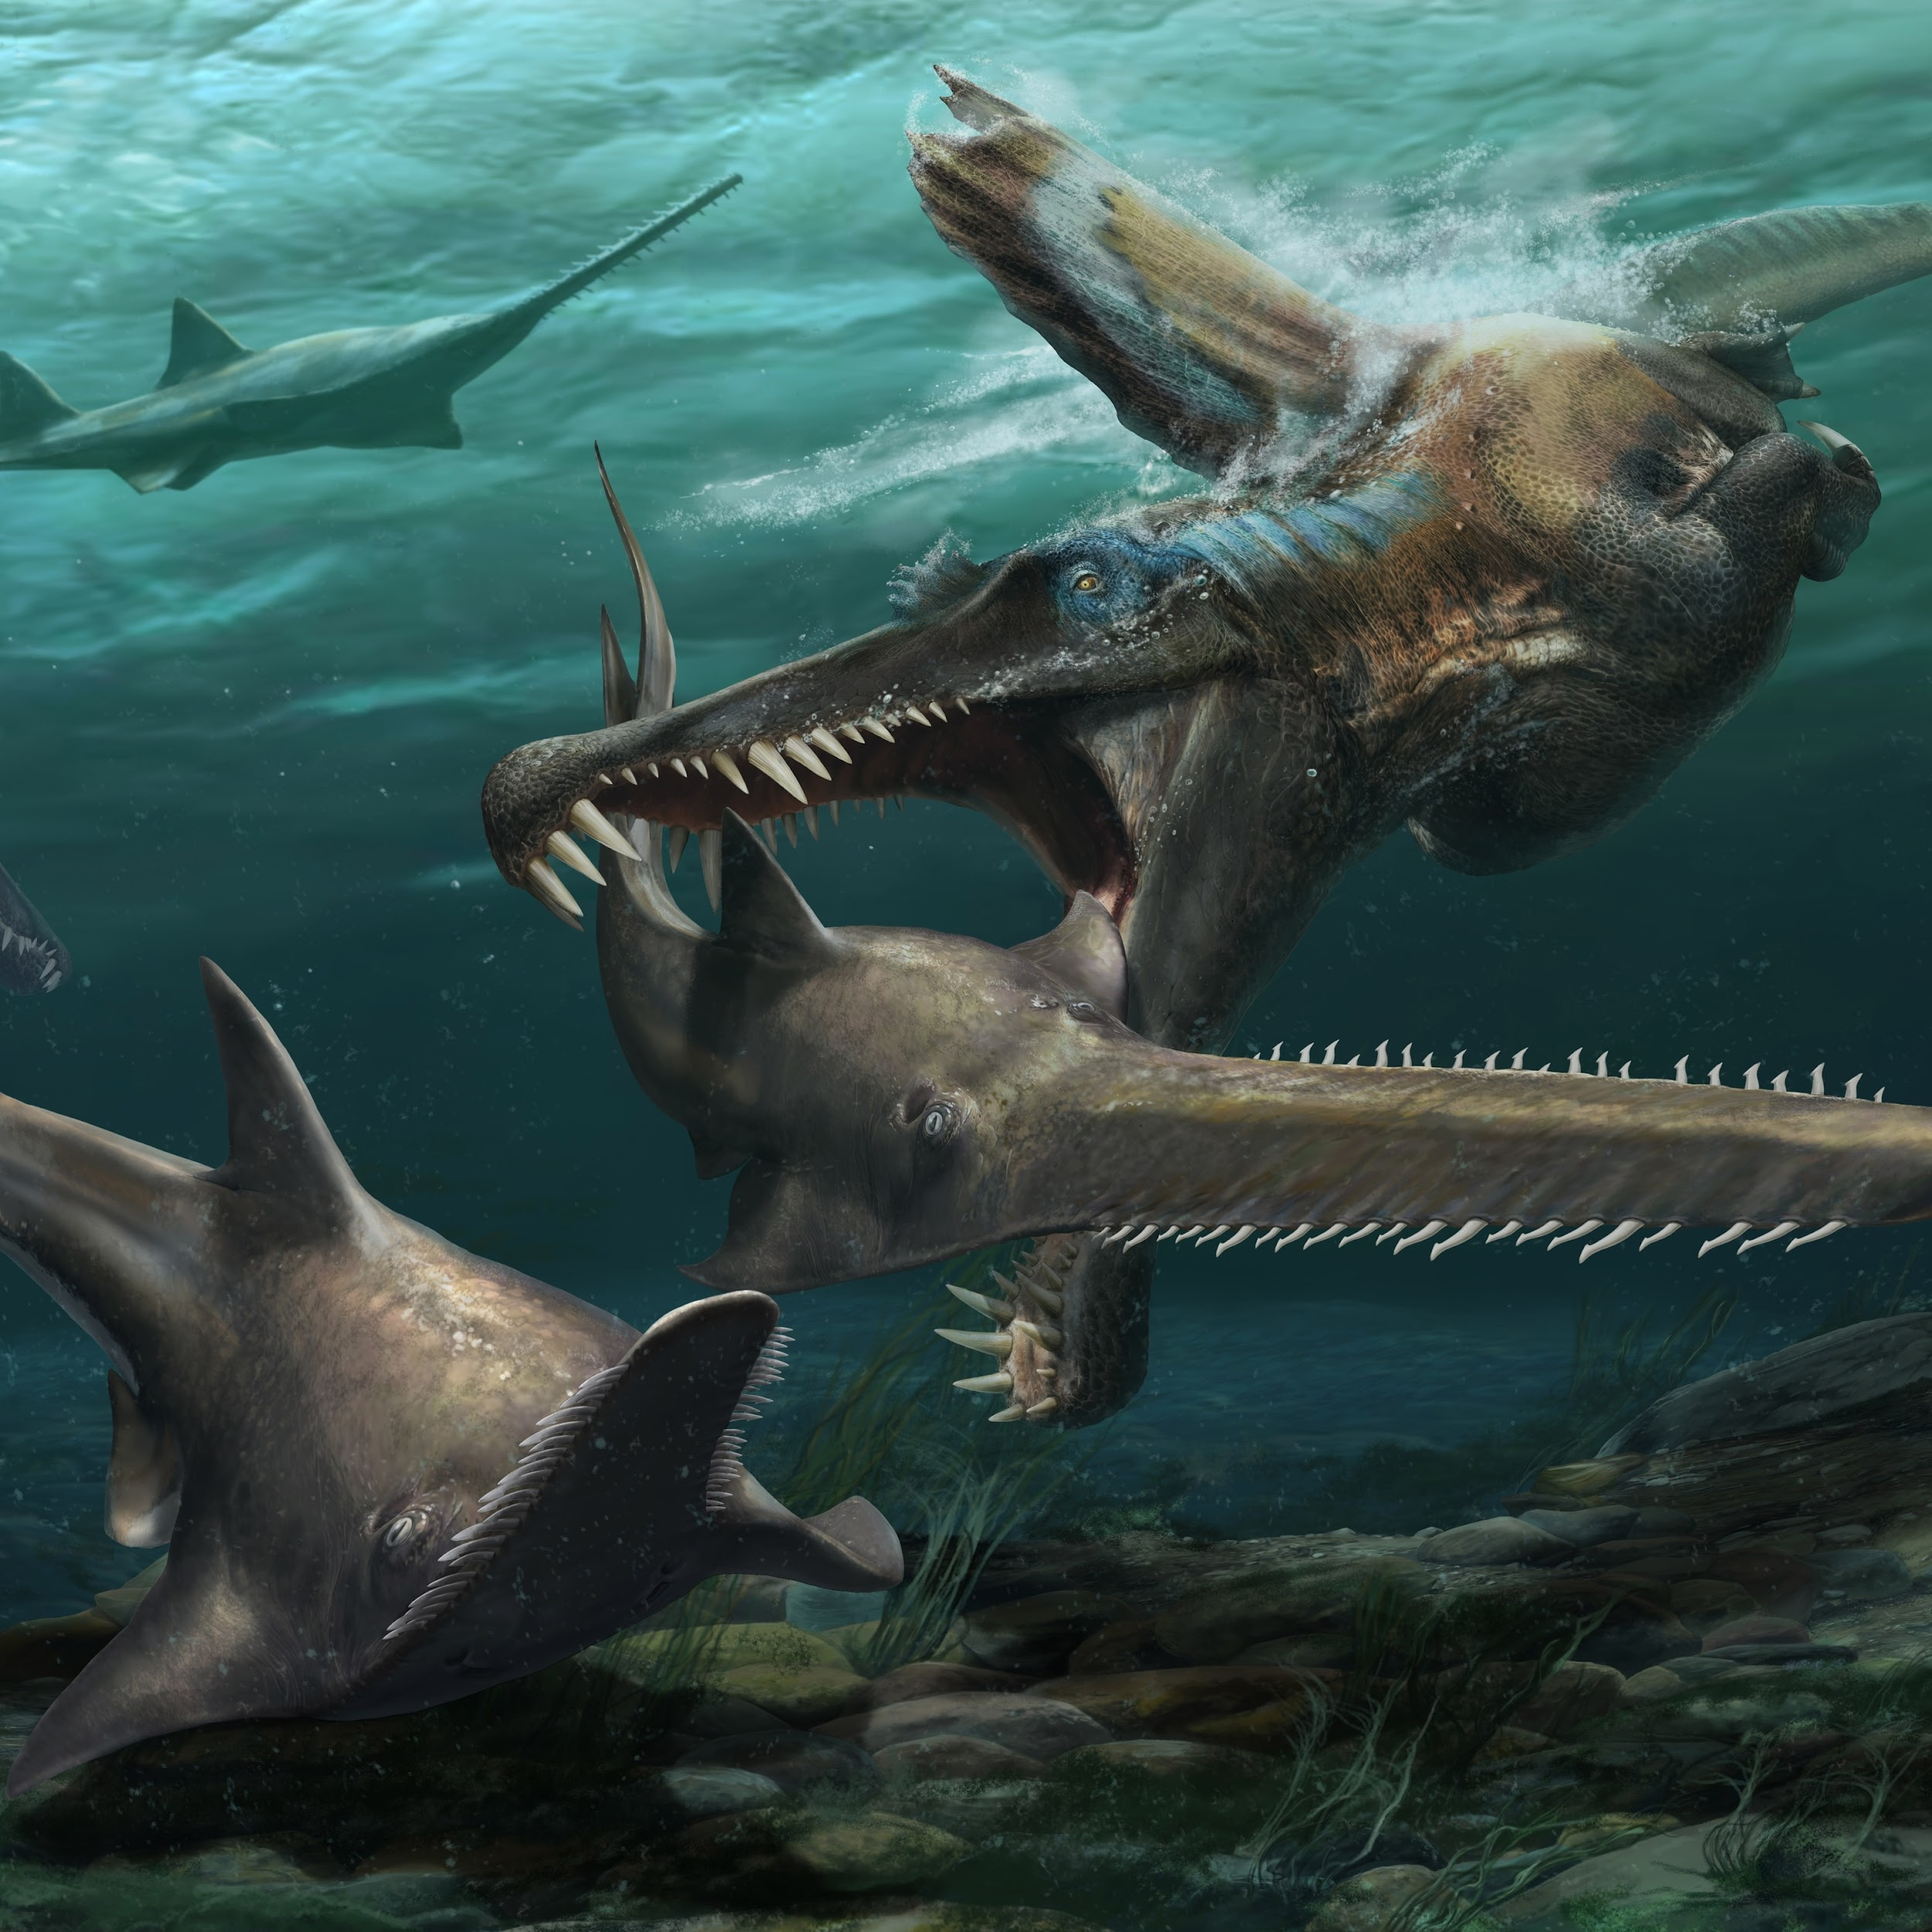
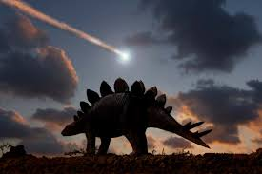
Key Takeaways
The velocity of an asteroid is determined by its conserved momentum, gravity, size, mass, and angle of entry.
Air friction is minimal in reducing the velocity of an asteroid that has entered the atmosphere.
An asteroid’s impact energy in Joules is calculated by KE = ½ * mv^2 and is linearly dependent of its mass.
An asteroid 5% of Chicxulub’s mass will yield 5% of its impact energy.
Larger asteroids cause larger crater diameters, but the relationship is not linear.
As the asteroid size is reduced, the resulting crater size becomes exponentially smaller.
Tidal wave heights are highest at the point of impact, and diminish exponentially as the distance from the point of impact is increased.

