Slide 1
The Big Mac Analysis
Berry Tillage

Slide 2
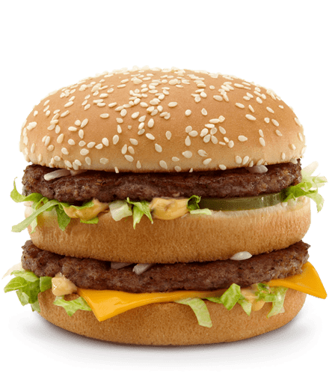
Background/Context
“The Big Mac Index is a price index published since 1986 by The Economist as an informal way of measuring the purchasing power parity (PPP) between two currencies and providing a test of the extent to which market exchange rates result in goods costing the same in different countries. “
Big Mac prices are similar in all McDonald's stores, made with similar ingredients and recipes. Meaning you can compare world's value of money using the Big Mac Index
Will examine trends and see if it is reliable using merged data of the Big Mac Index from 2000-2022

Slide 3
The expected rate of increase of a Big Mac in the US
The average rate of inflation of food in the US is stated to be 3.64%
The initial price of a Big Mac in the US is $2.40
With these assumptions we should see a shallow exponential growth over the 22 year time period

Slide 4
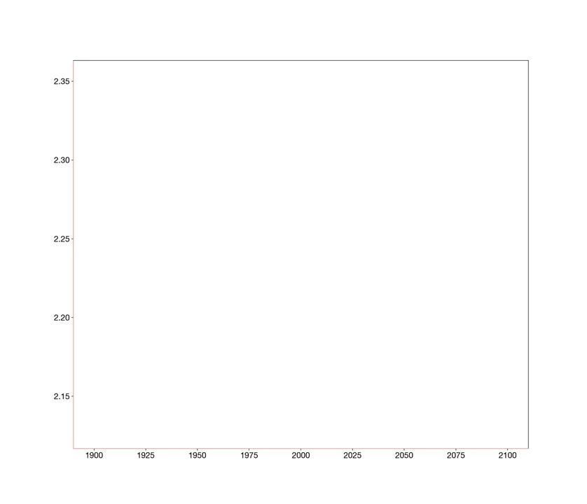
The actual rate of increase of a the Big Mac in the US
Used the data from the index to graph and see whether that trend would actually hold
Can be seen to not be exponential as predicted. Reason for this is inflation rates are not always consistent. The economy goes through peaks and troughs that vary for numerous reasons with COVID being one of the most prevalent

Slide 5
Comparing the Big Mac to GDP rates over the years
To do this GDP was averaged out globally while prices globally were adjusted
With the given data it is hard to say if there is a correlation between the price of a Big Mac and GDP
In lower rates we see a strong correlation however as rates increase that correlation seems to taper off and not be as strong

