Slide 1
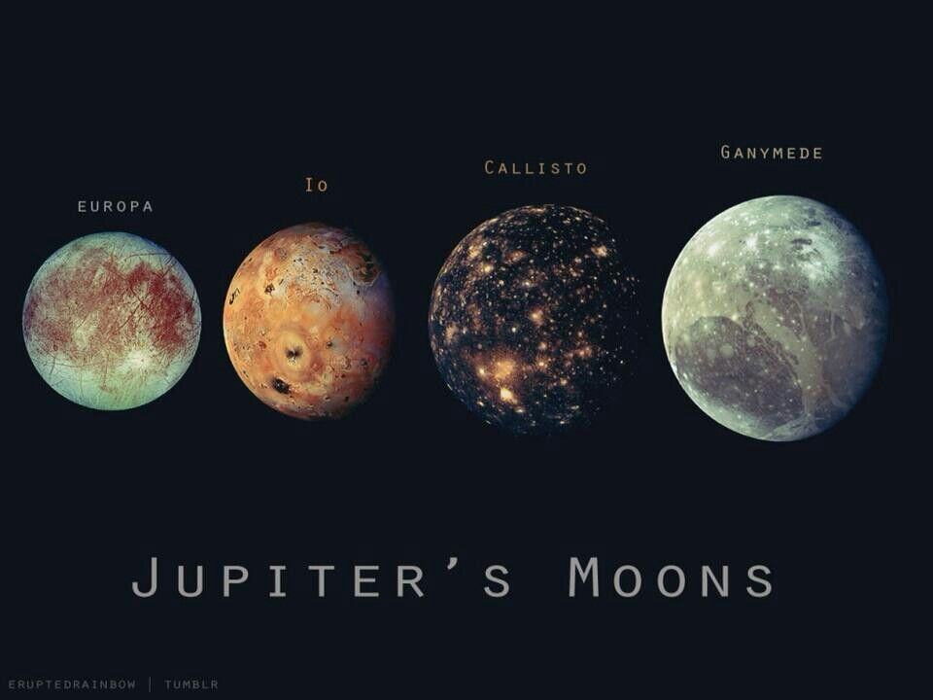
Jupiter’s Moons
By: Alondra Martinez

Slide 2
What did I do/used?
Did an animation of Io, Europa, Ganymede, and Callisto (Jupiter’s 4 main moons)
I used ODE (Ordinary Differential Equations)
Resources that helped me out:
https://www.youtube.com/watch?v=Sg5glDFjWNg
https://esahubble.org/videos/heic1504c/

Slide 3
The Animation

