Slide 1
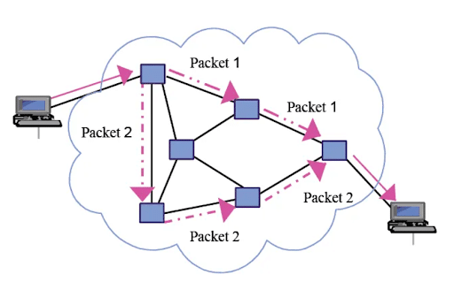
Simulating communication on the internet
Afees Tiamiyu

Slide 2
Background
2 devices communicating
Components
Router (squares)
End host (circles)
Links (lines)
Broken Links( yellow lines)
How does a packet know where to go?
Random Walk

