Slide 1
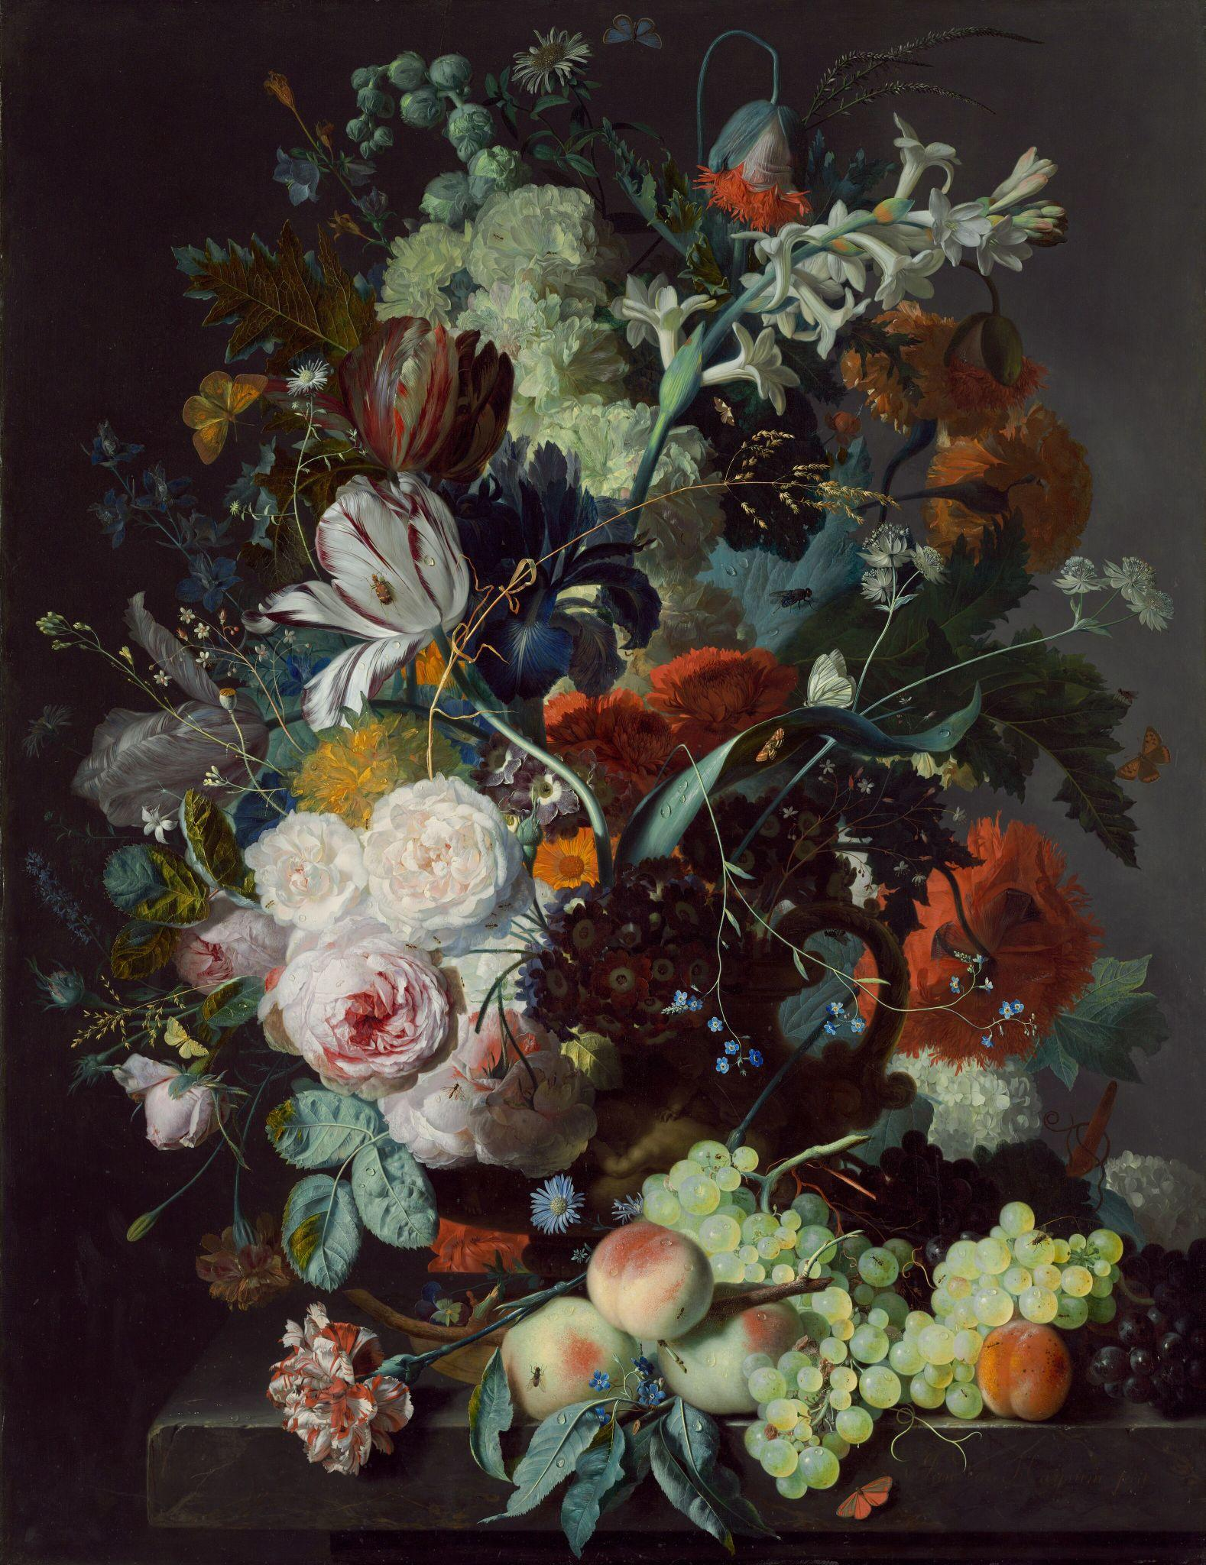
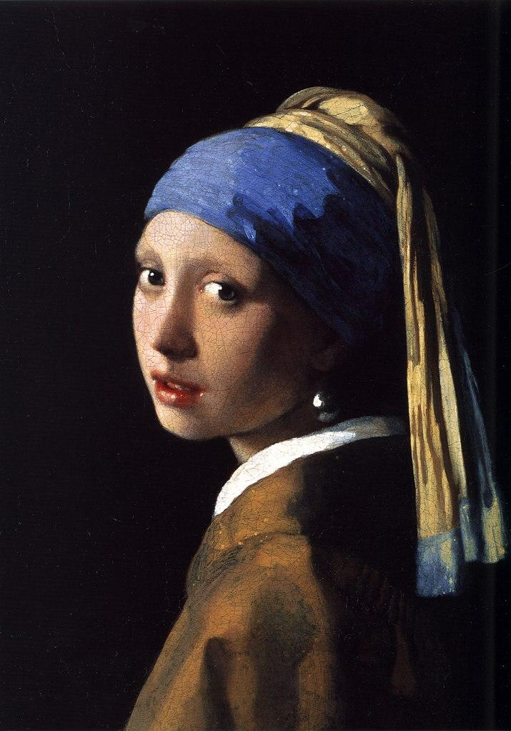
Eroding Famous Arts
By: Ida Ma

Slide 2
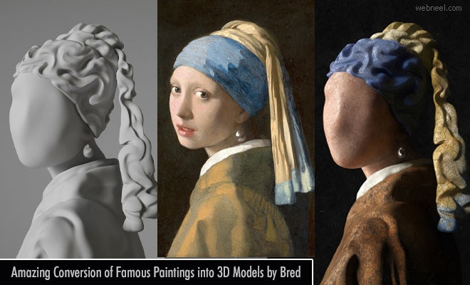
Art as a depiction of the real world!
Art uses light and dark colors to portray the different depths of a surface. I utilized similar methods to create a 3d image of the famous art pieces. ("Le Kunst")
Methods used:
numpy
matplotlib
skimage
Notes:
https://webneel.com/amazing-conversion-famous-painting-3d-model-bred

Slide 3
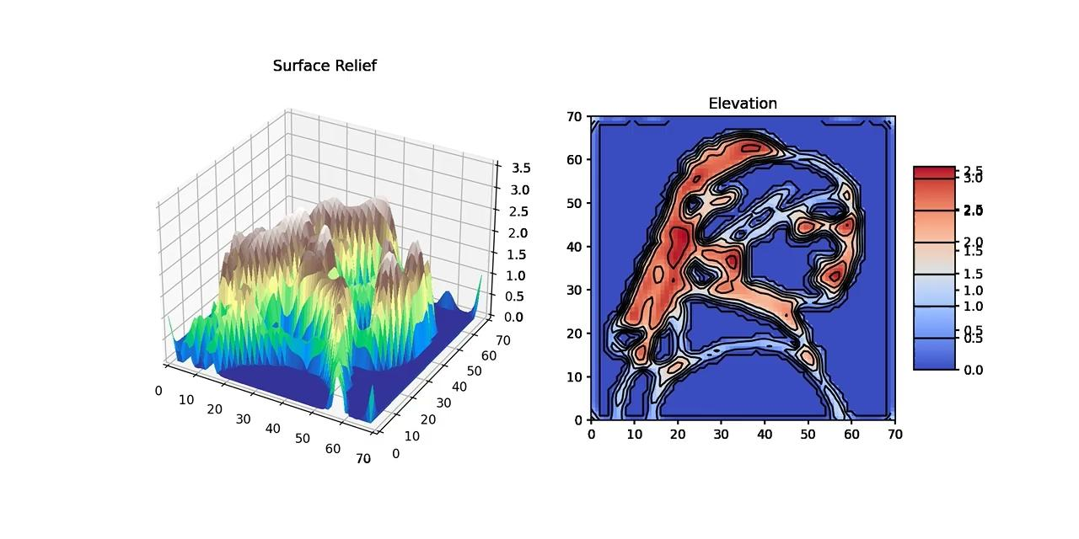
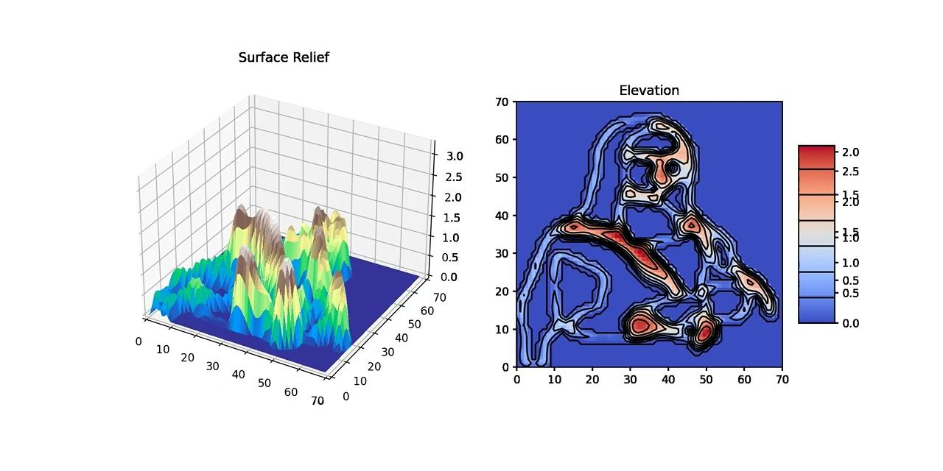
My Animations
Girl With Pearl Earrings
Mona Lisa
Oil painting on canvas by Dutch artist Johannes Vermeer
Portrait painting by Italian artist
Leonardo da Vinci.

