Slide 1
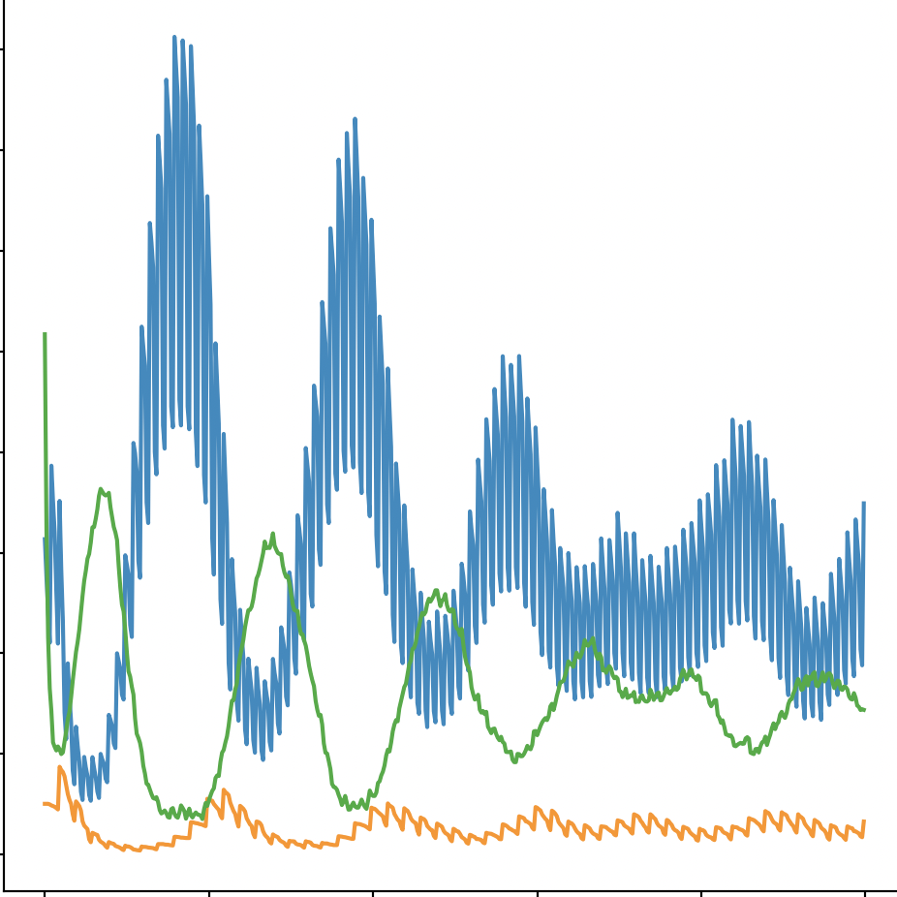
Crude Prey Predator Behavior Simulation
Junha Kim

Slide 2
Background
Natural Selection is everywhere
Nature prefers certain “qualities” over others
Population Control depending on situations
My model is not as sophisticated as the real world…

Slide 3
Project Description
Simulation of prey-predator-food behavior
Predator → Prey → Food
Predators and Prey may “reproduce” after survival for n number of rounds
Predators and Prey “die” after not eating their food for n number of rounds
Each simulation is different and random:
generate random number of prey, predators, and food in random location
Semi-random moves for preys and predators
Different types of predators

Slide 4
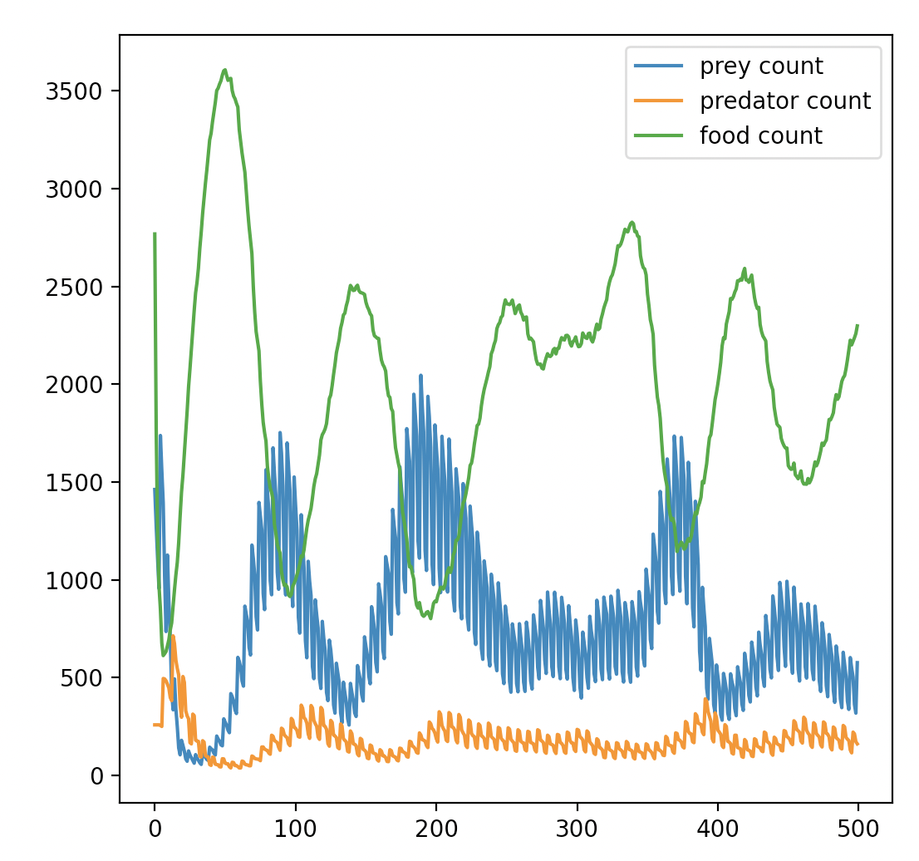
Simulation 1

Slide 5
Simulation 2

Slide 6
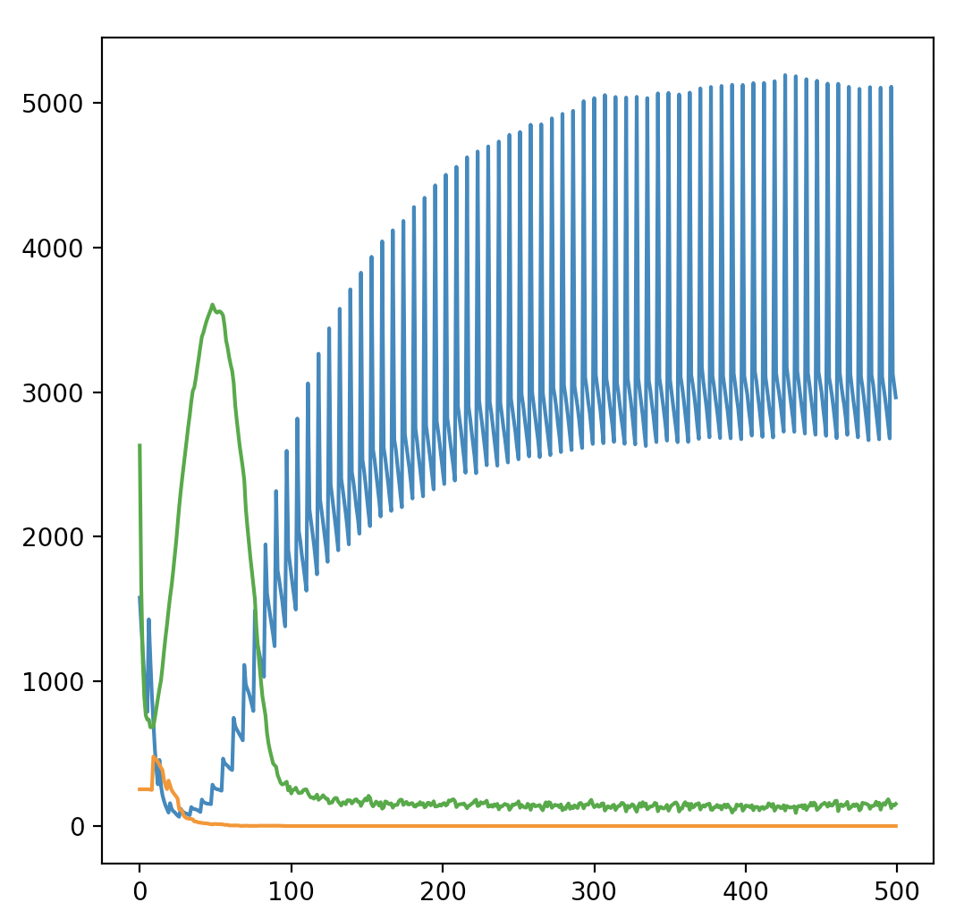
Simulation 3

Slide 7
Questions?

