Slide 1
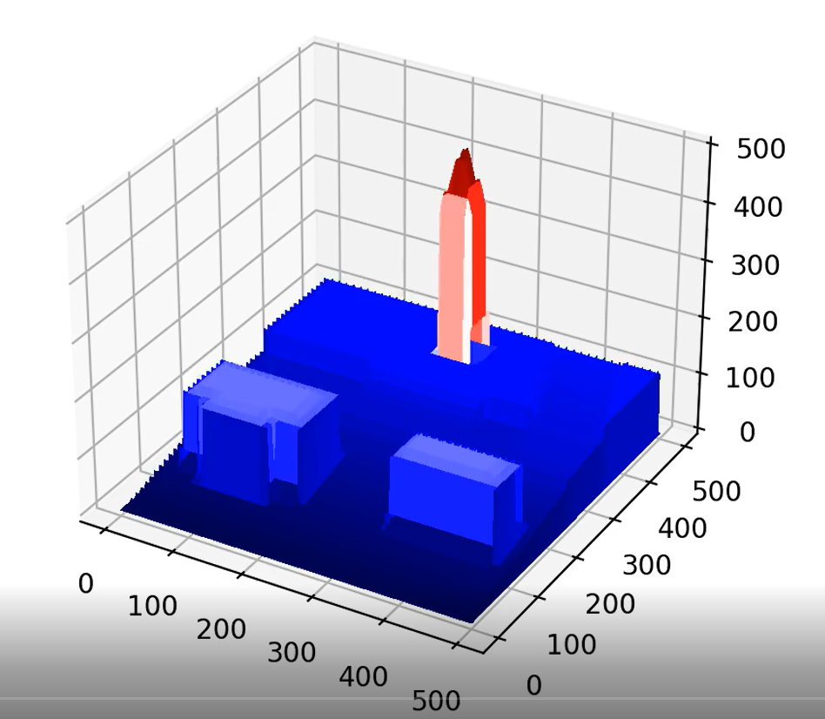
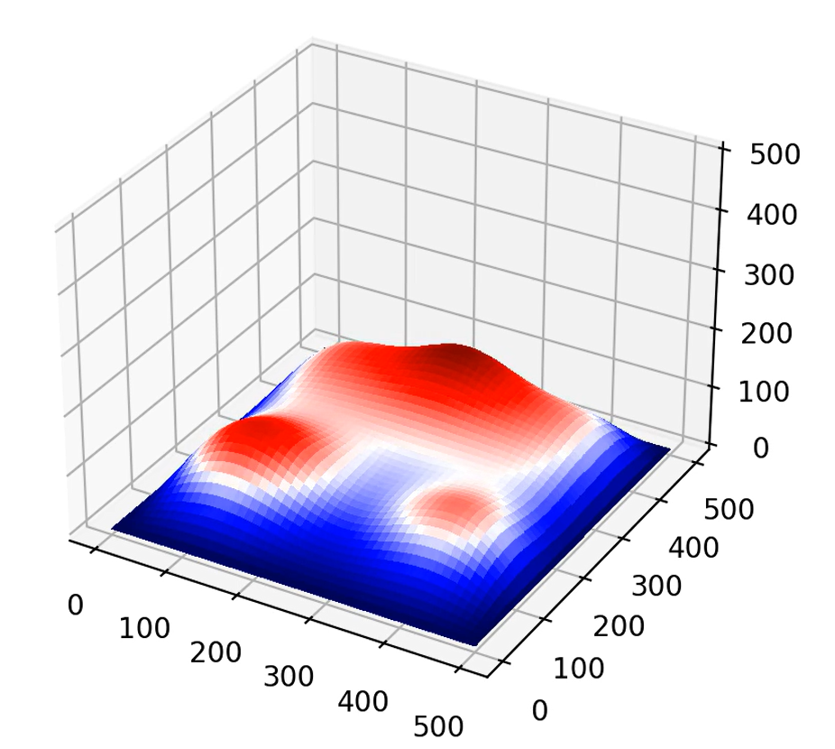
Melting Berkeley
Edward Truong EPS 109

Slide 2
Topic and Methods
Using PDE (partial differential equations) to show the heat equation with respect to time.
Heat in 2D with initial conditions being buildings on campus (area around Campanile and Hearst Mining Circle).
(Equation from lecture 11)

Slide 3
Topic and Methods (Continued)
To prevent heat from leaking out, we can specify our boundary conditions to account for this.
This will make it so the heat is not drained out.
Buildings are created from an N x N matrix with each value representing how tall or the height of that point is.
(Equations from Homework 7)

Slide 4
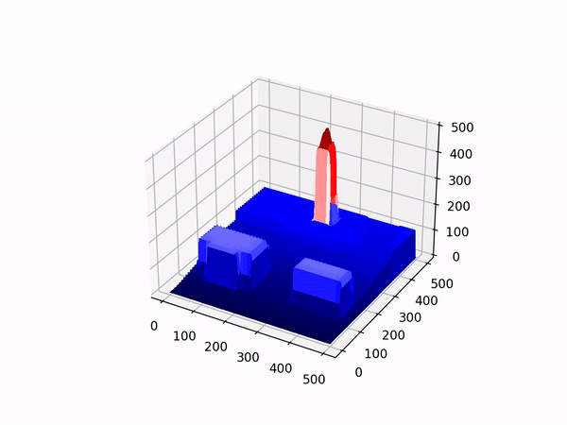
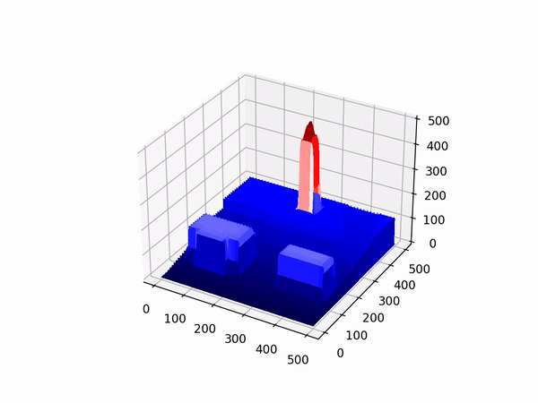
Animations (Sather Tower)
Drained Not Drained

Slide 5
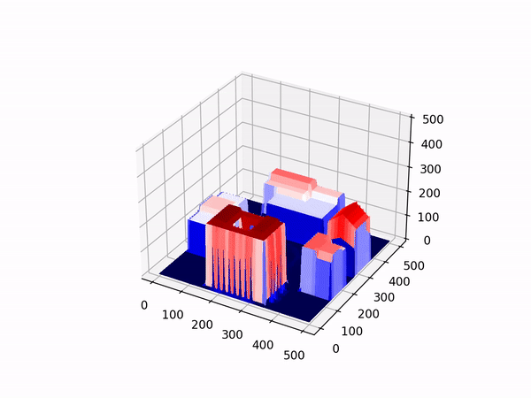
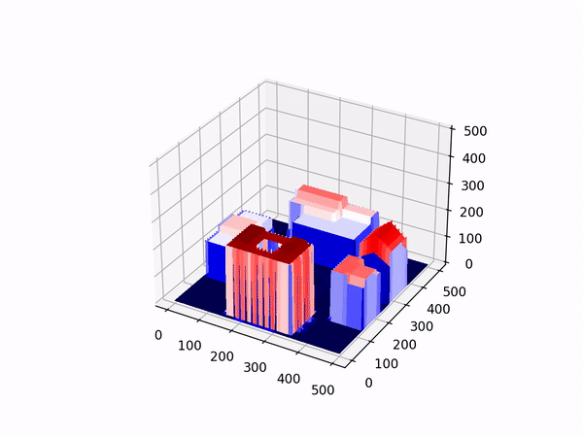
Animations (Hearst Mining Circle)
Drained Not Drained

