Slide 1
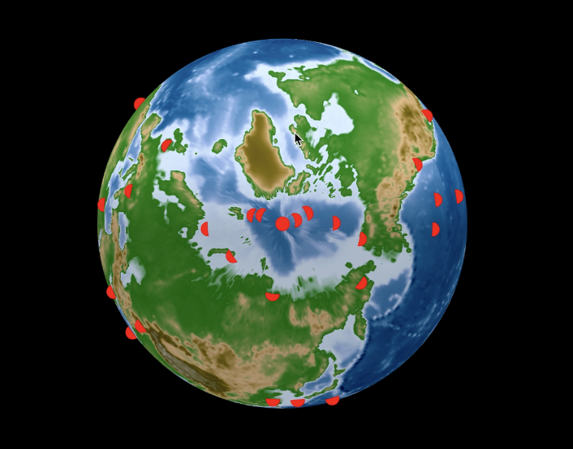
Mr. Worldwide’s random tour
Simulating a random walk tour
By: Amy Castillo

Slide 2
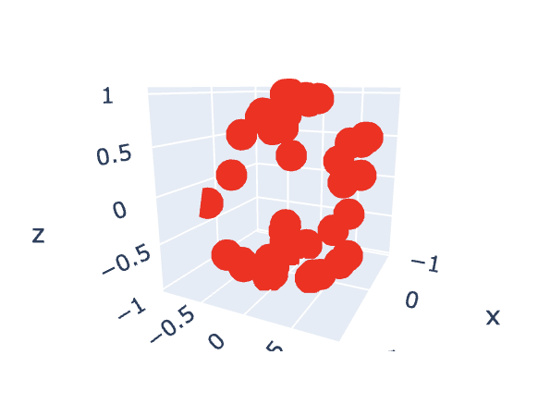
Method
GOAL: Simulate a random worldwide tour that moves each year from its previous location
METHODS:
CREATE 3D GLOBE
GET LATITUDE AND LONGITUDE COORDINATES
TRANSLATE INTO SPHERE COORDINATES
PLOT THE EARTH MAP
https://towardsdatascience.com/create-interactive-globe-earthquake-plot-in-python-b0b52b646f27
https://plotly.com/python/static-image-export/
RANDOM WALK
INITIAL RANDOM COORDINATES
EACH POINT HAS EQUAL PROBABILITY OF MOVING NORTH, SOUTH, EAST, WEST FROM THE PREVIOUS LOCATION
RANDOM INT ’R’ GENERATED AND USED TO DETERMINE WHICH DIRECTION TO CHANGE
REPEATS A NUMBER OF YEARS
** I noticed the 2021 winner used the same 3D globe and I referenced their code to help me use the globe and save the animation when I couldn’t figure it out at first

Slide 3
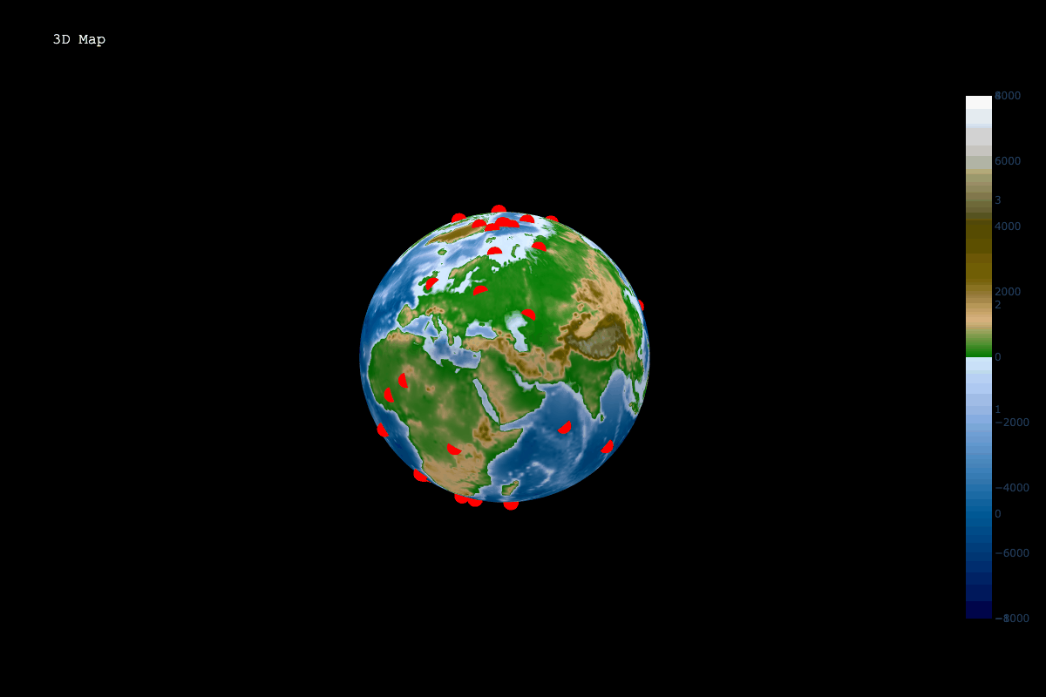
random walk Animation

Slide 4
Thank You!

