Slide 1
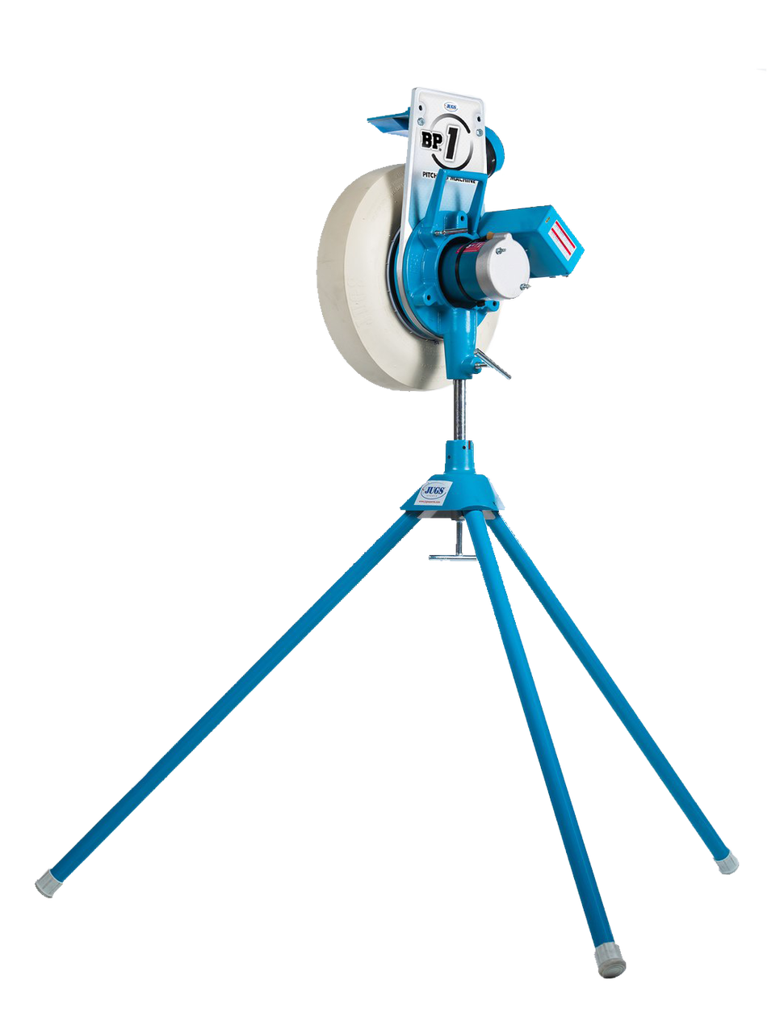
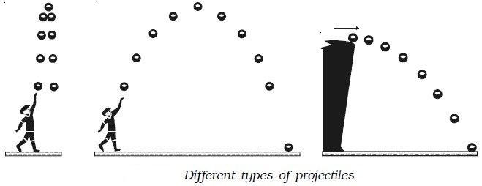
Launching Baseballs
Marcos Hernandez

Slide 2
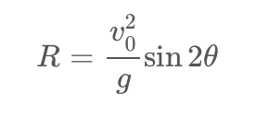
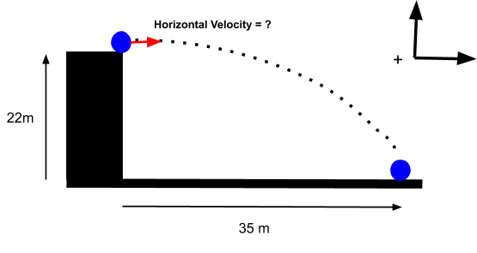
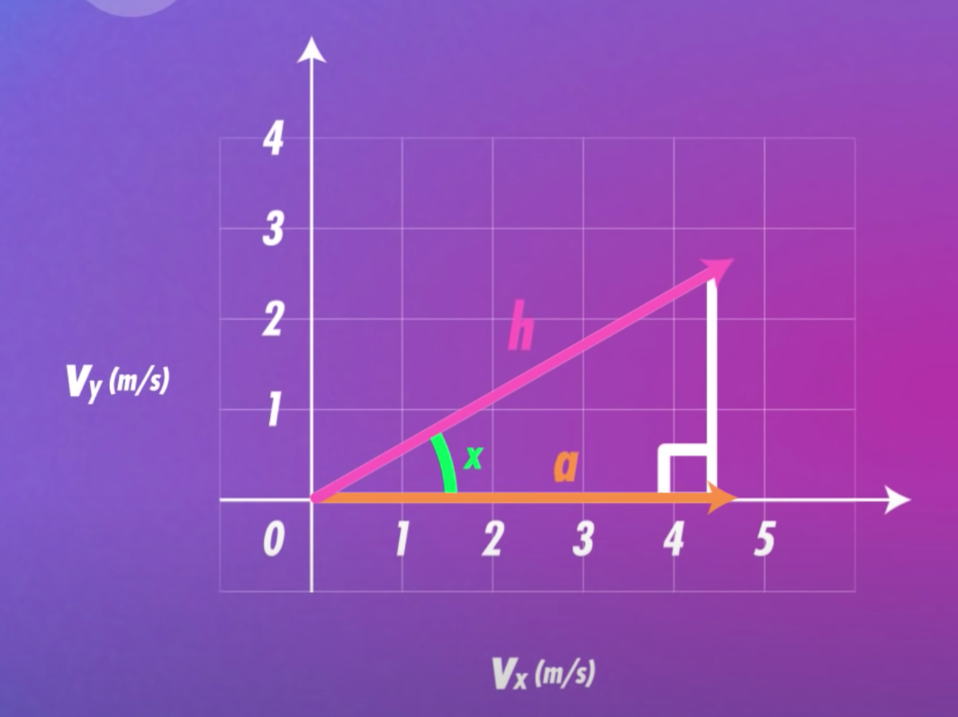
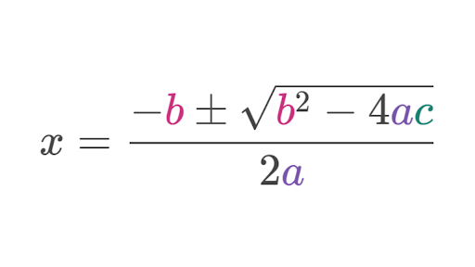
R
Displacement curve: simulate the position of the object at every second
Quadratic formula: solve for the time the object hits the ground using displacement curve
Trigonometry: calculate the position of the object with a given angle
Range equation: calculate the range of the object (initial to final position)
Simulate a ball/object being thrown (helpful for pitching machines)

Slide 3
WORKING THE CODE
Run the entire code (all of the cells) at first to make sure you get an animation
If you want to change the starting position of the object, velocity, or the angle the object is thrown at (even the gravity if you want)
Anything that has “CAN CHANGE” commented in the second to last cell, feel free to change
After, run the last two cells:
Run the cell where the changes were made (second to last cell) which will also print out information about the object’s path)
Run the final cell which will create the animation along with information about the object’s path (the only thing you can change are the dimensions of the graph where it says plt.xlim or plt.ylim)

Slide 4
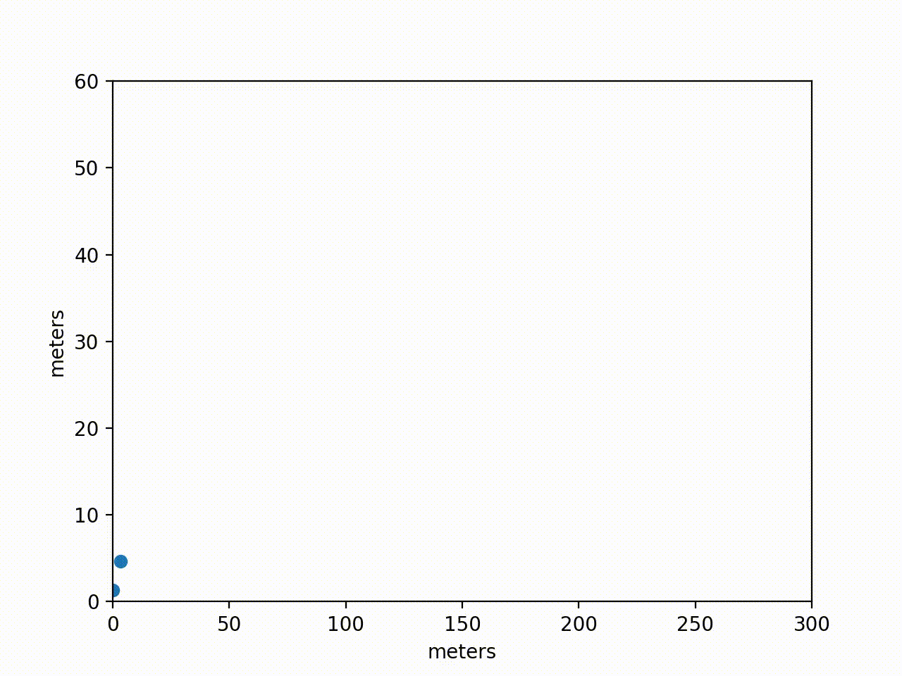
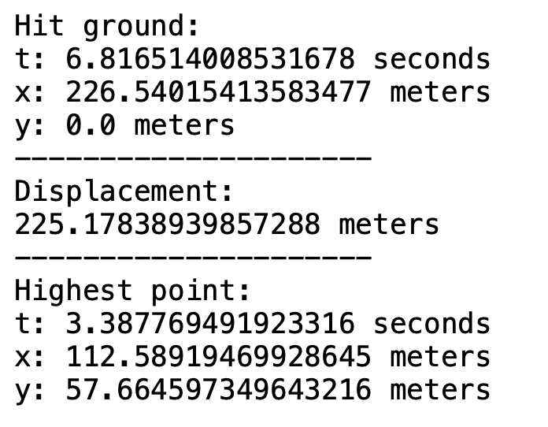
Aroldis Chapman has one of the fastest pitches of around 105 mph (47 m/s). Let’s simulate this throw with a pitching machine with a 45 degree angle. The machine would release the ball at around a 1.37 meter height.
Velocity = 47 m/s
Angle = 45 degrees
Height = 1.37 meters

Slide 5
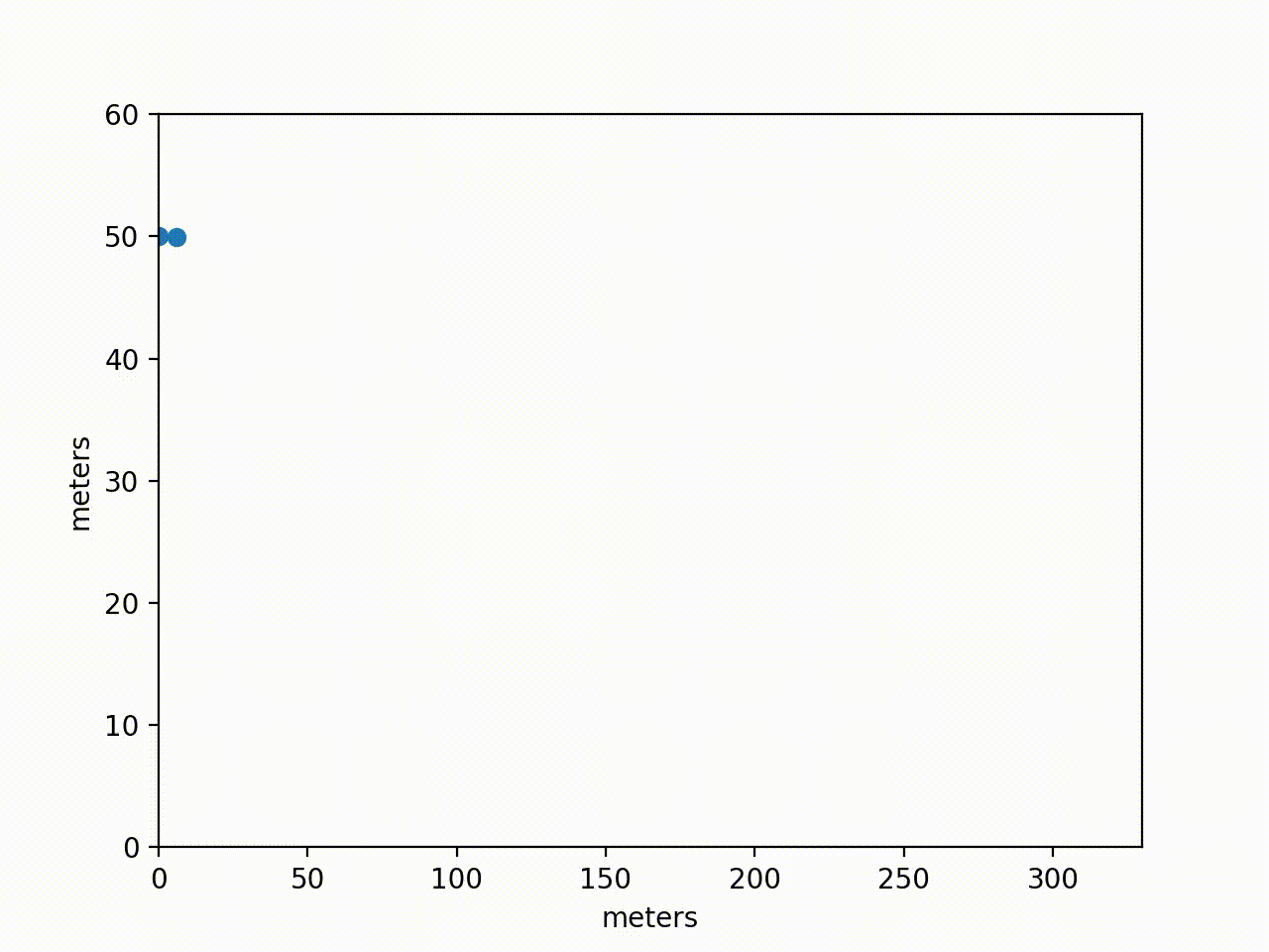
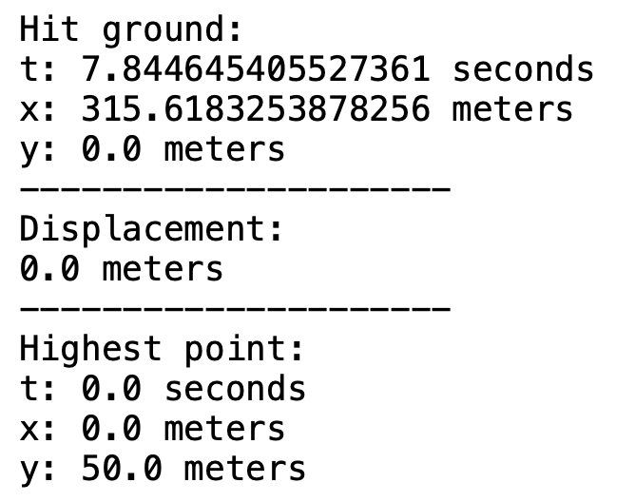
Let’s throw a ball from a cliff 50 meters high the horizontal direction on the moon at
90 mph (40.2336 m/s).
Velocity = 40.2336 m/s
Angle = 0 degrees
Height = 50 meters

