Slide 1
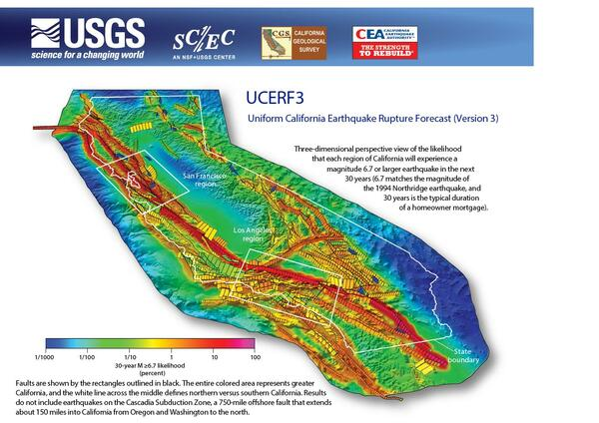
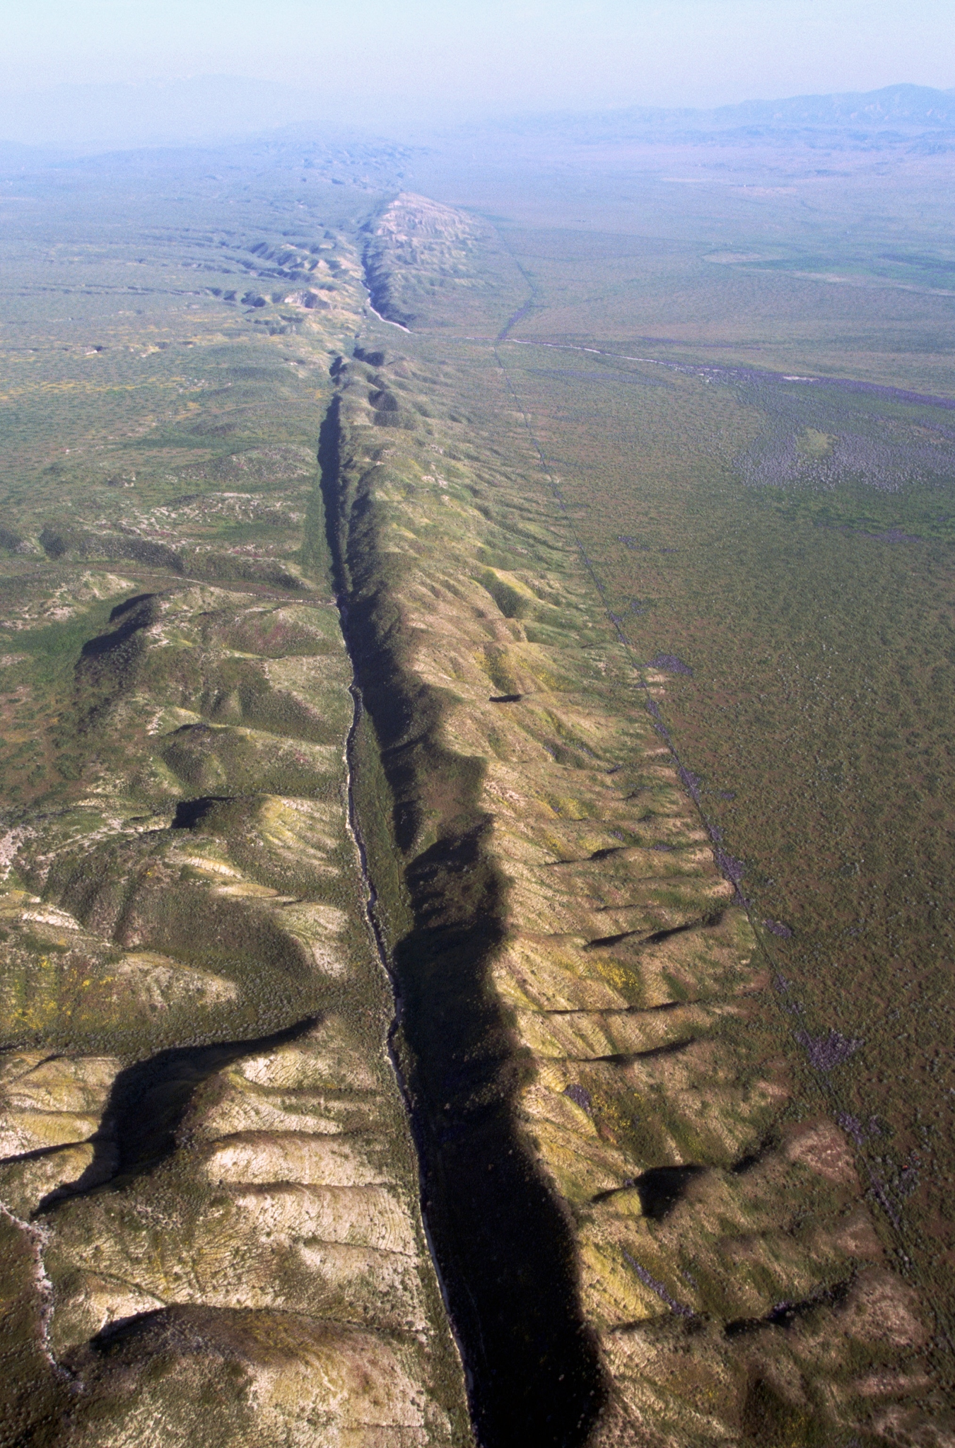
California Earthquakes Investigation
By Lee Lalunio

Slide 2
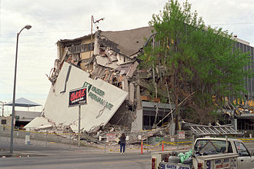
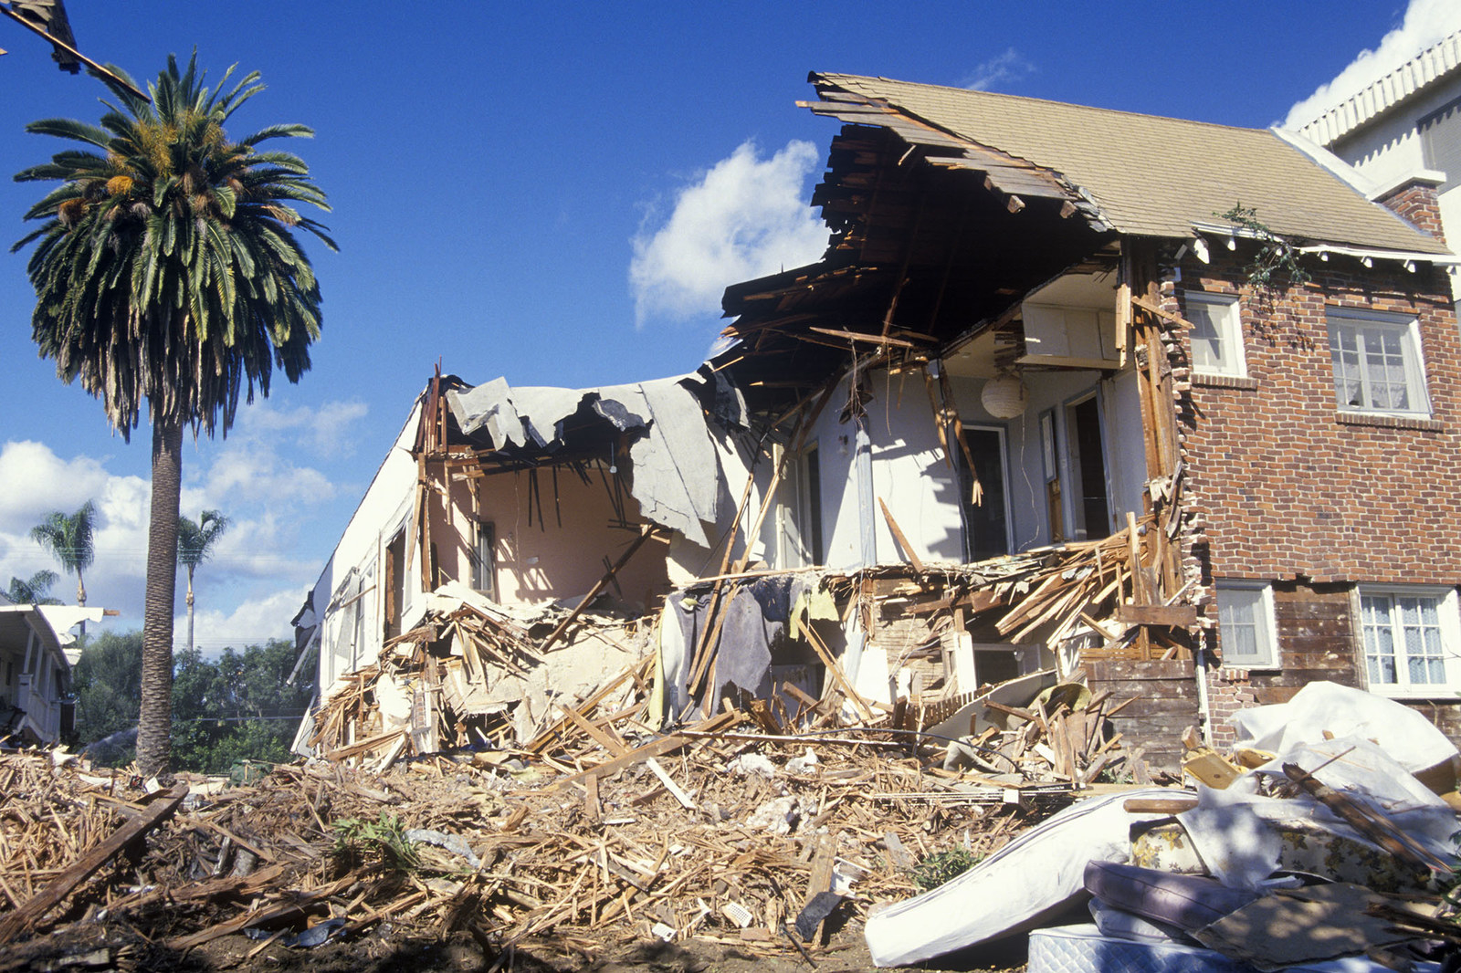
Focus
From 1970 to present- exploring ‘cause for concern’ (CFC) eqs in Southern & Northern California
M (magnitude) > 5.3 but will be exploring M > 5
Evaluating areas where CFC eqs are common and where damaging/dangerous (D) eqs, with M > 6, occur
1994 Northridge eq- M = 6.7

Slide 3
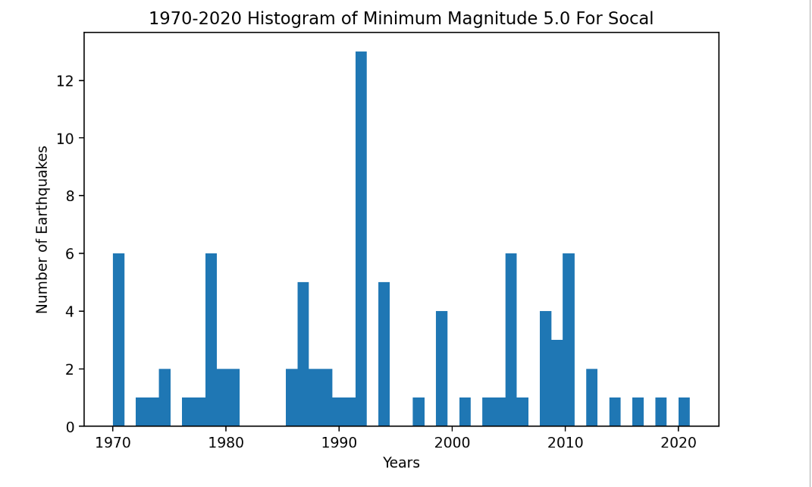
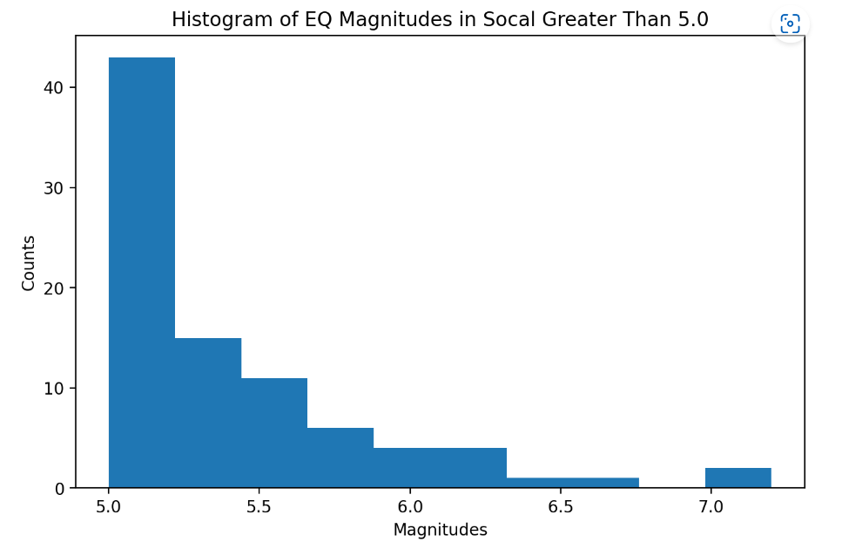
Southern California
87 CFC eqs from 1970-Present
Avg of 1.64 CFC eqs every year
90% of these eqs are below 6
90% of eqs are non ‘D’ earthquakes
10% are ‘D’ eqs
Average of 0.164 D eqs every year
Roughly one D eq every 6 years

Slide 4
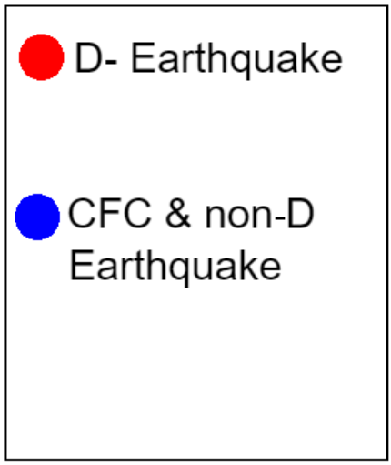
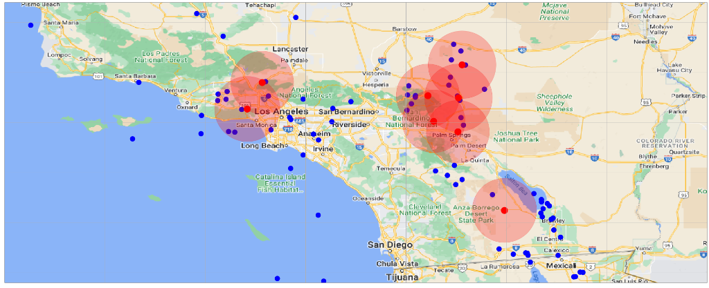
Southern California (D-Earthquakes)
D-earthquakes common in Northridge area (northwest of LA) as well as Palm Springs area
One D-eq in Anza Borrego Desert Park
Red transparent radius - where the eq damage may be significant
Blue eqs common in north Palm Springs and somewhat common in LA area

Slide 5
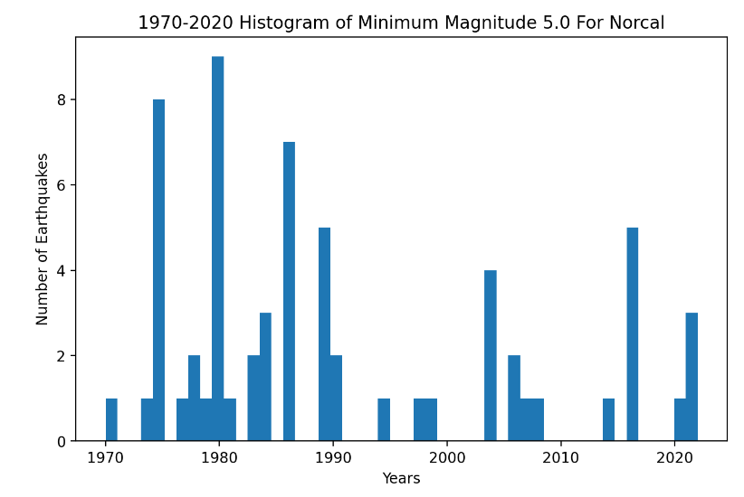
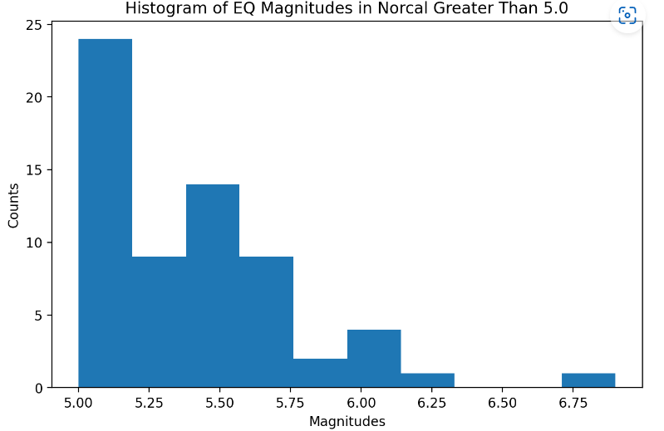
Northern California
64 CFC eqs from 1970-Present
Avg of 1.21 CFC eqs every year
5 of them (8%) were D-eqs
Avg of about 0.1 D-eqs per year
Roughly one D eq every 10 years

Slide 6
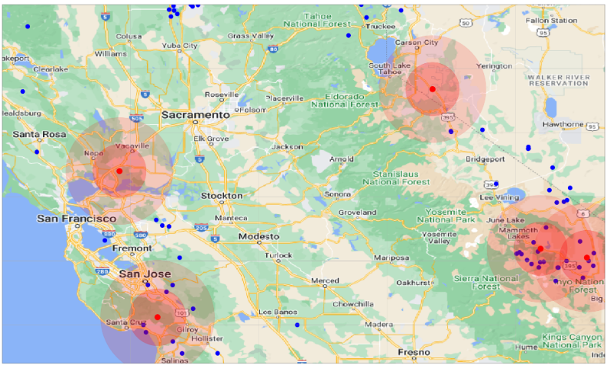
Northern California (D-Earthquakes)
D-earthquakes common in Santa Cruz area & San Jose as well as Vallejo area (NE of San Francisco)
Areas like San Francisco and Oakland are more damage prone than Socal due to unsteady soil
Very common CFC and D eqs in Sierra and Inyo National Forest (away from metropolitan areas)

Slide 7
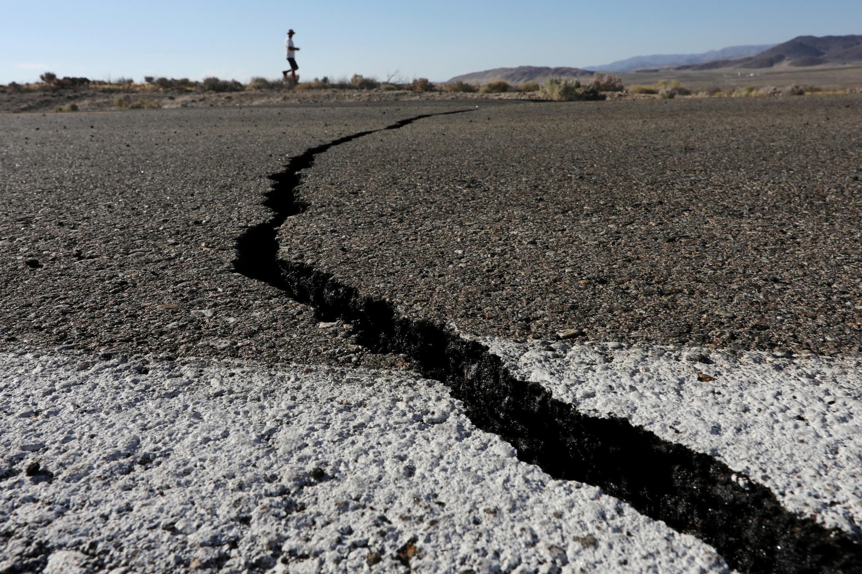
Conclusion
CFC earthquakes are common in both norcal and socal
Norcal has less CFCs, but more risky
Most of CA’s eqs occur in the forests or national parks, which are away from city areas (observations from blue dots)
Should still be cautious
$10 Billion in Northridge area
$6 Billion in Santa Cruz, Oakland, and San Francisco area

Slide 8
Thanks for watching!

