Slide 1
Fourier Epicycle
By: Lawrence Lam

Slide 2
What is a fourier Transform
A Fourier Transform is a way to break up something into a bunch of smaller sin waves.
You may remember that we used it in the most recent homework in part 4 but it was presented by its mathematical formula.

Slide 3
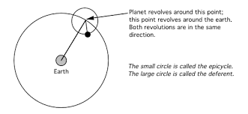
Epicycle
An epicycle is a smaller circle whose center moves around the circumference of a larger circle.
Notes:
Oxford Languages - defintiion

Slide 4
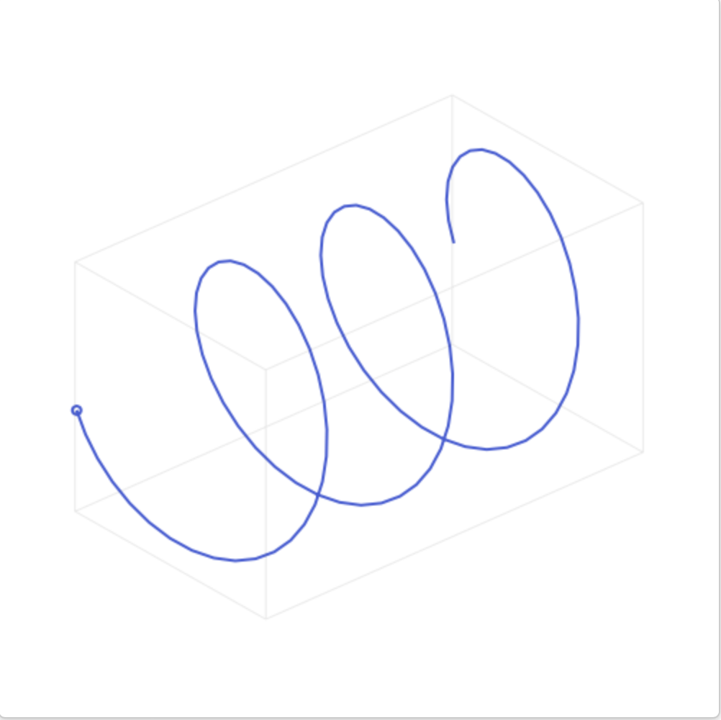
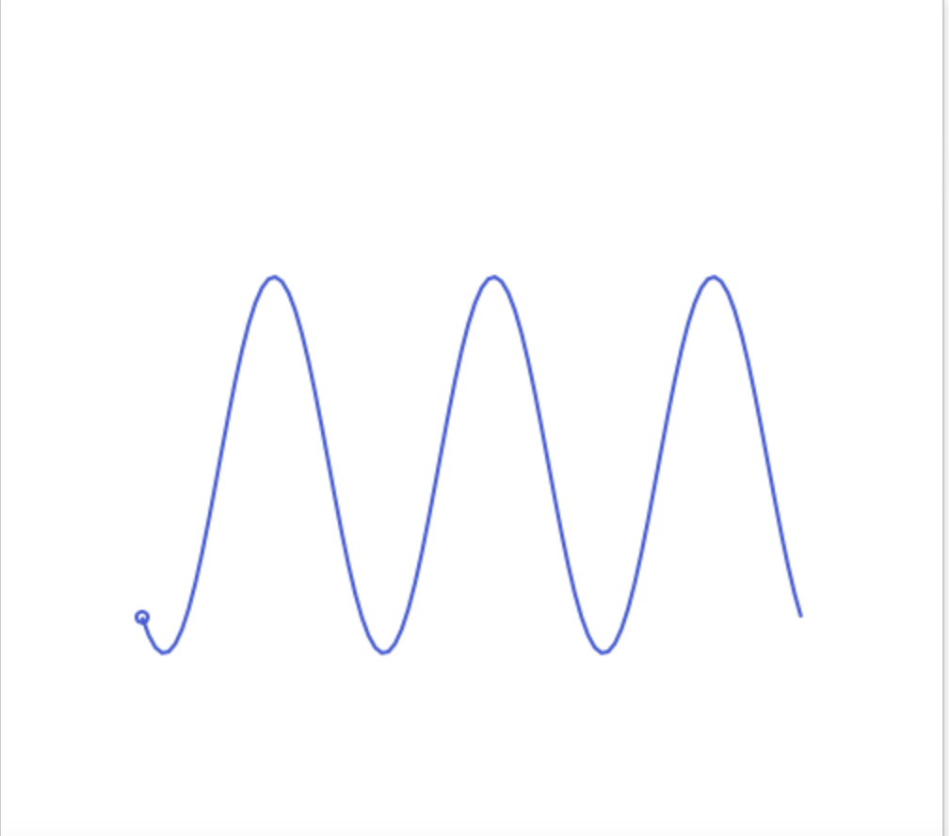
Fourier Epicycle
The Fourier Decomposition doesn’t just break down signals into sin waves but it can break them into complex sinusoids which can be seen on the left.
If you look at the sinusoid on the left from the side, it will look exactly like the 2d signal on the right.

Slide 5
Fourier Epicycle cont.
By adding these complex sinusoids we can in the same way that we did for 2d sin waves we can create any drawing.
By adding specific sized sinusoids you will distort the spiral, and using this distortion you can morph the original spiral into any shape that you want.

Slide 6
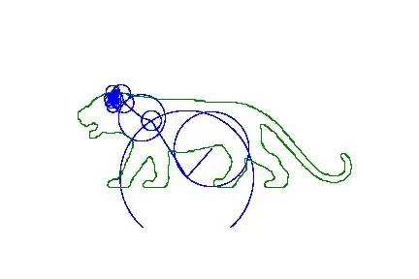

Slide 7
Work Cited
https://www.jezzamon.com/fourier/
But what is the Fourier Transform? A visual introduction.https://www.youtube.com › watch
https://efyang.dev/media/documents/efyang_KAM_Paper_Approximating_Images_with_Epicycles.pdf

