Slide 1
Gravity Assist:
Modeling the Trajectory of Voyager 1

Slide 3
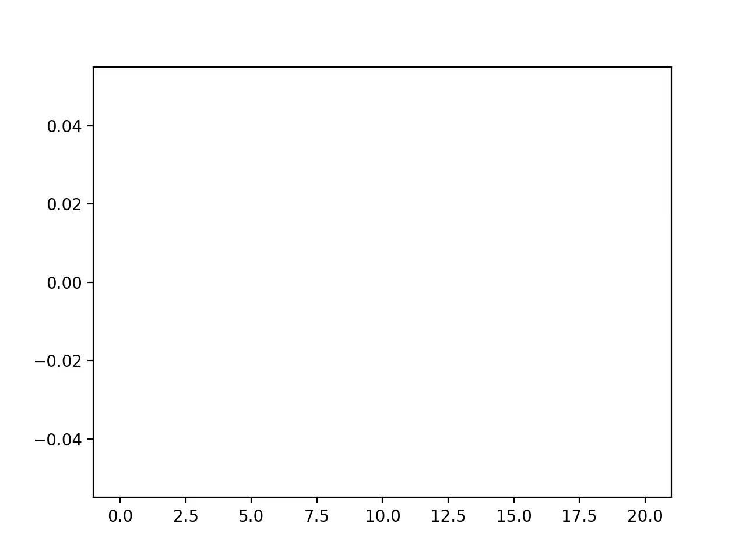
Modeling an Incident of Gravity Assist

Slide 4
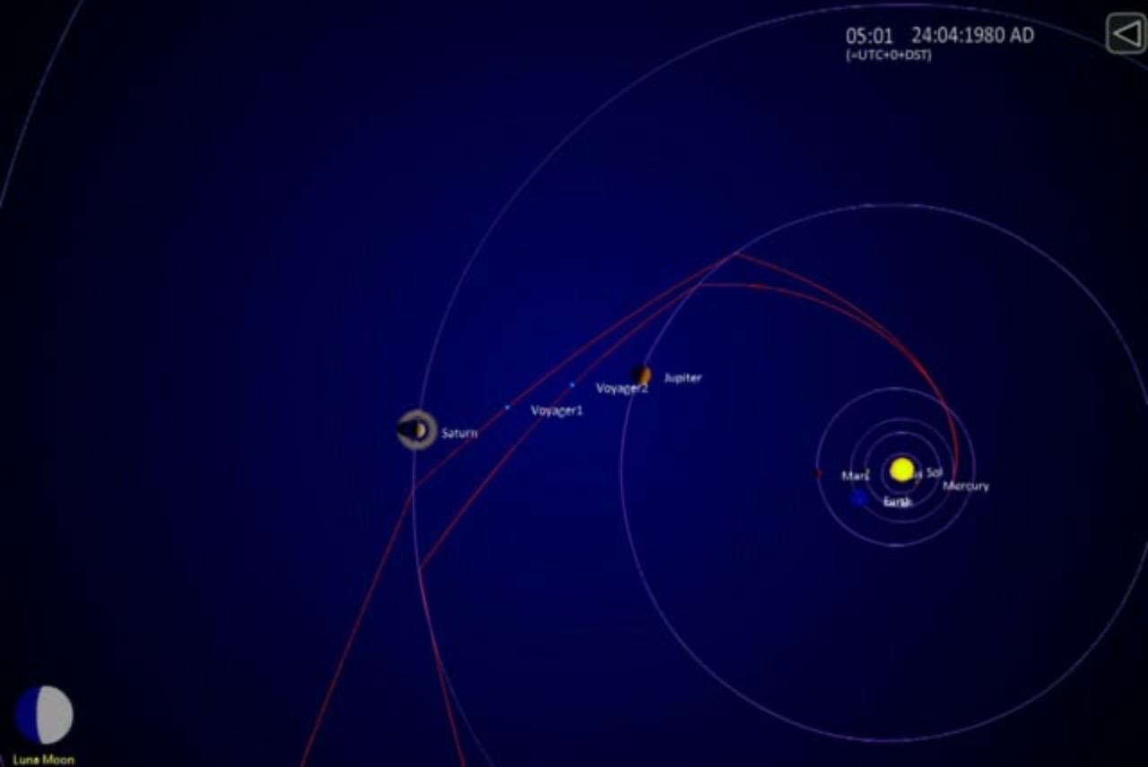
What I Didn’t achieve

