Slide 1
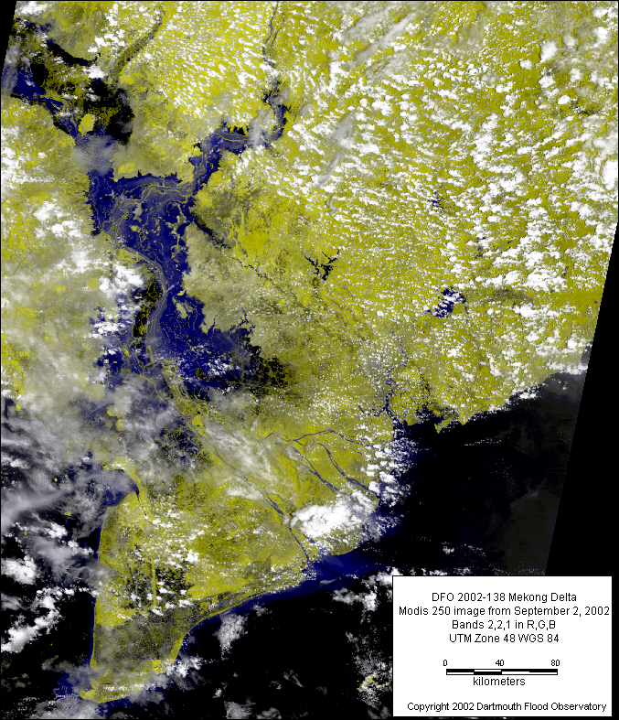
Climate-induced Displacement during the 2011 Floods in the Mekong Delta, Việt Nam
Thao Tran
Trần Thị Phương Thảo
EPS 109 FA 22 · Final Project

Slide 2
Motivation
International Organization for Migration (IOM) in their Outlook on Migration, Environment and Climate Change report states:
History provides us with many examples of individuals and communities using migration to adapt to changing environmental conditions. In some contexts, migration can constitute an important and positive adaptation strategy that can be supported by policy action. [...] It is key to develop the evidence base on how migration contributes to adaptation in the current context and how it could contribute to addressing future environmental change.
World Bank’s Natural Disaster Hotspots: A Global Risk Analysis report findings:
The most flood-prone regions affect 37.7% of the world’s population–greater than the combined total of 34.5% for the other natural hazards.
Floods also have the largest impact on the world’s Gross Domestic Product (GDP) per unit area (33.2%), agricultural GDP per unit area (27.2%) and encompass the second largest amount of land area (8.8%, droughts impact 9.8%). These significant economic losses coincide with the understanding that flood-prone areas often have more intensive agricultural activity.
IPCC’s Special Report of Working Groups I and II states:
the likelihood for extreme floods in the Mekong River has increased during the second half of the 20th century although the probability of an average flood has decreased
Climate-human system analyses advance progress towards UN SDGs
#1: End poverty in all its forms everywhere
#2: End hunger, achieve food security and improved nutrition and promote sustainable agriculture
# 10: Reduce inequality within and among countries

Slide 3
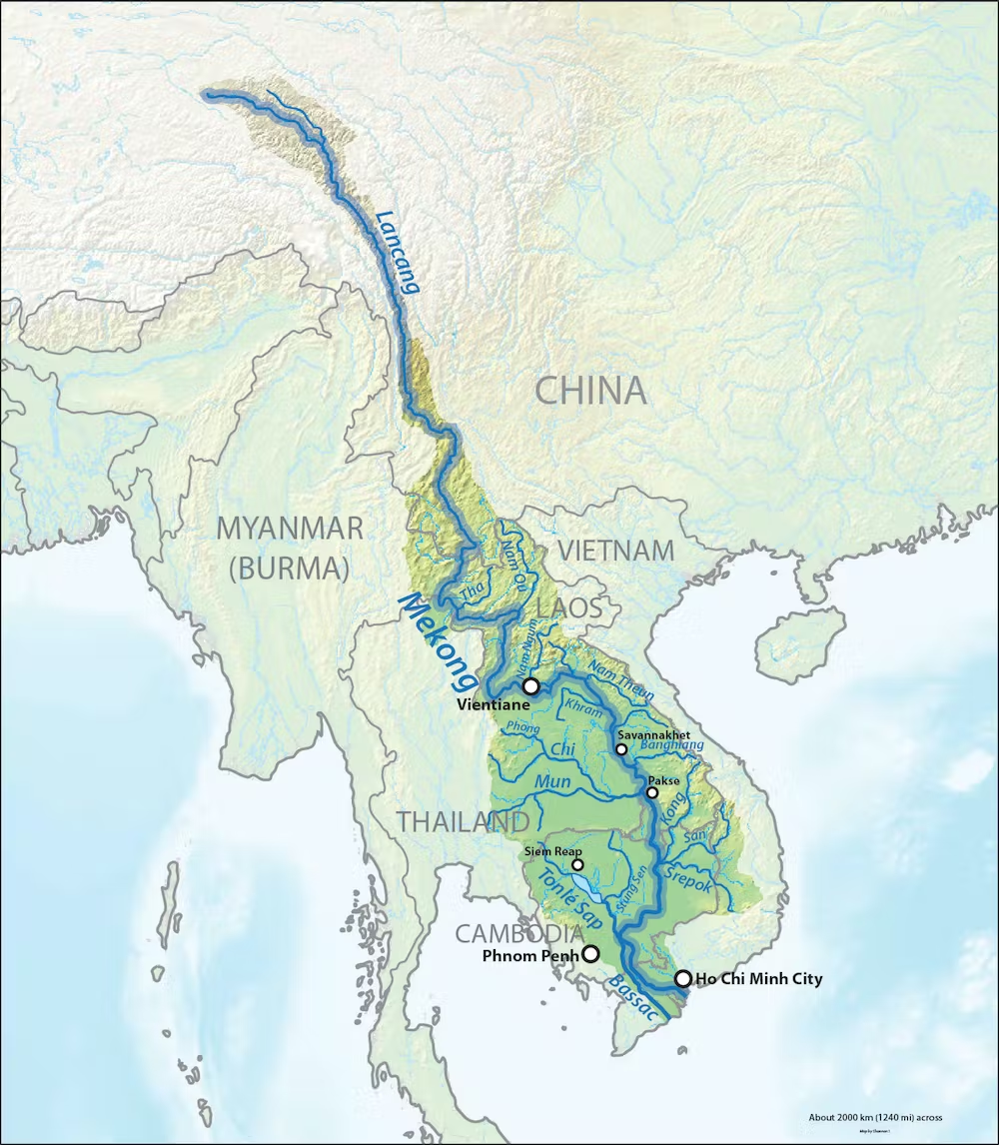
Overview
Simulated flood-induced* displacement within a rural, flood-prone province
Country: Việt Nam
Subregion: Mekong Delta
Province: Long An
Goal: Model 10 individuals’ path as they try to leave their inundated province
Treated people as “particles” in the 2 dimensional, finite state of Việt Nam and tracked each individual’s daily displacement.
*Title slide says climate-induced because the ultimate goal of this project is to scale this pilot model across many years. For this initial phase, I only modeled the 2011 floods, which is technically using weather data.
Source: Wikimedia

Slide 4
Model Design
Methods:
Random Walks
Markov Chains
Each individual’s velocity is controlled by:
a Markov Chain
whether the daily total precipitation and runoff thresholds were exceeded (i.e., if flood conditions are met)
their direction is uniformly distributed over the half-open interval [0, π) through NumPy random sampling
Data:
European Center for Medium-range Weather Forecasting (ECMWF)’s ERA5 reanalysis: 2011 Climate Data
daily total precipitation (m) and runoff (m) (resampled from hourly)
Vietnam General Statistics Office: annual provincial out migration rate data (per mille)
Post-flood behavioral interviews conducted on Việt Nam residents by news outlets or the UN

Slide 5
Markov Chains
A stochastic process {X_{n}} is a Markov Chain if
p(X_{n-1},X_{n-2},…,X₀) = P(X_{n} = x | X_{n-1})
where p denotes probability and x ∈ S.
For a finite state space, a random walk can be represented as a Markov Chain (MC).
The transition matrix is a critical component of MCs–for a finite state space, it arranges the probability of an individual moving from one state to another (known as the transition probability) into a matrix. The transition probabilities can and often do differ between different states.
The transition matrix P has transition probabilities p_{ij}, which are the probabilities of transitioning from state i to state j. Each row in P is a probability mass function (PMF), which states
∑ p_{ij}=1

Slide 6
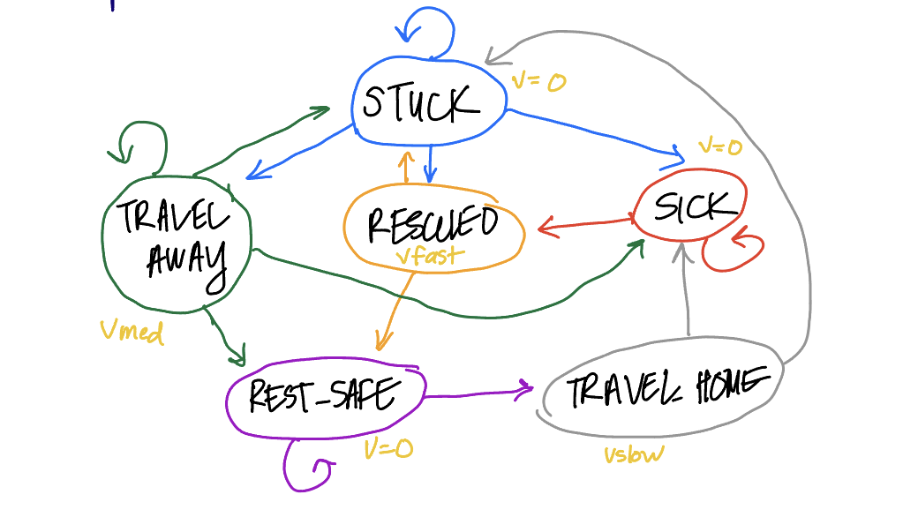
Markov Chain Design
 | Stuck | Rescued | Travel_away | Travel_home | Sick | Rest_safe
Stuck | 0.55 | 0.15 | 0.15 | 0.00 | 0.15 | 0.00
Rescued | 0.50 | 0.00 | 0.00 | 0.00 | 0.00 | 0.50
Travel_away | 0.25 | 0.00 | 0.25 | 0.00 | 0.25 | 0.25
Travel_home | 0.75 | 0.00 | 0.00 | 0.00 | 0.25 | 0.00
Sick | 0.00 | 0.25 | 0.00 | 0.00 | 0.75 | 0.00
Rest_safe | 0.00 | 0.00 | 0.00 | 0.25 | 0.00 | 0.75
My Markov Chain on the potential states an individual can have in this simulation and their associated velocity for each state. States were determined from behavioral interviews on Việt Nam residents by news outlets and the UN.
My transition matrix P with the transition probabilities p_{ij}.

Slide 7
Final Version

Slide 8
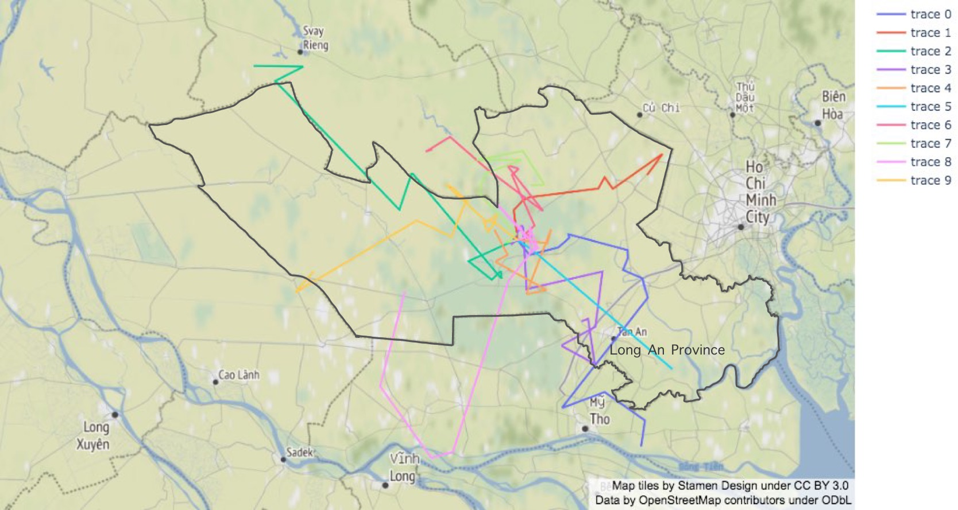
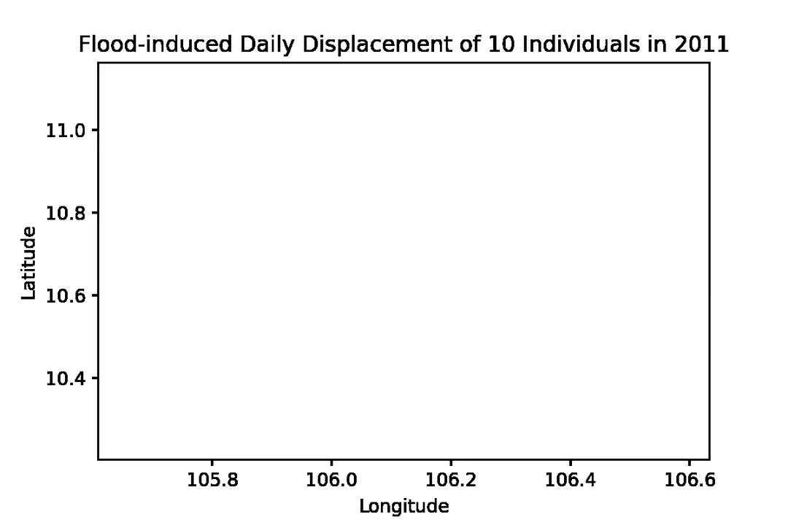
Path taken depends on each individual’s Markov Chain
Map View
Simulation

Slide 9
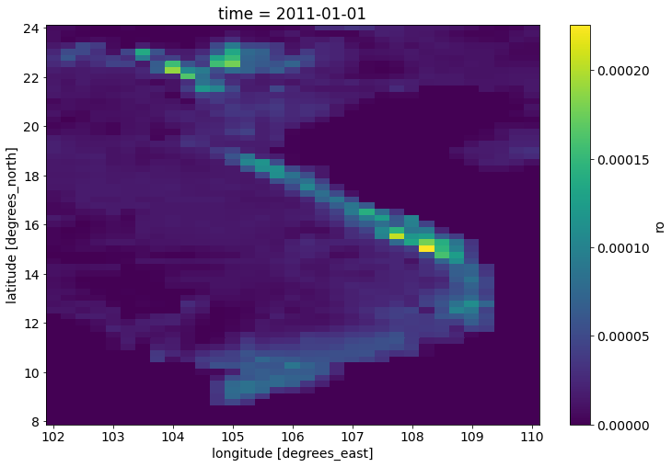
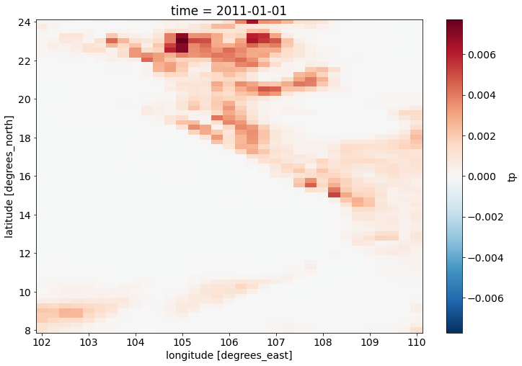
Why the slow initial migration?
Since migration depends on whether flood criteria (i.e., runoff and total precipitation thresholds) are met, let’s look at t=0. In the province of Long An in Southern Việt Nam, there were low-levels of both.
Runoff (m)
Total Precipitation (m)

Slide 10
Initial Version
Model 10 individuals’ path as they try to leave their inundated province
Individual velocity = faster closer to the center of the flood and slower farther away
Method: Random Walks

Slide 11
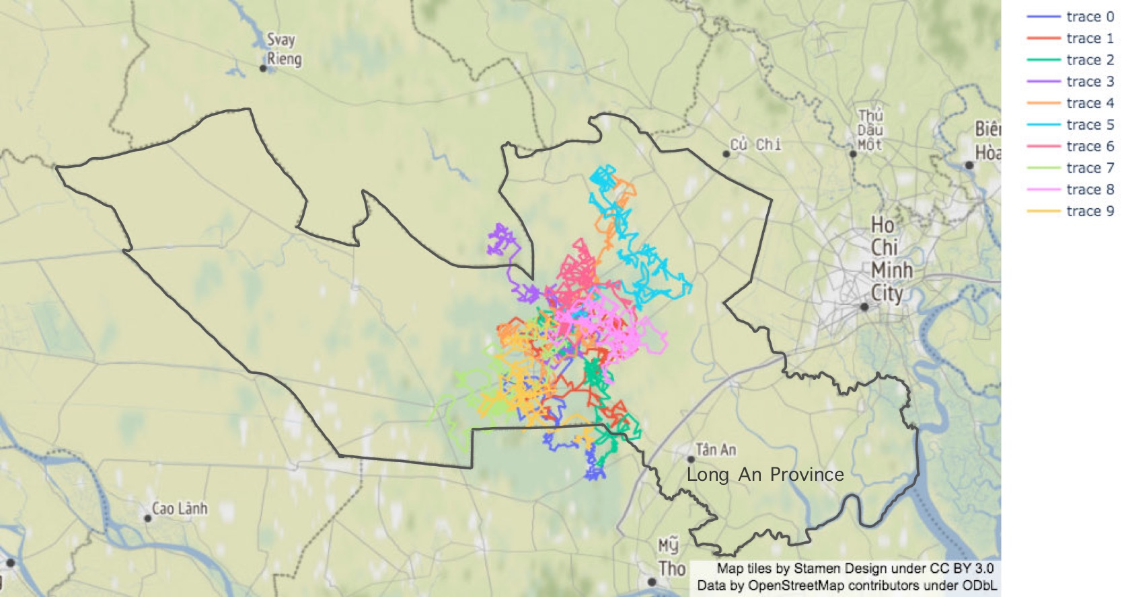

Slide 12
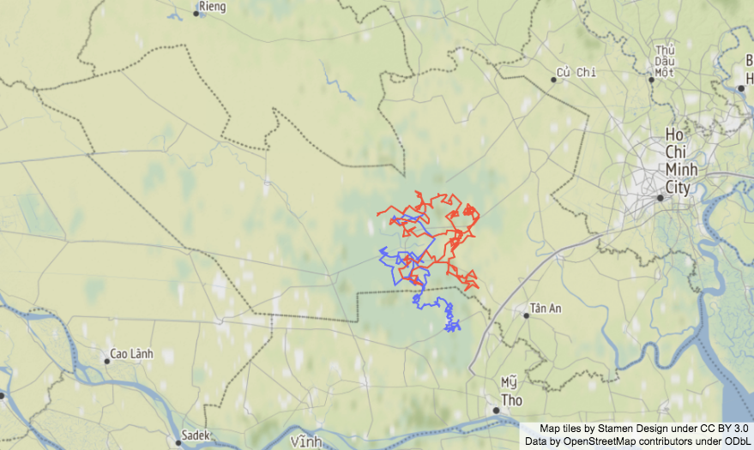
Discussion: Close-up
Inter-Provincial Displacement of Individual 0
Velocity (km/min) decreases once they cross into a flood-free zone
Implication: Less urgency, more likely to settle in between locations
Intra-Provincial Displacement of Individual 1
Within a flood-zone, velocity is maintained and constant displacement occurs
Implications: They’re unable to secure shelter or safety in every location.

Slide 13
Refining the Model
Improve flood parameters. Current thresholds are arbitrarily set.
Include topographical information. Individuals will avoid uninhabitable and uncrossable terrains (e.g., mountains, rivers).
Adding more realistic constraints on movement (i.e., more thorough behavioral interviews required).
Scale to multi-province populations and analyze ensemble behavior rather than individual behavior.
Compare results with non-Việt Nam studies (wasn’t able to find any in Việt Nam) and determine accuracy.

Slide 14
References
[1] Dilley, M. et al. (2005). Natural Disaster Hotspots : A Global Risk Analysis, World Bank Publications. ProQuest Ebook Central, http://ebookcentral.proquest.com/lib/berkeley-ebooks/detail.action?docID=3050779
[2] Seneviratne, S.I., N. Nicholls, D. Easterling, C.M. Goodess, S. Kanae, J. Kossin, Y. Luo, J. Marengo, K. McInnes, M. Rahimi, M. Reichstein, A. Sorteberg, C. Vera, and X. Zhang, 2012: Changes in climate extremes and their impacts on the natural physical environment. In: Managing the Risks of Extreme Events and Disasters to Advance Climate Change Adaptation [Field, C.B., V. Barros, T.F. Stocker, D. Qin, D.J. Dokken, K.L. Ebi, M.D. Mastrandrea, K.J. Mach, G.-K. Plattner, S.K. Allen, M. Tignor, and P.M. Midgley (eds.)]. A Special Report of Working Groups I and II of the Intergovernmental Panel on Climate Change (IPCC). Cambridge University Press, Cambridge, UK, and New York, NY, USA, pp. 109-230
[3] United Nations (2015). Transforming Our World: The 2030 Agenda for Sustainable Development. New York: UN Publishing.
[4] IPCC (2007). Climate Change 2007: Synthesis Report. Contribution of Working Groups I, II and III to the Fourth Assessment Report of the Intergovernmental Panel on Climate Change [Core Writing Team, Pachauri, R.K and Reisinger, A. (eds.)]. IPCC, Geneva, Switzerland, 104 pp.
[5] International Organization for Migration (2014). Outlook on Migration, Environment and Climate Change. Link.
[6] Bangalore, M., Smith, A. & Veldkamp, T. (2019). Exposure to Floods, Climate Change, and Poverty in Vietnam. EconDisCliCha 3, 79–99. https://doi.org/10.1007/s41885-018-0035-4
[7] https://github.com/non-ceterisparibus/Vietnam-development-map

