Slide 1
How a "cold Jupiter" becomes a "hot one"?
Runyi Liu

Slide 2
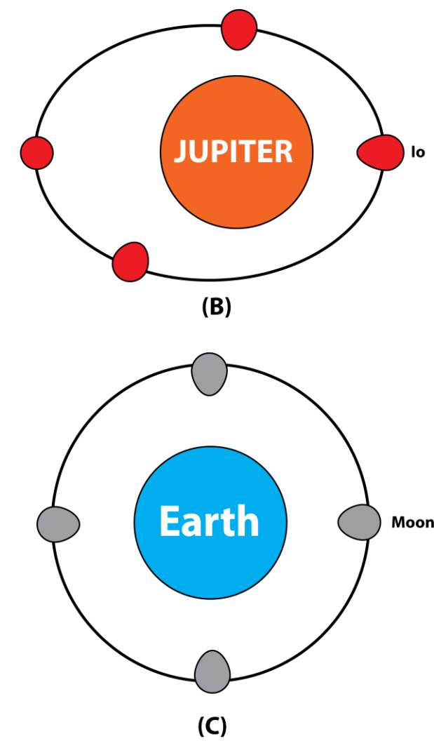
Topic & Method
Topic:
Orbit evolution by eccentricity tide from a 5AU circle
to ~0.1AU circle
Method
Simulation: Solve ODE with Runge – Kutta method
Physics:
Sudden deceleration at first
***Tidal dissipation process then (i) keeps angular momentum constant (ii) decreases the orbit energy (iii) makes it related to orbit’s eccentricity

