Slide 1
EPS 109 Final Project:
Can You Beat Alpha Tic-Tac-Toe?
By: JinWoo Ahn

Slide 2
Sources Used for Understanding the Logic
https://gsurma.medium.com/tic-tac-toe-creating-unbeatable-ai-with-minimax-algorithm-8af9e52c1e7d
https://www.geeksforgeeks.org/minimax-algorithm-in-game-theory-set-3-tic-tac-toe-ai-finding-optimal-move/
https://realpython.com/tic-tac-toe-ai-python/
https://www.youtube.com/watch?v=KU9Ch59-4vw
+ to run the program, just run the “main” file.

Slide 3
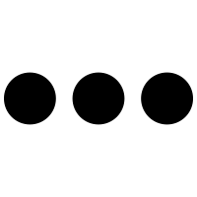
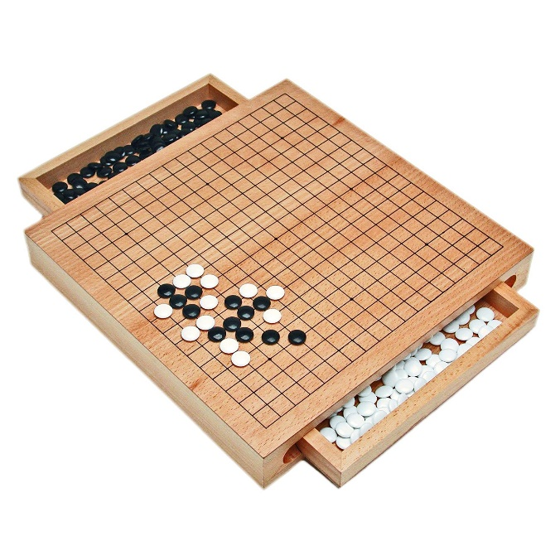
In 2015…
AlphaGo beats European Go champion Fan Hui to become the first program to beat a professional Go player.
In 2015…
Shortly after publishing the technical details on Nature, AlphaGo creators confidently claim that no human will be able to beat AlphaGo
In 2014…
Google experiments with using neural networks to create AlphaGo
In 2016, AlphaGo team agrees to perform a match against the 18-time Go world champion
Lee Sedol
Despite the world champion’s confidence, he loses 4 out of 5 games. However, he currently stands the only human who has beaten AlphaGo.

Slide 4
Let’s Dumb It Down!
What I am NOT doing is
(and probably can’t anyways)
Fine-tune a whole new Deep Learning model using neural networks that performs better than AlphaGo
What I AM doing, instead:
Use a simple decision-making algorithm called “Minimax” to create a Tic-Tac-Toe AI that never loses!

Slide 5
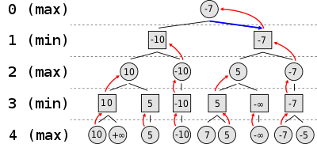
What Is “Minimax?”
Some of you might have heard of decision trees in data science.
If not?
Then Too bad! don’t worry!
The algorithm goes like this:
There are two players, circle and square.
At a circle, you will always choose the bigger number.
At a square, you will choose the smaller number.

Slide 7
Final Thoughts…
The algorithm seems pretty simple when I explain it, but it requires ~50 lines of code alone.
The program looks pretty simple as well, but it requires ~350 lines of code.
The program is unbeatable but we are.
We make mistakes; the program does not. Because this is a simple game, with no mistakes, you will always tie.

Slide 8
☺

