Slide 1
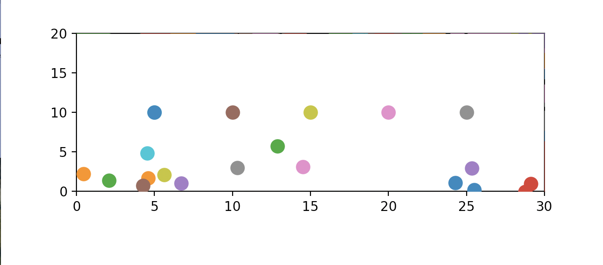
Falling Balls Probability
By Juan Carlos Martinez

Slide 2
What my project is?
Simulating Balls falling with gravity
Seeing where they fall and creating histogram to see probability
Adding obstacles to interfere
Using Random Walks and some physics simulation I simulated random balls falling with gravity

Slide 3
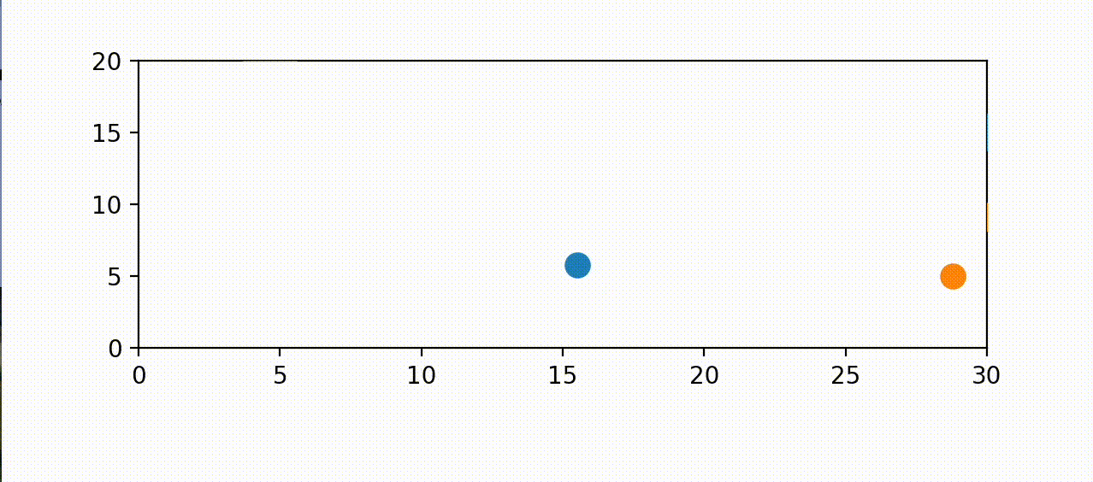
This is a video of two random balls just falling

Slide 4
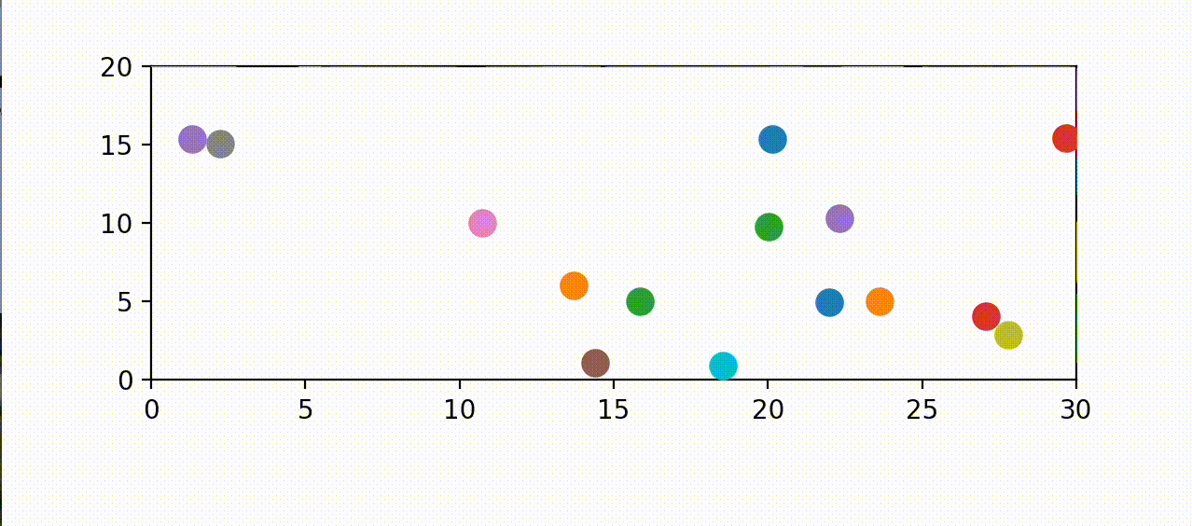
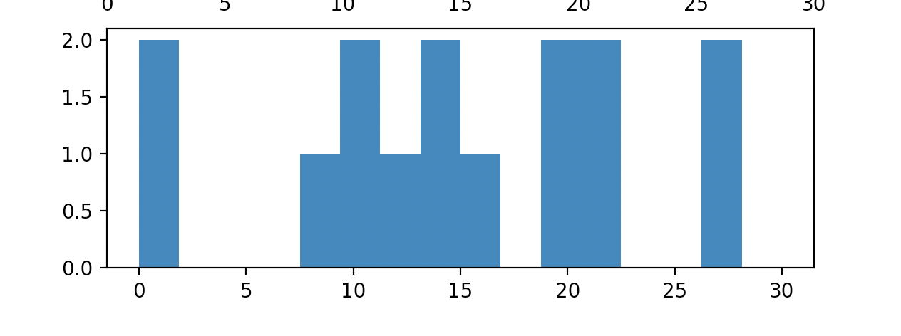
Random Balls
Using a class function and a randomizer I created
random ball instances with different initial positions

Slide 5
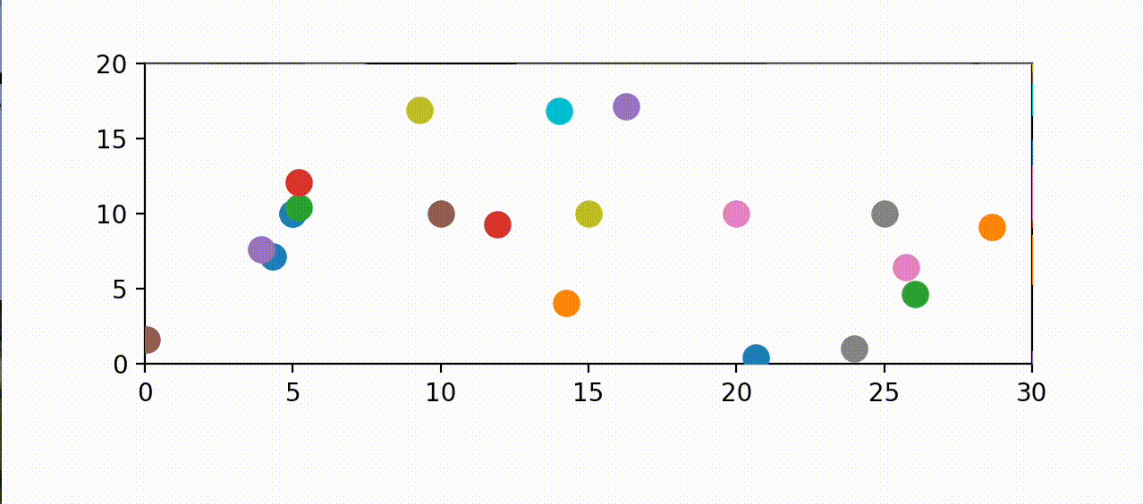
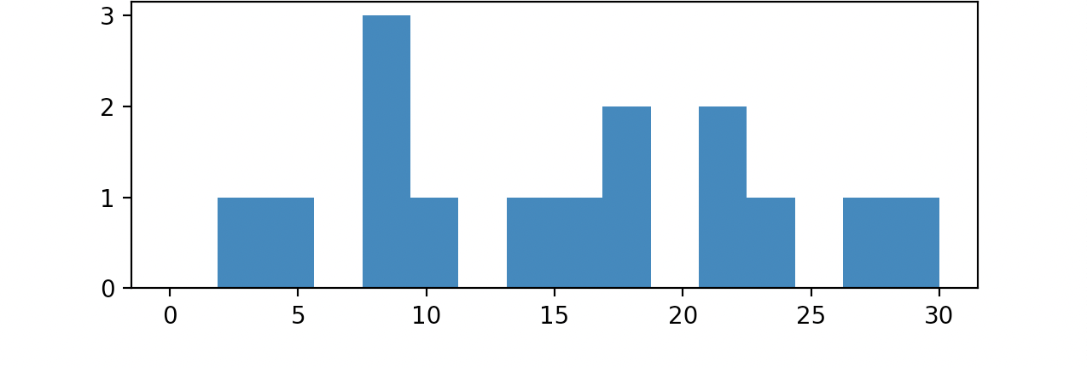
Obstacles
Created another class for obstacles which interfered with the balls falling,
creating different probabilities

Slide 6
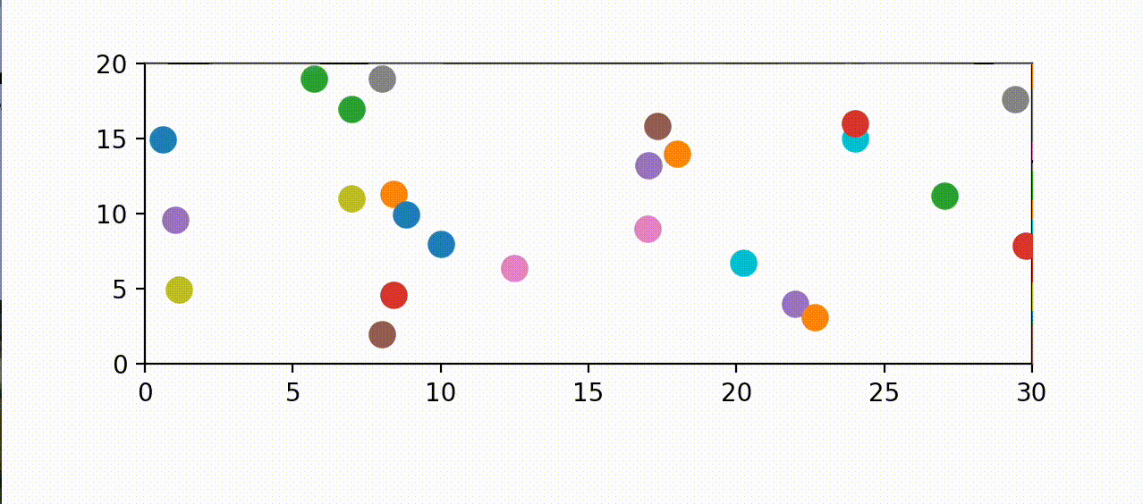
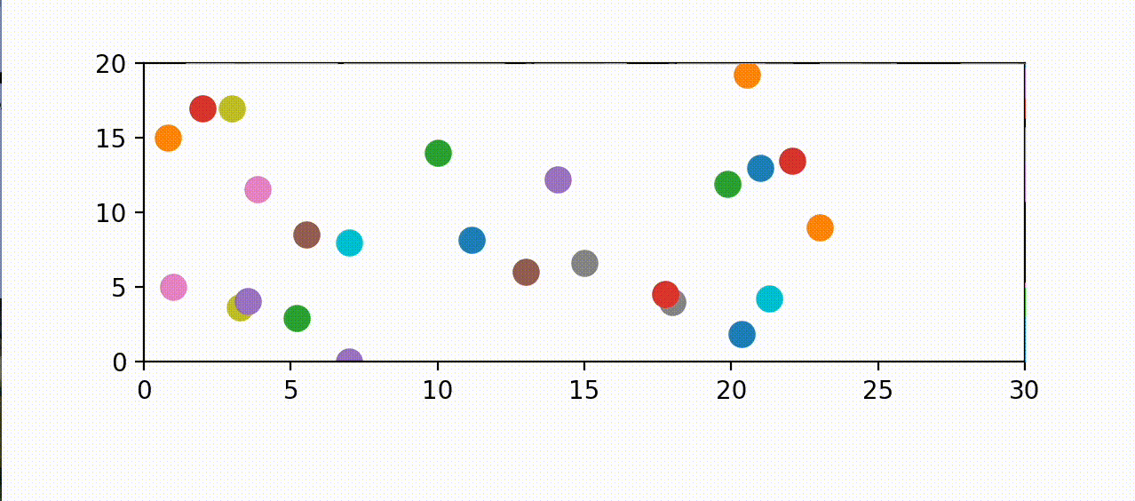
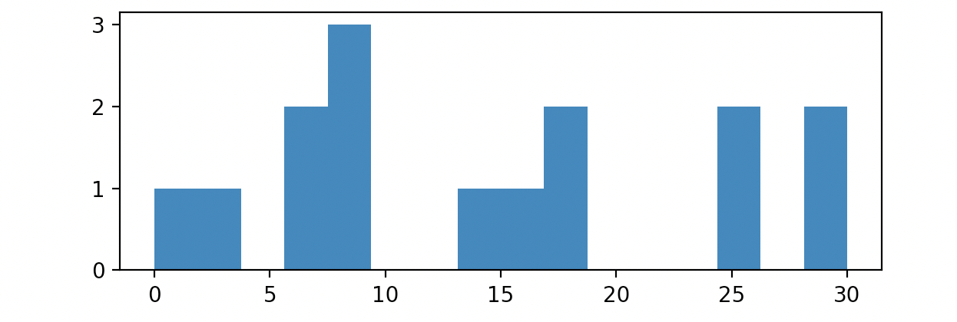
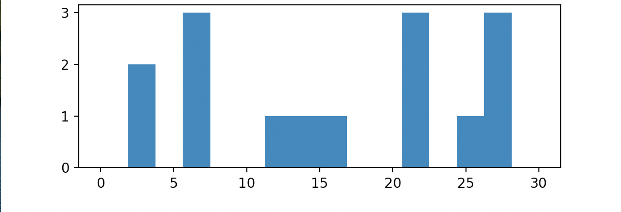
Random Obstacles
Using the same np random library I made random obstacles which again just interfered with the balls falling.

