Slide 1
The growth and decay of moss over a surface with varying concentrations of nutrients
Tyler McNierney

Slide 2
Project: Simulating the Growth and Decay of Moss
Goal: Simulate the growth and decay of moss/weed on a terrain with limited nutrients.
Steps:
Implement diffusion limited aggregation on a sticky wall to simulate the growth of moss.
Create a `nutrientLevels` matrix that represents the level of nutrients at each point of the terrain for every timestep
Incorporate this matrix into the condition that turns on a pixel in the `A` matrix
Develop an algorithm that “plucks” out moss/weed that are growing at points with no more nutrients

Slide 3
Step 1: DLA
r = np.random.random() if r <= 0.25: y = y + 1 elif r <= 0.5: y = y - 1 elif r <= 0.75: x = x + 1 else: x = x - 1 ... xp = x + 1 if xp >= maxX: xp = maxX - xp xm = x - 1 if xm < 0: xm = maxX + xm yp = y + 1 if yp >= maxY: yp = maxY - yp ym = y - 1 if ym < 0: ym = maxY + ym n = int(mossMatrix[xp, y] == 1) + int(mossMatrix[xm, y] == 1) + int(mossMatrix[x, yp] == 1) + int(mossMatrix[x, ym] == 1) currStickingProb = stickingProb if n >= 2: currStickingProb = 1 sticking_p = np.random.random() if sticking_p < currStickingProb: if (mossMatrix[xp, y] == 1 or mossMatrix[xm, y] == 1 or mossMatrix[x, yp] == 1 or mossMatrix[x, ym] == 1): mossMatrix[x, y] = 1 ...

Slide 4
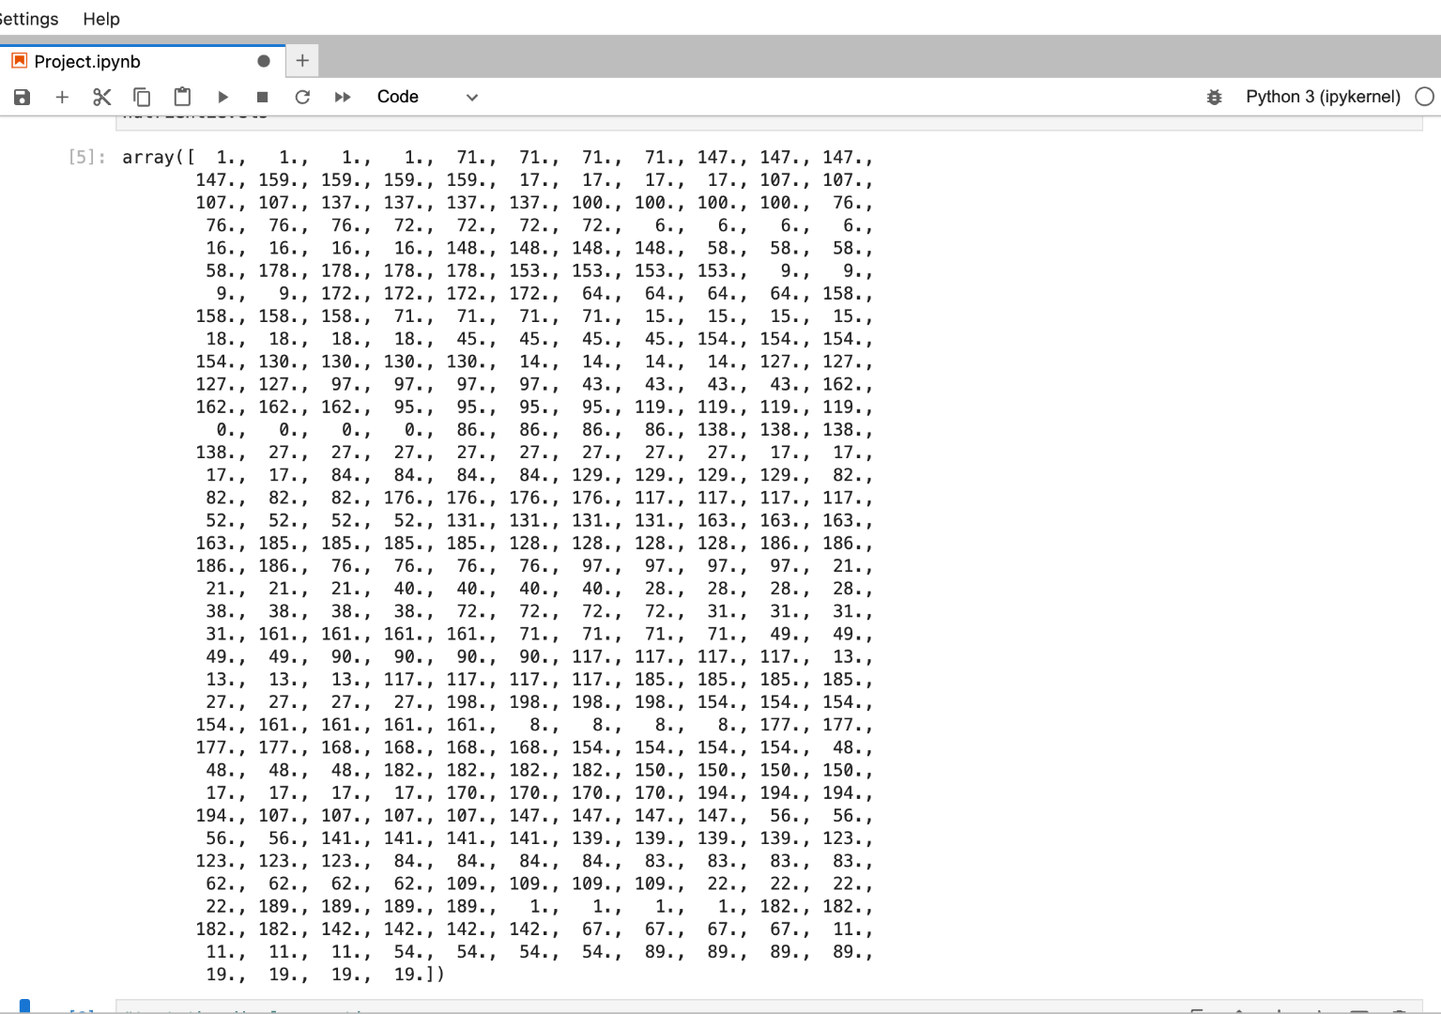
Step 2: `nutrientLevels` Matrix
from numpy import random randomLevels = random.randint(200, size=(maxX // 4)) # Create a layer of nutrients that has different concentrations of nutrients every # 4 units of length nutrientLevels = np.array([]) for num in randomLevels: segment = np.array([num, num, num, num]) nutrientLevels = np.concatenate((nutrientLevels, segment))

Slide 5
Step 3: Incorporate matrix into DLA
if (mossMatrix[xp, y] == 1 or mossMatrix[xm, y] == 1 or mossMatrix[x, yp] == 1 or mossMatrix[x, ym] == 1): depletion = 1 + y x_pos, path = findRoot(x, y) nutrientLevels[x_pos] = max(0,
nutrientLevels[x_pos] - depletion) if (nutrientLevels[x_pos] > 0): mossMatrix[x,y] = 1 else: for coord in path: mossMatrix[coord[0], coord[1]] = 0
Nutrient depletion is calculated by the height of the moss particle; taller moss/weed will require more nutrients
A single weed will continue to grow so long as the nutrient level at its location is still positive

Slide 6
Step 4: Develop root-finding algorithm
def findRoot(x, y): path = [[x, y]] while y != 0: xp = x + 1 if xp >= maxX: xp = maxX - xp xm = x - 1 if xm < 0: xm = maxX + xm yp = y + 1 if yp >= maxY: yp = maxY - yp ym = y - 1 if ym < 0: ym = maxY + ym if mossMatrix[x, ym] == 1 and [x, ym] not in path: path.append([x, ym]) y = ym elif mossMatrix[xp, y] == 1 and [xp, y] not in path: path.append([xp, y]) x = xp elif mossMatrix[xm, y] == 1 and [xm, y] not in path: path.append([xm, y]) x = xm elif mossMatrix[x, yp] == 1 and [x, yp] not in path: path.append([x, yp]) y = yp else: # Stranded moss particles, abort break return x, path
This algorithm attempts to locate the pixel along the sticky wall that’s rooting an individual weed
The path taken to locate the root is recorded, which is then used to eradicate most of the weed when it decays

Slide 7
Final results

Slide 8
Normal DLA
DLA with half the terrain devoid of nutrients
Moss growth & decay with scarce nutrients
Moss growth & decay with abundant nutrients

Slide 9
Future Improvements
findRoot algorithm: Currently, this algorithm does not pick up every particle along an individual weed because the path it takes to the root isn’t exhaustive.
Devise a separate algorithm that takes in the root and perhaps recursively traces all of its branches
Color coding: While dead weeds are currently removed, it’d be easier to distinguish healthy ones from dying ones by different shades of green and brown.
Replenishing nutrients, adding water, etc: Make this simulation more representative of reality by adding more natural elements.

Slide 10
Thank you!
Any questions?

