Slide 1
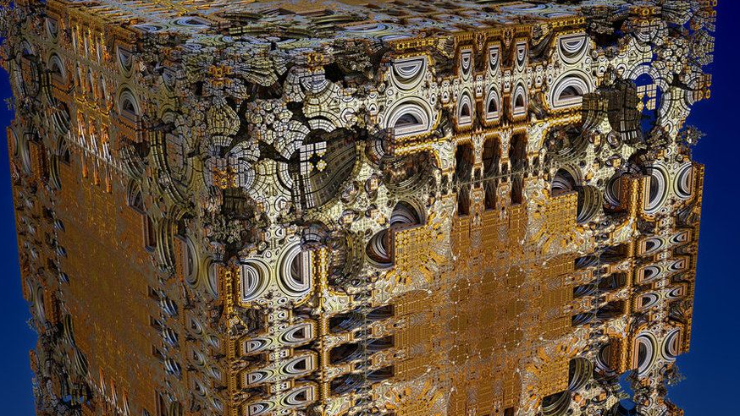
THINKING INSIDE THE MANDELBOX
ANGELA CHENG

Slide 2
Mandelbox Description, Generation, and Animation
A Mandelbox is a map of continuous Julia sets and is defined as the following:
For every component in the vector, if the value is greater than 1, replace it with 2 minus that value, and if the value is less than -1, replace it with -2 minus that value
The Mandelbox can be defined in any number of dimensions
Animation1 shows the 2D Mandelbox from scales -1.5 to 1.5
Animation2 shows a 2D slices of a 3D Mandelbox at scale = -1.5
For the fractal image generation, if the magnitude of the transformed vector is greater than 10 before iterating over this function 250 times, we assume it diverges and we save the number of iterations it diverged at for the value at that poisiton. Otherwise, if we iterate this function 250 times and the value is still less than 10, we assume it doesn’t diverge and save the value at that position as 0 or False.

Slide 3
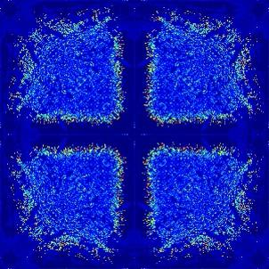
Animation
2D Mandelbox. Lower res to get shorter computing time.
2D slices of 3D Mandelbox. Took 10 hours to generate!

