Slide 1
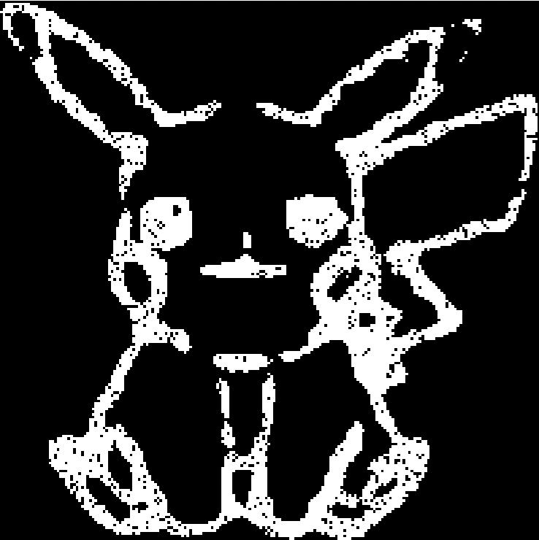
Pokémon Evolutions
Laura Pei

Slide 2
Topics & Methods:
Use image processing to convert images to binary arrays and manipulate them later
Use random walks to transform and move each pixel around
Algorithm:
Process images, find appropriate thresholds, set as inputs
Random walks repeat up until it reaches its final state
Goal: Create an animation that simulates the evolving of Pokemon from one evolution stage to another.

Slide 3
Animations
Evolution 1:
Pichu → Pikachu
Parameters: 200x200 pixels

Slide 4
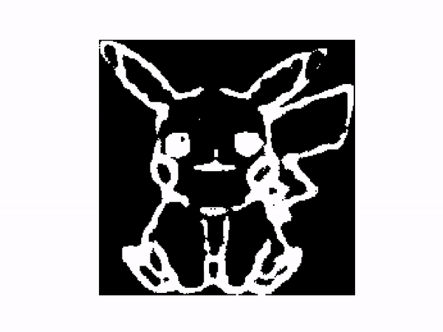
Animations
Evolution 2:
Pikachu → Raichu
Parameters: 200x200 pixels

Slide 5
Animations
Evolution 3:
Charmander → Charmeleon
Parameters: 200x200 pixels

Slide 6
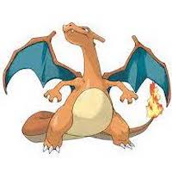
Animations
Evolution 4:
Charmeleon → Charizard
Parameters: 200x200 pixels

Slide 7
Thank you!

