Slide 1
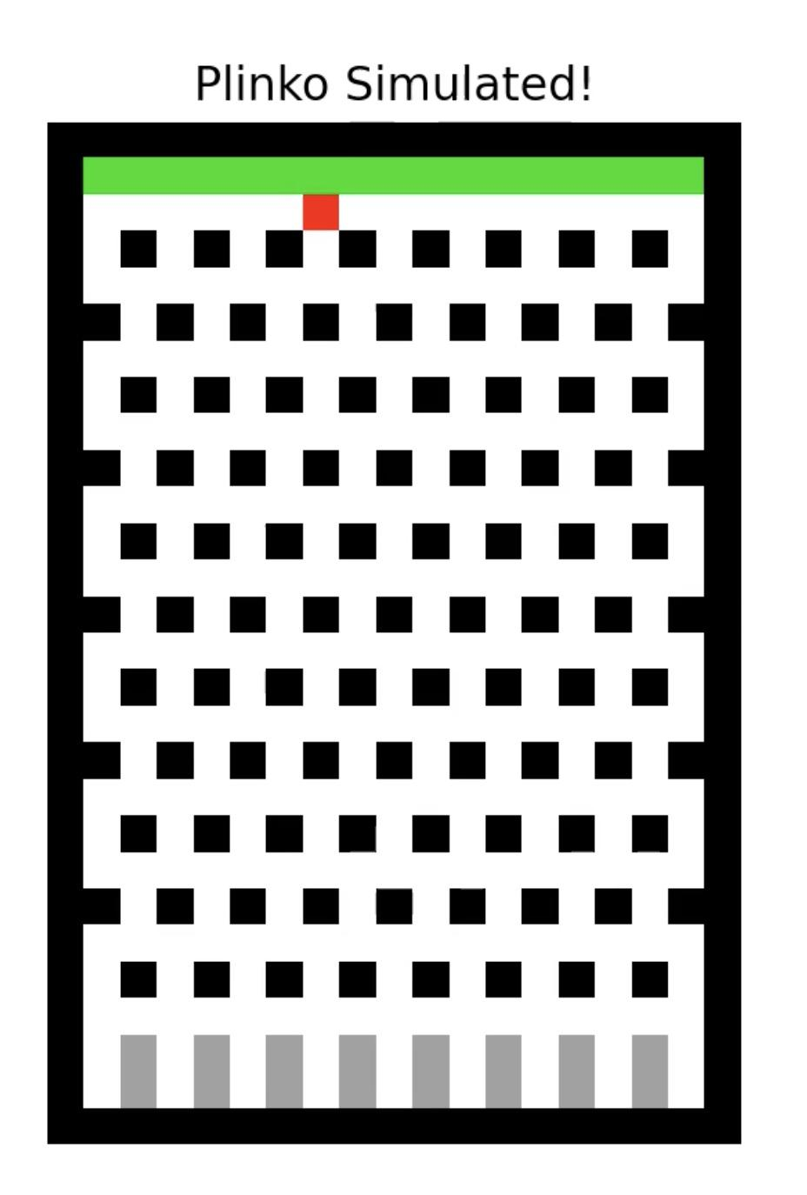
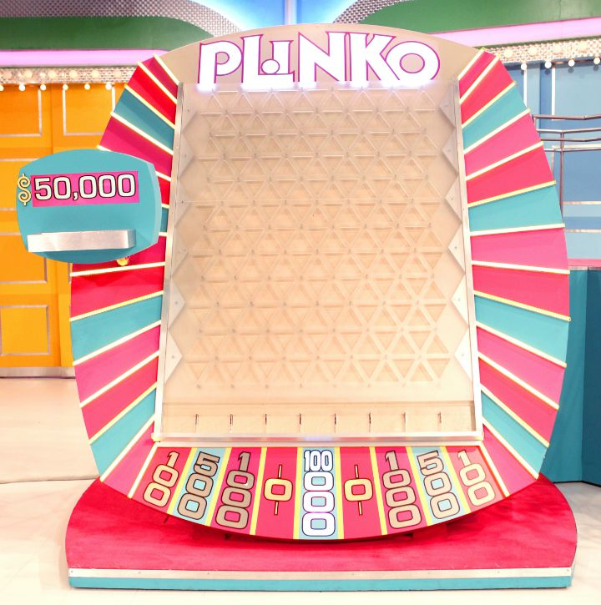
Plinko Simulated!
Jeffrey Chen

Slide 2
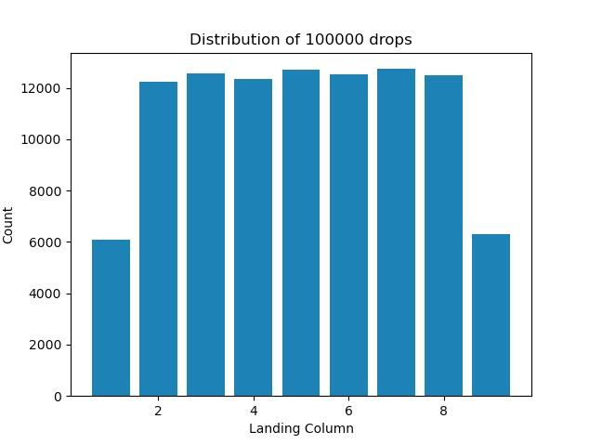
Methods
Emulate Plinko from The Price is Right TV show
Random walk to simulate the ball randomly changing direction when hitting an obstacle
Simulate 100K drops to explore distributions and drop strategies

Slide 4
extra information
required to upload all jupyter notebooks, py files, data files
more than 1 ipynb file: say instructions on slide 2
also cite sources on slide 2
youtube.txt description - 1 short paragraph that describes animation in simple terms
use “_” in file names
place file data.txt in the same directory as jupyter notebook (keep everything together)
upload animation(s) as a SEPARATE mp4 file as well
animation1.mp4, animation2.mp4, etc
high resolution but smaller than 25 MB
gif format -> use imagemagick convert or imageJ to produce animation file

