Slide 1
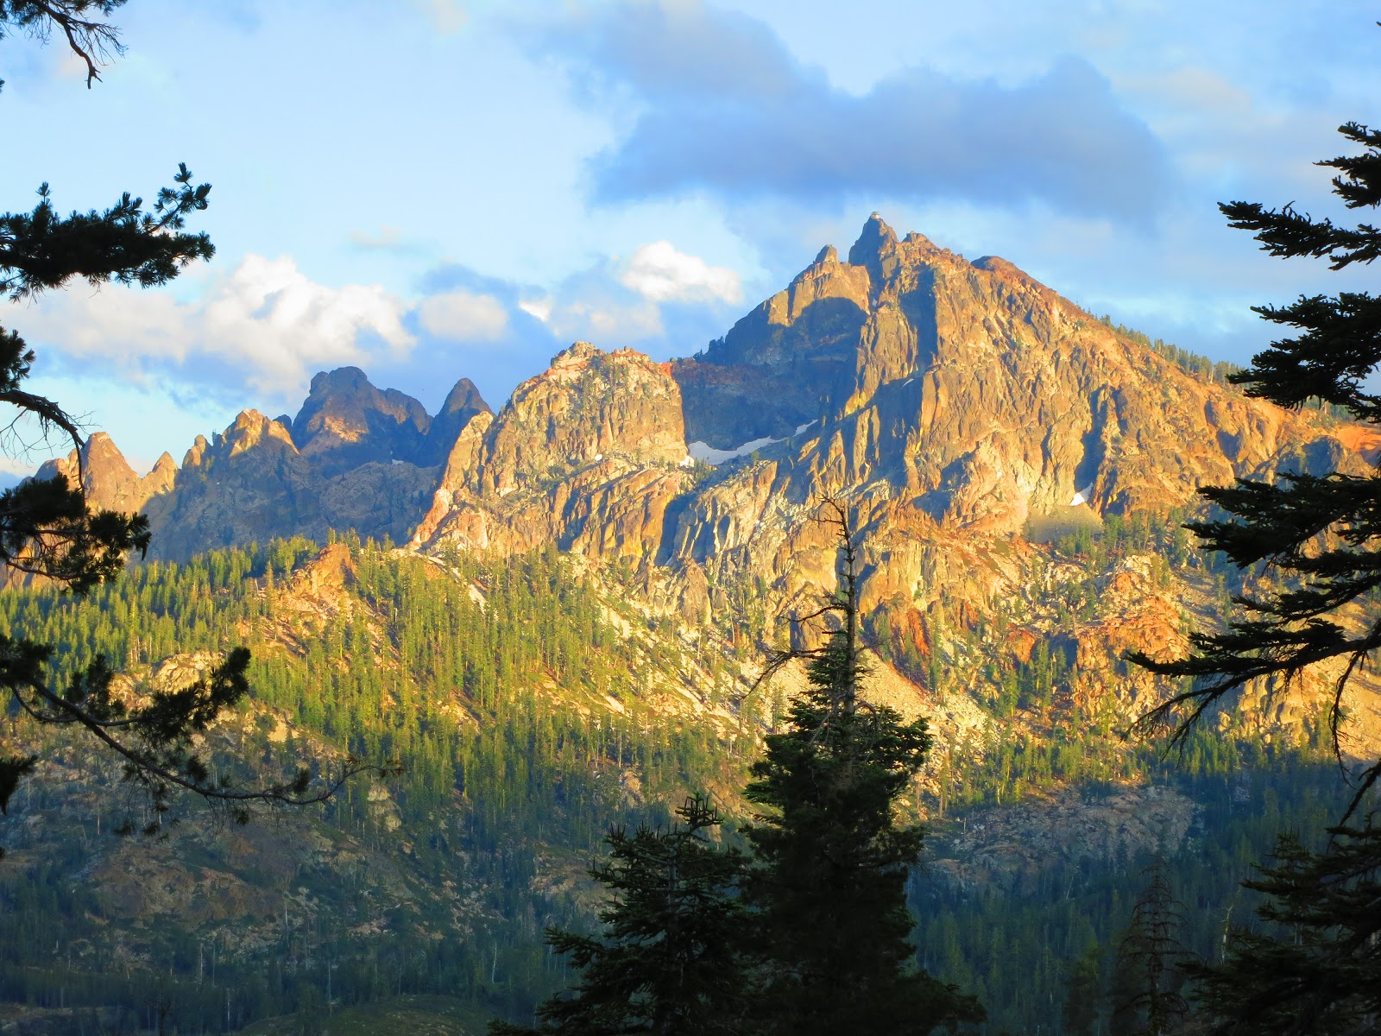
Creating A landscape with fractals and random numbers By Joanna Hardesty
Photo credit: https://russmease.blogspot.com/2012/10/day-85-sierra-buttes-fire-tower.html

Slide 2
How Fractals can be used to make a landscape
In the first iteration the code decides whether to create a peak or dip in elevation and creates one pyramid with a randomly assigned elevation (within a specified range).
The following iterations loop through and smooth out the topography using random number generation and the average elevation values of nearby areas.
With successive iterations the grid squares are divided into smaller fractions and the elevation calculations are repeated.
Ocean surface fraction is also calculated and displayed.
Code used from: Github user dafarry and Dr. Millitzer: “landscapeWithOcean.py”

