Slide 1
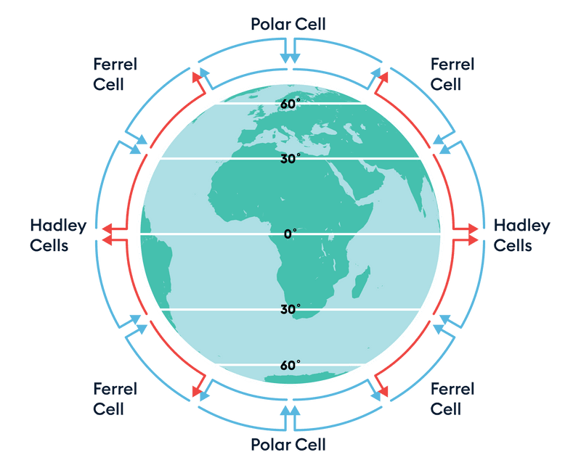
Advection-Diffusion Equation Atmospheric Model
Brian Alvarado Cruz
Eps 109, Fall 2022

Slide 2
Advection and Diffusion PDEs and FDEs
Chapter 3 of Atmospheric Modeling, Data Assimilation and Predictability (Kalnay 2002)
Advection-Diffusion equation:$\frac{∂u}{∂t}+c\frac{∂u}{∂x}=σ\frac{∂^{2}u}{∂x^{2}}$
c = velocity (m/s) (written as v), $σ$ = thermal diffusivity (m²/s) (often written as k)
Initial conditions, u, can be a wave, a gaussian, etc. (ex. u = Asin(x*pi))
Solve and model in code using finite difference equation (FDE)
Upstream scheme: $\frac{U_{j}^{n}−U_{j}^{n−1}}{∆t}+μ\frac{U_{j}^{n−1}−U_{j−1}^{n−1}}{∆x}=κ\frac{U_{j−1}^{n−1}−2U_{j}^{n−1}−U_{j+1}^{n−1}}{∆x^{2}}$
Notes:
Advection: Transfer of matter or energy by a fluid, normally horizontally
Diffusion: The movement of matter or energy from a place of high density to a place of lower density
Add them together to get the combined advection-diffusion equation
The initial conditions can be a wave, such as a sin wave, a gaussian, etc. Basically, anything that has a solution that can represented by a wave equation
One way to numerically solve this and therefore model it in a programming software like python is by using the finite difference method.
In my project I have modeled and produced animations for this upstream scheme corresponding to different initial conditions. One thing I should mention is that when looking at advection only, you set sigma equal to 0. When looking at diffusion only, you set c equal to zero. That’s because of the definitions of advection and diffusion that I just gave a few moments ago.

Slide 3
Advection-Diffusion of a gaussian along an equator
Advection of a wave along an equator
Diffusion of a gaussian along an equator
Notes:
Now on to the animations. The first plot shows how a wave changes as it moves horizontally along the circumference of the earth at the equator. I just picked this wave right here as an example. There is no diffusion, only advection, which is why its only showing horizontal change. The second plot shows a standing wave, in this case a gaussian, as it changes over time in the same latitude. Since the simple wave initial condition only works for the advection model, I have to chose a different initial condition that would satisfy the diffusion model. And finally, the third plot shows how a gaussian changes as it advects along the equator while simultaneously experiencing diffusion. All of these plots show the upstream scheme of a finite difference equation, but there are other schemes that are shown in the book.

Slide 4
References
Kalnay, E., & Eugenia, K. (2003). Atmospheric modeling, data assimilation and predictability. Cambridge University Press.
Fung, I. (2022, October 11). Numerical Considerations [PDF document].

