Slide 1
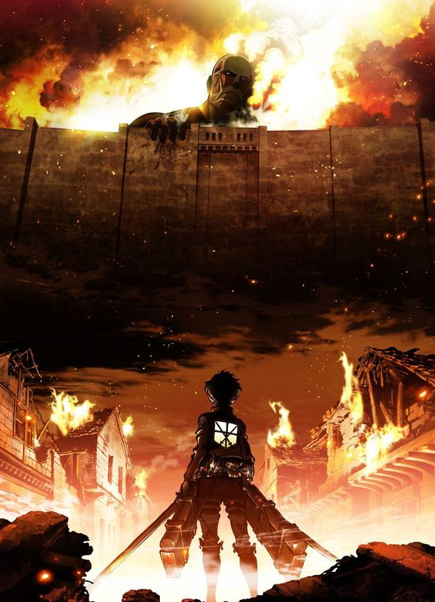
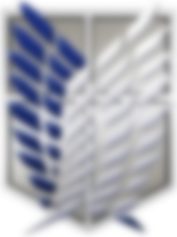
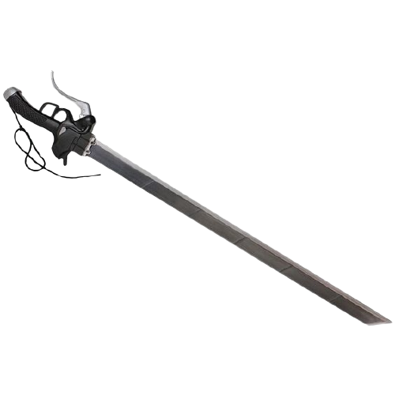
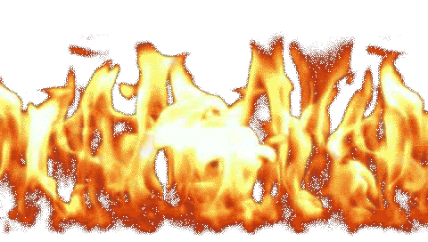

Slide 2
Escape The Titans
Escape The Titans

Slide 3
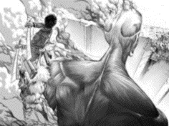
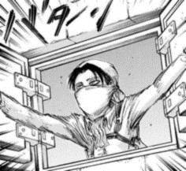
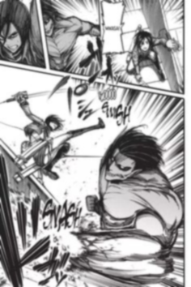
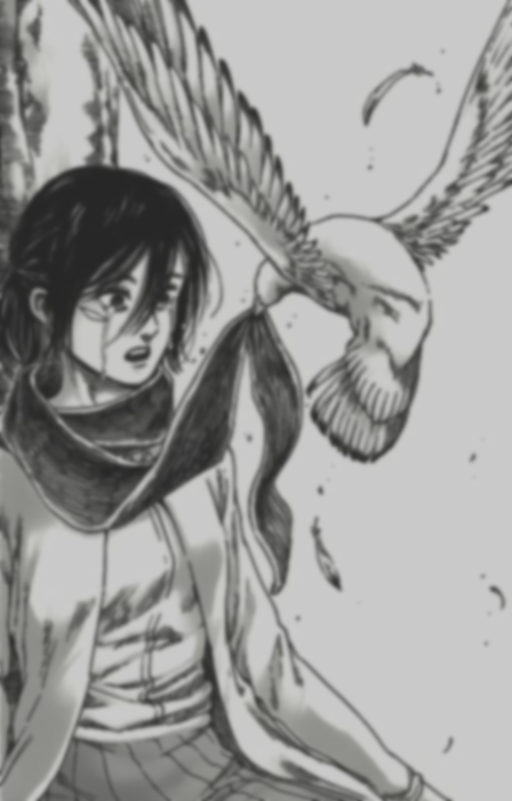
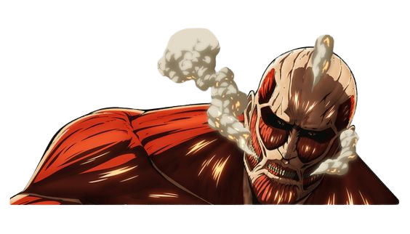
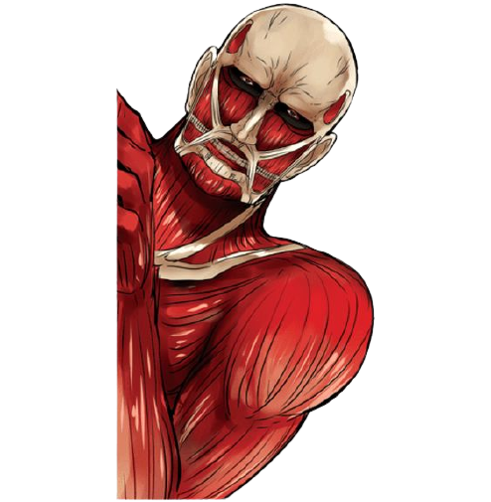
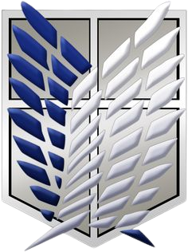
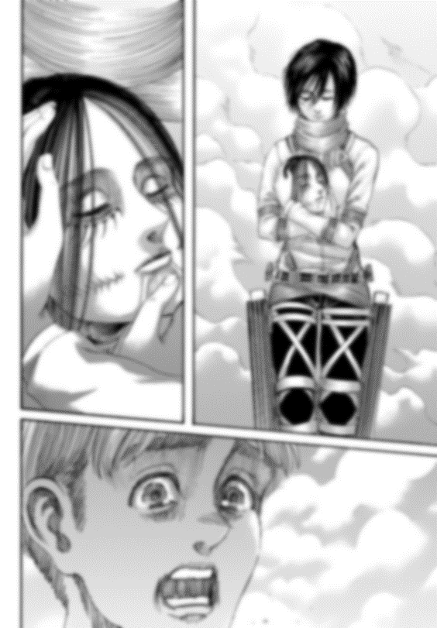
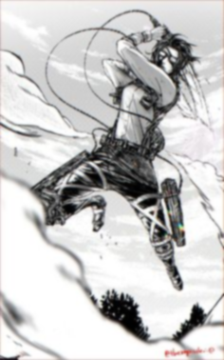
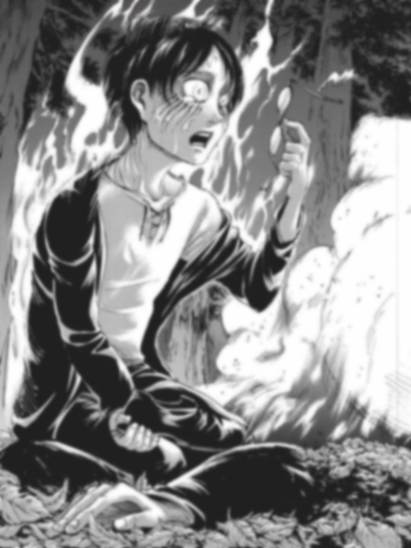
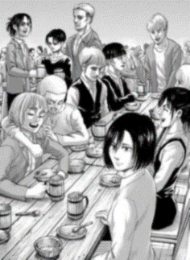
Background
Background
Attack on Titan (Japanese: 進撃の巨人, Hepburn: Shingeki no Kyojin, lit. "The Advancing Giants") is a Japanese manga series written and illustrated by Hajime Isayama. It is set in a world where humanity lives inside cities surrounded by three enormous walls that protect them from the gigantic man-eating humanoids referred to as Titans; the story follows Eren Yeager, who vows to exterminate the Titans after a Titan brings about the destruction of his hometown and the death of his mother.

Slide 4
More on Titans
More on Titans
Titans Random Moving
In the show Titans spawn and move randomly until they interact with a human
Once they interact with a human, they begin trying to catch the human and devour it

Slide 5
The Simulation
The Simulation
There will be a house in the middle of the map
Random number of Titans (1 - 10) will spawn in random positions in the bottom corner of the map
The Titans will move around randomly throughout the map
The people in the house have to wait 10 seconds before help arrives
If the Titans reach the house within 10 seconds they lose if the Titans don’t then they win

Slide 6
The Simulation
The Simulation
I reduced the simulation to the humans winning in only 2 seconds to show what it would be like to win

Slide 7
Thank You Everyone!
Thank You Everyone!

