Slide 1
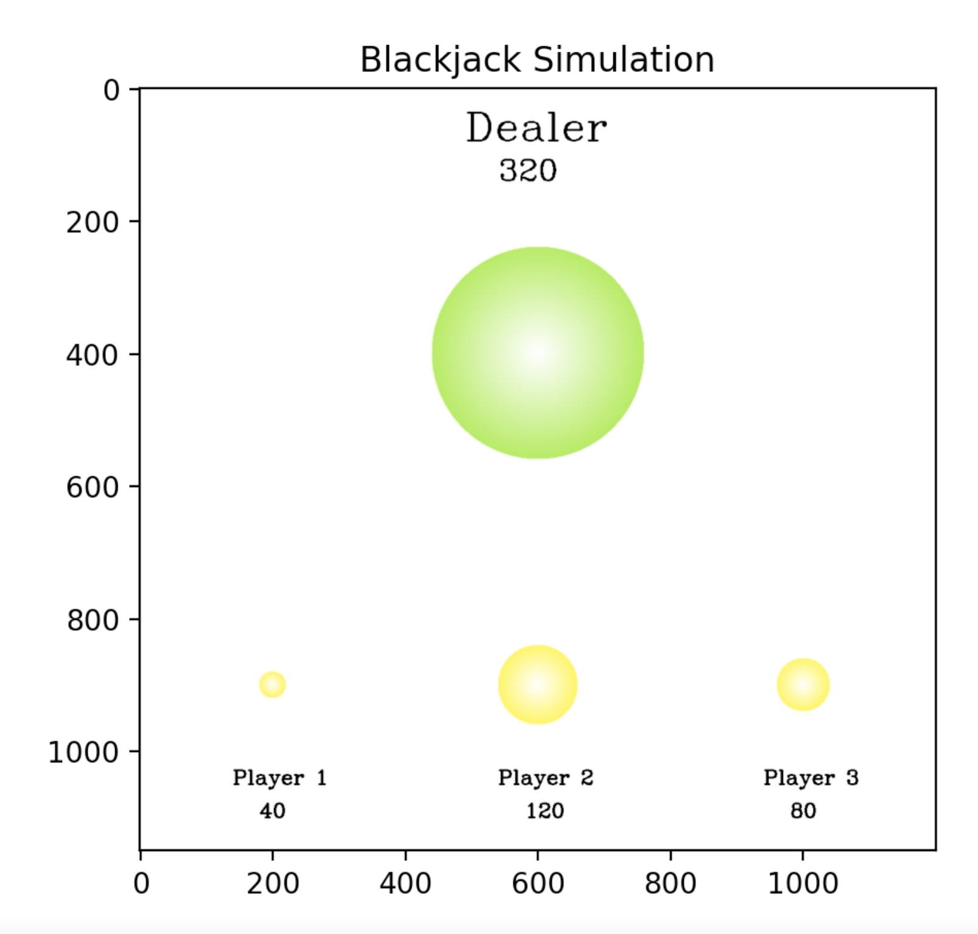
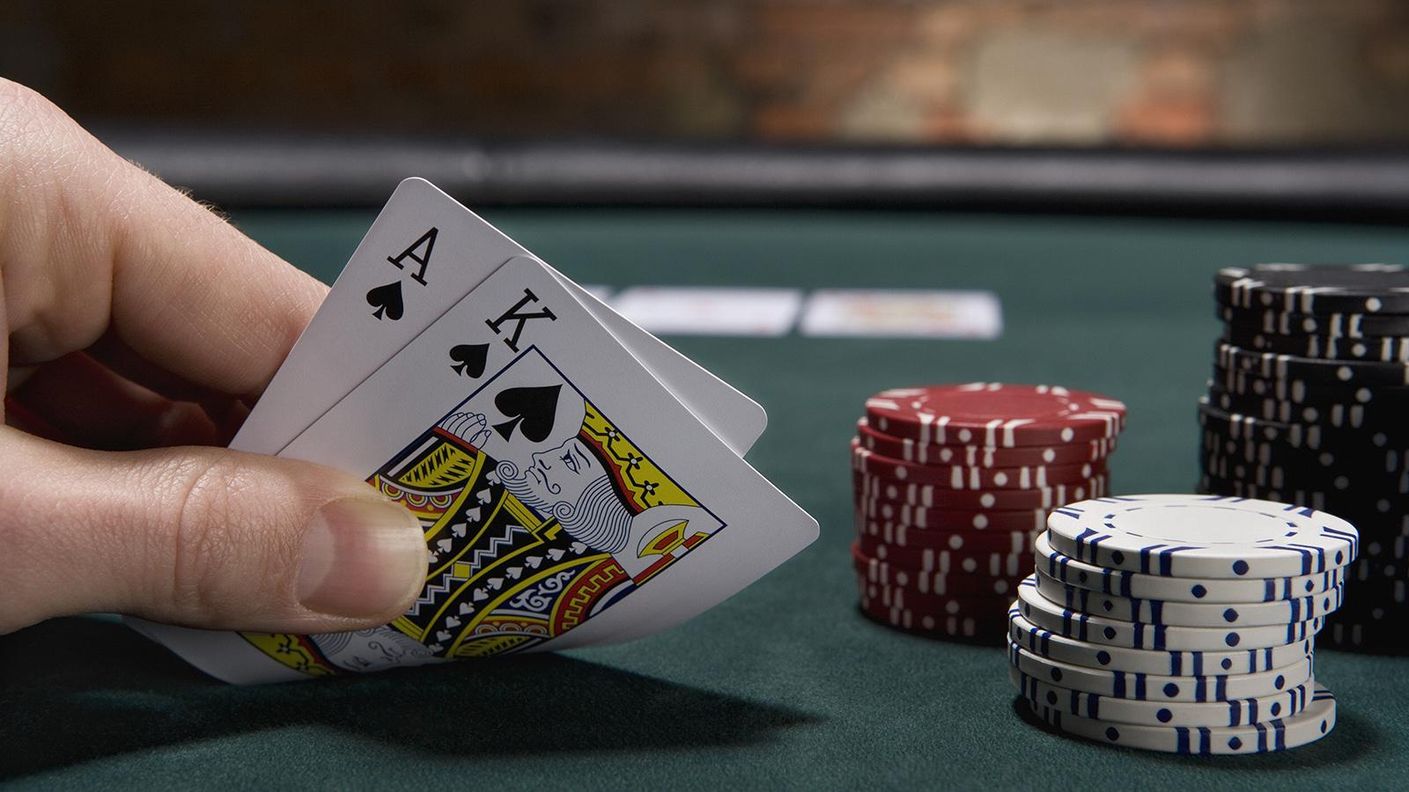
Blackjack: Why The Dealer Always Wins
Noppapon Chalermchockcharoenkit

Slide 2
The chance of winning a Blackjack hand is at 42.22%, tying and losing at 8.48% and 49.3% respectively. The final project will simulate the total amount of money earned by a casino (and each table) over time, with the casino consisting of multiple Blackjack tables operating simultaneously. The goal is to give insights to those who are interested in how much a casino might be making through illustrative animations.
The main technique that I will use is randomness (random walk), in which outcomes distributed over the standard Blackjack odds, assuming that all players play optimally.
bet size = 100, #turns = 1000

Slide 3
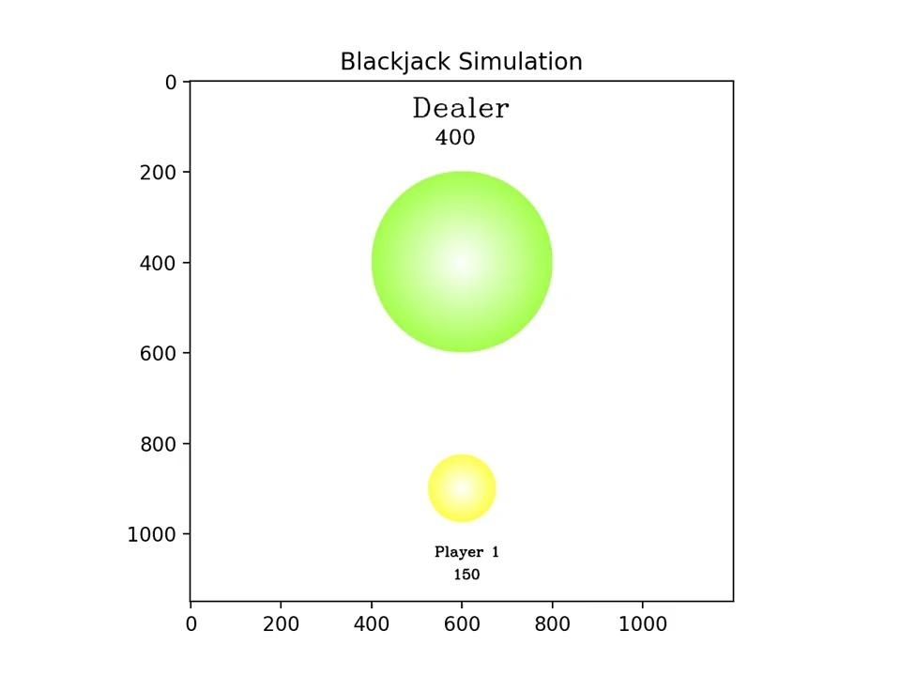

Slide 4
