Slide 1
Music Generation and Analysis
By: Kira Cope

Slide 2
Why this Project?
One of my greatest passions is music!
I am in Data 8 right now
I find the Infinite Monkey Theorem amusing
The Infinite Monkey Theorem is a theory that an unlimited number of monkeys, given typewriters and sufficient time, will eventually produce a particular text, such as Hamlet or even the complete works of Shakespeare.

Slide 3
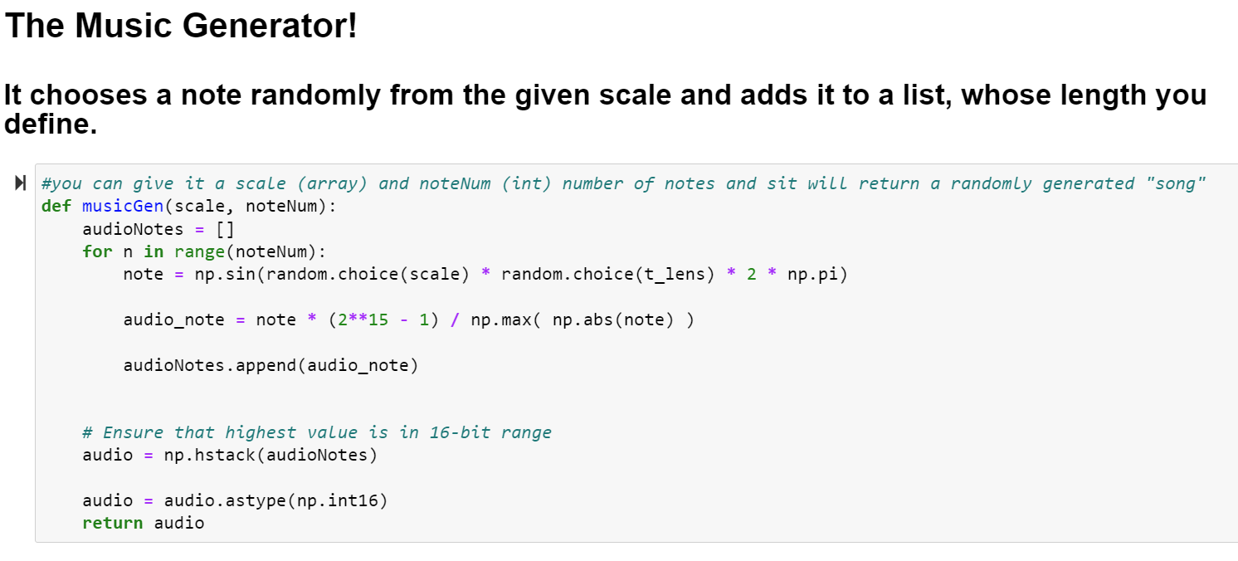
My Music Generator
Random Note Lengths
Random Notes (given a scale)
You give it the number of notes so we don’t create extremely long songs
Notes:
My music Generator generates random note lengths, and random notes within the given scale, you do give it the number of notes you want, in order to keep it predictable and not outrageously long.

Slide 4
My Methods
I used various methods of analysis from homeworks/labs
simpleaudio
Audio Information for Generated Music
Fast Fourier Transform
Comparing generated FFT with actual FFT of the song
Created a program that will take a list of frequencies and put them into the song
Calculating the Probabilities

Slide 5
Music Generator Results
Yankee Doodle Attempt
(About a minute long)
5 notes out of all notes in an octave

Slide 6
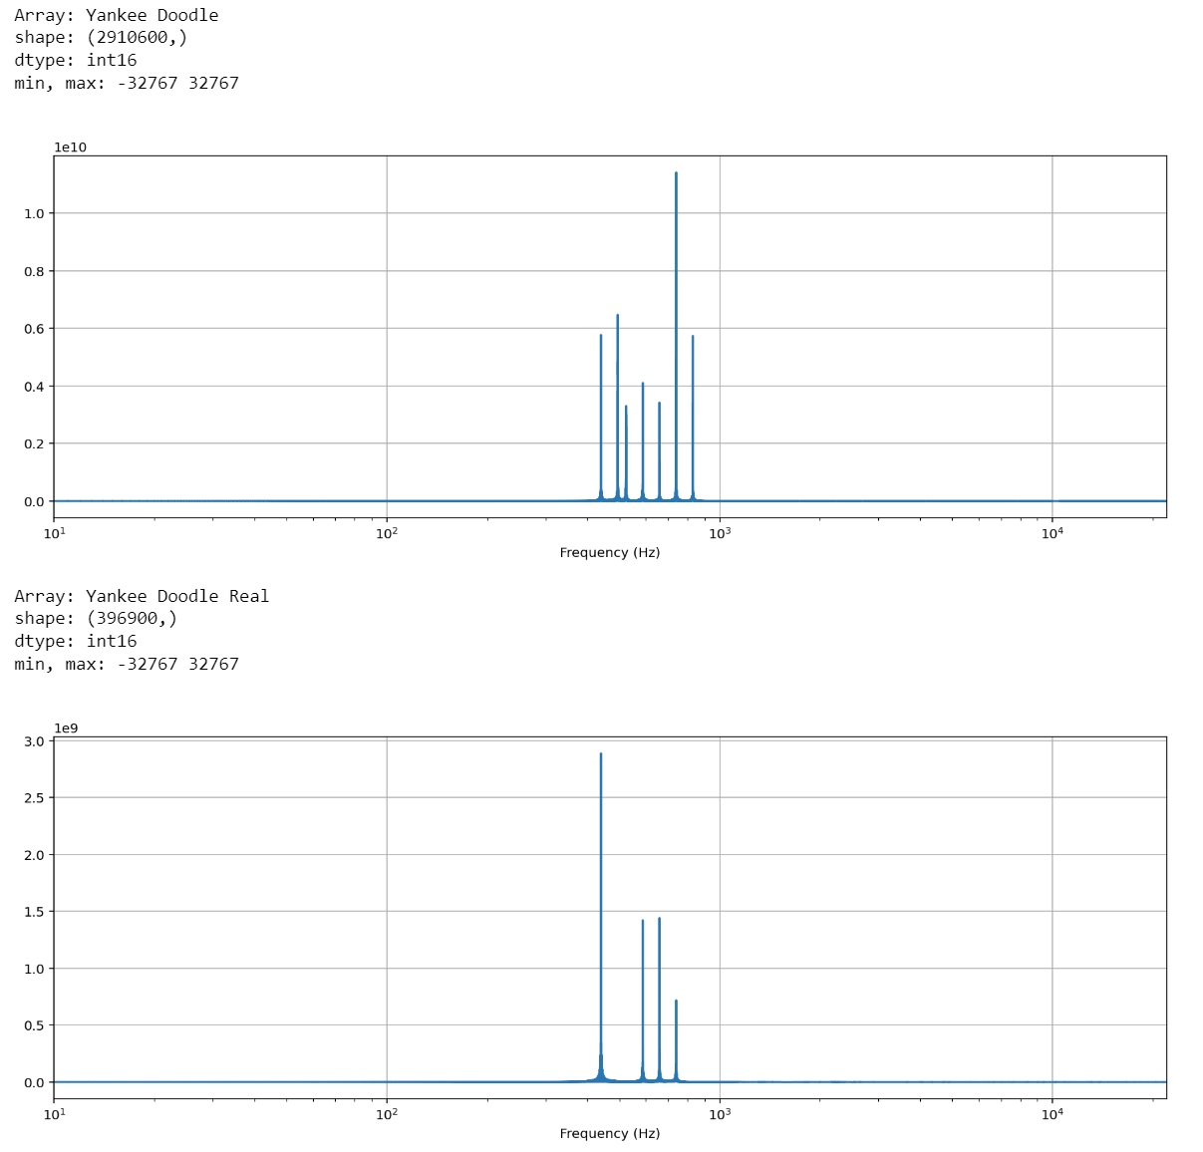
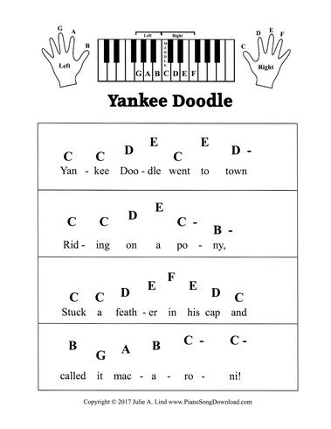
Probability Analysis/Example Yankee Doodle
My music Gen has a probability of about 0.013019 of producing the same note lengths and notes in the right order to make Yankee Doodle

Slide 7
Thank you for listening! Do you have any questions?

Slide 8
This is where the Presentation Stops in Class, but I have more information after this slide for future years

Slide 9
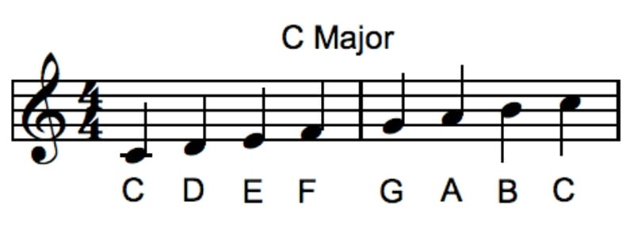
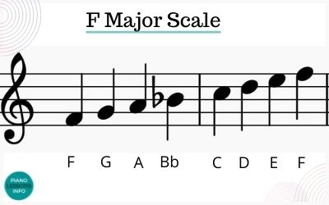
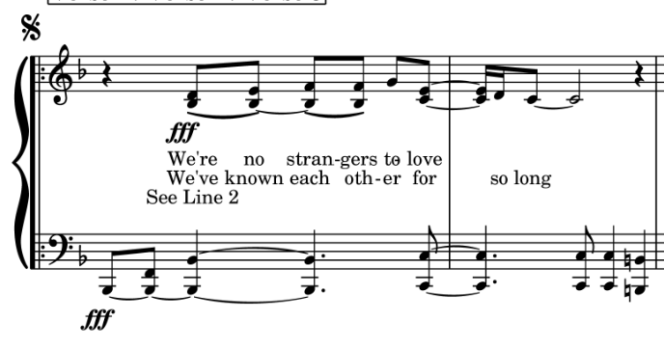
Music Theory
Songs have keys and scales that make them up
Old McDonald is in C major
Never Gonna Give You Up is in F Major
Notes:
In order for a song to sound good, it usually uses notes from the same key, shown here by scales.
This is more prevalent in simpler songs like old mcdonald, but you can find it in all songs.

