Slide 1
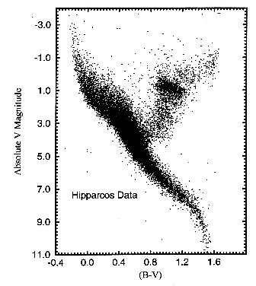
HERTZSPRUNG-RUSSELL DIAGRAM
MAHUM KHAN

Slide 2
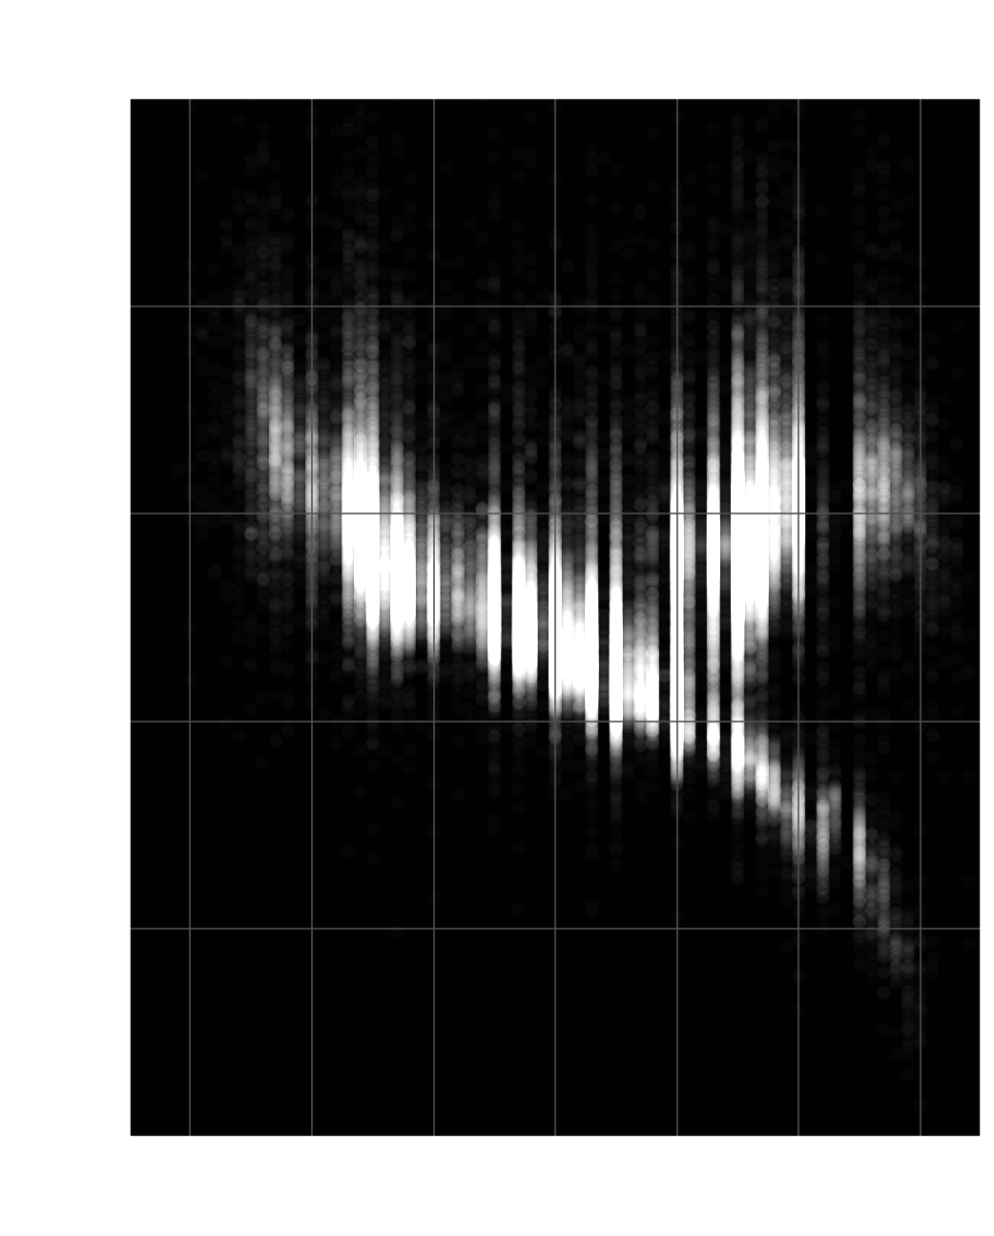
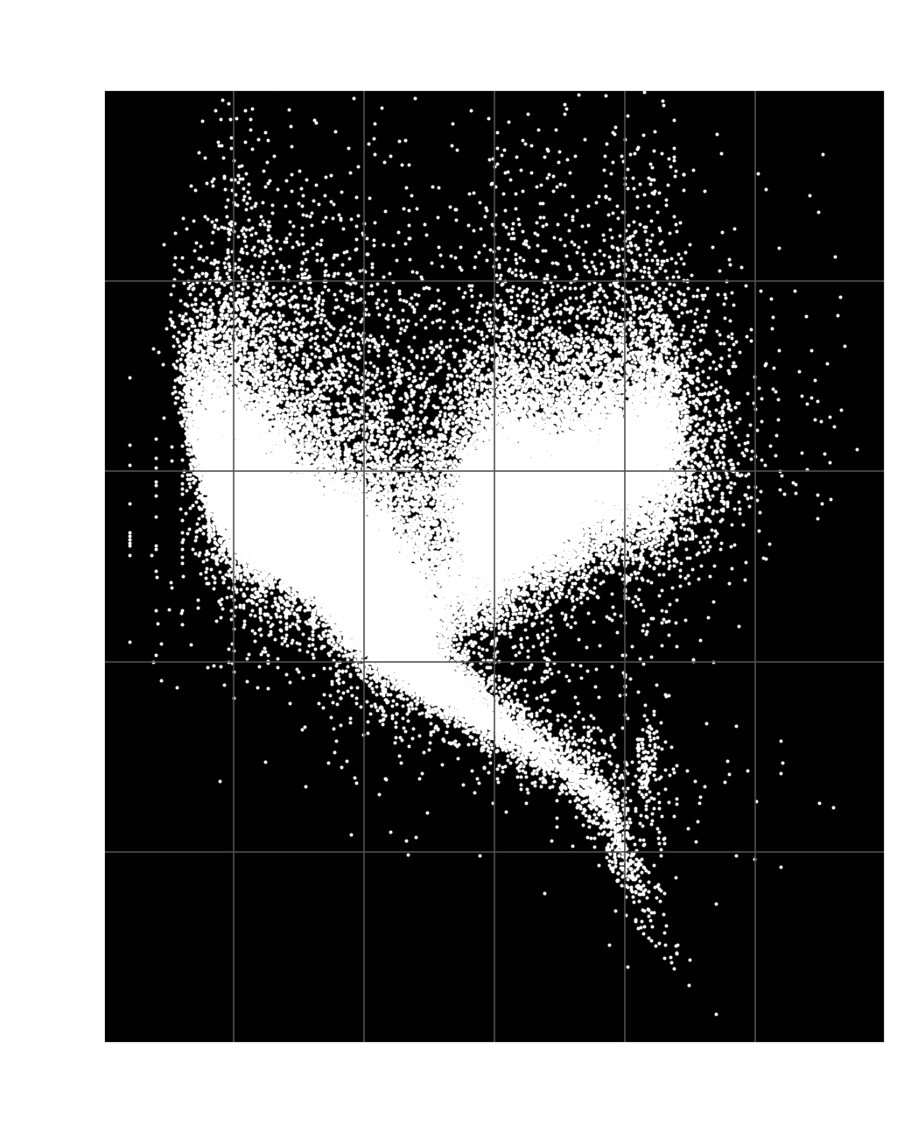
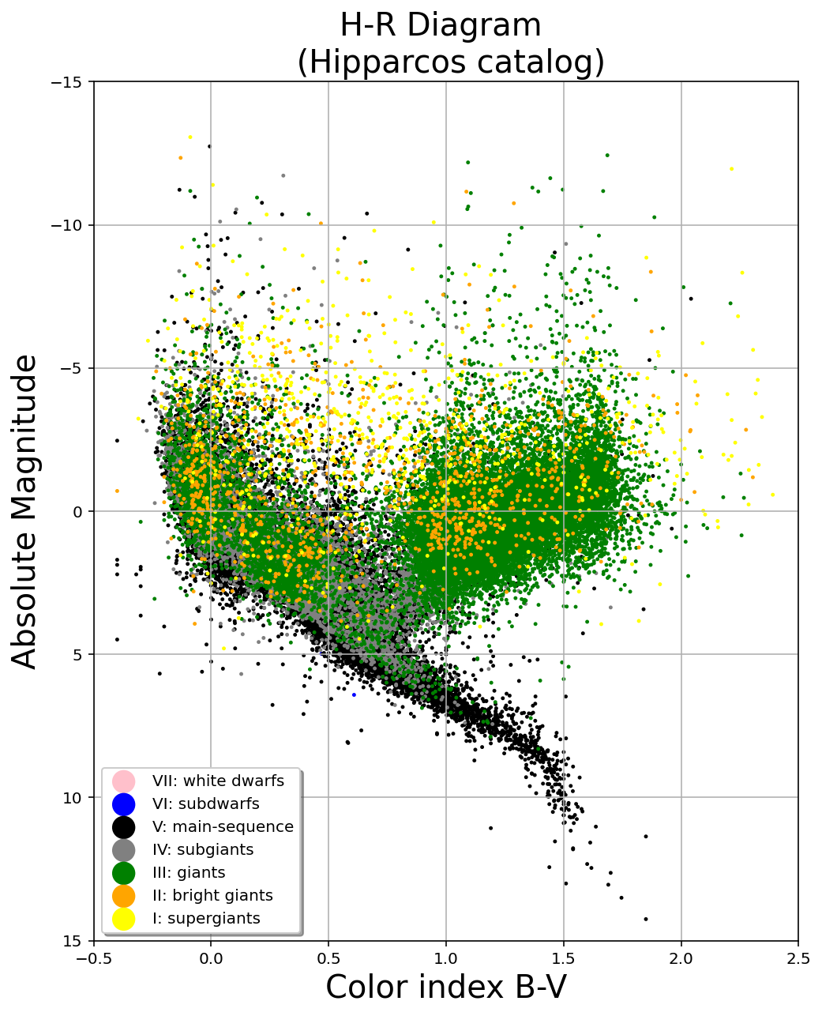
Data Analysis - The Hipparcos and Tycho Catalogues (ESA 1997)
Data from http://vizier.cds.unistra.fr/

Slide 3
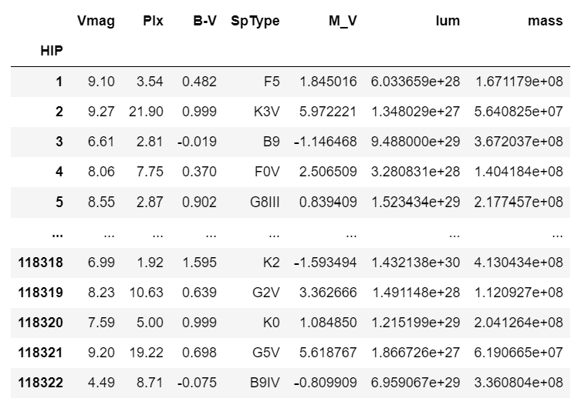
💡
💡
WHAT TO
ANIMATE?
just animate all 100,000 individually and see what happens
💡

